Slide 1
Monsters
Sustainability

Slide 2
Textiles Week 2
Use the information on this powerpoint, and on the video to fill in the table on the next slide

Slide 3
Textile Design: Monsters
Decorative Techniques
Date:
Technique | Description | Picture
Appliqué
Running stitch
Back stitch
Satin stitch
Stem stitch
Chain stitch
Buttons/Sequins
Fabric pens/paint

Slide 4
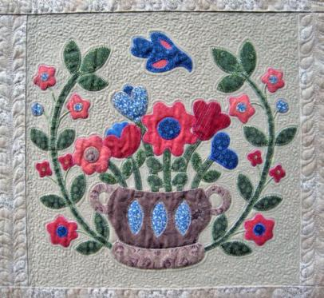
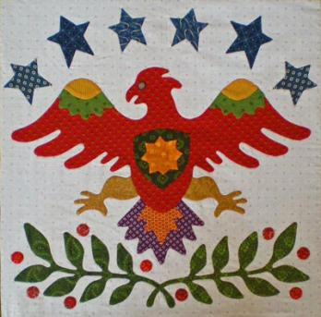
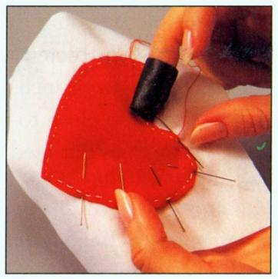
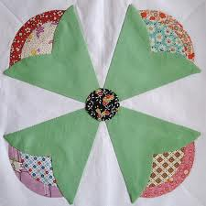
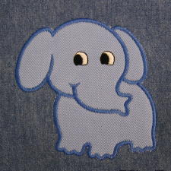
Appliqué
Attaching one piece of fabric on top of another
Can be done on a machine or by hand

Slide 5
Video: Embroidery Stitches

Slide 6
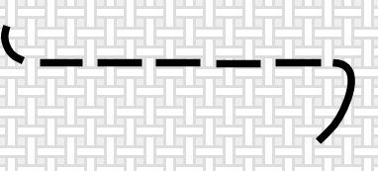
Running Stitch

Slide 7
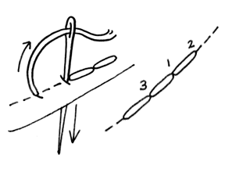
Back stitch

Slide 8
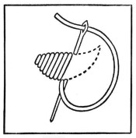
Satin Stitch

Slide 9
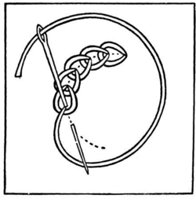
Chain Stitch

Slide 10
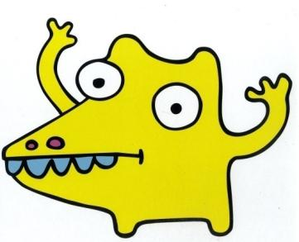
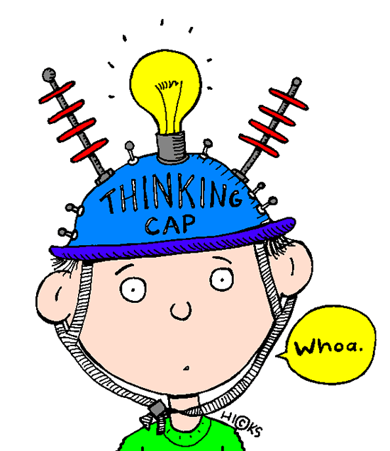
Design Ideas
Learning Objectives
Applying knowledge of decorative techniques
Developing creative skills
Success Criteria
Producing a range of detailed, annotated design ideas
Extension work
Name your monsters. Write their name in a way that describes their personality

Slide 11
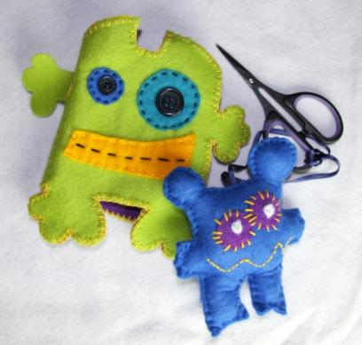
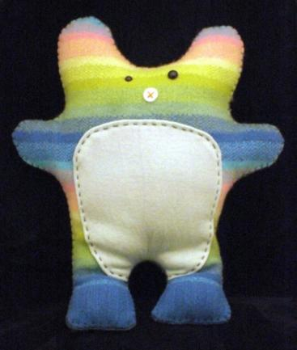
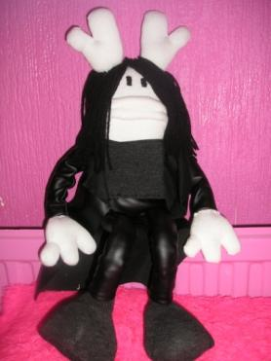
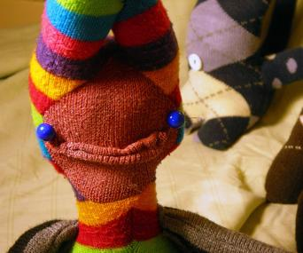
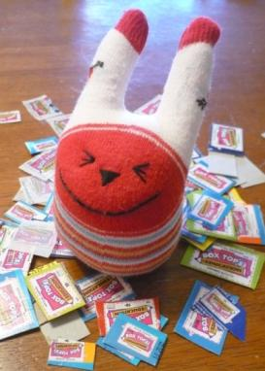
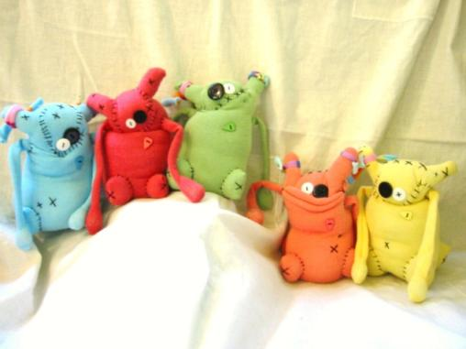
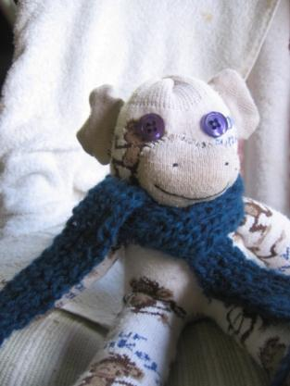
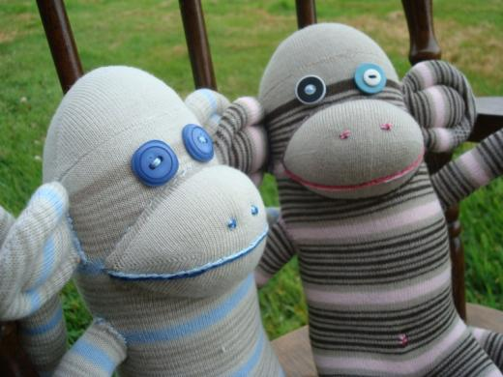
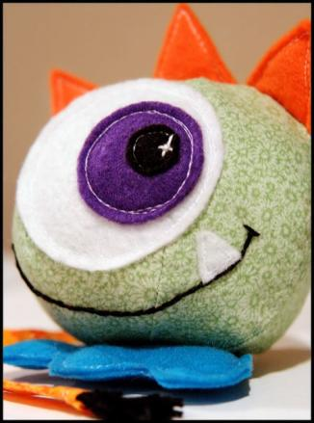
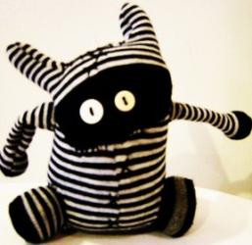
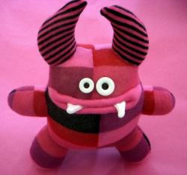
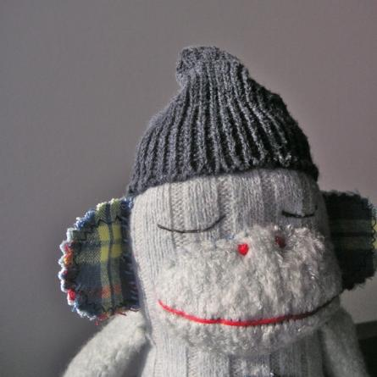
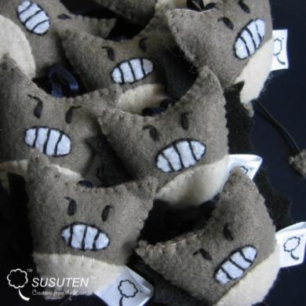
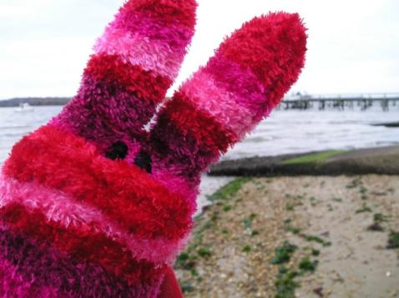
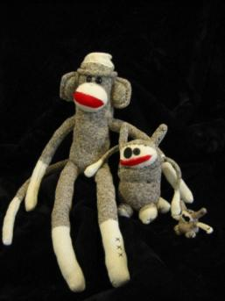
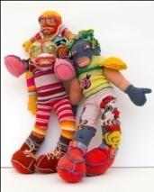

Slide 12
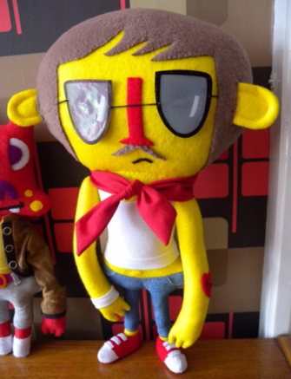
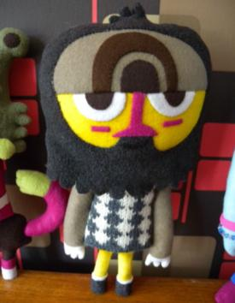
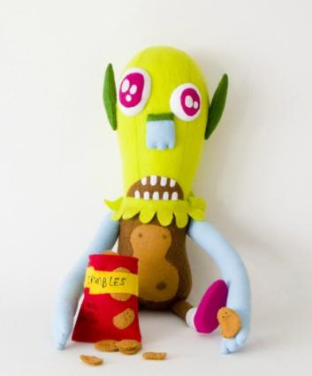
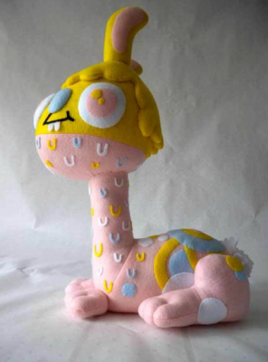
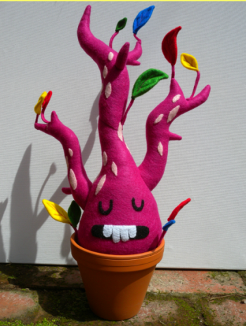
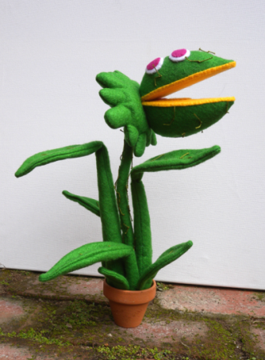
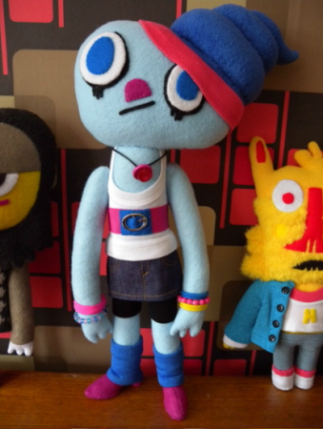
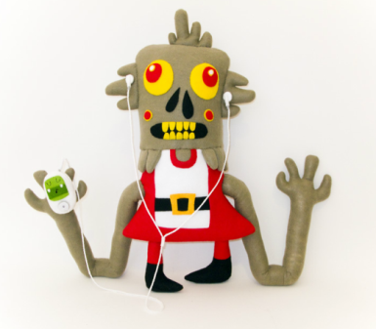
Felt Mistress

Slide 13
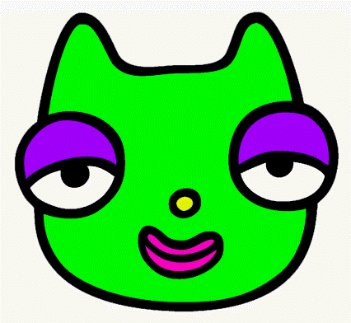
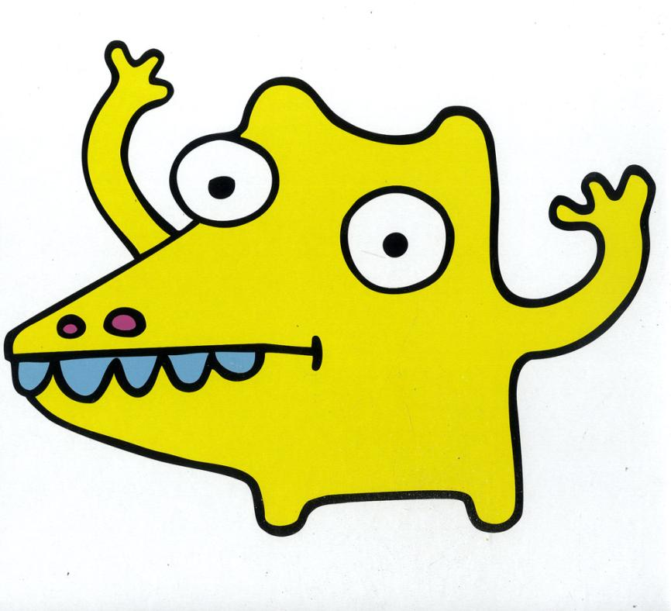
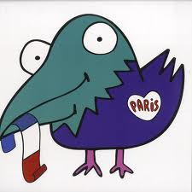
Masomenos

Slide 14
Design Ideas
You must come up with four ideas for your monster
You need to decide on the shape, and the decoration – look back at the table
Make sure your designs are detailed, coloured in and annotated with the technique you are going to use

Slide 15
Textile Design: Monsters
Design Ideas
Date:
WWW:
EBI:
MRI:

Slide 16
Home Learning
You have looked at a number of stitches in lesson, that could be used to decorate your monster
You need to find a different stitch that you could use for your monster
Create an information sheet showing the stitch, and explain how to do it

