Slide 1
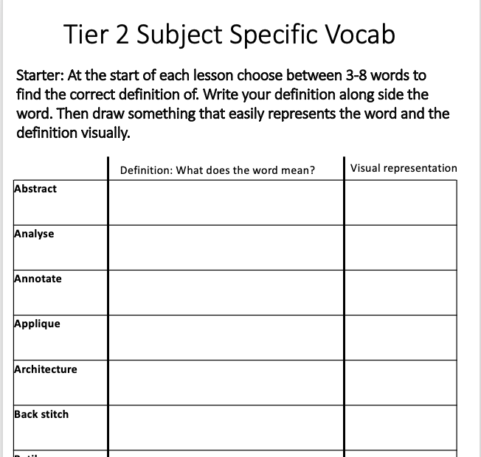
Welcome to Textiles!!
Starter Please complete the following:
Name
Reg group
Read the classroom expectations and sign
Turn to Tier 2 Vocab and research the definition for the first 4 Tier 2 words.

Slide 2
Tier 2 Subject Specific Vocab
Starter: At the start of each lesson choose between 3-8 words to find the correct definition of. Write your definition along side the word.
Key Word | Definition
 | art that does not attempt to represent an accurate depiction of a visual reality but instead use shapes, colours, forms and gestural marks to achieve its effect.
 | examine (something) methodically and in detail, typically in order to explain and interpret it.
 | add notes to (a text or diagram) giving explanation or comment
 | needlework in which pieces of fabric are sewn or stuck on to a larger piece to form a picture or pattern.
 | the art or practice of designing and constructing buildings.
 | a method of sewing with overlapping stitches.
 | a method (originally used in Java) of producing coloured designs on textiles by dyeing them, having first applied wax to the parts to be left undyed.
 | is a written explanation - given to a designer - outlining the aims, objectives and milestones of a design project. ... It may contain some functional requirements, aesthetics, materials, safety and quality considerations and other design constraints.
 | an embroidery or crochet stitch resembling a chain.
 | a stitch formed of two stitches crossing each other.
 | give a detailed account in words of.

Slide 3
 | a plan or drawing produced to show the look and function or workings of a building, garment, or other object before it is made.
 | to judge or determine the significance, worth, or quality of something.
 | produce or make (something) from whatever is available.
 | the process of being mentally stimulated to do or feel something, especially to do something creative.
 | is a type of visual presentation or collage consisting of images, text, and samples of objects in a composition. It can be based on a set topic or can be any material chosen at random.
 | used for hand-sewing, is a long slender tool with a pointed tip at one end and a hole at the other.
 | he way a thing turns out; a consequence.
 | the systematic investigation into and study of materials and sources in order to establish facts and reach new conclusions.
 | a simple needlework stitch consisting of a line of small even stitches which run back and forth through the cloth without overlapping.
 | a particular group at which a product such as a film or advertisement is aimed.
 | a long, thin strand of cotton, nylon, or other fibres used in sewing or weaving.
 | produce patterns in (a garment or piece of cloth) by tying parts of it to shield it from the dye.
Word Bank:
Abstract Art |Analyse |Annotate |Applique |Architecture |Back stitch |Batik |Brief |Chain stitch |Cross Stitch |Describe
Design |Evaluate |Improvise |Inspiration |Mood Board |Needle |Outcome |Research |Running stitch |Target Audience Thread |Tie – Dye

Slide 4
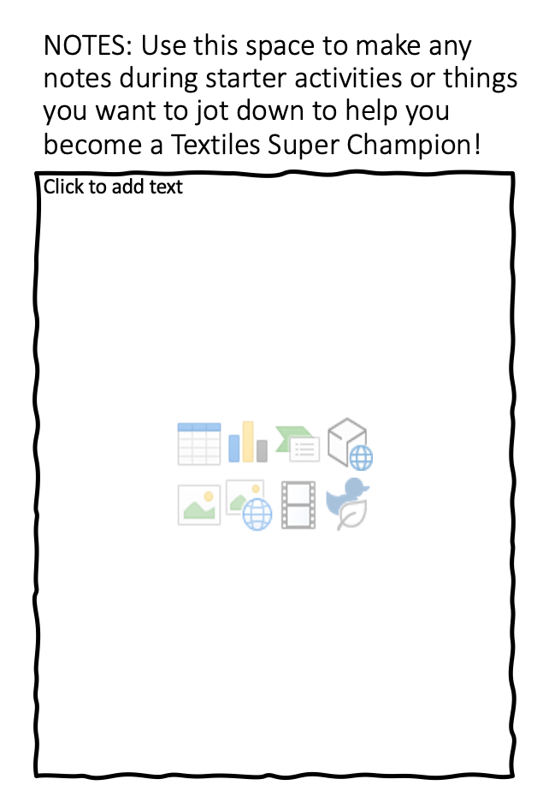
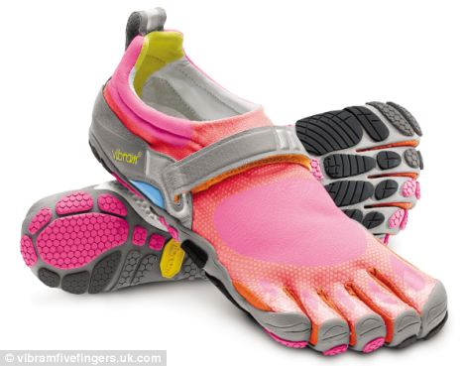
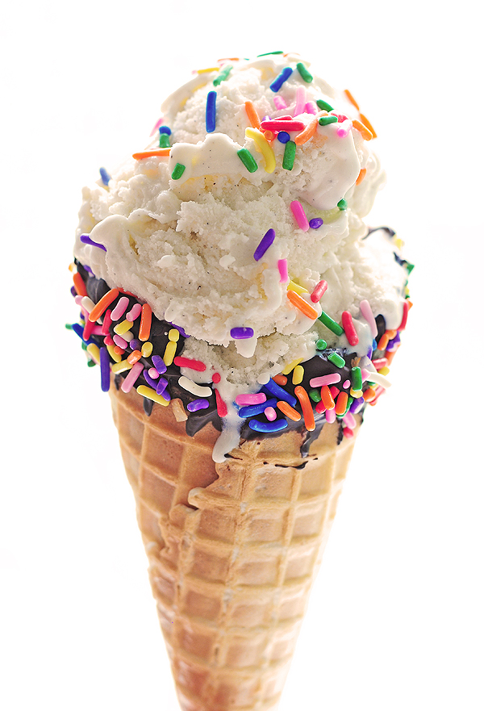
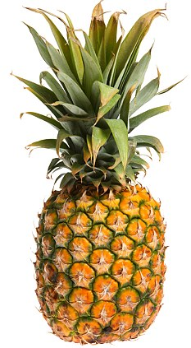
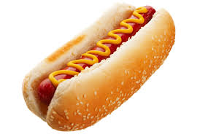
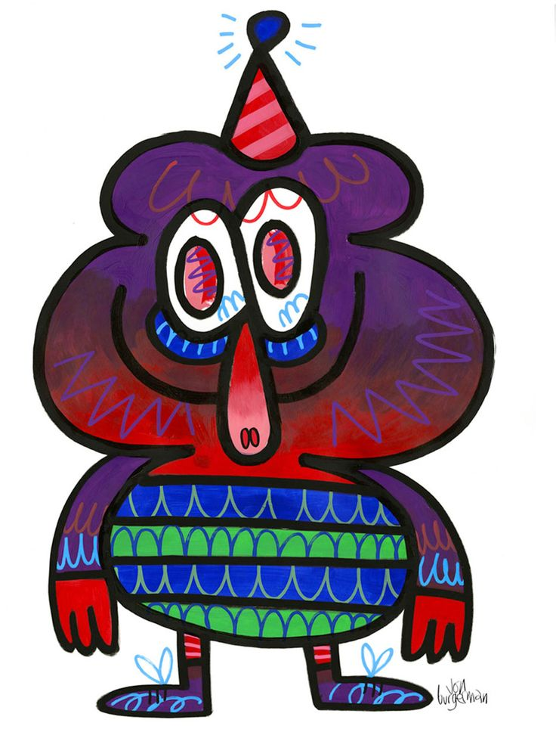

Main: Watch the video on Jon Burgerman. Create your own Burgerman monster using these objects to inspire you! – This is to be done on the page titled “Lesson 1 – Design Task”
TIP: Consider merging objects together and remember the techniques Burgerman uses.
https://www.youtube.com/watch?v=YRIjbDzweM8
Extra Challenge:
Merge ALL 5 objects together to make a JB monster and receive a p point!
Dessert: Evaluate your work today. Give yourself a WWW, EBI. Try to include the key words we have discussed in today’s lesson.
WWW:
EBI:

