Slide 1
Tier 2 Subject Specific Vocab
Starter: At the start of each lesson choose between 3-8 words to find the correct definition of. Write your definition along side the word.
Key Word | Definition
 | art that does not attempt to represent an accurate depiction of a visual reality but instead use shapes, colours, forms and gestural marks to achieve its effect.
 | examine (something) methodically and in detail, typically in order to explain and interpret it.
 | add notes to (a text or diagram) giving explanation or comment
 | needlework in which pieces of fabric are sewn or stuck on to a larger piece to form a picture or pattern.
 | the art or practice of designing and constructing buildings.
 | a method of sewing with overlapping stitches.
 | a method (originally used in Java) of producing coloured designs on textiles by dyeing them, having first applied wax to the parts to be left undyed.
 | is a written explanation - given to a designer - outlining the aims, objectives and milestones of a design project. ... It may contain some functional requirements, aesthetics, materials, safety and quality considerations and other design constraints.
 | an embroidery or crochet stitch resembling a chain.
 | a stitch formed of two stitches crossing each other.
 | give a detailed account in words of.

Slide 2
 | a plan or drawing produced to show the look and function or workings of a building, garment, or other object before it is made.
 | to judge or determine the significance, worth, or quality of something.
 | produce or make (something) from whatever is available.
 | the process of being mentally stimulated to do or feel something, especially to do something creative.
 | is a type of visual presentation or collage consisting of images, text, and samples of objects in a composition. It can be based on a set topic or can be any material chosen at random.
 | used for hand-sewing, is a long slender tool with a pointed tip at one end and a hole at the other.
 | he way a thing turns out; a consequence.
 | the systematic investigation into and study of materials and sources in order to establish facts and reach new conclusions.
 | a simple needlework stitch consisting of a line of small even stitches which run back and forth through the cloth without overlapping.
 | a particular group at which a product such as a film or advertisement is aimed.
 | a long, thin strand of cotton, nylon, or other fibres used in sewing or weaving.
 | produce patterns in (a garment or piece of cloth) by tying parts of it to shield it from the dye.
Word Bank:
Abstract Art |Analyse |Annotate |Applique |Architecture |Back stitch |Batik |Brief |Chain stitch |Cross Stitch |Describe
Design |Evaluate |Improvise |Inspiration |Mood Board |Needle |Outcome |Research |Running stitch |Target Audience Thread |Tie – Dye

Slide 3
Lesson 2: Tie Dye Design
Today you will learn about the Textile process Tie Dye.
Starter: Finish off the doodle! What monster could it turn into?

Slide 4
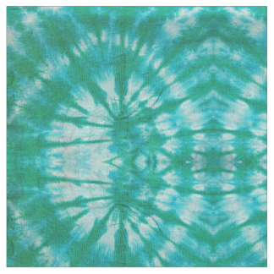

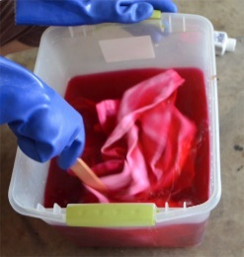
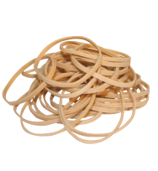
Tie Dye
You will need:
Step – by – step guide to Tie Dye:
White Cotton
On your white cotton decide how you will tie the string to create your pattern/ see Tie dye options on next page
Tie elastic bands tightly around the material
Soak your material in dye bath overnight
Take out and leave to dry
Iron your tie dye.
Extension Task:
Choose a task to complete!
1. In you book write the tie dye technique you have used and why.
2. Research the word “Shibori”. In your book describe what it is and where it has come from?
Dye bath
Elastic bands
Highdown School
and Sixth Form Centre
White Cotton
Dye Bath
String

Slide 5
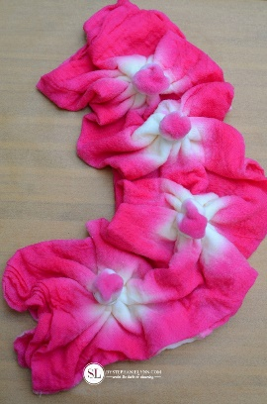
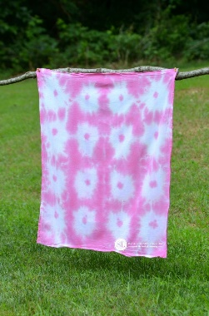
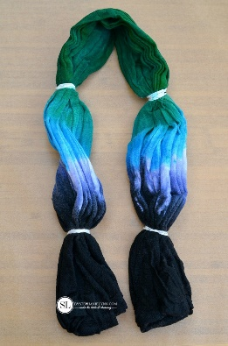
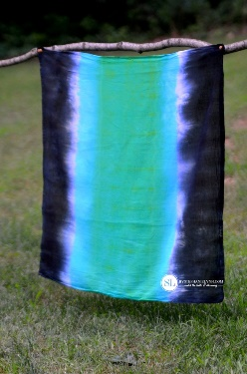
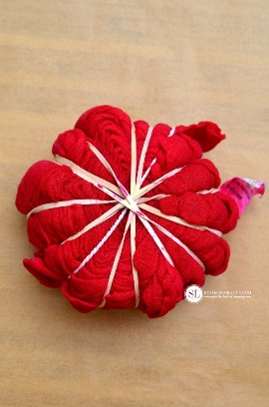
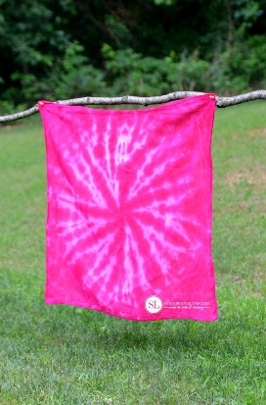
Tie Dye options
Sunburst Tie Dye Technique
Lay the fabric flat.
Fold the fabric in half.
Fold the fabric in half, again, lengthwise.
To create the sunbursts pinch the fabric and pull upward, 1 to 2 inches. Secure the fabric with a rubber band and repeat for the desired number of sunbursts.
Apply the dye to the outer edges of the fabric, the fabric between each sunburst and the centre of each sunburst.
Task: Read through the techniques and highlight Tier 2 key words.
Main Task: Using the three tie dye techniques, design a Jon Burgerman t-shirt that incorporates both your Jon Burgerman monster from Lesson 1 and 2-3 of the tie dye techniques from this lesson.
Super Challenge: Annotate your work using as many key words from your Tier 2 vocab as possible.
Stripes Tie Dye Technique
Lay the fabric flat.
Accordion fold the fabric from the bottom up.
Secure with rubber bands.
Apply the dye to the fabric.
Flip the fabric over and repeat on the backside.
One Colour Spiral Tie Dye Technique
Lay the fabric flat.
Pinch the fabric in the centre.
Begin twisting the fabric in a circular motion and continue until all of the fabric is in a spiral shape.
Tightly secure the spiral rubber bands.
Apply the dye to the fabric.
Flip the fabric over and repeat on the backside.

Slide 6
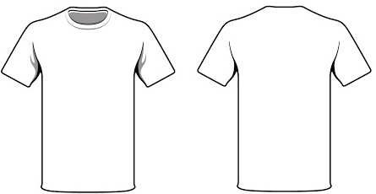
Lesson 2 - Main
Success Check list
Jon Burgerman monster
Tie Dye Techniques (2-3 versions)
Stitch lines
Annotation
Neatly presented with colour
Use of pencil to draw and colour in

