Slide 1
Tier 2 Subject Specific Vocab
Starter: At the start of each lesson choose between 3-8 words to find the correct definition of. Write your definition along side the word.
Key Word | Definition
 | art that does not attempt to represent an accurate depiction of a visual reality but instead use shapes, colours, forms and gestural marks to achieve its effect.
 | examine (something) methodically and in detail, typically in order to explain and interpret it.
 | add notes to (a text or diagram) giving explanation or comment
 | needlework in which pieces of fabric are sewn or stuck on to a larger piece to form a picture or pattern.
 | the art or practice of designing and constructing buildings.
 | a method of sewing with overlapping stitches.
 | a method (originally used in Java) of producing coloured designs on textiles by dyeing them, having first applied wax to the parts to be left undyed.
 | is a written explanation - given to a designer - outlining the aims, objectives and milestones of a design project. ... It may contain some functional requirements, aesthetics, materials, safety and quality considerations and other design constraints.
 | an embroidery or crochet stitch resembling a chain.
 | a stitch formed of two stitches crossing each other.
 | give a detailed account in words of.

Slide 2
 | a plan or drawing produced to show the look and function or workings of a building, garment, or other object before it is made.
 | to judge or determine the significance, worth, or quality of something.
 | produce or make (something) from whatever is available.
 | the process of being mentally stimulated to do or feel something, especially to do something creative.
 | is a type of visual presentation or collage consisting of images, text, and samples of objects in a composition. It can be based on a set topic or can be any material chosen at random.
 | used for hand-sewing, is a long slender tool with a pointed tip at one end and a hole at the other.
 | he way a thing turns out; a consequence.
 | the systematic investigation into and study of materials and sources in order to establish facts and reach new conclusions.
 | a simple needlework stitch consisting of a line of small even stitches which run back and forth through the cloth without overlapping.
 | a particular group at which a product such as a film or advertisement is aimed.
 | a long, thin strand of cotton, nylon, or other fibres used in sewing or weaving.
 | produce patterns in (a garment or piece of cloth) by tying parts of it to shield it from the dye.
Word Bank:
Abstract Art |Analyse |Annotate |Applique |Architecture |Back stitch |Batik |Brief |Chain stitch |Cross Stitch |Describe
Design |Evaluate |Improvise |Inspiration |Mood Board |Needle |Outcome |Research |Running stitch |Target Audience Thread |Tie – Dye

Slide 3
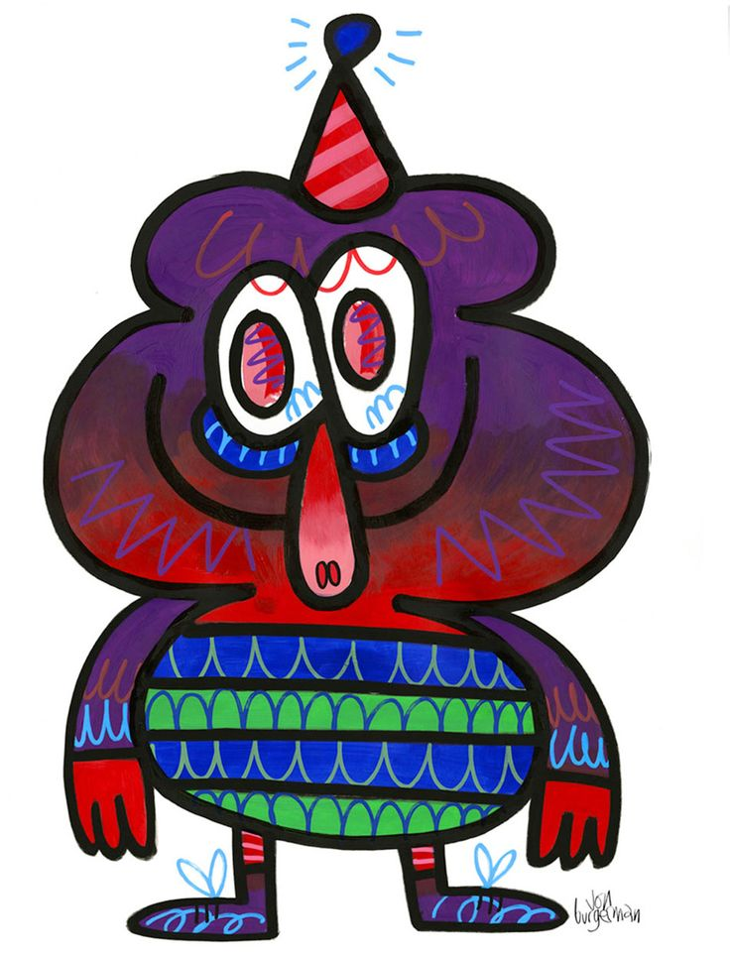
Lesson 3: Final Outcome
Starter: Read below and complete Task 1.
Jon Burgerman has left the office for the day. A brief has been sent via email. It states…
“We are a company that produces unique products suitable for the teenage market. We have recently seen your design work and would like to collaborate. We would like you to design a suitable item for “Back to School” particularly for use in the DT department. We want your design of a product to really show case the theme of monsters and Jon Burgermans designs. We want to see bright, vibrant colour, a theme of monsters and doodles, and something that can be used within a DT lesson but includes tie dye and applique. We look forward to seeing your creation”
Jon Burgerman themed apron to wear for food technology.
Task 1. Think about the subjects that fall under D&T. Create a mind map of the products you could make to fit the brief.
Products I could design
“Back to School”

Slide 4
Lesson 3 – Final Design

