Slide 1
Word | Definition
 | refers to the size of an object (a whole) in relationship to another object (another whole).
 | is the placement or arrangement of the visual elements, such as figures, trees, and so on in a work of art
 | is typically a combination of images, fonts, colours, and textures that define the style of the project.
 | the process of being mentally stimulated to do or feel something, especially to do something creative.
 | is large in size, number, or amount
 | is a reason or reasons for doing something, desire to do something; enthusiasm.
 | the connection and production of other words in response to a given word
 | refers to the light and dark values of an object
 | It is the technique of gently intermingling two or more colours or values to create a gradual transition or to soften lines.
 | establish or indicate who or what (someone or something) is. To discover or find out.
 | taking place or progressing slowly
 | to search or investigate exhaustively
 | a series of actions or steps taken in order to achieve a particular end.
 | the process of changing something
 | before the current event
 | A process to produce patterns in (a garment or piece of cloth) by tying parts of it to shield it from the dye
 | is the Japanese word for a variety of ways of embellishing textiles by shaping cloth and securing it before dying.
 | a form of printmaking that has lines or images that can only be made once, unlike most printmaking, which allows for multiple originals.
 | The process where pieces or patch of fabric in different shapes and patterns are sewn or stuck onto a larger piece to form a picture or pattern. It is commonly used as decoration, especially on garments. The technique is accomplished either by hand stitching or machine.
 | a method (originally used in Java) of producing coloured designs on textiles by dyeing them, having first applied wax to the parts to be left undyed.
 | a written document that provides relevant information including instructions the artist must follow to meet the desired vision.
 | To examine, typically in order to explain and interpret it.
 | A variety of materials used to produce a piece of art
 | A collection or combination of various different things
 | make minor changes so as to improve or clarify
Word Bank | Analyse | Applique | Batik | Blend | Brief | Collage | Composition | Gradual | Identify | Inspiration | Manipulation | Mixed Media | Mono Print | Mood Board | Motivation | Prior | Process | Refine | Research | Scale | Shibori | Substantial | Tie-Dye | Tone | Word Association
GCSE Ready Textiles – Subject Specific/ Tier 2 Language

Slide 2
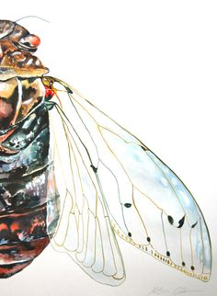
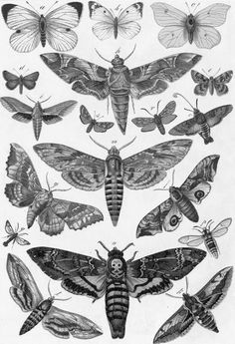
GCSE Ready
Textiles Yr 9
Lesson 1- Title Page
Lesson 1: At the start of any creative GCSE project you must begin with a title page. A title page is the first page the examiner/marker will see. It MUST set the standard of your work throughout your project. A title page introduces your project and visually sets the theme “Bugs and Insects.”
Produce a title page which visually sets the theme. Include the title “Bugs and Insects”
Success Criteria:
Title “Bugs and Insects”
Drawing of a Bug or Insect (You can do 1 or multiple)
Your title page must be visually pleasing to look at and interest the examiner to want to continue looking through your work.
Choose a composition landscape or portrait.
Super Challenge
To draw multiple bugs and insects. Each drawing experiment with the scale (size) and composition (layout).
Bugs & Insects
Bugs
&
Insects
Tier 2 Words:
Scale
Composition
This task you will be meeting AO 3. Drawing and Recording

Slide 3
Lesson 1: Title Page

Slide 4
GCSE Ready
Textiles Yr 9
Home Learning 1
Home learning 1: A mood board is a vital part of design. A mood board is a selection of images which represent a theme visually without any words.
Research into the variety of different bugs and insects. Produce a mood board that visually displays our theme and point of inspiration.
Your mood board should consist of a minimum of 12 images and have no white spaces.
Success Criteria:
A display of different bugs and insects.
Minimum of 10 photographs.
Presented in colour
Super Challenge:
Instead of copying and pasting from google, try to combine the images you find on google and make a collage including pictures from magazine, and books.
Tier 2 Words:
Mood board
Inspiration
This task you will be meeting AO 3. Drawing and Recording

