Slide 1
Word | Definition
 | refers to the size of an object (a whole) in relationship to another object (another whole).
 | is the placement or arrangement of the visual elements, such as figures, trees, and so on in a work of art
 | is typically a combination of images, fonts, colours, and textures that define the style of the project.
 | the process of being mentally stimulated to do or feel something, especially to do something creative.
 | is large in size, number, or amount
 | is a reason or reasons for doing something, desire to do something; enthusiasm.
 | the connection and production of other words in response to a given word
 | refers to the light and dark values of an object
 | It is the technique of gently intermingling two or more colours or values to create a gradual transition or to soften lines.
 | establish or indicate who or what (someone or something) is. To discover or find out.
 | taking place or progressing slowly
 | to search or investigate exhaustively
 | a series of actions or steps taken in order to achieve a particular end.
 | the process of changing something
 | before the current event
 | A process to produce patterns in (a garment or piece of cloth) by tying parts of it to shield it from the dye
 | is the Japanese word for a variety of ways of embellishing textiles by shaping cloth and securing it before dying.
 | a form of printmaking that has lines or images that can only be made once, unlike most printmaking, which allows for multiple originals.
 | The process where pieces or patch of fabric in different shapes and patterns are sewn or stuck onto a larger piece to form a picture or pattern. It is commonly used as decoration, especially on garments. The technique is accomplished either by hand stitching or machine.
 | a method (originally used in Java) of producing coloured designs on textiles by dyeing them, having first applied wax to the parts to be left undyed.
 | a written document that provides relevant information including instructions the artist must follow to meet the desired vision.
 | To examine, typically in order to explain and interpret it.
 | A variety of materials used to produce a piece of art
 | A collection or combination of various different things
 | make minor changes so as to improve or clarify
Word Bank | Analyse | Applique | Batik | Blend | Brief | Collage | Composition | Gradual | Identify | Inspiration | Manipulation | Mixed Media | Mono Print | Mood Board | Motivation | Prior | Process | Refine | Research | Scale | Shibori | Substantial | Tie-Dye | Tone | Word Association
GCSE Ready Textiles – Subject Specific/ Tier 2 Language

Slide 2
Lesson 2 - Artist Profile Page
STARTER:
Lucy Arnold
Lucy Arnold has created art since childhood, and has always been intrigued with nature. Born in 1954, she was raised in California. She earned a BA with Honors in Biology from the University of California at Santa Cruz. Her art career began with a needlepoint business: Designs by Lucy, with nation-wide distribution for over 12 years. Moving back to California in 1993 from New York, she focused on fine art. Her award-winning paintings, ranging from scientific realism to complete abstraction, have been exhibited in solo, invitational and juried shows for over 30 years. Lucy’s art has been published as prints, cards, stickers, book and CD covers as well as in calendars, textbooks and art instruction books. Travel destinations that have inspired her include the Amazon Jungle, the Galapagos Islands, Turkey, Greece, East Africa, Machu Picchu, and Hawaii. She is an Artist Member of Marin Museum of Contemporary Art and a signature member of Marin Society of Artists. She lives with her husband in lovely Marin County, California, and has two grown children.
Nature is my primary source of inspiration, and color my main mode of expression.
Each of us brings a personal filter to our view of the world. Insects, birds, flowers, stones, and fallen feathers always catch my eye. Painting allows me to reveal the beauty I discover in small, intimate details of nature. My love of nature, color, drawing and design – with just a touch of whimsy – come together in my natural history paintings. In abstract work, I employ multi-layered colors to explore micro and macrocosms of energy, dimensions, and the cosmos.
Color: I have a passion for color, which is a major, consistent component throughout my work. I find it thrilling to experience vivid color in nature, so I am especially attracted to the flora and fauna of the tropics. Skin diving is my favorite travel activity because it allows me to float through seemingly alien realms of incredible life forms. Nature provides such remarkable creations that I prefer depicting actual species of plants and animals, although they may seem imaginary through the lens of my interpretation.
Butterflies: Butterflies appear frequently in my work. Their infinite patterns and colors make them ideal art subjects, but they also hold a greater significance for me. I don’t consciously consider them as symbols or archetypes when I paint them, but they do represent several things to me, the foremost being the inner spirit. Beyond this, I see butterflies as metaphors for transformation, constant change, passage of time, and the stunning beauty of nature.
Abstracts: My abstract mixed media and pastel paintings come from an internal source of inspiration, and I allow intuition to guide me in their creation. I use colors to translate interactions and transformation of energies. Colors merge, flow gently from one to another – or clash to create excitement and tension. A great many partially transparent layers overlap to evoke a sense of depth and multidimensionality. I enjoy the ambiguity of seeing both micro and macrocosms in the same painting.
Task 1: Read through the text;
In one colour highlight key information about Lucy Arnold and her artwork.
In another colour highlight Tier 2 words you are unsure of.
Task 2. Make a word bank of Key words, from the information provided:

Slide 3
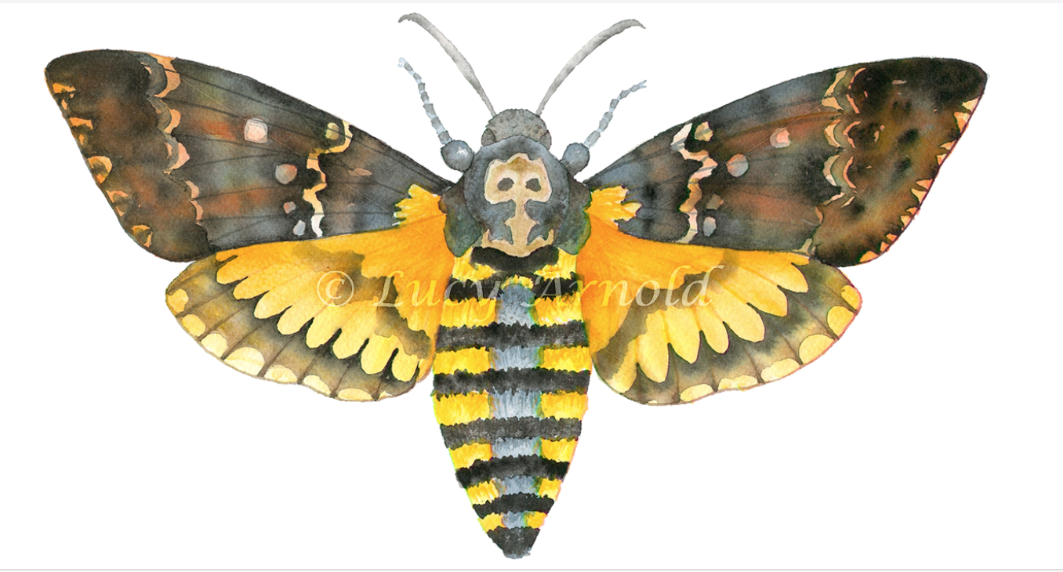
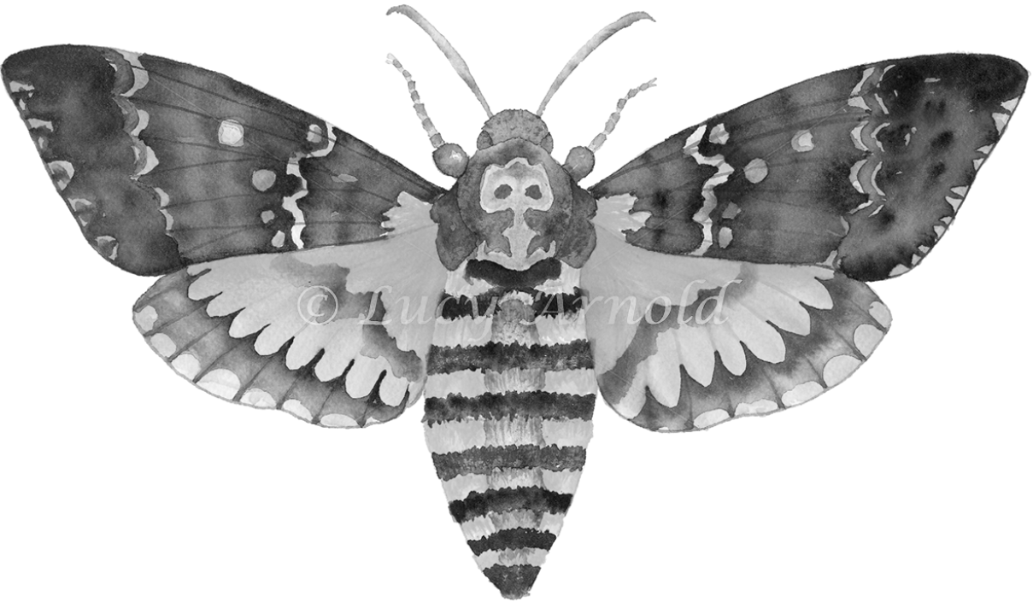
Artist Copy
Lesson 2 - Task 2 of 2
Task 2 of 2: Produce an artist copy of Lucy Arnolds work. Your drawing must be done in either pencil or coloured pencils. If you choose pencil you must show good tonal values throughout your drawing, identifying the light and dark areas. If you choose coloured pencils you must evidence that you understand how to blend and build layers of colour by applying the lightest colours first and gradually work into your drawing with darker colours.
Tips:
Your drawing must fill an A4 page.
First, draw the shape of the wolf LIGHTLY
Make sure the face is SYMMETRICAL
Make sure all of the features are correct BEFORE adding pattern.
Try to copy the PATTERN accurately
Try to show the wide range TONE by pressing harder or lighter with your pencil.
Coloured Pencil Version
Black and white Version
This task you will be meeting AO 3. Drawing and Recording

