Slide 1
Word | Definition
 | refers to the size of an object (a whole) in relationship to another object (another whole).
 | is the placement or arrangement of the visual elements, such as figures, trees, and so on in a work of art
 | is typically a combination of images, fonts, colours, and textures that define the style of the project.
 | the process of being mentally stimulated to do or feel something, especially to do something creative.
 | is large in size, number, or amount
 | is a reason or reasons for doing something, desire to do something; enthusiasm.
 | the connection and production of other words in response to a given word
 | refers to the light and dark values of an object
 | It is the technique of gently intermingling two or more colours or values to create a gradual transition or to soften lines.
 | establish or indicate who or what (someone or something) is. To discover or find out.
 | taking place or progressing slowly
 | to search or investigate exhaustively
 | a series of actions or steps taken in order to achieve a particular end.
 | the process of changing something
 | before the current event
 | A process to produce patterns in (a garment or piece of cloth) by tying parts of it to shield it from the dye
 | is the Japanese word for a variety of ways of embellishing textiles by shaping cloth and securing it before dying.
 | a form of printmaking that has lines or images that can only be made once, unlike most printmaking, which allows for multiple originals.
 | The process where pieces or patch of fabric in different shapes and patterns are sewn or stuck onto a larger piece to form a picture or pattern. It is commonly used as decoration, especially on garments. The technique is accomplished either by hand stitching or machine.
 | a method (originally used in Java) of producing coloured designs on textiles by dyeing them, having first applied wax to the parts to be left undyed.
 | a written document that provides relevant information including instructions the artist must follow to meet the desired vision.
 | To examine, typically in order to explain and interpret it.
 | A variety of materials used to produce a piece of art
 | A collection or combination of various different things
 | make minor changes so as to improve or clarify
Word Bank | Analyse | Applique | Batik | Blend | Brief | Collage | Composition | Gradual | Identify | Inspiration | Manipulation | Mixed Media | Mono Print | Mood Board | Motivation | Prior | Process | Refine | Research | Scale | Shibori | Substantial | Tie-Dye | Tone | Word Association
GCSE Ready Textiles – Subject Specific/ Tier 2 Language

Slide 2
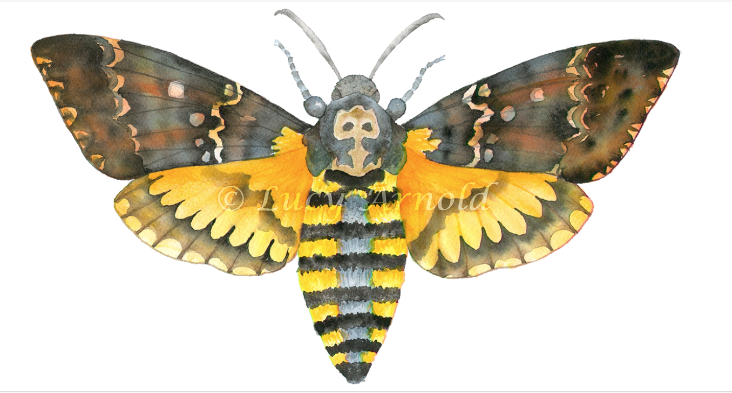
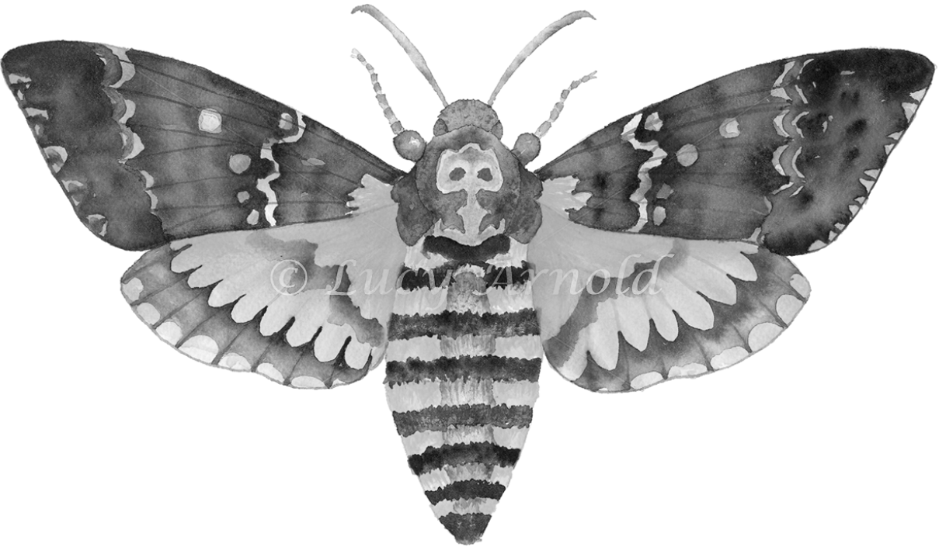
Artist Copy
Lesson 2 - Task 2 of 2
Task 2 of 2: Produce an artist copy of Lucy Arnolds work. Your drawing must be done in either pencil or coloured pencils. If you choose pencil you must show good tonal values throughout your drawing, identifying the light and dark areas. If you choose coloured pencils you must evidence that you understand how to blend and build layers of colour by applying the lightest colours first and gradually work into your drawing with darker colours.
Tips:
Your drawing must fill an A4 page.
First, draw the shape of the wolf LIGHTLY
Make sure the face is SYMMETRICAL
Make sure all of the features are correct BEFORE adding pattern.
Try to copy the PATTERN accurately
Try to show the wide range TONE by pressing harder or lighter with your pencil.
Coloured Pencil Version
Black and white Version
This task you will be meeting AO 3. Drawing and Recording

