Slide 1
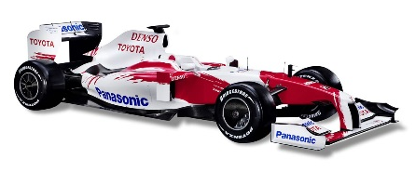


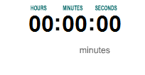
Speed
Starter: Select the hardest question you can answer.
Answer it on your post-it note, write your name AND target grade on it and stick it on the correct part of the board.
What is speed? What units can we measure speed in?
A car travels 180 kilometres in 6 hours. What is its speed?
A boat travels at 20mph. How long would it take to travel 80 miles?
A marathon runner runs at 5 m/s. How long will it take to run 1 kilometre?
Then write in your LO and BO please!
Describe what speed is
(L5a)
Calculate speed using a formula
(L6c)
Rearrange the formula to calculate distances and time
(L6a)
Convert distances and time when calculating speed
(L7c)
BO: To not shout out the answers!

Slide 2
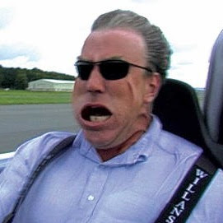

What is Speed?
Let’s take a look at a common measurement (unit) of speed:
mph
MILES
per
HOUR
Use this statement to complete the formula used to calculate speed:
Distance (miles) | Time (hours) | Speed (mph)
60 | 3
100 | 4
50 | 30 mins
Distance (miles) | Time (hours) | Speed (mph)
60 | 3 | 20
100 | 4 | 25
50 | 30 mins | 100
Speed
=
Distance
÷
Time

Slide 3
Units of Speed
Distance | Time | Speed
Miles | Hours | mph
Kilometres | Hours | Km/h
Metres | Seconds | m/s
Kilometres | Seconds | Km/s
Metres | Minutes | m/min

Slide 4

Traffic Light Check
I think I know how to describe speed, but I am unsure how to calculate it with the formula.
I need extra help and some clear questions before moving on.
I understand how to describe speed and I think I understand the formula.
I just need to double check before I can complete the questions.
I understand how to describe and calculate speed.
I can help explain the formula to others and I am ready to complete the harder questions.

Slide 5
Traffic Light Check
Speed
=
Distance
÷
Time
Helpsheet for converting units
Reds Start Here
A car travels 80 miles in 2 hours. What is the average speed in mph?
A javelin travels 50 metres in 5 seconds. What is the average speed in m/s?
A moped travels 20 kilometres in 30 minutes. Calculate its average speed in km/h.
An athlete completes a 800m race in 1 minute 40 seconds. What is the average speed in m/s?
A train travels 30 kilometres in 20 minutes. What is the average speed in km/h?
A cyclist completes a 100 mile trial in 150 minutes? What is the average speed in mph?
A bird migrates 1,200 miles in 2 days. What is its average speed in mph?
40 mph
10 m/s
Ambers Start Here
40 km/h
8 m/s
Greens Start Here
90 km/h
40 mph
Challenge Q
25 mph

Slide 6

Rearranging Formulae
Example example question:
A car travels at 50 miles per hour.
How far will it travel after 5 hours?
D = S x t
D = 50 x 5 = 250 miles
To rearrange a formula. Simply cover up the letter of what you want to work out and read the sum given!
Write the two formulae to calculate distance and calculate time
Use the numbers given to make your own example Q&A for distance and time
D
÷
÷
S
T
X
100 metres
50 km
10 m/s
10 seconds
25 km/h
2 hours

Slide 7
Traffic Light Check
I am unsure about rearranging the formula.
I need extra help and some clear questions before moving on.
I think I understand how to rearrange the formula.
I just need to double check before I can complete the questions.
I understand how to rearrange the formula.
I can help explain the formulae to others and I am ready to complete the harder questions.

Slide 8



Traffic Light Check
D
÷
÷
S
X
T
Mild Questions
Reds Start Here
Medium Questions
Ambers Start Here
Helpsheet for converting units
HOT Questions
Greens Start Here
Write a sub-heading: Mild, Medium or Hot and question number in the margin
Show your working out!
Grab an extension challenge off the teacher!

Slide 9
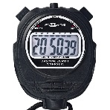


Platinum challenge:
Evaluate my Practical
Aim: To investigate the effect of ramp height on the speed of a toy car
Equipment List:
Toy car, long ramp, different 20-30cm blocks, 1 metre ruler, Stopwatch
Method:
Set up the apparatus with one block
Put the car on top of the ramp
Release the car and start the stopwatch
Stop the stopwatch when the car reaches the end of the ramp
Add another block and repeat with a larger car for more stability
Independent Variable | Dependent Variable | Control Variable
Number of blocks on the ramp | The time taken for the car to travel the ramp

Slide 10
Try Again
Select the hardest question you can answer.
Answer it on your post-it note, write your name AND target grade on it and stick it on the correct part of the board.
What is speed? What units can we measure speed in?
A car travels 180 kilometres in 6 hours. What is its speed?
A boat travels at 20mph. How long would it take to travel 80 miles?
A marathon runner runs at 5 m/s. How long will it take to run 1 kilometre?
Then Self-Reflect:
I have achieved a _______ medal today because…
WWW and EBI
Burning Question (focus your marking on)
Describe what speed is
(L5a)
Calculate speed using a formula
(L6c)
Rearrange the formula to calculate distances and time
(L6a)
Convert distances and time when calculating speed
(L7c)

