Slide 1

Measuring Forces

Slide 2
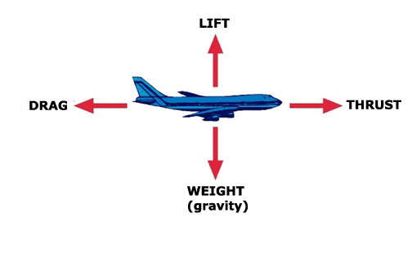
Label the diagram below with the relevant forces

Slide 3


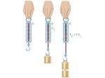

Measuring forces
Forces are measured in newtons.
We can write this as N.
We use a Newton meter to measure forces.
It is sometimes called a force meter.

Slide 4
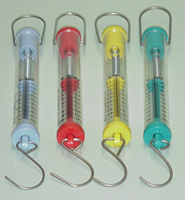
Let’s estimate!
How much force does it take to carry out the following?
-open a cupboard door
-drag a stool
-turn on a water tap
-open a notebook
-lift a pencil case

Slide 5
Why doesn’t the box fall?
Force of Floor acting on Box
Force from floor on box
cancels gravity.
If the floor vanished, the
box would begin to fall.
Force of Earth acting on Box (weight)

Slide 6
Forces have direction
Total Force
Force #2
Force #1
Force #1
Total Force = 0
Force #2
Forces Add
Forces Cancel!

Slide 7
Interaction pairs
Newton’s 3rd Law
For every action (force), there is an equal and opposite reaction (opposing force).
The two forces will form an interaction pair.
An interaction pair must have two objects and the same type of force
InteractionPairs:
  Earth pulls the satellite and the satellite also pulls the Earth
satellite
earth

Slide 8

Notes:
When more than one force acts on an object, the forces COMBINE to form a RESULTANT FORCE
Forces may be BALANCED or UNBALANCED
If the effects of the forces cancel each other out, and do not cause an object to change its motion, the forces are said to be BALANCED
If the forces don’t cancel each other out – 1 force is stronger than the others – the forces are UNBALANCED and will cause ACCELERATION

Slide 9

Examples:
Two forces can ADD together to produce a LARGER net force.
Two forces can ADD to produce a SMALLER net force in the direction of the larger force.
C. Two forces may CANCEL and produce NO NET FORCE.
+
=
+
=
+
= 0

Slide 10
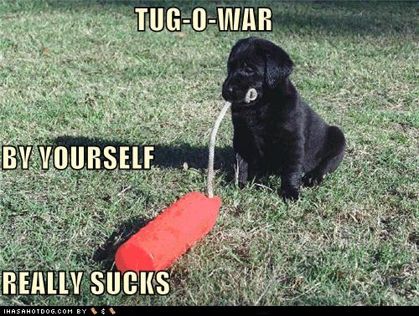
Let’s act it out!

Slide 11
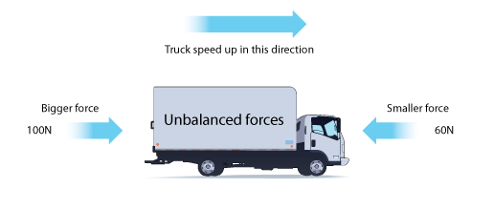
Unbalanced Forces
If the forces acting on an object are not balanced then the object will either:
  Speed up
  Slow down
  Change direction
  Change its shape

Slide 12
We can use force diagrams to show this:
4N
7N
The block has 2 opposing forces being applied to it:
7N to the right and 4N to the left. They are Unbalanced Forces.
To Calculate the Resultant Force (Fr),
subtract one from the other: 7N – 4N = 3N to the right
3N

Slide 13

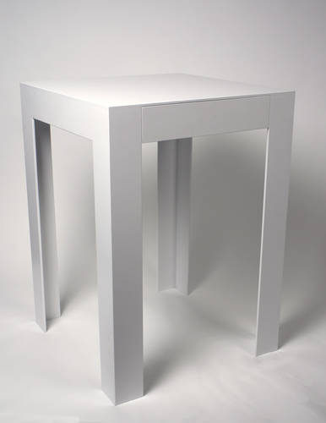
Group Problem:
A man of mass 75kg has a weight of 750N. This 750N will act downward on the table and the table will exert a 750N force upwards on the man. The forces are balanced.
What would happen if the upward force were less than 750N?
Force down 750N
Force up 750N

Slide 14
Your tasks for the rest of the lesson
Complete the practice problems on your worksheet
Try the Balanced and Unbalanced Forces extension sheet
Revise key terms with the Forces wordsearch

