Slide 1
Welcome to Year 8 Science!
Mr Martin

Slide 2
Can you unscramble these anagrams?
XASUELA PREUCROTOIDN
ASEXUAL REPRODUCTION
XSUELA CROTPREUNODI
SEXUAL REPRODUCTION

Slide 3
Learning Objectives
To describe the changes that happen to girls and boys during adolescence
To explain what is meant by the terms ‘puberty’ and ‘adolescence’.
To explain that there are two types of reproduction

Slide 4
G
M
rowth
ovement
R
eproduction
R
espiration
E
xcretion
S
ensitivity
N
utrition

Slide 5
Cell division.
https://www.youtube.com/watch?v=nB6gFn0_wr8

Slide 6
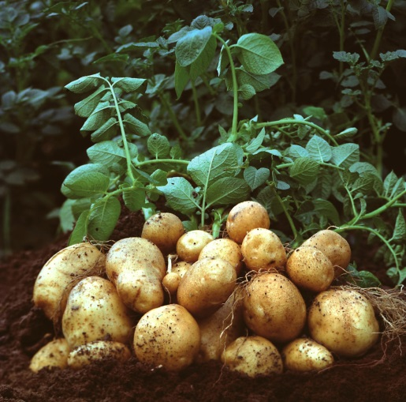
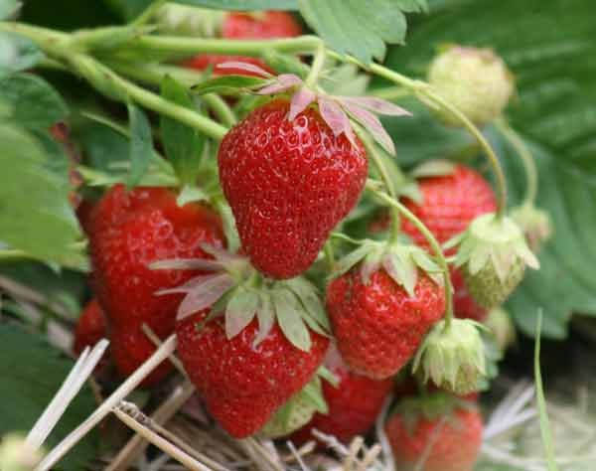
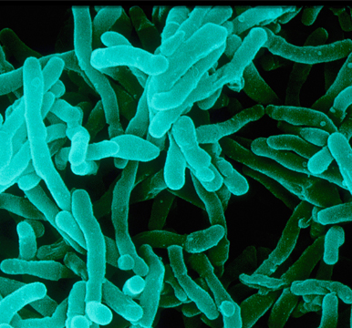
Asexual Reproduction
An individual can reproduce without involvement with another individual of that species.
Advantage | Disadvantage
Much quicker than sexual reproduction. | Offspring are identical to the parent so no new varieties are created.
Notes:
For example, one bacterial cell can divide into two daughter cells.
Some plants also reproduce asexually, examples include tomato plants, potatoes and some types of cacti.

Slide 7
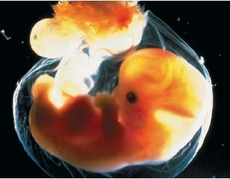
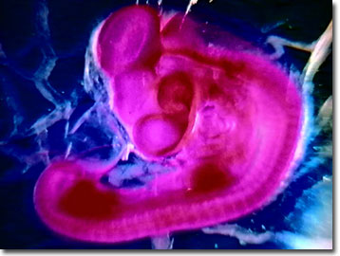
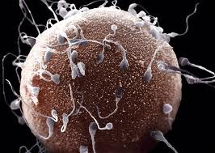
Sexual reproduction
A new life starts when the nuclei of two sex cells join. These sex cells usually come from two different members of the species, a male and a female.
Advantage | Disadvantage
Offspring are not identical to their parents, this is called variation. Variation in a species means that they are less likely to all be wiped out by the same disease. | Slower than asexual reproduction
Notes:
In humans, the male sex cell is called a sperm, and the female sex cell is called an egg.
Different animals fertilise their eggs in different ways. Male fish and male frogs fertilise the egg cells outside the female’s body. We call this external fertilisation. The egg cells of birds and mammals are fertilised inside the female’s body, we call this internal fertilisation.

Slide 8
Decide whether the statements below are asexual reproduction or sexual reproduction
Requires two organisms, requires more energy | Time Efficient; no need to search for mate, requires less energy
Two parents are required to mate | No formation or fusion of gametes(sex cells)
One parent needed | Leads to genetic variation in new generations of offspring.
No variation - if the parent has a genetic disease, offspring does too. | Formation and fusion of gametes (sex cells) occurs
There is very little chance of variation | Variation, Unique, organism is more protected.

Slide 9
Decide whether the statements below are asexual reproduction or sexual reproduction
Asexual | Sexual
One parent needed | Two parents are required to mate
Time Efficient; no need to search for mate, requires less energy | Variation, Unique, organism is more protected
No variation - if the parent has a genetic disease, offspring does too. | Requires two organisms, requires more energy
There is very little chance of variation | Leads to genetic variation in new generations of offspring.
No formation or fusion of gametes(sex cells) | Formation and fusion of gametes (sex cells) occurs

Slide 10
Puberty
A series of key events that occur to turn a sexually immature child into a sexually mature adult. These changes are brought about by sex hormones.
Adolescence
The period of time between childhood and adulthood, many physical and emotional changes occur to a person in this period.
http://www.bbc.co.uk/education/clips/zmmr87h

Slide 11


Slide 12
Both
Boys
Girls

Slide 13
Put these statements in to the correct segment:
Breasts develop
Ovaries start to produce egg cells.
Experience emotional changes
Growth spurt – get taller
Periods start
Hips widen.
Pubic hair and underarm hair grows
Testicles start to produce sperm
Shoulders widen
Hair grows on the face and chest.
Voice gets deeper – it ‘breaks’
Testicles and penis get bigger
Body smell becomes stronger – ‘body odour’.
Challenge:
What do you think is the reason for some of these changes?

Slide 14
Both
Boys
Girls
Voice gets deeper – it ‘breaks’
Testicles and penis get bigger
Testicles start to produce sperm
Shoulders widen
Hair grows on the face and chest.
Pubic hair and underarm hair grows
Body smell becomes stronger – ‘body odour’.
Experience emotional changes
Growth spurt – get taller
Breasts develop
Ovaries start to produce egg cells.
Periods start
Hips widen.

Slide 15
"What are the names of the hormones that cause puberty in boys and girls?"
Boys – Testosterone
Girls - Oestrogen

Slide 16
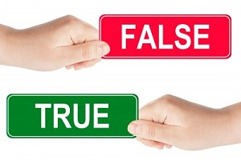
Whiteboard quiz

Slide 17

1
Puberty starts as soon as you turn 12.

Slide 18
2
The female sex hormone is called oestrogen.

Slide 19
3
During puberty a girl develops breasts

Slide 20
4
During puberty a girls hips get narrower

Slide 21
5
During puberty a boys testes start to produce sperm

Slide 22
6
During puberty only boys grow pubic hair

Slide 23
7
During puberty girls grow hair on their face and chest

Slide 24
8
During puberty a girls ovaries start to release egg cells

Slide 25
9
During puberty a boy’s voice gets higher.

Slide 26
10
During puberty both boys and girls get taller

Slide 27

Write a short tweet in your books to summarise what you have learnt this lesson.
(No more than 30 words!!!)
Each keyword should start with a #. How many keywords can you get into your tweet:
#puberty
#adolescence
#develop
#testosterone
#growth
#taller
#hair
#oestrogen
#sperm
#egg
#cells

