Slide 1
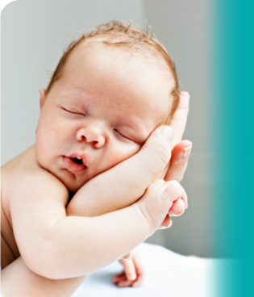
Reproductive systems.
Starter:
Where did this baby come from?
What form of reproduction led to this baby being born?
What changes might happen to this baby at puberty if its:
Female
Male

Slide 2
Learning Objectives
To describe the structure of different sex cells
To explain the functions of the different parts of the reproductive systems
To label the different reproductive systems

Slide 3
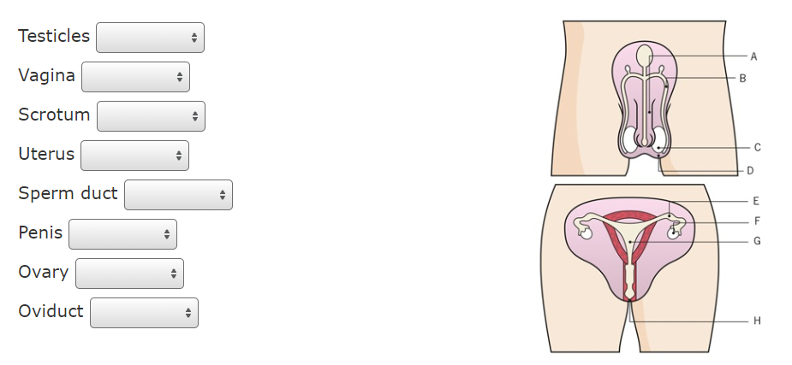
Label the parts of the reproductive system

Slide 4
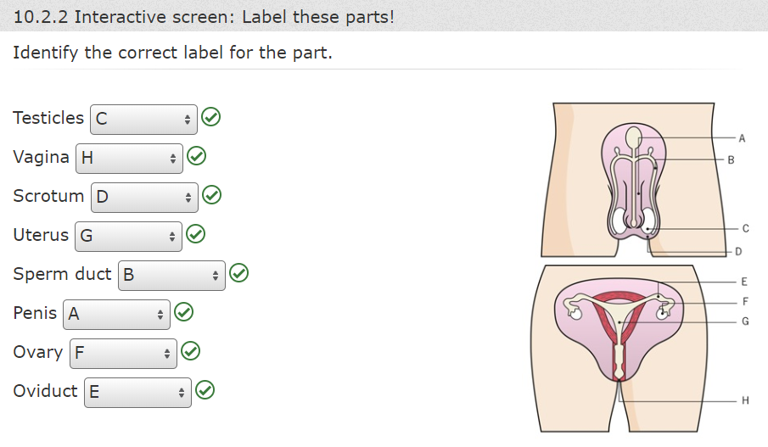
Label the parts of the reproductive system

Slide 5
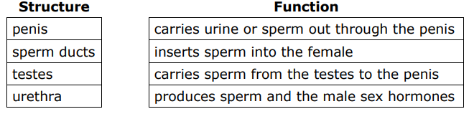
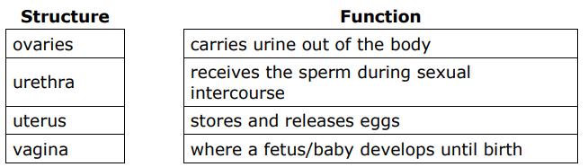
Task: Match each reproductive structure to its function

Slide 6
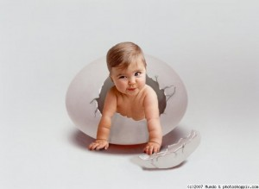
What if humans laid eggs?

Slide 7
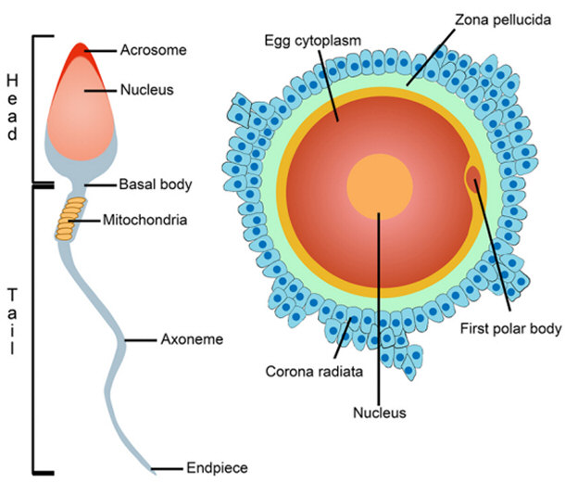
Sex cells

Slide 8
Sex cell diagrams
Acrosome containing enzymes
Cytoplasm
Nucleus
Cytoplasm
Nucleus
Cell membrane
Flagellum
Jelly coat
Cell membrane

Slide 9
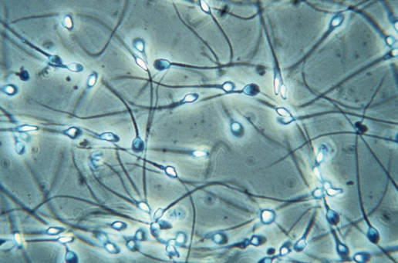
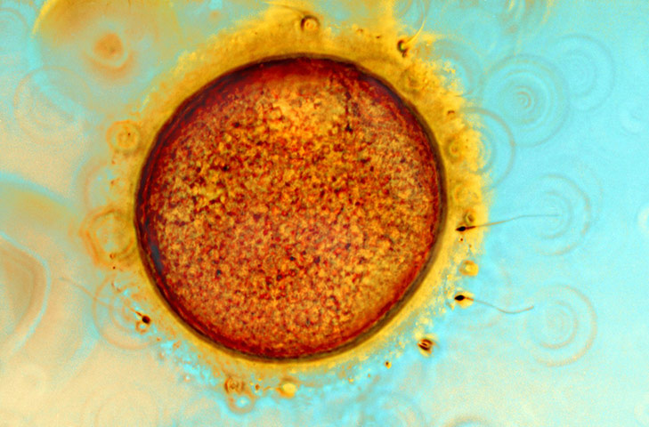
Microscopy of sex cells
Sperm cells
Egg cell

Slide 10
Summary questions
Why does the sperm cell have a flagellum?
What is the function of the uterus?
What is the function of the scrotum?
Where do the sperm and egg cells usually meet?
The flagellum or tail enables it to swim towards the egg cell
To provide a protected, nutrient rich environment for a fetus to develop
To regulate the temperature of the testis making sure the sperm are protected
In the oviduct

Slide 11
Key words
Sperm tube
Semen glands
Oviduct
Egg cell
Uterus
Testis
Sperm cell
Urethra
Scrotum
Ovaries
Cervix
Vagina
Penis

Slide 12

Reproductive system quiz

Slide 13
1
Which of the following is not a part of the male reproductive system?
penis
testes
uterus

Slide 14
2
Which of the following is not a part of the female reproductive system?
ovary
vagina
sperm duct

Slide 15
3
What are the male sex cells called?
sperm cells
sperm ducts
scrotum

Slide 16
4
Where are the male sex cells made?
In the testes
In the sperm ducts
In the penis

Slide 17
5
What are the female sex cells called?
cilia
egg cells
cervix

Slide 18
6
Where are the female sex cells made?
in the ova
in the ovaries
in the uterus

Slide 19
7
What is a change that happens to both boys and girls at puberty?
underarm hair grows
the penis gets bigger
the breasts develop

Slide 20
8
What is the function of the semen glands?
To release eggs
To add fluid to the sperm
To produce sperm

