Slide 1
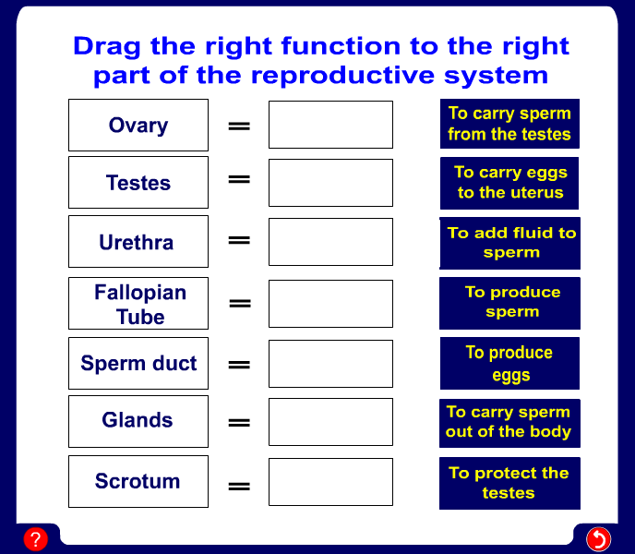
Reproductive system
Notes:
A drag and drop activity

Slide 2
Reproductive system
Notes:
A drag and drop activity

Slide 3
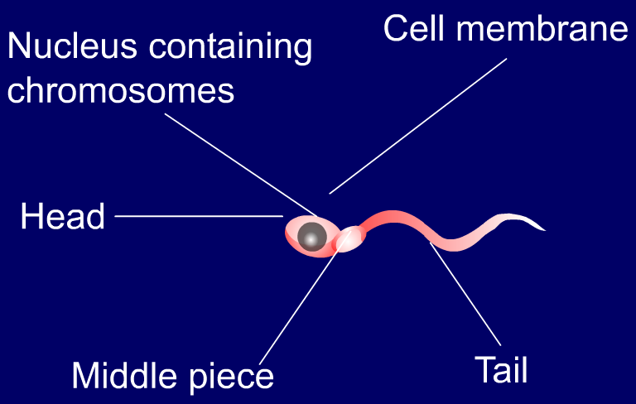
Sex cells - Sperm
In males the sex cells are called sperm.
Sperm are produced in sex organs called testes.
Notes:
The sperm and it’s labels are flash animations

Slide 4
Sex cells - Egg
In females the sex cells are called eggs.
Eggs are produced in sex organs called ovaries.
Nucleus containing chromosomes
cytoplasm
membrane
jelly coat
An egg is so big that this is how big a sperm looks next to it.

Slide 5
Sperm or egg cell?
Both sperm and eggs have special features that makes it possible for them to carry out their jobs.
Look at the statements on the next page and decide which one you think belongs to an egg and which one belongs to a sperm. Once you think you know push the buttons to see if you are right.

Slide 6
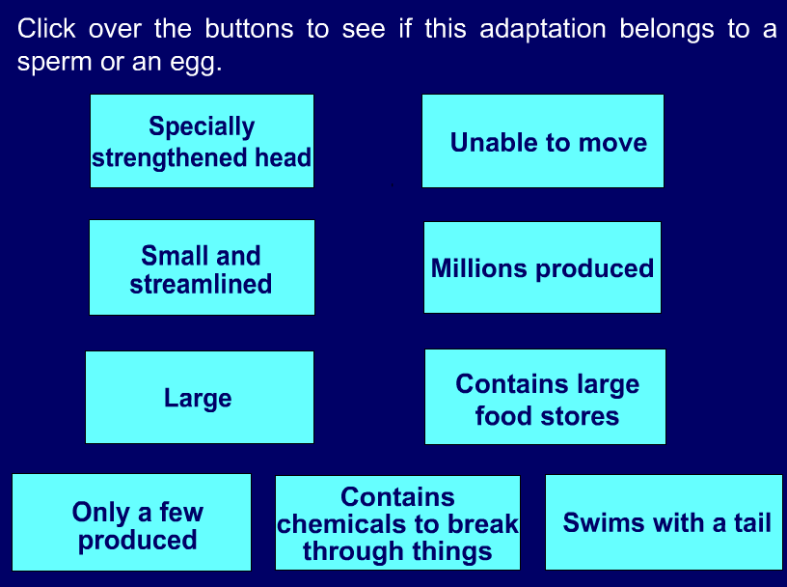
Sperm or egg cell?
Notes:
The buttons on this screen will reveal the word sperm or egg when the mouse button is put over them and held.

Slide 7
What is meant by these terms:
Write a definition, in pencil for these terms:
Ovulation
Ejaculation
Fertilisation
Implantation

Slide 8
Ovulation and fertilisation
In the female one of the ovaries produces an egg every 28 days.
This is called ovulation.
During sexual intercourse sperm is ejaculated into the vagina.
If the sperm and egg meet the sperms nucleus will join with the eggs nucleus.
This is called fertilisation.
The fertilised egg (called an embryo) sinks to the uterus. This is called implantation.

Slide 9
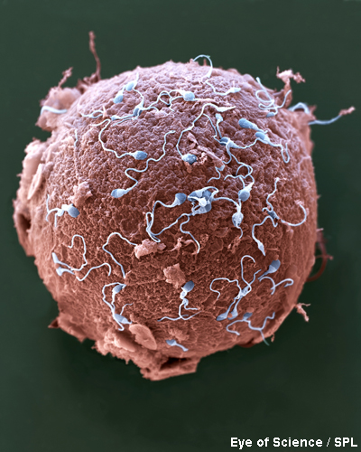
Sexual intercourse
During sexual intercourse the man inserts his penis into the woman’s vagina.
Millions of sperm cells are ejaculated into the top of the vagina.
They enter the uterus through the cervix, where the sperm cells may meet an egg.
Now fertilization can occur.
Notes:
Photo credit: Eye of Science/SPL

Slide 10
Gap Fill.
During sexual ________ the man's penis releases _________ into the woman's vagina. Sperm cells travel in semen from the penis and into the top of the _______. They enter the uterus through the _______ and travel to the _________. If a sperm cell meets with an ______ ______ there, __________ can happen. Fertilisation happens when an egg cell meets with a sperm cell and fuses with it.
Notes:
Intercourse
Sperm
Vagina
Cervix
Egg Cell
Fertilisation

Slide 11
Fertilisation
http://www.bbc.co.uk/learningzone/clips/human-fertilisation/12227.html

Slide 12
Fertilisation
Try to explain each of these statements – write an answer for each in your books.
Fish and frogs produce thousands of eggs into the water
Humans usually produce one egg at a time inside the body of the woman
Men produce millions of sperm
Think, Pair, Share!

Slide 13
Developing embryo
https://www.youtube.com/watch?v=O52oMM5YrpI

Slide 14
1) Draw a cartoon strip showing the fertilisation of an egg cell.
2) Complete the following sentences:
Fertilisation is the joining together of ……..
The sperm cells are released into the ………
To get to the oviduct the sperm cells swim …….
An egg cell is released from an ovary every ……….
The fertilised egg cell passed down the oviduct ……..

Slide 15
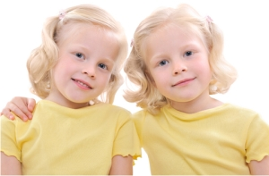
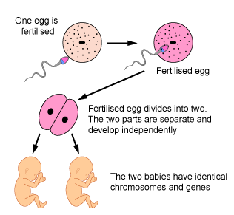
Identical twins

Slide 16
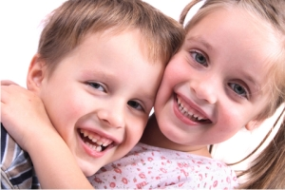



Non-identical twins
Two eggs are released from the ovaries and both are fertilised by different sperm
Both fertilised eggs develop into a fetus independently in the uterus

Slide 17
Twins
http://www.bbc.co.uk/learningzone/clips/pregnancy-and-multiple-births/12230.html

Slide 18
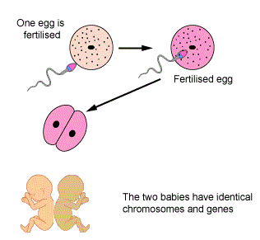
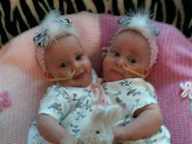
Conjoined twins
The fertilised egg divides in two but only partially separates
The babies develop partially joined.
https://www.youtube.com/watch?v=guRwgwY-j8E

Slide 19
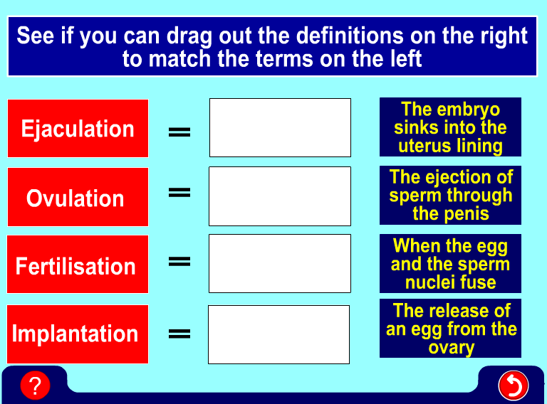
Word check
Notes:
A drag and drop activity

Slide 20
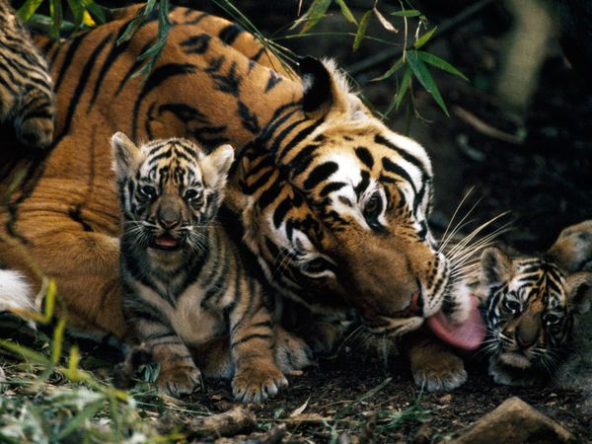
Discussion question
Why do you think that tigers and other species have multiple births much more often than humans?
Notes:
A drag and drop activity

