Slide 1
Fertilisation and implantation
Where in the female body does a sperm fertilise an egg?
Where does an embryo implant and grow inside the woman?
For how long does a human fetus develop inside the woman?
Notes:
Put these on the board

Slide 2
Learning Objectives
Describe what happens at different stages during human gestation periods.
Explain the role of the placenta during pregnancy
State what is meant by the term ‘gestation’

Slide 3
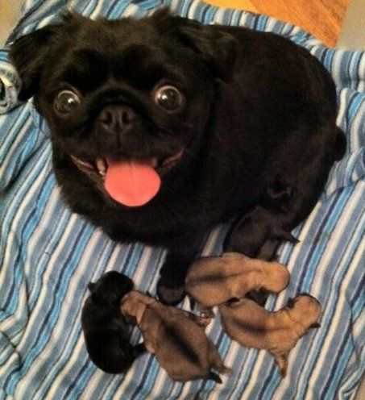
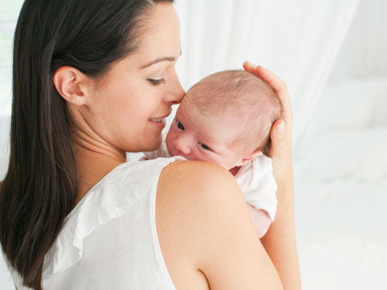
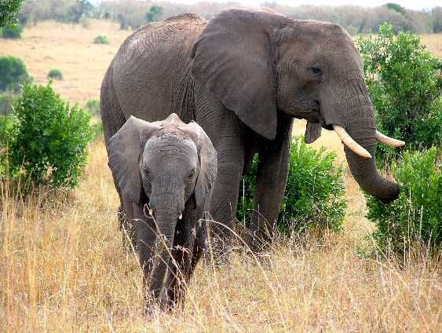
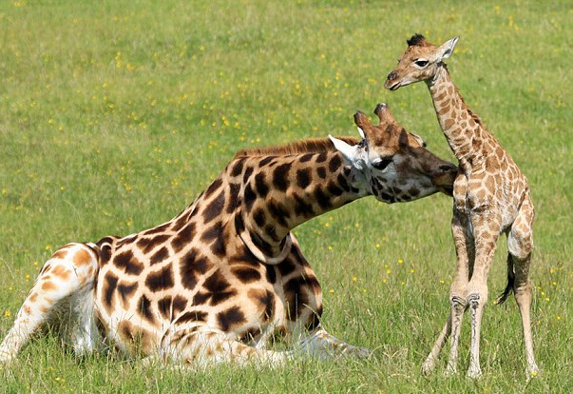
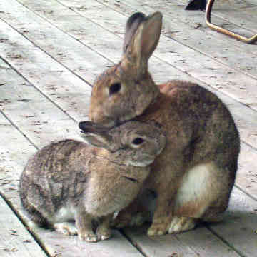
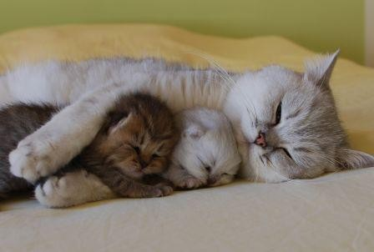
Can you match the animal to the length of its pregnancy?
2 months
1 month
21 months
2 months
15 months
9 months

Slide 4
Can you match the animal to the length of its pregnancy?
The length of an animal’s pregnancy is know scientifically as the gestation period
9 months
21 months
2 months
15 months
2 months
1 month

Slide 5
The Placenta
How does the embryo (or fetus) get the food and oxygen it needs and get rid of carbon dioxide it produces over the next 9 months?
A structure called the Placenta develops in the uterus wall of a pregnant woman.
The fetus is joined to the placenta by the umbilical cord.
INSIDE THE PLACENTA:
Food and Oxygen pass from the mothers blood into the blood of the fetus….
…..AND AT THE SAME TIME…..
Carbon dioxide passes from the blood of the fetus back into the mothers blood.

Slide 6
The Placenta

Slide 7
The Developing Fetus

Slide 8
Task: Use the information on these websites to fill out the table on the next slide
http://www.bbc.co.uk/learningzone/clips/development-of-a-foetus/861.html
http://www.bbc.co.uk/learningzone/clips/pregnancy-and-multiple-births/12230.html
http://www.bbc.co.uk/learningzone/clips/the-role-of-the-placenta-in-embryo-development/1851.html

Slide 9
Time | Diagram | Size of Foetus | Features

Slide 10
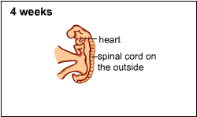
The embryo at this stage is about 6mm long and has a heart, brain, spinal cord and tiny arm and leg buds.

Slide 11
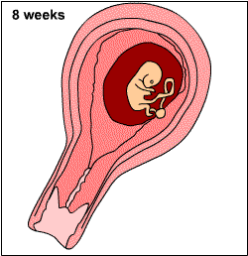
By now the embryo is about 25mm long and
weighs about 2g.
Most of the main
organs, arms and
legs are forming.
It is now called a fetus.

Slide 12
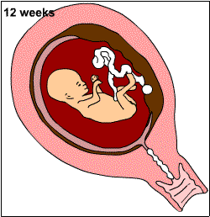
The Fetus is now about 75mm long
and weighs about 18g.
The main internal organs have nearly fully developed.
Nails are growing
on the fingers and
toes.
The ears, eyelids
and teeth have also
formed.

Slide 13
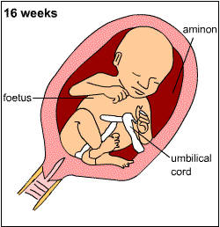
The fetus is now around 160mm long and weighs about 140g
The fetus is now strangely covered in very fine hair.

Slide 14
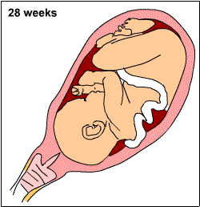
The fetus by now is around 280mm long
Its eyes open and it has a
strong desire to
suck.

Slide 15
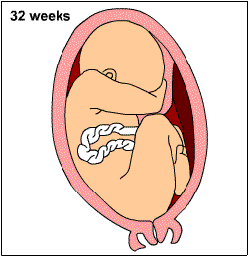
By now the fetus is around 370mm long, and space is starting to become slightly cramped in the uterus
The fetus has a good chance
of surviving if it is born at this stage.

Slide 16
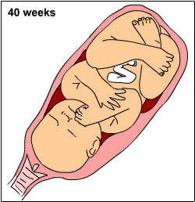
The fetus is now around 50cm long,
weighs between
2.7 - 4.1kg and is getting really cramped for space now.
Its head faces
downwards and
it is ready to
be born.

Slide 17
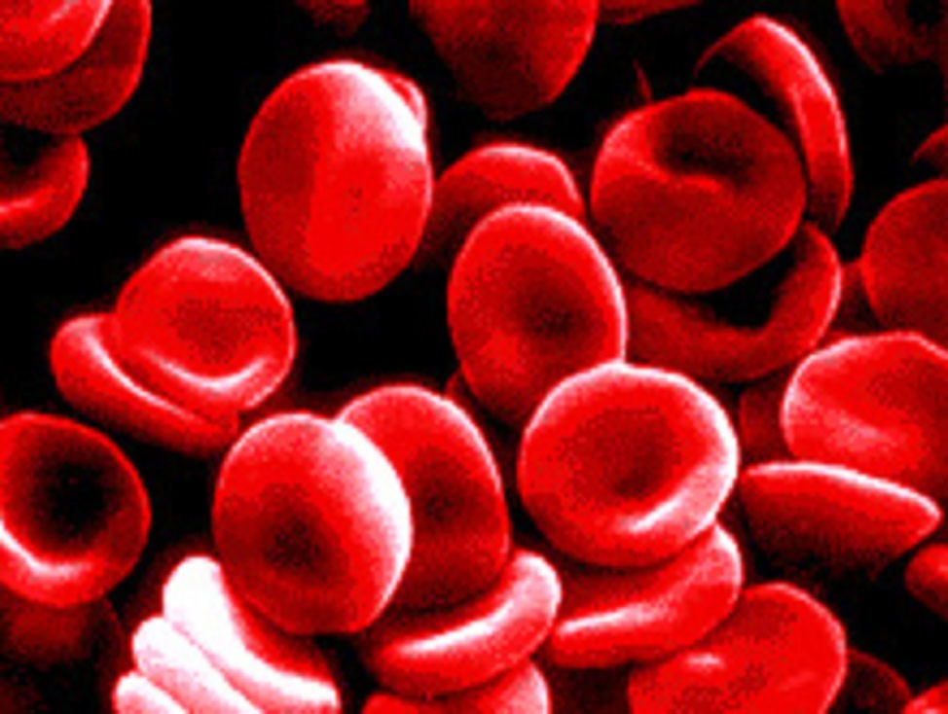
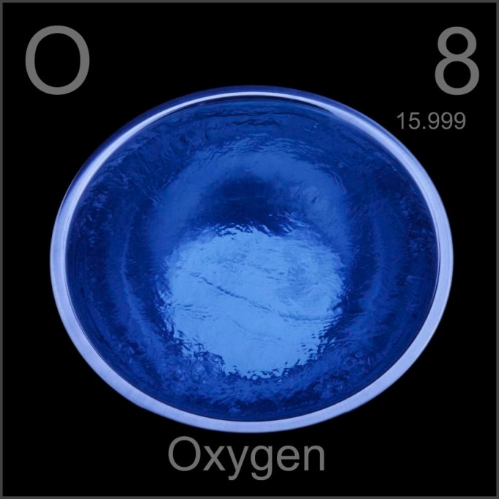
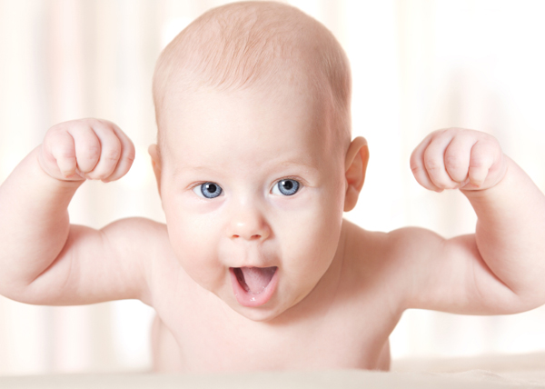
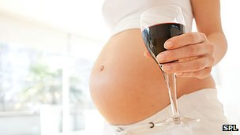
Can you link these images using the key words at the bottom of the page?
Uterus Umbilical cord Fetus Placenta

Slide 18
True or false?
Puberty starts at age 11
Egg cells are made in the ovary
Sperm and egg cells swim towards each other
Fertilisation happens in the oviduct
Egg cells contain enough food for them to develop into a fetus
An egg cell must be fertilised to become an embryo
The fetus develops inside a bag full of fluid
The fetus gets its oxygen by breathing in water like a fish
A fetus takes 9 months to grow and develop in the womb

Slide 19
True or false?
False
The menstrual cycle is a weekly cycle
Puberty starts at age 11
Egg cells are made in the ovary
Sperm and egg cells swim towards each other
Fertilisation happens in the oviduct
Egg cells contain enough food for them to develop into a fetus
An egg cell must be fertilised to become an embryo
The fetus develops inside a bag full of fluid
The fetus gets its oxygen by breathing in water like a fish
A fetus takes 9 months to grow and develop in the womb
False
True
False
True
False
True
True
False
True

