Slide 1
1. Where does a fetus develop for 9 months?
A. Carbon Dioxide
2. What structure connects the fetus to the placenta?
B. Oxygen and glucose (food)
3. How is the fetus protected as it develops?
C. 9 Months
4. Which chemicals pass from the mothers blood to the blood of the fetus in the placenta?
D. The Umbilical Cord
5. Which chemical passes from the blood of the fetus to the mother’s blood in the placenta?
E. By a bag of fluid
6. How long does a fetus develop inside the mother?
F. In the Uterus

Slide 2
1. Where does a fetus develop for 9 months?
A. Carbon Dioxide
2. What structure connects the fetus to the placenta?
B. Oxygen and glucose (food)
3. How is the fetus protected as it develops?
C. 9 Months
4. Which chemicals pass from the mothers blood to the blood of the fetus in the placenta?
D. The Umbilical Cord
5. Which chemical passes from the blood of the fetus to the mother’s blood in the placenta?
E. By a bag of fluid
6. How long does a fetus develop inside the mother?
F. In the Uterus

Slide 3
Learning Objectives:
Describe what happens at the different stages of birth
Describe the effects of smoking and alcohol on fetal development

Slide 4
Using the information on the next two slides, create a poster informing pregnant women about the dangers of smoking and drinking during pregnancy
BBC bitesize is a good information source

Slide 5
Alcohol and pregnancy
The Department of Health recommends that if you're pregnant you should avoid alcohol altogether. If you do opt to have a drink, it recommends that you stick to one or two units of alcohol (equivalent to one small glass of wine) once or twice a week to minimise the risk to your baby.
Risks of drinking during pregnancy
Miscarriage
Birth abnormalities.
Premature birth
Low birthweight.
Fetal alcohol syndrome. Children with FAS have:
  Restricted growth
  Facial abnormalities
  Learning and behavioural disorders
How is drinking in pregnancy potentially harmful?
When you drink, alcohol passes from your blood through the placenta and to your baby. A baby's liver is one of the last organs to develop fully and doesn't mature until the latter stages of pregnancy. So, your baby cannot process alcohol as well as you can and too much exposure to alcohol can seriously affect their development.

Slide 6
Smoking and pregnancy
Smoking and the unborn baby
Protecting your baby from tobacco smoke is one of the best things you can do to give your child a healthy start in life. Cigarettes can restrict the essential oxygen supply to your baby, so their heart has to beat harder every time you smoke.
Benefits of not smoking
Less morning sickness
Fewer complications in pregnancy
Reduces the risk of stillbirth
Reduces the risk of premature birth
Reduces the risk of cot death
Children whose parents don’t smoke are less likely to suffer from asthma
Stopping smoking will benefit both the mother and the baby immediately. Harmful gases like carbon monoxide and other damaging chemicals will clear from the body.

Slide 7
Birth rate
https://www.youtube.com/watch?v=sc4HxPxNrZ0

Slide 8
Task: Arrange the steps into the correct order for childbirth
At about 9 months (40 weeks) the baby is ready to beborn
At some stage the amnion breaks and the amniotic fluid comes out of the vagina.
The baby comes out head first, the umbilical cord is tied and cut.
The uterus starts to contract, this is the beginning of labour.
About half an hour after the baby is born the placenta breaks away and
passes out of the vagina. This is called the afterbirth.
Once the cervix is 10cm dilated the strong contractions begin to push the baby out.
The contractions becomes stronger and the cervix muscle starts to relax.
Notes:
Challenge is to describe the functions of the key words in bold.

Slide 9
Answers
At about 9 months (40 weeks) the baby is ready to be
born
The uterus starts to contract, this is the beginning of labour.
At some stage the amnion breaks and the amniotic fluid comes
out of the vagina.
The contractions becomes stronger and the cervix muscle
starts to relax.
Once the cervix is 10cm dilated the strong contractions
begin to push the baby out.
The baby comes out head first, the umbilical cord is tied and
cut.
About half an hour after the baby is born
the placenta breaks away and passes out of the vagina. This is called the afterbirth

Slide 10
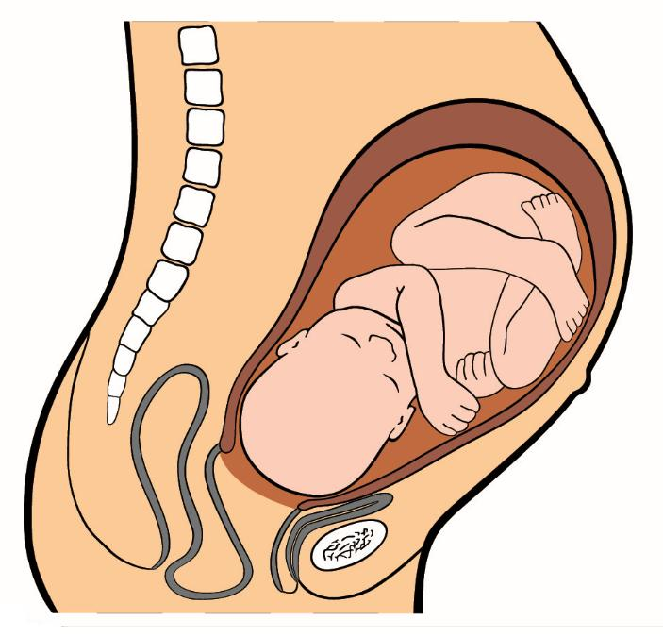
Before Birth – In the Womb
Notes:
Label:
Amniotic Fluid

Slide 11
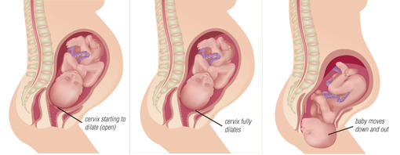
Giving birth

Slide 12

Giving birth
Draw a box about a third of a page and fill it with new information you hear during the video.

Slide 13
Questions
How long does a human pregnancy last?
During birth which two groups of muscles produce contractions?
What is meant by afterbirth?
What does a mothers breast milk provide for the baby?
Where is breast milk made?

Slide 14
Questions
How long does a human pregnancy last? 9 months
During birth which two groups of muscles produce contractions? Uterus and abdomen
What is meant by afterbirth? When the placenta is passed from the body
What does a mothers breast milk provide for the baby? Energy/ nutrients/antibodies
Where is breast milk made? In mammary glands

Slide 15
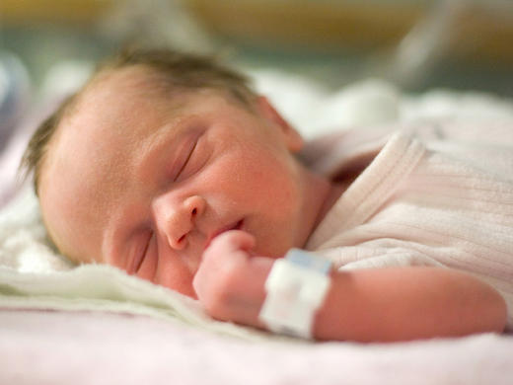
Needs of a new-born

Slide 16
Key word anagrams
Nomicait dlfiu
leapcant
Biulmilac droc

