Slide 1
P1 L10 Wave Motion
Starter
Match the words to their definition
Key Term | Definition
Transverse | The number of waves passing a certain point every second.
Longitudinal | The height of the wave from origin to peak/crest.
Wavelength | The unit we use to measure frequency. 1 Hz = 1 wave a second. Human hearing is limited to 20,000Hz. Dogs can apparently hear sounds at 30,000Hz
Amplitude | The speed at which each wave crest moves measured in metres per second (m/s).
Frequency | A wave that is produced by vibrations at right angles to the direction of the wave (dropping a stone in water)
Hertz | A wave that is produced by vibrations in the same direction as the wave travels (sound waves from a speaker)
Period | This affects the wave speed of a wave, it can slow it down and speed it up. It is the material the wave is travelling through (water, glass, air etc).
Wave speed | The distance from one crest to the next. EM waves have different wavelengths.
Medium | The time taken for one vibration to take place (measured in seconds)

Slide 2
P1 L10 Wave Motion
Starter
Match the words to their definition
Key Term | Definition
Transverse | The number of waves passing a certain point every second.
Longitudinal | The height of the wave from origin to peak/crest.
Wavelength | The unit we use to measure frequency. 1 Hz = 1 wave a second. Human hearing is limited to 20,000Hz. Dogs can apparently hear sounds at 30,000Hz
Amplitude | The speed at which each wave crest moves measured in metres per second (m/s).
Frequency | A wave that is produced by vibrations at right angles to the direction of the wave (dropping a stone in water)
Hertz | A wave that is produced by vibrations in the same direction as the wave travels (sound waves from a speaker)
Period | This affects the wave speed of a wave, it can slow it down and speed it up. It is the material the wave is travelling through (water, glass, air etc).
Wave speed | The distance from one crest to the next. EM waves have different wavelengths.
Medium | The time taken for one vibration to take place (measured in seconds)

Slide 3
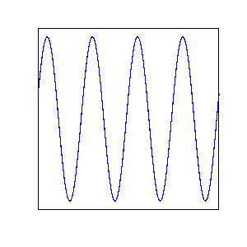
Learning Outcomes
Describe the difference between transverse and longitudinal waves
Define wavelength and frequency
Recall and apply the relationship between speed, frequency and wavelength to waves

Slide 4
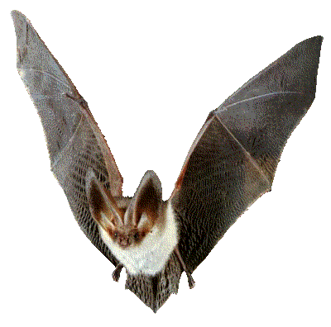

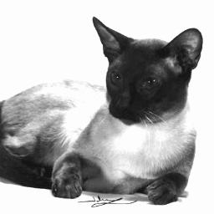
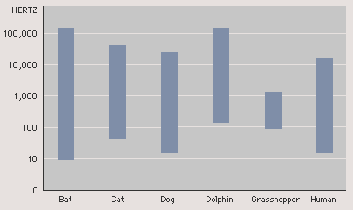
P1 L10 Wave Motion
How old are your ears?
https://www.youtube.com/watch?v=VxcbppCX6Rk

Slide 5
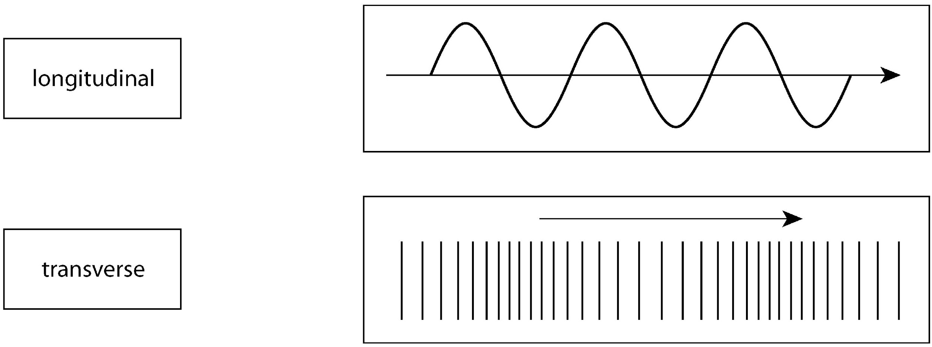
Wave Anatomy
Task: Label your diagram with the following:
Label bank- rest position, wavelength, amplitude, source, direction of travel
Task: If this diagram represents one second of time, predict what the frequency of the wave is in Hz.
Stretch- Using your answer from the “should” task, the period is the number of seconds taken for once full cycle. Do 1/frequency to calculate.

Slide 6
Wave Anatomy
wavelength
amplitude
Source
rest position
direction
Task: If this diagram represents one second of time, predict what the frequency of the wave is in Hz.
If the diagram is 1 second, there are 3 crests/waves in the diagram. So the frequency is 3Hz

Slide 7
Transverse Wave
Start
Peak
Oscillations
Trough
Direction of wave travel

Slide 8

Longitudinal Wave
Start
Rarefaction
Oscillations
Compression
Direction of wave travel

Slide 9
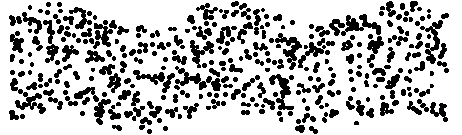
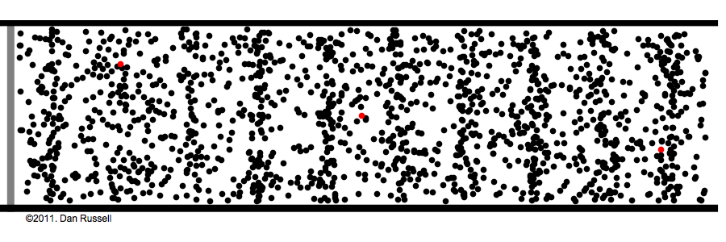

Types of Wave
Task: Copy and complete
Waves transfer _______, and are caused by oscillations in a ________.
Transverse waves are caused by ________ in a medium ______________ (90º) to the direction the wave travels. _____ and other electromagnetic waves are transverse.
___________ waves are caused by oscillations ________ to the direction of the wave. ______ waves are longitudinal.
Word bank
parallel, oscillations, light, energy, longitudinal, sound, perpendicular, source
Stretch
On the left is a picture of a Mexican Wave at a football game. What type of wave does this model and explain your decision.

Slide 10
Types of Wave
MUST: Copy and complete
Waves transfer Energy, and are caused by oscillations in a Source.
Transverse waves are caused by Oscillations in a medium Perpendicular (90º) to the direction the wave travels. Light and other electromagnetic waves are transverse.
Longitudinal waves are caused by oscillations Parallel to the direction of the wave. Sound waves are longitudinal.
Word bank
parallel, oscillations, light, energy, longitudinal, sound, perpendicular, source
Stretch
On the left is a picture of a Mexican Wave at a football game. What type of wave does this model and explain your decision.

Slide 11
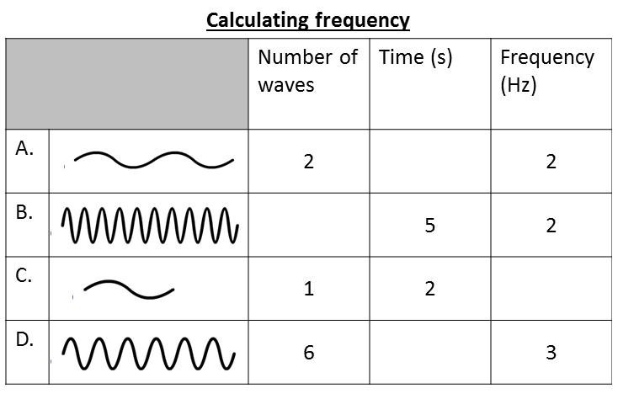
Wavelength and Frequency
1
10
0.5
2
Stretch
Paul’s ball has kicked his ball into the middle of a pond. He is trying to make waves to get the ball back. He thinks the waves will carry the ball to the other side. Evaluate his statement.

Slide 12
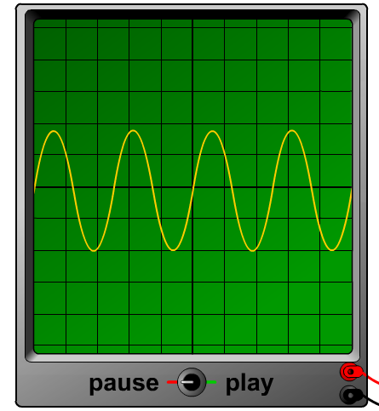
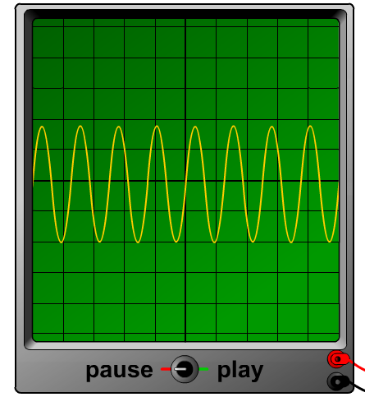
Loudness and Pitch
A sound can be high or low – this is the pitch of the sound.
http://www.physics-chemistry-interactive-flash-animation.com/electricity_electromagnetism_interactive/oscilloscope_description_tutorial_sounds_frequency.htm
On an oscilloscope trace, the pitch of a sound is shown by how many waves there are. This is called the frequency.
low pitch
4 Graphs
Low volume, low frequency
Low volume, high frequency
High volume, low frequency
High volume, high frequency
high pitch

Slide 13
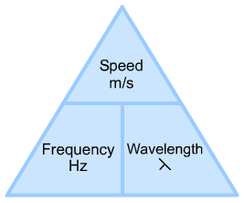
Wave Speed
We can calculate the speed of other waves by using the following equations (copy into your books).
Wave speed (m/s) = frequency (Hz) x wavelength (m)

Slide 14
Wave Speed
Wave speed (m/s) = frequency (Hz) x wavelength (m)
Task 1:
1. Calculate the speed of a wave with a frequency of 100Hz and a wavelength of 2m
2. Calculate the speed of a wave with a wavelength of 0.5m and a frequency of 4000Hz
Task 2:
Calculate the frequency of a wave travelling at 500m/s with a wavelength of 25m
Task 3:
Calculate the wavelength of a wave travelling at 1100m/s with a frequency of 55000Hz

Slide 15
Wave Speed
Wave speed (m/s) = frequency (Hz) x wavelength (m)
Task 1:
1. Calculate the speed of a wave with a frequency of 100Hz and a wavelength of 2m= 200m/s
2. Calculate the speed of a wave with a wavelength of 0.5m and a frequency of 4000Hz= 2000m/s
Task 2:
Calculate the frequency of a wave travelling at 500m/s with a wavelength of 25m= 20Hz
Task 3:
Calculate the wavelength of a wave travelling at 1100m/s with a frequency of 55000Hz= 0.02m

