Slide 1
Try to put the sentences on the next slide into the correct order.

Slide 2
1. Mixtures can be separated by physical processes such as filtration, crystallisation, simple distillation, fractional distillation and chromatography.
2. The technique of filtration is used to separate substances that are insoluble from a solvent. You could also separate 2 solids, such as salt and sand using filtration. The salt will dissolve in water and pass through the filter paper.
3. This way, you have the salt needed. If you want to collect the water, you need to carry out distillation instead (more on this next lesson…).
4. A mixture consists of two or more elements or compounds not chemically combined together.
5. To separate the salt from the water, you can use crystallisation. Heating the solution in an evaporating dish until crystals begin to form, then leaving the solvent to evaporate will collect as much salt as possible.
6. These physical processes do not involve chemical reactions and no new substances are made.

Slide 3
1. Mixtures can be separated by physical processes such as filtration, crystallisation, simple distillation, fractional distillation and chromatography.
2. The technique of filtration is used to separate substances that are insoluble from a solvent. You could also separate 2 solids, such as salt and sand using filtration. The salt will dissolve in water and pass through the filter paper.
3. This way, you have the salt needed. If you want to collect the water, you need to carry out distillation instead (more on this next lesson…).
4. A mixture consists of two or more elements or compounds not chemically combined together.
5. To separate the salt from the water, you can use crystallisation. Heating the solution in an evaporating dish until crystals begin to form, then leaving the solvent to evaporate will collect as much salt as possible.
6. These physical processes do not involve chemical reactions and no new substances are made.
2
4
6
1
5
3

Slide 4
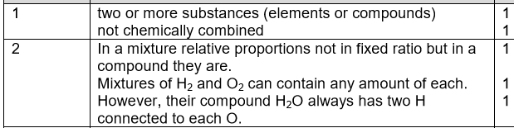
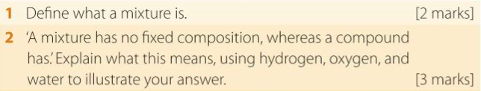
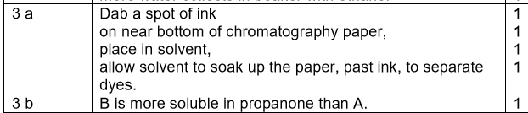
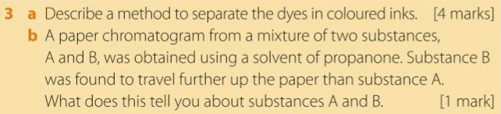
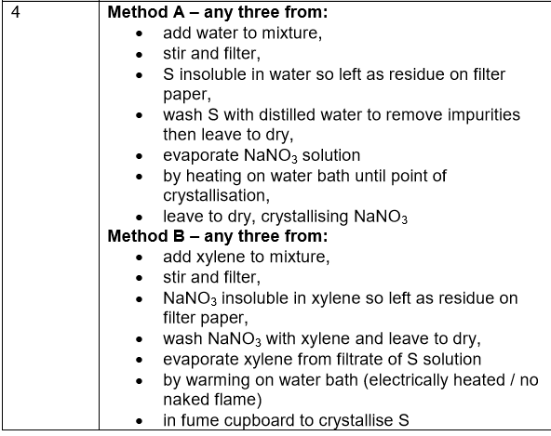
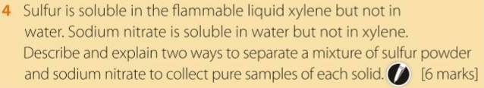
Challenge: How could you separate oil and water? What about water and ink? Draw diagrams to accompany your answers.

Slide 5
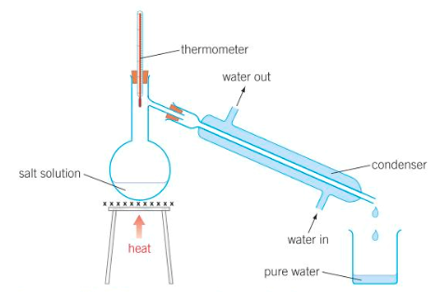
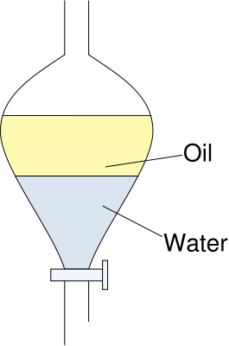
Challenge:

