Slide 1


The PiXL Club The PiXL Club The PiXL Club The PiXL Club The PiXL Club The PiXL Club The PiXL Club The PiXL Club The PiXL Club The PiXL Club The PiXL Club The PiXL Club The PiXL Club The PiXL Club The PiXL Club The PiXL Club The PiXL Club The PiXL Club The PiXL Club The PiXL Club The PiXL Club The PiXL Club The PiXL Club The PiXL Club The PiXL Club The PiXL Club The PiXL Club The PiXL Club The PiXL Club The PiXL Club The PiXL Club The PiXL Club The PiXL Club The PiXL Club The PiXL Club The PiXL Club The PiXL Club The PiXL Club The PiXL Club The PiXL Club The PiXL Club The PiXL Club The PiXL Club The PiXL Club The PiXL Club XL Club The PiXL Club The PiXL Club The PiXL Club The PiXL Club The PiXL Club The PiXL Club The PiXL Club The PiXL Club The PiXL Club The PiXL Club The PiXL Club The PiXL Club The PiXL Club The PiXL Club The PiXL Club The PiXL Club The PiXL Club The PiXL Club The PiXL Club The PiXL Club The PiXL Club The PiXL Club The PiXL Club The PiXL Club The PiXL Club The PiXL Club The PiXL Club The PiXL Club The PiXL Club The PiXL Club The PiXL Club The PiXL Club The PiXL Club The PiXL Club The PiXL Club The PiXL Club The PiXL Club The PiXL Club The PiXL Club The PiXL Club The PiXL Club The PiXL Club The PiXL Club The PiXL Club The PiXL Club The PiXL Club The PiXL Club The PiXL Club The PiXL Club The PiXL Club The PiXL Club The PiXL Club The PiXL Club The PiXL Club The PiXL Club The PiXL Club The PiXL Club The PiXL Club The PiXL Club The PiXL Club The PiXL Club The PiXL Club The PiXL Club The PiXL Club The PiXL Club The PiXL Club The PiXL Club The PiXL Club The PiXL Club The PiXL Club The PiXL Club The PiXL Club The PiXL Club The PiXL Club The PiXL Club The PiXL Club The PiXL Club The PiXL Club The PiXL Club The PiXL Club The PiXL Club The PiXL Club The PiXL Club The PiXL Club The PiXL Club The PiXL Club The PiXL Club The PiXL Club The PiXL Club The PiXL Club The PiXL Club The PiXL Club The PiXL Club The PiXL Club The PiXL Club The PiXL Club The PiXL Club The PiXL Club The PiXL Club The PiXL Club The PiXL Club The PiXL Club The PiXL Club The PiXL Club The PiXL Club The PiXL Club The PiXL Club The PiXL Club The PiXL Club The PiXL Club The PiXL Club The PiXL Club The PiXL Club The PiXL Club The PiXL Club The PiXL Club The PiXL Club The PiXL Club The PiXL Club The PiXL Club The PiXL Club The PiXL Club The PiXL Club The PiXL Club The PiXL Club The PiXL Club The PiXL Club The PiXL Club The PiXL Club The PiXL Club The PiXL Club The PiXL Club The PiXL Club The PiXL Club The PiXL Club The PiXL Club The PiXL Club The PiXL Club The PiXL Club The PiXL Club The PiXL Club The PiXL Club The PiXL Club The PiXL Club The PiXL Club The PiXL Club The PiXL Club The PiXL Club The PiXL Club The PiXL Club The PiXL Club The PiXL Club The PiXL Club The PiXL Club The PiXL Club The PiXL Club The PiXL Club The PiXL Club The PiXL Club The PiXL Club The PiXL Club The PiXL Club The PiXL Club The PiXL Club The PiXL Club The PiXL Club The PiXL Club The PiXL Club The PiXL Club The PiXL Club The PiXL Club The PiXL Club The PiXL Club The PiXL Club The PiXL Club The PiXL Club The PiXL Club The PiXL Club The PiXL Club The PiXL Club The PiXL Club The PiXL Club The PiXL Club The PiXL Club The PiXL Club The PiXL Club The PiXL Club The PiXL Club The PiXL Club The PiXL Club The PiXL Club The PiXL Club The PiXL Club The PiXL Club The PiXL Club The PiXL Club The PiXL Club The PiXL Club The PiXL Club The PiXL Club The PiXL Club The PiXL Club The PiXL Club The PiXL Club The PiXL Club The PiXL Club The PiXL Club The PiXL Club The PiXL Club The PiXL Club The PiXL Club The PiXL Club The PiXL Club The PiXL Club The PiXL Club The PiXL Club The PiXL Club The PiXL Club The PiXL Club The PiXL Club The PiXL Club The PiXL Club The PiXL Club The PiXL Club The PiXL Club The PiXL Club The PiXL Club The PiXL Club The PiXL Club The PiXL Club The PiXL Club The PiXL Club The PiXL Club The PiXL Club The PiXL Club The PiXL Club The PiXL Club The PiXL Club The PiXL Club The PiXL Club The PiXL Club The PiXL Club The PiXL Club The PiXL Club The PiXL Club The PiXL Club The PiXL Club The PiXL Club The PiXL Club The PiXL Club The PiXL Club The PiXL Club The PiXL Club The PiXL Club The PiXL Club The PiXL Club The PiXL Club The PiXL Club The PiXL Club The PiXL Club The PiXL Club The PiXL Club The PiXL Club The PiXL Club The PiXL Club The PiXL Club The PiXL Club The PiXL Club The PiXL Club The PiXL Club The PiXL Club The PiXL Club The PiXL Club The PiXL Club The PiXL Club The PiXL Club The PiXL Club The PiXL Club The PiXL Club The PiXL Club The PiXL Club The PiXL Club The PiXL Club The PiXL Club The PiXL Club The PiXL Club The PiXL Club The PiXL Club The PiXL Club The PiXL Club The PiXL Club The PiXL Club The PiXL Club The PiXL Club The PiXL Club The PiXL Club The PiXL Club The PiXL Club The PiXL Club The PiXL Club The PiXL Club The PiXL Club The PiXL Club The PiXL Club The PiXL Club The PiXL Club The PiXL Club The PiXL Club The PiXL Club The PiXL Club The PiXL Club The PiXL Club The PiXL Club The PiXL Club The PiXL Club The PiXL Club The PiXL Club The PiXL Club The PiXL Club The PiXL Club The PiXL Club The PiXL Club The PiXL Club The PiXL Club The PiXL Club The PiXL Club The PiXL Club The PiXL Club The PiXL Club The PiXL Club The PiXL Club The PiXL Club The PiXL Club The PiXL Club The PiXL Club The PiXL Club The PiXL Club The PiXL Club The PiXL Club The PiXL Club The PiXL Club The PiXL Club The PiXL Club The PiXL Club The PiXL Club The PiXL Club The PiXL Club The PiXL Club The PiXL Club The PiXL Club The PiXL Club The PiXL Club The PiXL Club The PiXL Club The PiXL Club The PiXL Club The PiXL Club The PiXL Club The PiXL Club The PiXL Club The PiXL Club The PiXL Club The PiXL Club The PiXL Club The PiXL Club The PiXL Club The PiXL Club The PiXL Club The PiXL Club The PiXL Club The PiXL Club The PiXL Club The PiXL Club The PiXL Club The PiXL Club The PiXL Club The PiXL Club The PiXL Club The PiXL Club The PiXL Club The PiXL Club The PiXL Club The PiXL Club The PiXL Club The PiXL Club The PiXL Club The PiXL Club The PiXL Club The PiXL Club The PiXL Club The PiXL Club The PiXL Club The PiXL Club The PiXL Club The PiXL Club The PiXL Club The PiXL Club The PiXL Club The PiXL Club The PiXL Club The PiXL Club The PiXL Club The PiXL Club The PiXL Club The PiXL Club The PiXL Club The PiXL Club The PiXL Club The PiXL Club The PiXL Club The PiXL Club The PiXL Club The PiXL Club The PiXL Club The PiXL Club The PiXL Club The PiXL Club The PiXL Club The PiXL Club The PiXL Club The PiXL Club The PiXL Club The PiXL Club The PiXL Club The PiXL Club The PiXL Club The PiXL Club The PiXL Club The PiXL Club The PiXL Club The PiXL Club The PiXL Club The PiXL Club The PiXL Club The PiXL Club The PiXL Club The PiXL Club The PiXL Club The PiXL Club The PiXL Club The PiXL Club The PiXL Club The PiXL Club The PiXL Club The PiXL Club The PiXL Club The PiXL Club The PiXL Club The PiXL Club The PiXL Club The PiXL Club The PiXL Club The PiXL Club The PiXL Club The PiXL Club The PiXL Club The PiXL Club The PiXL Club The PiXL Club The PiXL Club The PiXL Club The PiXL Club The PiXL Club The PiXL Club The PiXL Club The PiXL Club The PiXL Club The PiXL Club The PiXL Club The PiXL Club The PiXL Club The PiXL Club The PiXL Club The PiXL Club The PiXL Club The PiXL Club The PiXL Club The PiXL Club The PiXL Club The PiXL Club The PiXL Club The PiXL Club The PiXL Club The PiXL Club The PiXL Club The PiXL Club The PiXL Club The PiXL Club The PiXL Club The PiXL Club The PiXL Club The PiXL Club The PiXL Club The PiXL Club The PiXL Club The PiXL Club The PiXL Club The PiXL Club The PiXL Club The PiXL Club The PiXL Club The PiXL Club The PiXL Club The PiXL Club The PiXL Club The PiXL Club The PiXL Club The PiXL Club The PiXL Club The PiXL Club The PiXL Club The PiXL Club The PiXL Club The PiXL Club The PiXL Club The PiXL Club The PiXL Club The PiXL Club The PiXL Club The PiXL Club The PiXL Club The PiXL Club The PiXL Club The PiXL Club The PiXL Club The PiXL Club The PiXL Club The PiXL Club The PiXL Club The PiXL Club The PiXL Club The PiXL Club The PiXL Club The PiXL Club The PiXL Club The PiXL Club The PiXL Club The PiXL Club The PiXL Club The PiXL Club The PiXL Club The PiXL Club The PiXL Club The PiXL Club The PiXL Club The PiXL Club The PiXL Club The PiXL Club The PiXL Club The PiXL Club The PiXL Club The PiXL Club The PiXL Club The PiXL Club The PiXL Club The PiXL Club The PiXL Club The PiXL Club The PiXL Club The PiXL Club The PiXL Club The PiXL Club The PiXL Club The PiXL Club The PiXL Club The PiXL Club The PiXL Club The PiXL Club The PiXL Club The PiXL Club The PiXL Club The PiXL Club The PiXL Club The PiXL Club The PiXL Club The PiXL Club The PiXL Club The PiXL Club The PiXL Club The PiXL Club The PiXL Club The PiXL Club The PiXL Club The PiXL Club The PiXL Club The PiXL Club The PiXL Club The PiXL Club The PiXL Club The PiXL Club The PiXL Club The PiXL Club The PiXL Club The PiXL Club The PiXL Club The PiXL Club The PiXL Club The PiXL Club The PiXL Club The PiXL Club The PiXL Club The PiXL Club The PiXL Club The PiXL Club The PiXL Club The PiXL Club The PiXL Club The PiXL Club The PiXL Club The PiXL Club The PiXL Club The PiXL Club The PiXL Club The PiXL Club The PiXL Club The PiXL Club The PiXL Club The PiXL Club The PiXL Club The PiXL Club The PiXL Club The PiXL Club The PiXL Club The PiXL Club The PiXL Club The PiXL Club The PiXL Club The PiXL Club The PiXL Club The PiXL Club The PiXL Club The PiXL Club The PiXL Club The PiXL Club The PiXL Club The PiXL Club The PiXL Club The PiXL Club The PiXL Club The PiXL Club The PiXL Club The PiXL Club The PiXL Club The PiXL Club The PiXL Club The PiXL Club The PiXL Club The PiXL Club The PiXL Club The PiXL Club The PiXL Club The PiXL Club The PiXL Club The PiXL Club The PiXL Club The PiXL Club The PiXL Club The PiXL Club The PiXL Club The PiXL Club The PiXL Club The PiXL Club The PiXL Club The PiXL Club The PiXL Club The PiXL Club The PiXL Club The PiXL Club The PiXL Club The PiXL Club The PiXL Club The PiXL Club The PiXL Club The PiXL Club The PiXL Club The PiXL Club The PiXL Club The PiXL Club The PiXL Club The PiXL Club The PiXL Club The PiXL Club The PiXL Club The PiXL Club The PiXL Club The PiXL Club The PiXL Club The PiXL Club The PiXL Club The PiXL Club The PiXL Club The PiXL Club The PiXL Club The PiXL Club The PiXL Club The PiXL Club The PiXL Club The PiXL Club The PiXL Club The PiXL Club
PiXL KnowIT!
GCSE Chemistry
AQA Topic – Atomic structure and the periodic table
© Copyright The PiXL Club Ltd, 2017
This resource is strictly for the use of member schools for as long as they remain members of The PiXL Club. It may not be copied, sold nor transferred to a third party or used by the school after membership ceases. Until such time it may be freely used within the member school.
All opinions and contributions are those of the authors. The contents of this resource are not connected with nor endorsed by any other company, organisation or institution.
www.pixl.org.uk The PiXL Club Ltd, Company number 07321607

Slide 2
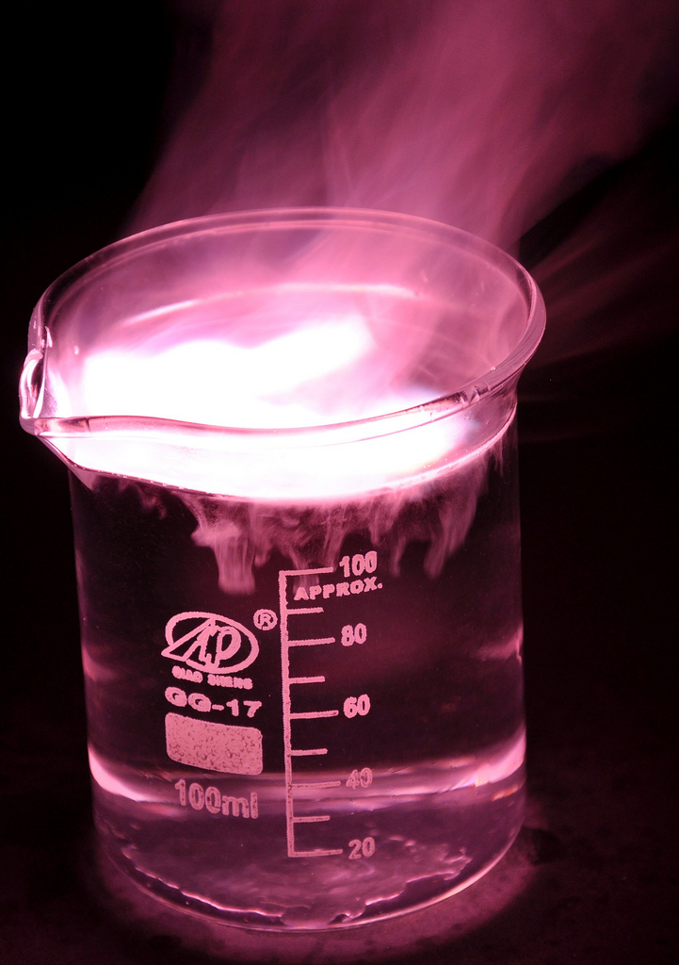
Overview
Atomic structure and the periodic table
Atoms, elements, compounds and mixtures
  Atoms, elements and compounds
  Word and symbol equations
  Separation techniques
Atomic model
  History of the atomic model
  Size and mass of atoms
  Atomic structure
Periodic table
  History of the periodic table
  Group 0, group 1 and group 7
  Transition metals (chemistry only)
Notes:
https://c2.staticflickr.com/4/3178/4076380768_03994aed44_b.jpg

Slide 3

LearnIT!
KnowIT!
Atoms, elements,
compounds and
mixtures PART 1
  Atoms, elements and compounds
  Word and symbol equations

Slide 4
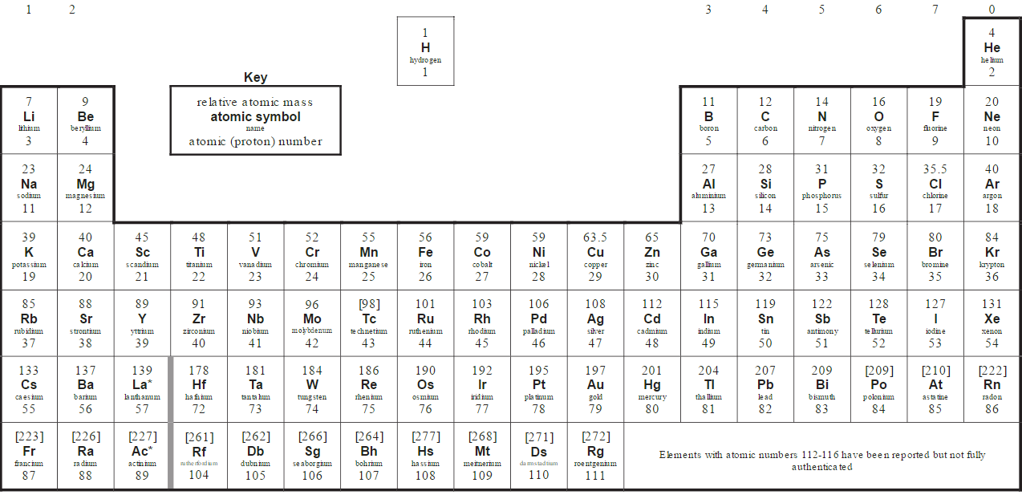
  Atoms, elements, compounds and mixtures - PART 1
All substances are made of atoms that cannot be chemically broken down. It is the smallest part of an element.
Elements are made of only one type of atom. Each element has its own symbol.
e.g. Na is sodium.
There are about 100 different elements
Compounds contain more than one type of atom. They are formed from elements by chemical reactions, which always involve the formation of one or more new substance, often involving an energy change.
The components of a compound cannot be separated by physical means. They can be separated only by chemical means.
You need to:
Know the names and symbols for the first 20 elements and all of group 1, 7 and 0
Name compounds when given the formulae or symbol equations
MgCl₂
magnesium
chlorine
Magnesium chloride

Slide 5
  Atoms, elements, compounds and mixtures - PART 1
Compounds contain two or more elements chemically combined in fixed proportions and can be represented by formulae using the symbols of atoms from which they formed.
For example:
Na₂S = sodium sulfide
K₂O = potassium oxide
Naming a compound with two elements (usually a metal and a non metal) apply these rules:
The metal name does not change
The non-metal's name ends in ide
When a compound contains a transition metal, the names become a bit more complicated. To distinguish them, Roman numerals indicate the charge on the metal ion
e.g. iron(II) chloride.
Naming a compound with a metal that reacts with ions that consist of two or more non-metal atoms covalently bonded together apply these rules:
The metal name does not change
The non-metal's name ends in ate if oxygen is present
For example: Na₂CO₃ = sodium carbonate
KNO₃ = potassium nitrate

Slide 6
  Atoms, elements, compounds and mixtures - PART 1
Chemical equations: Show the reactants (what we start with) and the products (what we end with).
No atoms are lost or made. The mass of the products equals the mass of the reactants.
You need to:
Write word equations
Balanced symbol equations
Word equation: methane + oxygen → carbon dioxide + water
Symbol equation: CH₄ + 2O₂ → CO₂ + 2H₂O
There are 4 hydrogens here, bonded together.
There are 2 molecules of oxygen not bonded together.
There are 4 hydrogens here. You multiply the big number by the little number.
+
+
Equations MUST balance
We can ONLY add BIG numbers to the front of a substance
We can tell elements within a compound by BIG letters
We can check an equation is balanced by counting the number of each type of atom on either side

Slide 7
  Atoms, elements, compounds and mixtures - PART 1
We can add state symbols to a symbol equation to show whether the reactants and products in a chemical reaction are solids, gases, liquids or dissolved in water.
Solid = s
Liquid = l
Gas = g
Aqueous (dissolved in water) = aq
Word equation: sodium + water → sodium hydroxide + hydrogen
Symbol equation: 2Na(s) + 2H₂O(l) → 2NaOH(aq) + H₂(g)
The reaction between copper sulfate and sodium hydroxide is:
copper sulfate + sodium hydroxide → sodium sulfate + copper hydroxide
CuSO₄(aq) + 2NaOH(aq) → Na₂SO₄(aq) + Cu(OH)₂(s)
You can tell that the copper hydroxide forms a solid (the precipitate) because its state symbol is (s) for solid, rather than (aq) for aqueous (dissolved in water).
The reaction can also be shown by an ionic equation:
Cu²⁺(aq) + 2OH–(aq) → Cu(OH)₂(s)
HT only – write balanced half equations and ionic equations

Slide 8

QuestionIT!
Atoms, elements,
compounds and mixtures
PART 1
  Atoms, elements and compounds
  Word and symbol equations

Slide 9
  Atoms, elements, compounds and mixtures PART 1 – QuestionIT
Around how many different types of element are there in the periodic table?
What does it mean if a compound ends in –ide?
What does it mean if a compound ends in –ate?
What does a chemical reaction involve?
Name the following substances:
  NaCl
  NaSO₄
Why is it useful to have symbols for atoms of different elements?
What is the difference between an element and a compound?
Explain why it is difficult to separate a compound, compared to an element.
Solid sodium reacts with water to form a sodium hydroxide (NaOH) solution and hydrogen gas.
a) Write a word equation to represent this reaction.
b) Give the balance symbol equation for the reaction.
HT only:
When magnesium reacts with sulfuric acid, the hydrogen ions in the acid will be displaced from the solution by magnesium. Balance the following ionic equation.
Mg(s) + H⁺(aq) → Mg²⁺(aq) + H₂(g)

Slide 10

AnswerIT!
Atoms, elements,
compounds and
mixtures
PART 1
  Atoms, elements and compounds
  Word and symbol equations

Slide 11
  Atoms, elements, compounds and mixtures PART 1 – QuestionIT
Around how many different types of elements are there in the periodic table?
1000
What does it mean if a compound ends in –ide?
Contains 2 elements; usually metal and non-metal.
What does it mean if a compound ends in –ate?
Contains 3 or more elements, 1 of which is always oxygen.
What does a chemical reaction involve?
The formation of one or more new substances; usually with an energy change.
Name the following substances:
  NaCl Sodium chloride.
  NaSO₄ Sodium sulfate.

Slide 12
  Atoms, elements, compounds and mixtures PART 1 – QuestionIT
Why is it useful to have symbols for atoms of different elements?
When elements join together to form a compound, it tells you
how many atoms there are.
What is the difference between an element and a compound?
Elements contain one type of atom and compounds contain
more than one type.
Why is it difficult to separate a compound?
A compounds elements are chemically joined together.

Slide 13
  Atoms, elements, compounds and mixtures PART 1 – QuestionIT
Solid sodium reacts with water to form a sodium hydroxide solution and hydrogen gas.
a) Write a word equation to represent this reaction.
Sodium + water → sodium hydroxide + hydrogen
b) Give the balance symbol equation for the reaction.
2Na(s) + 2H₂O(l) → 2NaOH(aq) + H₂(g)
HT only:
When magnesium reacts with sulfuric acid, the hydrogen ions in the acid will be displaced from the solution by magnesium.
Balance the following ionic equation.
Mg(s) + 2H⁺(aq) → Mg²⁺(aq) + H₂(g)

Slide 14
LearnIT!
KnowIT!
Atoms, elements,
compounds and
mixtures PART 2
  Mixtures

Slide 15
  Atoms, elements, compounds and mixtures - PART 2
A mixture consists of two or more elements or compounds not chemically combined together. The chemical properties of each substance in the mixture are unchanged.
Solvent | the liquid in which a solute dissolves
Solute | the substance that dissolves in a liquid to form a solution
Solution | is the mixture formed when a solute has dissolved in a solvent
Soluble | describes a substance that will dissolve
Insoluble | describes a substance that will not dissolve
Mixtures can be separated by physical processes including:
Filtration
Crystallisation
Simple distillation
Fractional distillation
Chromatography
These physical processes do not involve chemical reactions and no new substances are made.
FILTRATION: This technique separates substances that are insoluble in a solvent from those that are soluble

Slide 16
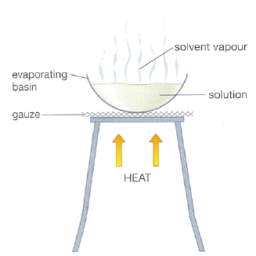
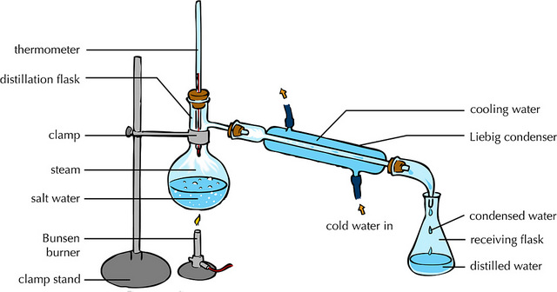
  Atoms, elements, compounds and mixtures - PART 2
Crystallisation Simple distillation
This technique separates a soluble substance from a solvent by evaporation
This technique separates a liquid from a mixture by evaporation follow by condensation
Example - crystallisation of sodium chloride from salt solution
Example - obtaining water from sea water

Slide 17
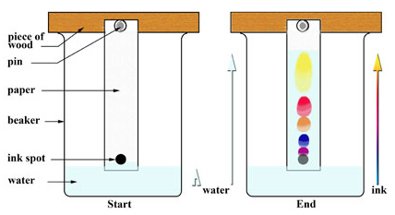
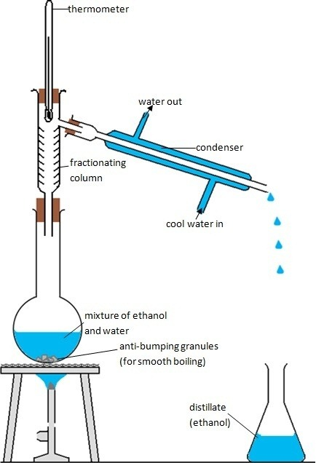
  Atoms, elements, compounds and mixtures - PART 2
Fractional distillation Chromatography
This technique separates a mixture into a number of different parts, called fractions. Substances with high boiling points condense at the bottom and substances with low boiling points condense at the top.
Fractional distillation works because the different substances in the mixture have different boiling points.
This technique separates small amounts of dissolved substances by running a solvent along absorbent paper
Example - obtaining ethanol from a mixture of ethanol and water
Example - separating the different colours in ink
Notes:
https://qph.ec.quoracdn.net/main-qimg-171088c70ca34c66600fb6b1a115fc62-c
http://www.micromountain.com/sci_diagrams/sci_app/sci_app_assets/ctography_lab_eng.jpg

Slide 18
QuestionIT!
Atoms, elements,
compounds and mixtures
PART 2
  Mixtures

Slide 19
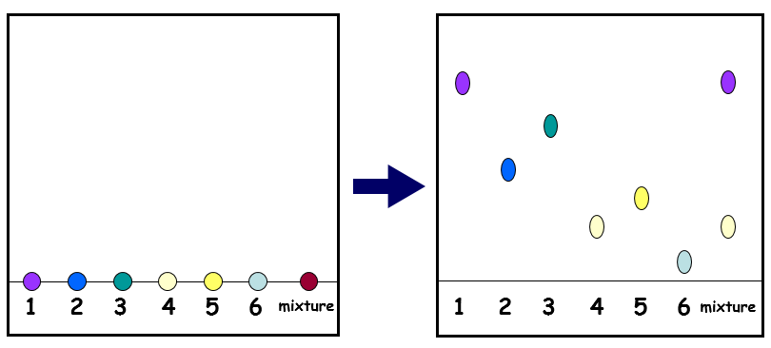
  Atoms, elements, compounds and mixtures PART 2 – QuestionIT
What is the difference between a compound and a mixture?
Describe the method used to collect the salt from a mixture of sand and salt.
What process is used to purify seawater to obtain usable water?
A mixture and six colours are tested using chromatography. The following chromatogram was produced.
a) What can you conclude about the mixture?
b) Why do the inks separate?

Slide 20
AnswerIT!
Atoms, elements,
compounds and mixtures
PART 2
  Mixtures

Slide 21
  Atoms, elements, compounds and mixtures PART 2 – QuestionIT
What is the difference between a compound and a mixture?
The substances in a mixture are not chemically bonded together,
but they are in a compound.
2. Describe the method used to collect the salt from a mixture of
sand and salt.
Add water and stir to dissolve the salt. Use filtration to remove
the sand. Heat the water (gently) to allow the salt to crystallise
(to avoid dryness).
3. What process is used to purify seawater to obtain usable water?
Simple distillation.

Slide 22
  Atoms, elements, compounds and mixtures PART 2 – QuestionIT
A mixture and six colours are tested using chromatography. The following chromatogram was produced:
a) What can you conclude about the mixture?
The mixture is made up from substance 1 and 4.
b) Why do the inks separate to produce a chromatogram?
The separation depends on how soluble the chemical is in the
solvent and how strongly the chemical is attracted to the paper.

Slide 23
LearnIT!
KnowIT!
Atomic model
PART 1
  Development of the atomic model

Slide 24
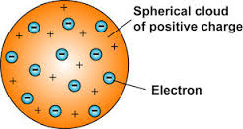
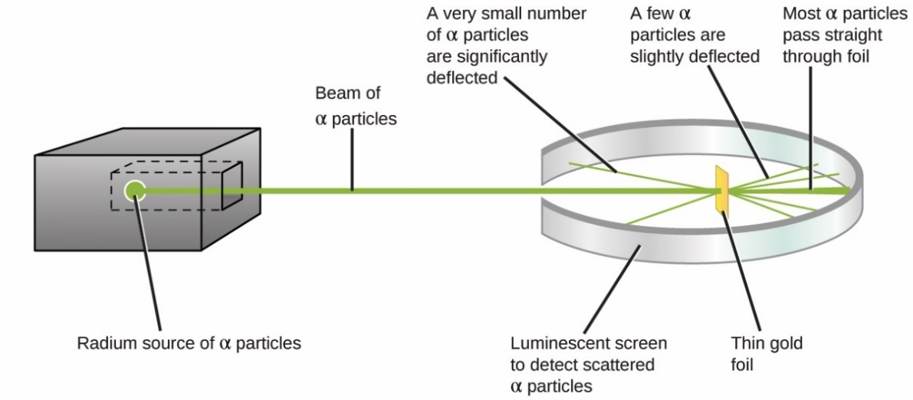
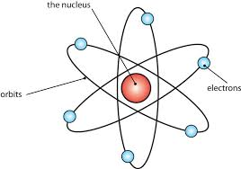
  Atomic model - PART 1
Early 1800s
Before the discovery of electrons, John Dalton’s experiments led to the idea that atoms were tiny spheres that could not be divided.
End of 1800s
The electron was discovered by JJ Thomson. Scientists believed
that atoms were spheres of positive charge with negative
charges spread throughout - the ‘plum-pudding’ model.
1908-1913
Ernst Rutherford designed an experiment carried out by Geiger and Marsden. They fired alpha particles at a piece of very thin gold foil (only a few atoms thick) which scattered, leading to the conclusion that the
mass of an atom was concentrated in a nucleus,
which was charged.
It proposed that electrons orbited
around the nucleus.

Slide 25
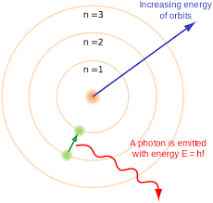
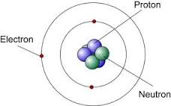
  Atomic model - PART 1
1914
Niels Bohr noticed that the light given out when atoms were heated only had specific amounts of energy and he adapted the nuclear model by suggesting that electrons orbit the nucleus at specific distances in certain fixed energy levels (or shells). The energy must be given out when excited electrons fall from a high to low energy level.
Later experiments led to the idea that the positive charge of the nucleus could be subdivided into a whole number of smaller particles, each particle having the same amount of positive charge. The name proton was given to these particles.
1932
James Chadwick bombarded beryllium atoms with alpha particles. An unknown radiation was produced. Chadwick interpreted this radiation as being composed of particles with a neutral electrical charge and the approximate mass of a proton. This particle became known as the neutron.

Slide 26
  Atomic model - PART 1
1800s
John Dalton – tiny spheres that could not be divided.
1890s
JJ Thomson – electron discovered. Plum pudding model - spheres of positive charge with negative charges spread evenly though.
1908 -1913
E. Rutherford, Geiger and Marsden - alpha particle scattering experiment. Nuclear model - mass of atom concentrated in a charged nucleus, with orbiting electrons.
1914
Niels Bohr – electrons orbit nucleus at specific distances in fixed energy levels (shells). Energy given out when electrons change level.
Later…
Positive charge of nucleus could be subdivided into particles of positive charge – protons.
1932
James Chadwick – provided evidence for the existence of neutrons within the nucleus.

Slide 27
QuestionIT!
Atomic model
PART 1
  Development of the atomic model

Slide 28
  Atomic model PART 1 – QuestionIT
What was the earliest model of the atom?
Which subatomic particle did JJ. Thomson discover?
Which early atomic model does the following diagram show?
Name Rutherford’s experiment.
State two ways in which Rutherford’s experiment changed Thomson’s model of the atom.
How did Bohr adapt the nuclear model?
Explain why Bohr revised Rutherford’s model of the atom.

Slide 29
AnswerIT!
Atomic model
PART 1
  Development of the atomic model

Slide 30
  Atomic model PART 1 – QuestionIT
What was the earliest model of the atom?
Tiny spheres that could not be divided.
Which subatomic particle did JJ. Thomson discover?
The electron
3. Which early atomic model does the following diagram show?
The plum pudding model.
Name Rutherford’s experiment.
Alpha particle scattering.
State two ways in which Rutherford’s experiment changed Thomson’s model of the atom.
He said the positive charge was concentrated into very small
volume at centre of atom (nucleus) and the electrons orbit
nucleus.

Slide 31
  Atomic model PART 1 – QuestionIT
Explain why Bohr revised Rutherford’s model of the atom.
Suggesting electrons orbit the nucleus at different distances.
Explain why Bohr revised Rutherford’s model of the atom.
Energy emitted from electron transitions can only have certain
fixed energies, so he refined the ‘orbiting electrons’ in
Rutherford’s nuclear model to ‘orbiting electrons in energy levels
(or shells) at fixed distances from the nucleus’.

Slide 32
LearnIT!
KnowIT!
Atomic model
PART 2
  Relative electrical charges of subatomic particles.
  Size and mass of atoms
  Atomic structure

Slide 33
  Atomic model - PART 2
Subatomic particles
 | Mass | Charge | Location
Proton | 1 | + | nucleus
Neutron | 1 | 0 | nucleus
Electron | Very small | - | shells
An atom contains equal numbers of protons and electrons.
Atoms have no overall electrical charge because the number of positive protons equals the number of negative electrons.
Number of protons = atomic number.
All atoms of an element have the same number of protons.
Atoms of different elements have different numbers of protons.

Slide 34
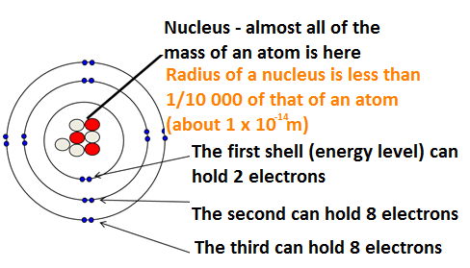
  Atomic model - PART 2
Atoms are very small, having a radius of about 0.1nm (1 x 10 ^{-10m}).
Protons and Neutrons are found in the nucleus. Electrons orbit the nucleus in shells.
Mass number = Number of protons and neutrons
7
Protons = 3
Electrons = 3
Neutrons = 4
Li
Atomic number = Number of protons
3
To calculate the number of neutrons = Mass Number – Atomic Number

Slide 35
  Atomic model - PART 2
Atoms sometimes lose or gain electrons (e.g. when a metal reacts with a none metal). When they do this they become a charge atom or an ion.
If an atom loses one or more electrons, it gains a positive charge because it has less electrons than protons.
If an atom gains one or more electrons, it gains a negative charge because it has more electrons than protons.
e.g. If sodium atom loses one electron, it forms a Na⁺ ion.
It has 11 protons, 12 neutrons and 10 electrons.
e.g. If an oxygen atom gains two electrons, it forms a O²⁻ ion.
It has 8 protons, 8 neutrons and 10 electrons.

Slide 36
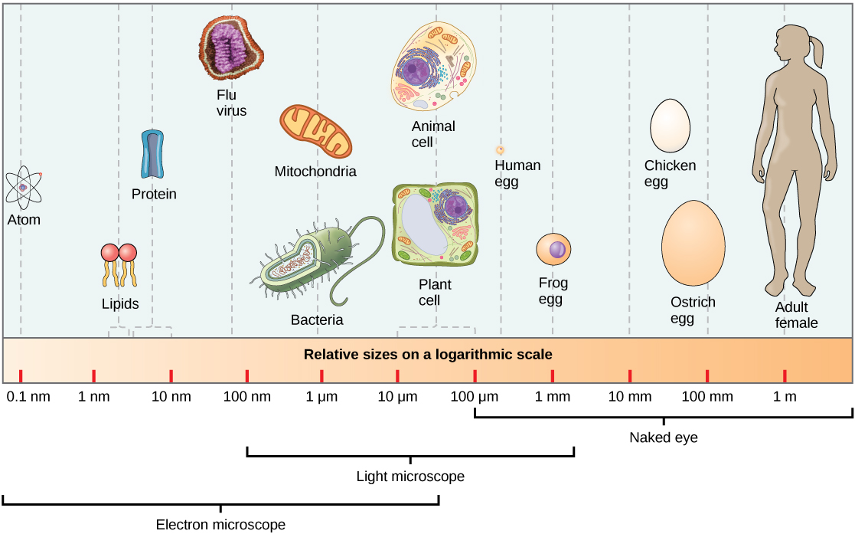
Atoms are tiny - the radius of a typical atom is one tenth of a billionth of a meter.

Slide 37
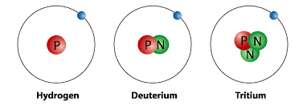
  Atomic model - PART 2
Atoms of the same element can have different numbers of neutrons – an isotope.
Isotopes of Hydrogen
The relative atomic mass of an element is an average value that takes account of the abundance of the isotopes of the element. Samples of different isotopes of an element have different physical properties (e.g. different density), however, they always have the same chemical properties. It is calculated by working out the relative abundance of each isotope.
The relative atomic mass is therefore calculated using the equation:
(% of isotope 1 × mass of isotope 1) + (% of isotope 2 × mass of isotope 2) ÷ 100
Chlorine’s relative atomic mass of 35.5 is an average of the masses of the different isotopes of chlorine.
For example, in any sample of Chlorine 25% will be ³⁷Cl and 75% ³⁵Cl.
(25 x 37) + (75 x 35) ÷ 100 = 35.5

Slide 38
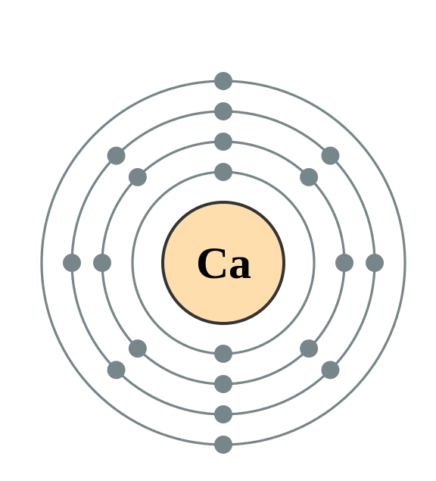
  Atomic model - PART 2
The electrons in an atom occupy the lowest available energy levels (innermost available shells). The electronic structure of an atom can be represented by numbers or by a diagram e.g.
Calcium has 2 electrons on its lowest energy level,
8 on the second energy level,
8 on the third energy level
and 2 on the fourth (the highest) energy level.
So the electron configuration for Calcium = 2,8,8,2

Slide 39
QuestionIT!
Atomic model
PART 2
  Relative electrical charges of subatomic particles.
  Size and mass of atoms
  Atomic structure

Slide 40
  Atomic model PART 2 – QuestionIT
Name three subatomic particles and their charges.
Complete the sentence ‘All atoms of one type of element have the same number of…’
What does the atomic number tell us about an atom?
What does the mass number tell us about an atom?
How is an isotope different to an atom?
What is the electron configuration for sodium?

Slide 41
  Atomic model PART 2 – QuestionIT
Why is the overall charge of an atom zero?
Draw the electron configuration for a chlorine atom.
Write the electron configuration for potassium.
How many electrons does potassium have on its highest energy level?

Slide 42

  Atomic model PART 2 – QuestionIT
Calculate how many protons, electrons and neutrons there are in
a) A silver atom with atomic number 47 and mass number 108
b)
The atomic radius of a bromine atom is 9 x 10 ⁻¹¹m
a) Give its atomic radius in nanometres
b) Calculate the radius of the nucleus (in nm), given that it will be
about 1/10,000 the radius of the atom. Give your answer in
standard form.

Slide 43
AnswerIT!
Atomic model
PART 2
  Relative electrical charges of subatomic particles.
  Size and mass of atoms
  Atomic structure

Slide 44
  Atomic model PART 2 – QuestionIT
Name three subatomic particles and their charges.
  Proton – positive; neutron – no charge; electron – negative.
Complete the sentence ‘All atoms of one type of element have the same number of…’
  Protons.
What does the atomic number tell us about an atom?
  Number of protons.
What does the mass number tell us about an atom?
  Number of protons + number of neutrons.
How is an isotope different to an atom?
  Different number of neutrons.
What is the electron configuration for sodium?
  2,8,1

Slide 45
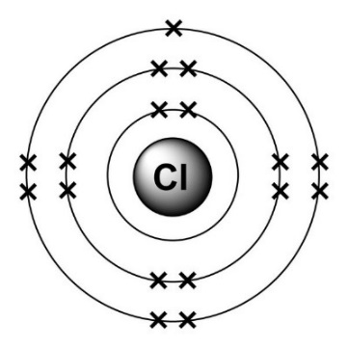
  Atomic model PART 2 – QuestionIT
Why is the overall charge of an atom zero?
  Number of protons (positive) = number electrons (negative).
Draw the electron configuration for a chlorine atom.
Write the electron configuration for potassium.
  2,8,8,1
How many electrons does potassium have on its highest energy level?
  1

Slide 46
  Atomic model PART 2 – QuestionIT
Calculate how many protons, electrons and neutrons there are in:
a) A silver atom with atomic number 47 and mass number 108
Protons = 47 Electrons = 47 Neutrons = 61
b)
Protons = 19 Electrons = 18 Neutrons = 20
12. The atomic radius of a bromine atom is 9 x 10 ⁻¹¹m
a) Give its atomic radius in nanometres.
0.09 nm
b) Calculate the radius of the nucleus (in nm), given that it will be
about 1/10,000 the radius of the atom. Give your answer in
standard form.
9 × 10⁻⁶nm

Slide 47
LearnIT!
KnowIT!
Periodic table
PART 1
  The periodic table
  Development of the periodic table
  Metals and non-metals

Slide 48
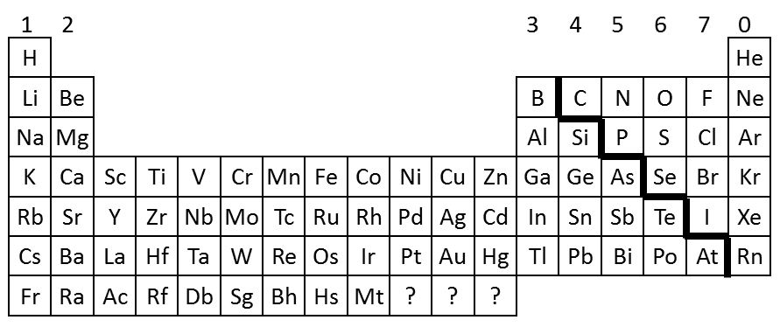
  Periodic table - PART 1
The elements are arranged in order of increasing atomic number.
Elements with similar properties are in columns, known as groups.
Elements in the same group have the same number of electrons in their outer shell.
It is called a periodic table because similar properties occur at regular intervals
The rows in the table are called periods
Group = electrons in outer shell
Period = number of shells
Group = 7
Period = 3

Slide 49
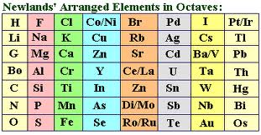
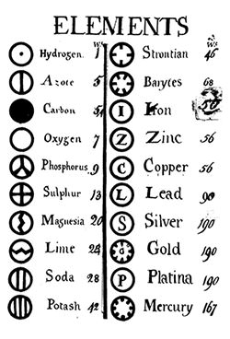
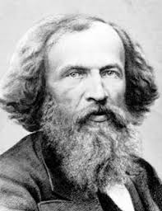
  Periodic table - PART 1
1864
John Newlands published the law of octaves. However the table was incomplete and elements were placed in inappropriate groups
1808
John Dalton published a table of elements that were arranged in order of their atomic weights, which had been measured in various chemical reactions
1869
Dmitri Mendeleev overcame Dalton’s problem by leaving gaps for the elements that he thought had not been discovered and in some places changed the order based on atomic weight (e.g. Argon and Potassium). Elements with properties predicted by Mendeleev were eventually discovered.
Early20th Century - Scientists began to find out more about the atom and knowledge of isotopes explained why the order was not always correct.

Slide 50
  Periodic table - PART 1
The elements can be divided into metals and non-metals.
1
2
H
3
4
5
6
7
0
Elements that do not form positive ions are non-metals
Elements that tend to form positive ions are metals
He
Li
Be
B
C
N
O
F
Ne
Na
Mg
Al
Si
P
S
Cl
Ar
K
Ca
Sc
Ti
V
Cr
Mn
Fe
Co
Ni
Cu
Zn
Ga
Ge
As
Se
Br
Kr
Rb
Sr
Y
Zr
Nb
Mo
Tc
Ru
Rh
Pd
Ag
Cd
In
Sn
Sb
Te
I
Xe
Cs
Ba
La
Hf
Ta
W
Re
Os
Ir
Pt
Au
Hg
Tl
Pb
Bi
Po
At
Rn
Non metals – found towards the right and towards the top of the periodic table
Fr
Ra
Ac
Rf
Db
Sg
Bh
Hs
Mt
?
?
?
Metals | Non-metals
Shiny Mostly solid Dense and strong Malleable Good heat and electrical conductors | Dull Low density Weak Brittle Poor heat and electrical conductors
Most elements are metals – found towards the left and towards the bottom of the periodic table

Slide 51
QuestionIT!
Periodic table
PART 1
  The periodic table
  Development of the periodic table
  Metals and non-metals

Slide 52
  Periodic table PART 1 – QuestionIT
How are elements arranged in the periodic table?
What are the columns of the periodic table called?
What are the rows of a periodic table called?
What does the column an element is in tell you about the atoms?
What does the row an element is in tell you about the atoms?
Which side of the periodic table are the non-metals found?

Slide 53
  Periodic table PART 1 – QuestionIT
How were elements classified before the discovery of subatomic particles?
What was the problem with early periodic tables?
How did Mendeleev overcome these problems?
Why is the order based on atomic masses not always correct?
What do we call elements that tend to form positive ions?

