Slide 1






Treasure chest
10 points
5 points
How to separate
ethanol and water
An example of
an element
How to separate
oil and water
An example of a
non-metal element
What was discovered
First: protons
or neutrons?
An example of a mixture
Balance this:
Fe + O₂ → Fe₂O₃
An example of a
compound
How to separate
sand and water
Describe the experiment
That provided evidence
For a nucleus
A difference between
Distillation and
Fractional distillation
Balance this:
KNO₃ → KNO₂ + O₂
Describe the ‘plum
pudding’ model
Name 3 scientists
Involved in the
History of the atom
How to get salt
crystals from
salt solution
Notes:
1
Play as a group
1

Slide 2
Structure of an Atom
To identify and describe the components of an atom
To correctly draw the electronic structure of a given element
To link atomic structure to the periodic table

Slide 3
Naming Compounds
In a formula, each new capital letter means a new element.
If there is a non-metal in the compound, the end of the element changes to “–ide” e.g. KBr = potassium bromide, not potassium bromine.
To give more information about some compounds, “mon” and “di” are sometimes used e.g. carbon monoxide = CO, carbon dioxide = CO₂
If there is oxygen in a compound with a metal and 2 non-metals, the last part of the name is “-ate”. e.g. CaS = calcium sulfide, CaSO₄ = calcium sulfate
Task 1: state how many of each element are in the compounds below e.g. H₂O = 2 x hydrogen, 1 x oxygen.
Task 2: Use the rules above to name each compound.
NaCl
NO₂
MgS
MgSO₄
H₂O
6. LiI
7. KNO₃
8. SrCO₃
9. Na₃PO₄
10. Be(CO₃)₂
Challenge: Have a go at writing the formulae of these compounds:
Sulfur dioxide
Lithium chloride
Magnesium oxide
Calcium sulfate

Slide 4
Naming Compounds
In a formula, each new capital letter means a new element.
If there is a non-metal in the compound, the end of the element changes to “–ide” e.g. KBr = potassium bromide, not potassium bromine.
To give more information about some compounds, “mon” and “di” are sometimes used e.g. carbon monoxide = CO, carbon dioxide = CO₂
If there is oxygen in a compound with a metal and 2 non-metals, the last part of the name is “-ate”. e.g. CaS = calcium sulfide, CaSO₄ = calcium sulfate
NaCl sodium chloride
NO₂ nitrogen dioxide
MgS magnesium sulfide
MgSO₄ magnesium sulfate
H₂O hydrogen oxide
Challenge: Have a go at writing the formulae of these compounds:
Sulfur dioxide SO₂
Lithium chloride LiCl
Magnesium oxide MgO
Calcium sulfate CaSO₄
6. LiI lithium iodide
7. KNO₃ potassium nitrate
8. SrCO₃ strontium carbonate
9. Na₃PO₄ sodium phosphate
10. Be(CO₃)₂ beryllium carbonate

Slide 5
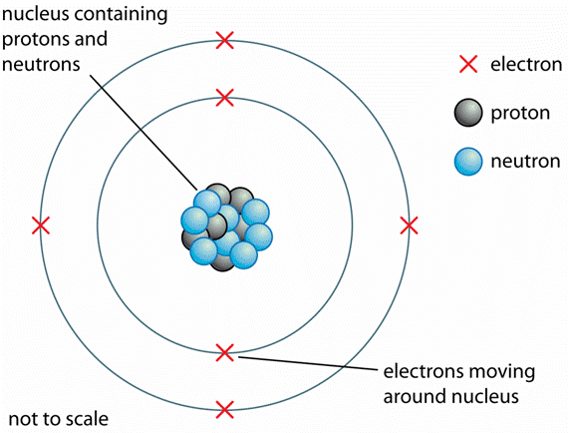
Inside Atoms
Inside an atom are electrons, protons and neutrons.
Protons and neutrons are in the nucleus (centre) of the atom. Electrons move around the outside of the nucleus.
Protons are positively charged, electrons are negatively charged and neutrons have no charge.
For an atom to have no charge, the number of protons and electrons must be equal.
Particle | Relative Charge | Relative Mass
electron | -1 | Very small
proton | +1 | 1
neutron | 0 | 1

Slide 6

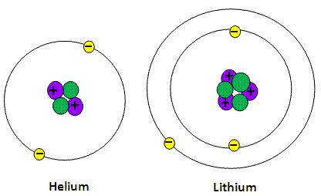
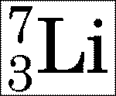
How can you tell how many protons, neutrons and electrons an atom has?
Draw an atom of hydrogen and an atom of beryllium

Slide 7
How Many Sub-Atomic Particles?
Element | Protons | Neutrons | Electrons
Lithium | 3 | 4 | 3
Carbon | 6 | 6 | 6
Hydrogen | 1 | 0 | 1
Helium | 2 | 2 | 2
Fluorine | 9 | 10 | 9
Nitrogen | 7 | 7 | 7
Sodium | 11 | 12 | 11
Challenge: What is weird about chlorine and copper? Why do you think this is the case?

Slide 8
An idiots guide…
Write a guide for a year 8 student to explain what you have learned today, include the following:
  What the three sub-atomic particles are called
  The relative charges and masses of the three sub-atomic particles
  Where the sub-atomic particles are found in the atom
  What the mass number tells you (and why)
  What the atomic (proton) number tells you
  How you can work out the number of protons, neutrons and electrons (include an example).

Slide 9
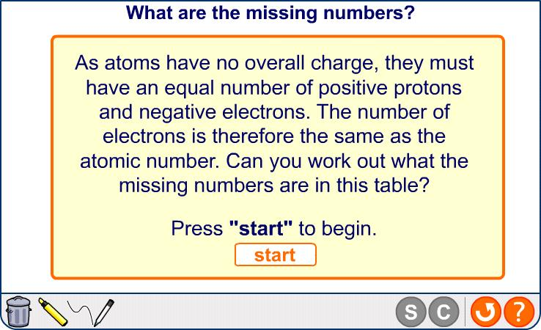

What are the missing numbers?
Notes:
Teacher notes
This completing activity could be used as a plenary or revision exercise on atomic structure and atomic and mass number. Students could be asked to write down the missing numbers in their books and the activity could be concluded by the completion on the IWB.
You may need to remind students that the mass number is equal to the number of protons plus the number of neutrons. Similarly, the number of neutrons equals the mass number minus the number of protons.
Boardworks GCSE Additional Science: Chemistry
Atomic Structure

Slide 10
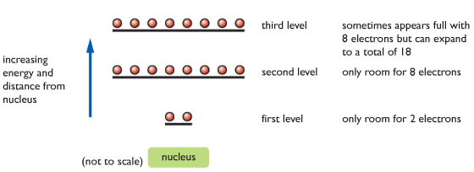
The arrangement of the electrons
Electrons are found in a series of energy levels, or shells.
Low energy levels are filled first.

Slide 11
The arrangement of the electrons
You can work out the arrangement by following some simple steps:
Look up the elements atomic number. This is the number of protons for that element. You know that the number of protons is the same as the number of electrons.
Start filling up the shells, starting with the lowest energy shell first: 2, 8, 8
Once you have finished, check that the number of electrons adds up to the atomic number.
e.g. Cl atomic number 17
e.g. 2, 8, 7
e.g. 2 + 8 + 7= 17 ✓

Slide 12
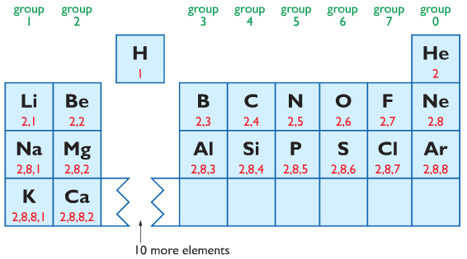
Quick Check
Write out the electron arrangements for the first 20 elements in the periodic table

Slide 13

Periodic Table Rules
The number of electrons in the outer shell is the same as the group number for groups 1-7.
The elements in group 0 have a “full” outer shell.
The group 0 elements are known as the noble gases because they are almost completely unreactive.

Slide 14

Drawing Electron Arrangements
Electrons can be drawn in their shells by using dots or crosses to represent each electron.
e.g. He
Electron configuration: 2

Slide 15
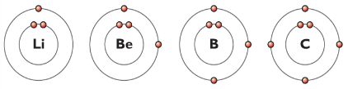
Drawing Electron Arrangements
To help with counting electrons, and understanding bonding later, shells are filled as follows:

Slide 16
Draw out the electronic configuration for these elements:
Neon, lithium, chlorine, oxygen, argon, silicon, carbon, boron
Extension:
Draw the electron arrangements for hydrogen and oxygen.
Both elements want a full outer shell. For hydrogen, this means 2 electrons. For oxygen, 8 electrons.
Draw what you think might happen when oxygen and hydrogen react together to form a molecule of water (H₂O).

Slide 17
Neon (10 electrons)

Slide 18
Lithium (3 electrons)

Slide 19
Chlorine (17 electrons)

Slide 20
Oxygen (8 electrons)

Slide 21
Argon (18 electrons)

Slide 22
Silicon (14 electrons)

Slide 23
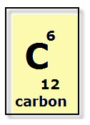
6 electrons

Slide 24
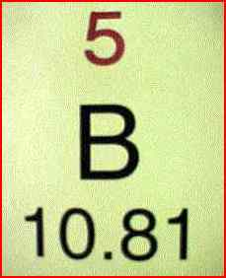
5 electrons

Slide 25


