Slide 1
Draw the electronic structure of these atoms:
Carbon lithium oxygen
Potassium chlorine sodium
Challenge: identify the number of protons and neutrons in each atom.
Super challenge: atoms are more stable with a full outer shell. How do you think sodium and chlorine might bond together?

Slide 2
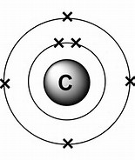
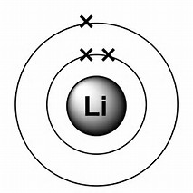
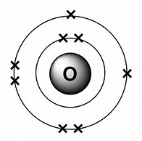
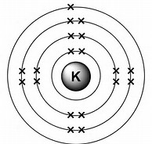
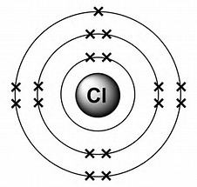
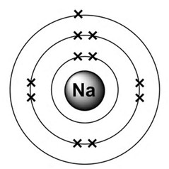
Carbon lithium oxygen
Potassium chlorine sodium
Challenge: carbon: 6p, 6n; lithium: 3p, 4n; oxygen: 8p, 8n; potassium: 19p, 20n; chlorine: 17p, 18.5n; sodium: 11p, 12n
Super challenge: sodium transfers it’s electron to chlorine (more on this later…)

Slide 3
Forming Ions
Content: To explain chemical differences between metals and non- metals
To relate metals and non-metals position on the periodic table to their electronic structure
To deduce the charge on an ion based on it’s group number and the number of protons and electrons
Process: Individual Work
Benefits: Perseverance!

Slide 4
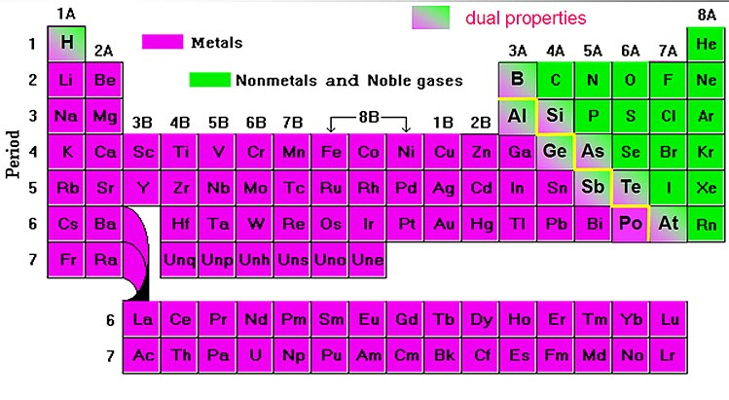
Metals and Non-metals

Slide 5
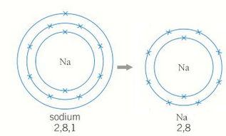
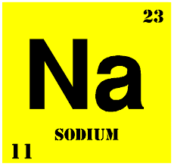
How many protons, neutrons and electrons does a sodium atom have?
What is the overall charge on a sodium atom?
How can a sodium atom get a full outer shell?

Slide 6
11 protons, 11 electrons and 12 neutrons
+11 – 11 = 0
Gain 7 electrons (not going to happen!)
Lose 1 electron

Slide 7
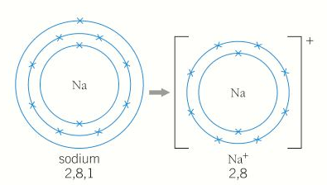
Sodium atom
11 protons, 11 electrons and 12 neutrons
+11 – 11 = 0
Sodium ion
11 protons, 10 electrons and 12 neutrons
+11 – 10 = +1

Slide 8
Metals form positive ions because they lose electrons.
1. Draw a similar diagram for lithium.
Show how the lithium atom forms a lithium ion. Work out the charge on the ion.
Sodium ion
11 protons, 10 electrons and 12 neutrons
+11 – 10 = +1
2. Draw a similar diagram for chlorine (a non-metal).
Show how the chlorine atom forms a chloride ion. Work out the charge on the chloride ion.
Challenge: Give one chemical difference between metals and non-metals, using what you have just found out.
Sodium atom
11 protons, 11 electrons and 12 neutrons
+11 – 11 = 0

Slide 9
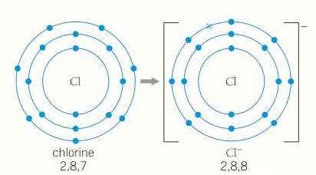
Metals form positive ions because they lose electrons.
Non-metals form negative ions because they gain electrons.
Chlorine atom
17 protons, 17 electrons and 18 neutrons
+17 – 17 = 0
Chloride ion
17 protons, 18 electrons and 18 neutrons
+17 – 18 = -1

Slide 10
Ionic Bonding:
Bonding in which there has been a transfer of electrons from one atom to another to form ions. The substance is held together by strong electrostatic attractions between the positive and negative ions.
A positively charged ion: cation
A negatively charged ion: anion

Slide 11
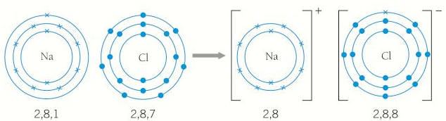
Draw a similar diagram to show the ionic bond between lithium and fluorine being formed (LiF).

Slide 12


Slide 13
Ionic Bonding examples
Group 1 form 1+ ions
Group 2 form 2+ ions
Group 3 form 3+ ions
Group 5 form 3- ions
Group 6 form 2- ions
Group 7 form 1- ions
e.g. calcium chloride
CaCl₂

Slide 14
Practice Practice Practice
Draw dot-cross diagrams for these ionic substances:
Li₂O NaBr MgCl₂ BeO
What are the formulae of these ionic substances? How do you know?
Calcium sulfide strontium iodide
Rubidium chloride francium oxide
Challenge: Make up your own compounds using the periodic table. What bonding do they have? What are their formulae?

Slide 15
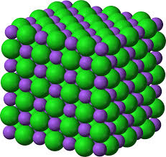
What Properties do Ionic Compounds Have?
Conducts?
Melting point?
What force holds it together?

