Slide 1
What do the numbers on the periodic tell you about an element?
How many protons, neutrons and electrons are in these atoms:
Element | Protons | Neutrons | Electrons
Sodium
Carbon
Nitrogen
Oxygen
Fluorine
Challenge: What are the relative charges and masses of the sub-atomic particles?

Slide 2
What do the numbers on the periodic tell you about an element?
atomic number = number of protons
Mass number = number of protons + neutrons
2. How many protons, neutrons and electrons are in these atoms:
Element | Protons | Neutrons | Electrons
Sodium | 11 | 12 | 11
Carbon | 6 | 6 | 6
Nitrogen | 7 | 7 | 7
Oxygen | 8 | 8 | 8
Fluorine | 9 | 10 | 9
Challenge: What are the relative charges and masses of the sub-atomic particles?
Particle | Relative charge | Relative mass
Proton | +1 | 1
Neutron | 0 | 1
Electron | -1 | Very small

Slide 3
Isotopes
Content: To perform calculations using atomic and mass numbers from the periodic table
To describe what an isotope is
To define and calculate the relative atomic mass of an element
Process: Individual work
Benefits: Perseverance

Slide 4
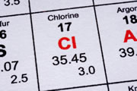
Isotopes
Using the numbers on the periodic table, how many protons, neutrons and electrons does chlorine have?
What is unusual about chlorine?

Slide 5
Isotopes
An isotope is an atom with the same number of protons, but a different number of neutrons.
Using the numbers on the periodic table, chlorine has:
17 protons
17 electrons
18.5 neutrons
Some chlorine atoms have 17 neutrons and some have 19 neutrons. The number on the periodic table is the average relative atomic mass.
It is impossible to have half a neutron! So how can this be….?

Slide 6
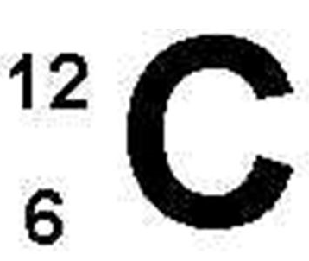
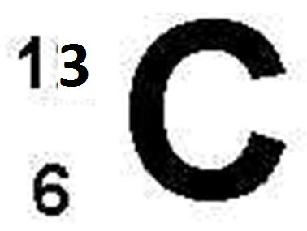
How many protons, neutrons and electrons are in each isotope of carbon?
What determines the element symbol for each isotope (i.e. why are they both carbon)?
What is an isotope?
What is the symbol for this isotope: ?
Challenge: Draw a diagram to show the atomic structure of these isotopes of hydrogen: H H and H
Super challenge: How do you think the physical and chemical properties of these isotopes are different/the same?
38
1
2
3
1
1
1
17

Slide 7

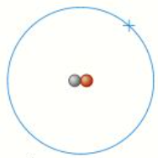
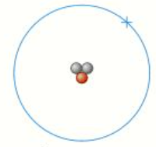



6 protons
6 neutrons
6 electrons
6 protons
7 neutrons
6 electrons
What determines the element symbol for each isotope (i.e. why are they both carbon)? The number of protons
What is an isotope? An atom with the same number of protons, but a different number of neutrons
What is the symbol for this isotope: Cl
38
Super challenge: How do you think the physical and chemical properties of these isotopes are different/the same? The number of electrons are the same, so the chemical properties will be the same. The physical properties, such as melting and boiling point would be different.
17

Slide 8
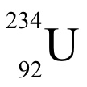

Fill in the gaps…
Isotope name | Number of protons | Number of neutrons | Number of electrons | Shown on the periodic table as…
Carbon-12 |  | 6
Carbon-13 |  | 7
Uranium-234
 | 90 |  | 90
?
Here are 3 isotopes. Write the symbol for each isotope.
Challenge: The three isotopes shown to the left all have the same chemical properties. Why do you think that is?

Slide 9

Fill in the gaps…
Isotope name | Number of protons | Number of neutrons | Number of electrons | Shown on the periodic table as…
Carbon-12 | 6 | 6 | 6
Carbon-13 | 6 | 7 | 6
Uranium-234 | 92 | 142 | 92
Thorium-230 | 90 | 140 | 90
Here are 3 isotopes. Write the symbol for each isotope.
Challenge: The three isotopes shown to the left all have the same chemical properties. This is because it is the number of electrons which effects how an element reacts.

Slide 10

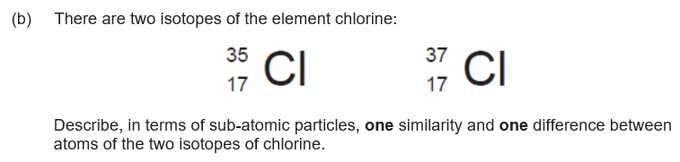
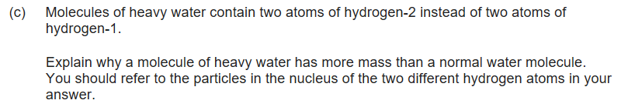
What is the definition of an isotope?
What are the relative charges of the three sub-atomic particles?
What are the relative masses of the three sub-atomic particles?
Are the chemical properties of isotopes different? Why/why not?
Describe the difference between carbon-12 and carbon-13.

Slide 11
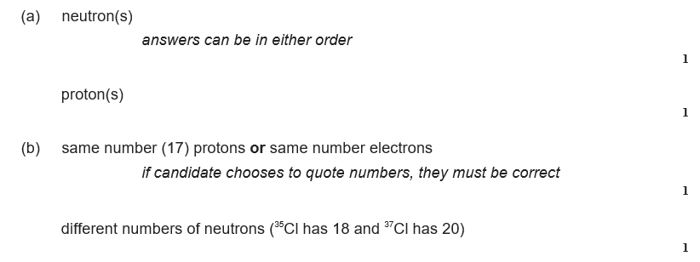
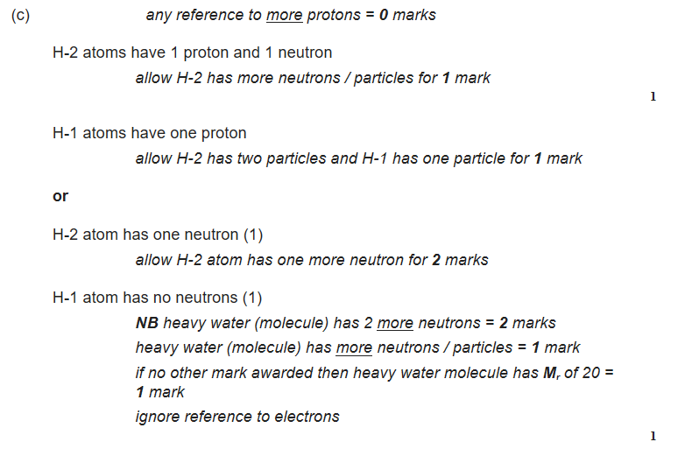

Slide 12
Relative Atomic Mass, A_{r}
Relative masses are much more convenient to use than actual masses of atoms.
Carbon-12 is used as the reference point. It is given a ‘mass’ of 12 units.
All of the other A_{r} values are the mass of the element compared to carbon.
A_{r} is the average relative atomic mass, taking isotopes into account.
e.g. copper has 2 isotopes, ⁶³Cu (69%) and ⁶⁵Cu (31%)
A_{r} of Cu = (69x63) + (31x65) = 63.5
100
What is the relative atomic mass, A_{r} for bromine, which has 2 isotopes, ⁷⁹Br (50%) and ⁸¹Br (50%)? Show your working.
A_{r} of Br = (50x79) + (50x81) = 80
100

Slide 13
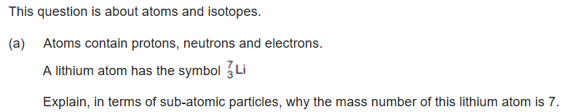


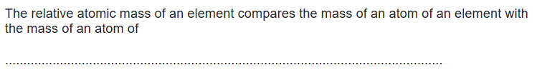

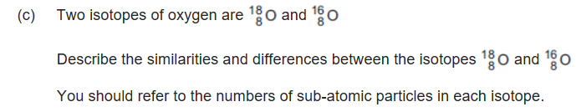

Slide 14


