Slide 1
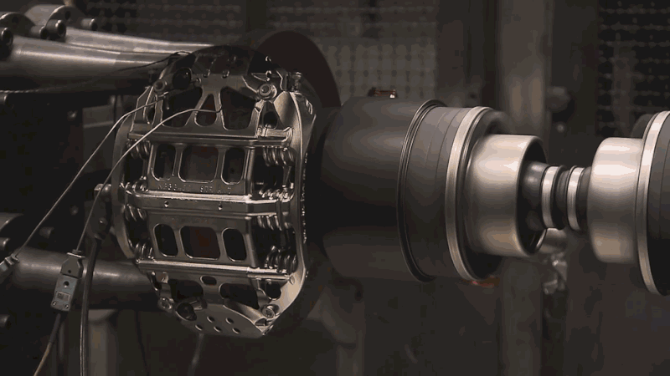
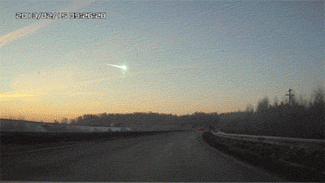

Starter –
What is the link?
Friction and Wasted Energy 24/09/18
Car brakes
Chelyabinsk meteor
Rubbing hands

Slide 2
Friction and Wasted Energy 24/09/18
Learning Objectives –
To know the link between friction, heat energy and work done.
To know what efficiency means and how to calculate it.
To be able to answer exam questions on energy.
Test start time – 10:20
Test end time – 10:55

Slide 3
What is the link?
Car brakes
Chelyabinsk meteor
Rubbing hands
Notes:
Searching for friction as linking word.

Slide 4
Friction and Work
In all 3 examples, friction increased the force required to move objects:
  Force needed to turn axel increases if brakes are on so energy needed to turn it a particular distance increases.
  Friction on meteor acts in opposite direction to it’s weight, so more energy is needed to move it towards the Earth.
  Friction from hands rubbing together increases the amount of work you have to do to move your hands.
Notes:
Explanations to previous slide

Slide 5


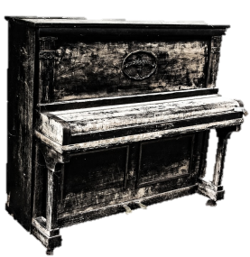

Friction and Work
Imagine pushing a piano across the floor. Will it be easier to push it along the wood floor or carpet? Why?
You need more force to push it along the carpet than the wood floor. So for any given distance, the more friction there is, the more work needs to be done as described by W = F x s.
Notes:
Simpler analogy for lower ability groups.

Slide 6
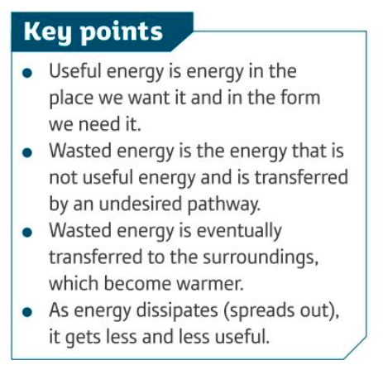
Friction and Wasted Energy

Slide 7
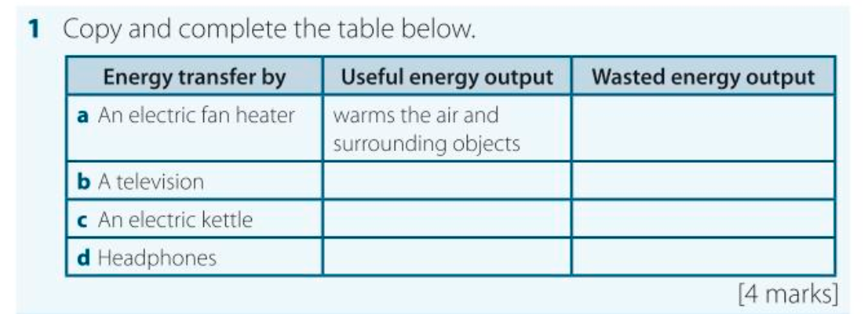

Slide 8
Tasks - Answer these questions in your exercise book…
Name the input energy, and two types of useful energy given out by a hairdryer.
Name two types of useful energy given out by a washing machine.
Name the input and output energies of a wind turbine.
Bonus – What does ‘efficiency’ mean?

Slide 9
Calculating efficiency – 2 ways of writing the equation
Efficiency = Useful energy output
Total energy input
OR
Efficiency = Useful energy output ÷ Total energy input
Memorise this!

Slide 10
Efficiency Example Question
A dishwasher uses1400J of electrical energy, and 725J of this is useful. What is the efficiency of the dishwasher?
Ans – The useful output energy is 725J
The total input energy is 1400J
725J ÷ 1400J = 0.52
Efficiency = 52%

Slide 11
Starter – Complete these questions to calculate efficiency.
1. Light bulb Input – 100J Electrical energy
Output – 10J Light energy, 90J Heat energy
2. Kettle Input – 400J Electrical energy
Output – 50J Sound energy, 350J Heat energy
3. iPod Input – 500J Chemical energy
Output – 300J Sound energy, 200J Heat energy

Slide 12
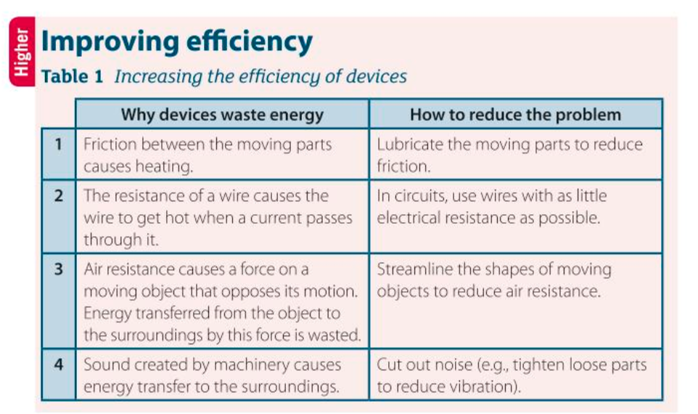

Slide 13
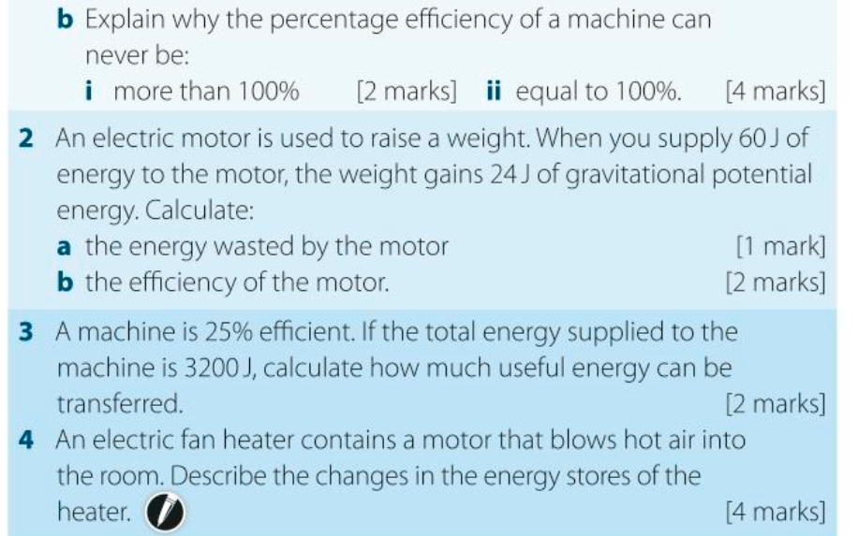

Slide 14
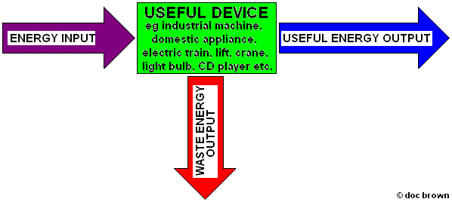
Constructing a Sankey diagram

Slide 15
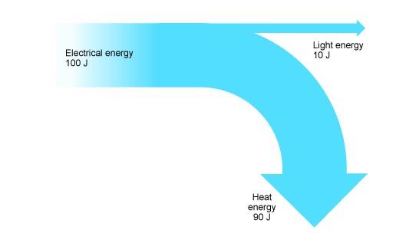
Sankey diagram for old style bulb.

Slide 16
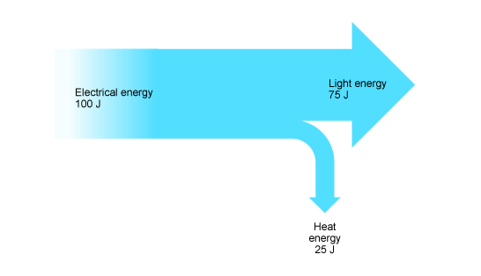
Sankey diagram for new style bulb.
What does this tell you about the new styles of light bulb? State the values that you have got from the Sankey diagram.

Slide 17
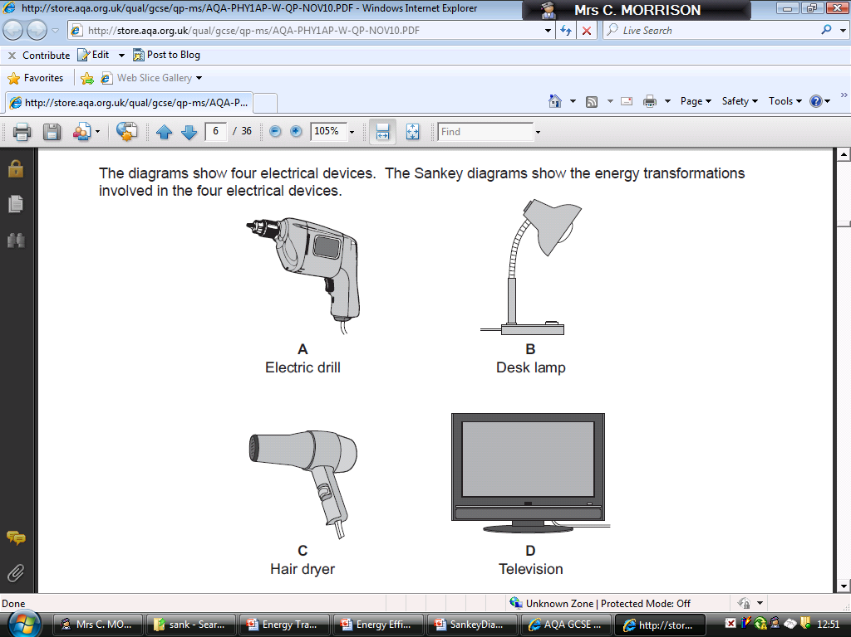
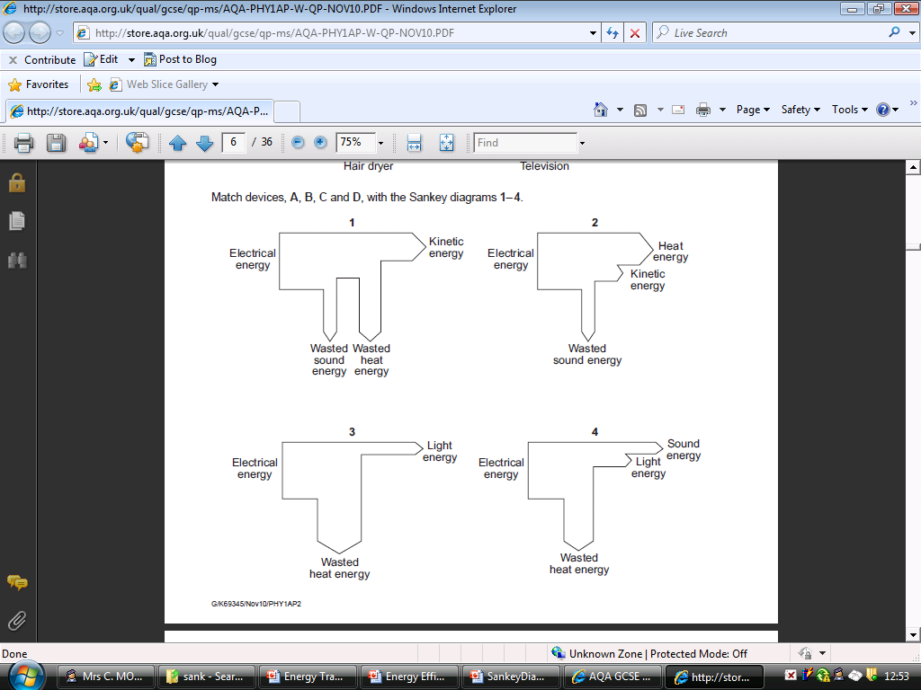

Slide 18
To find out how powerful something is, you need to know:
  how much energy it is transferring (the work done)
  how quickly it transfers the energy
Power (in W) = work done (in J)
time taken (in s)
Memorise this!
KEY FACT: One watt is the same as one joule per second

Slide 19
Power = Work done ÷ time taken
Power = Energy transferred ÷ time taken

Slide 20
Units of power
1000 watts (W) = 1 kilowatt (kW)
To change kilowatts (kW) into watts (W), multiply by 1000
For example, 2.2 kW = 2.2 x 1000 W
=2200 W

Slide 21
Q) The power of a hairdryer is 2000W and it takes 5 minutes to dry a woman’s hair. What is the work done in that time?
Work done
Force
disp
First, convert the time to seconds (standard units)
5 x 60 = 300s
Work done
Second, find out the work done.
Power x Time = Work Done
2000W x 300s = 600000J
Power
time

Slide 22
Q) What is the power of a woman who weighs 550N and climbs a vertical distance of 7m in 30 seconds?
Work done
Force
disp
First, find out the work done.
Force x Displacement = Work Done
550N x 7m = 3850 J
Work done
Second, find out the power.
Work Done ÷ Time = Power
3850 J ÷ 30 = 128W
Power
time

Slide 23
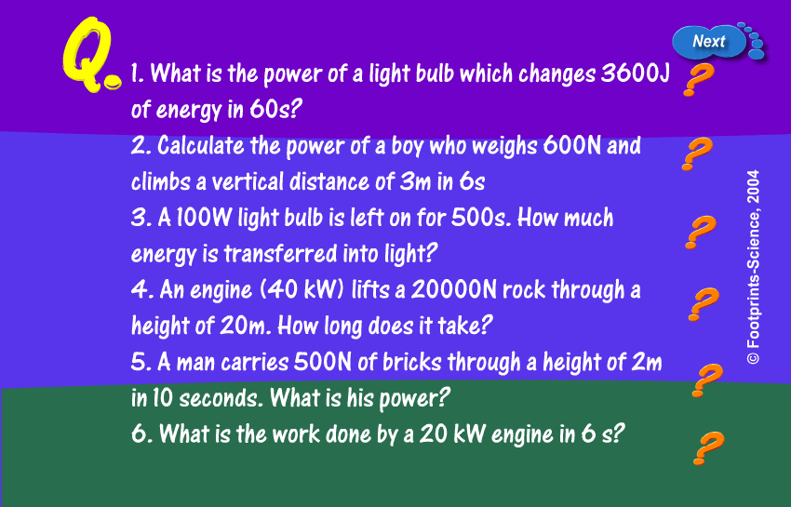
Power
Notes:
23

Slide 24
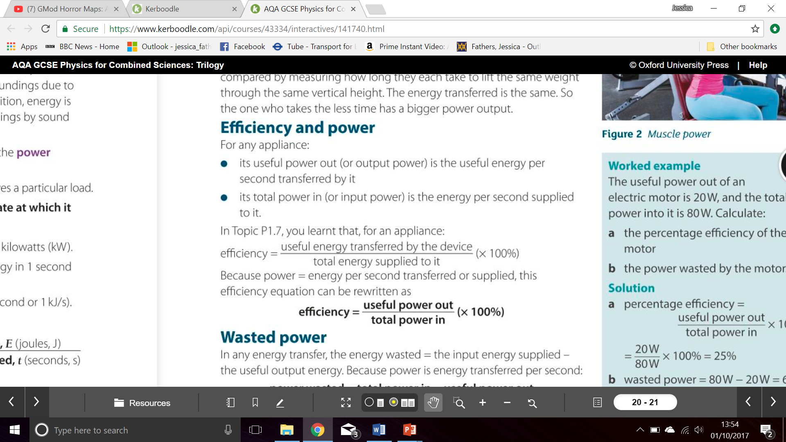

Slide 25
Memorise this!

Slide 26


