Slide 1
Heat Conduction
Starter – Write down what you think these words mean:
Conductor
Insulator
Thermal conductivity

Slide 2
Heat Conduction
Learning Objectives –
To be able to define thermal conductivity
To be able to compare the effectiveness of different insulators.

Slide 3
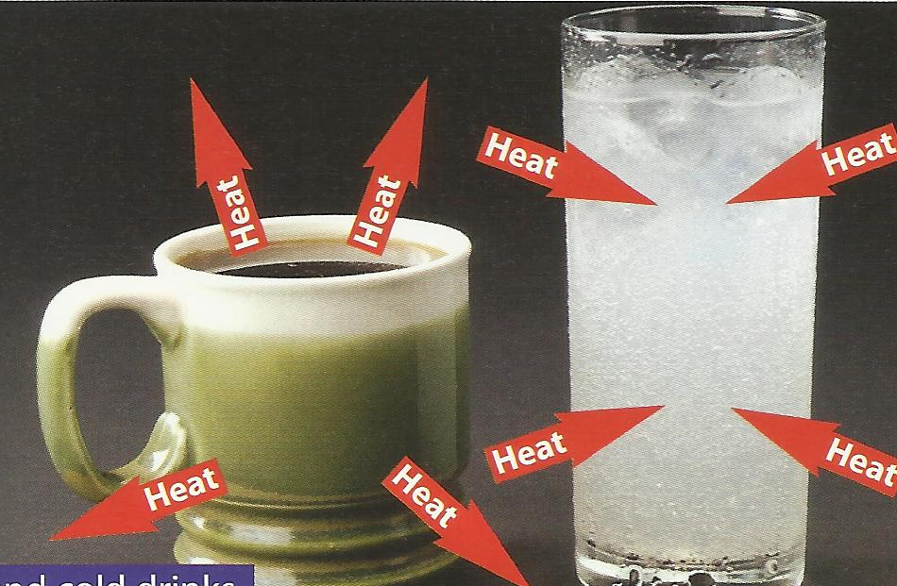
If an object is warmer than its surroundings heat will be transferred from the object to the surroundings until they are both at the same temperature.
Look at the photograph.
What will happen to the
temperature of each
drink?
Explain your answer.

Slide 4
Conductors and Insulators
Quick Recap
An item that is a conductor allows heat energy or electrical energy to flow through it.
An item that is an insulator will not allow heat energy or electrical energy to flow through it.
The more particles within an item vibrate the more thermal energy it has (ie the hotter it is!)
Conduction can only happen in SOLIDS!

Slide 5
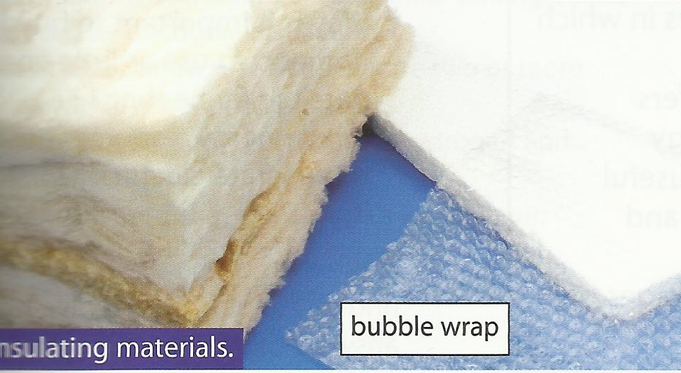
Most materials made from non-metals are thermal insulators. Materials that contain a lot of trapped air are usually very good insulators.
Look at the photograph.
Which one do you think is the best insulator?
Explain your answer

Slide 6

A temperature problem
Touch a piece of metal and a piece of wood at the same temperature. Which material feels warmer and why?
The metal feels cold and the wood feels warm.
Metal is a good conductor and conducts the heat away from your hands, so it feels cold.
Wood is not a good conductor and does not conduct the heat away from your hands as well as the metal, so the wood feels warmer than the metal.

Slide 7

Insulators
Some materials are very poor conductors of heat. These are called insulators.
Examples of materials that are insulators include plastics, wood, ceramics and air.
Gas and air are very effective insulators because the particles are far apart and do not bump into each other often enough to transfer the energy.
This is how your clothes keep you warm – air is trapped between the fibres and so acts as an insulator.
Other insulating materials, including polystyrene and loft insulation, use trapped air because it is so effective.

Slide 8
Heat Conduction
The amount of energy transfer through a material depends on its thermal conductivity.
The greater the thermal conductivity of a material, the more energy per second it transfers by conduction.

Slide 9
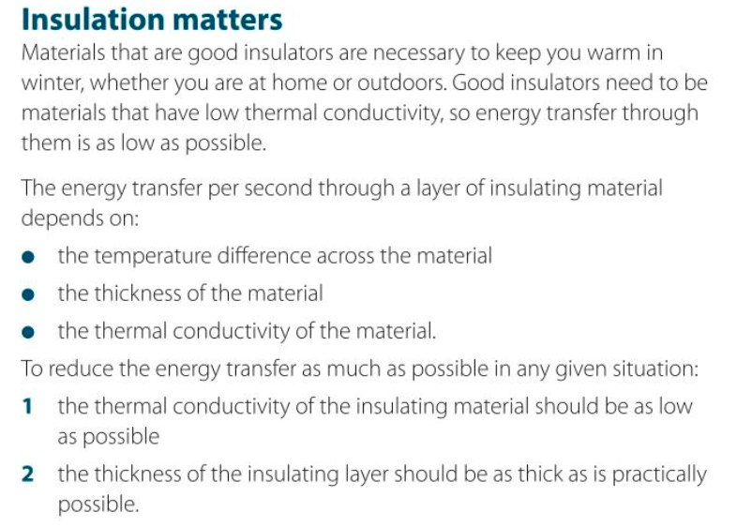

Slide 10
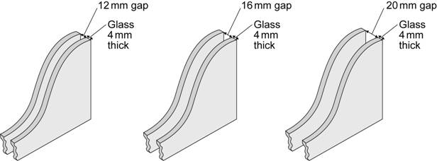
LO: Link your results to explain how we make sure that double glazed windows are energy efficient.
Type of window | 12 mm gap | 16 mm gap | 20 mm gap
1. Glass type X with air | 2.9 | 2.7 | 2.8
2. Glass type X with air and argon | 2.7 | 2.6 | 2.6
3. Glass type Y with air | 1.9 | 1.8 | 1.8
4. Glass type Y with air and argon | 1.6 | 1.5 | 1.5
The diagrams show the cross-section of three double glazed windows. The gap between the two sheets of glass can be filled with either air or a mixture of air and argon. The thermal conductivity for different types of double glazed windows, using different types of glass X and Y, are given in the table.
(a) Which type of window is the least energy efficient?
(b) Name two windows which could be compared to decide if adding argon to the gap improves the energy efficiency of the window?
(c) Which factor is the most important to consider when buying a window (glass type, gap size or gas). Explain your answer with evidence from the table
1
1 and 2 same gap
or 3 and 4 same gap
Glass type – e.g. 12mm gap adding argon makes a 0,2 difference, increasing gap 0.1, but type Y glass makes 1.0 difference
Notes:
Question based on AQA Core Physics (P1) paper from 2014.

Slide 11
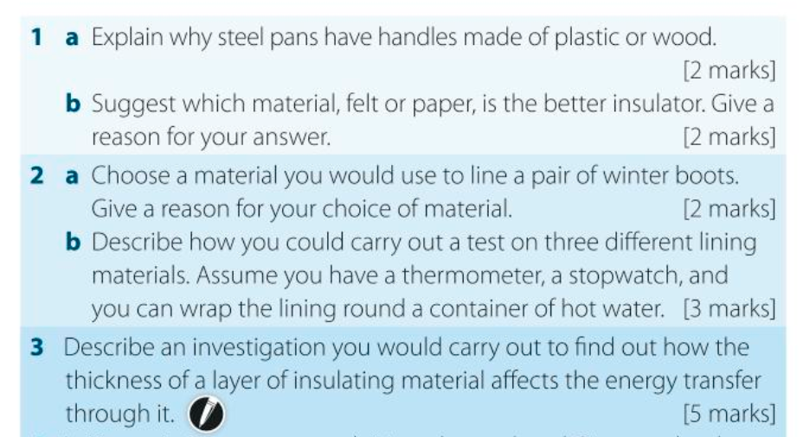

Slide 12
Specific Heat Capacity
Learning Objectives –
To be able to investigate the specific heat capacity of different materials.
To know how to calculate specific heat capacity.

Slide 13

At the end of a sunny day at the beach, you often notice that while the sand has become quite hot, the water has stayed cool.
Why? Discuss.

Slide 14



SAME amount of HEAT ENERGY
Small TEMPERATURE RISE
Large TEMPERATURE RISE
WATER
SAND
Putting the SAME AMOUNT OF HEAT ENERGY into some materials gives a BIGGER TEMPERATURE RISE than in other materials.

Slide 15
Specific Heat Capacity
The specific heat capacity of a material is the amount of energy needed to raise the temperature of 1kg of the material by 1°C.
You could also say, the specific heat capacity of a substance is a measure of how much heat energy it can hold.
The Units are J/kg°C.

Slide 16
Material | Specific Heat Capacity J/kg°C.
Water | 4200
Cooking oil | 1200
Aluminium | 880
Copper | 380

Slide 17
A higher heat capacity means a material is able to absorb and store more heat energy. Materials vary quite widely as to the amount of heat they can absorb for the same temperature rise.
Material | Specific Heat Capacity J/kg°C.
Water | 4200
Cooking oil | 1200
Aluminium | 880
Copper | 380

Slide 18
E = mcθ
change in temperature (ºC)
energy transferred (J)
mass (kg)
specific heat capacity (J/kgºC)

Slide 19

A kettle contains 1.5kg of water at a temperature of 18ºC. How much energy is needed to bring the water to the boil?
specific heat capacity of water is 4200J/kgºC

Slide 20
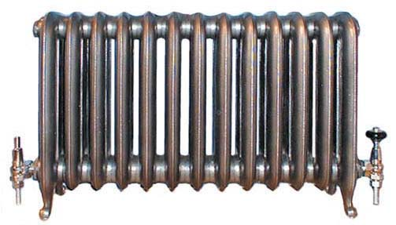
Water has a very high specific heat capacity – this is why it is used in radiators. The higher the specific heat capacity – the more energy the substance can store.

Slide 21
E = m x c x θ
A kettle contains 500g of water at a temperature of 22°C. How much energy is needed to bring the water to the boil?
A deep fat fryer contains 500g of oil, at a temperature of 22°C. How much energy is needed to raise the temperature to 100°C?
specific heat capacity of water - 4200J/kgºC
specific heat capacity of oil - 2100J/kgºC

Slide 22
For any substance, the higher the specific heat capacity, the more heat it requires to raise it’s temperature by 1°C.
Oil is used for cooking because it has a lower specific heat capacity than water, which means it is easier to heat up to a high temperature. This makes cooking with it quicker.

Slide 23
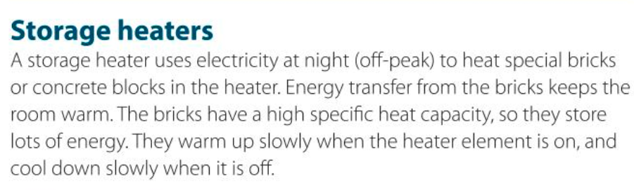

Slide 24
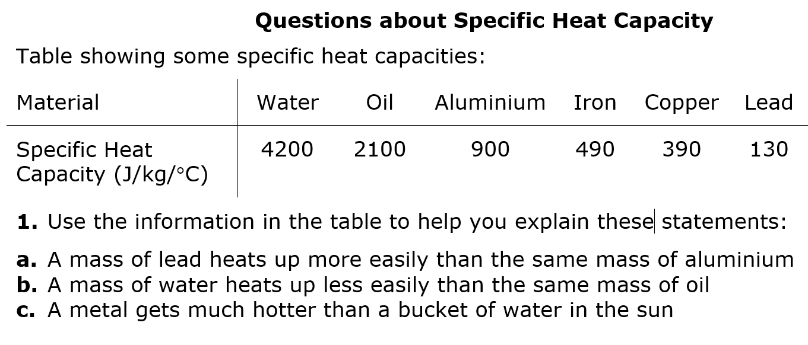

Slide 25
SPECIFIC HEAT CAPACITIES
Air | 1012 | Lead | 129
Aluminium | 897 | Mercury | 139.5
Carbon dioxide | 839 | Methane | 2191
Chromium | 449 | Nitrogen | 1040
Copper | 385 | Neon | 1030.1
Diamond | 509.1 | Oxygen | 918
Ethanol | 2440 | Paraffin wax | 2500
Gasoline | 2220 | Polyethylene | 2302.7
Glass | 840 | Iron | 450
Gold | 129 | Silica | 703
Granite | 790 | Steam (100°C) | 2080
Graphite | 710 | Water at 25 °C | 4181.3
Helium | 5193.2 | Ice −10 °C | 2050
Hydrogen | 14300 | Zinc | 387

Slide 26


