Slide 1
Required Practical 14 – Specific Heat Capacity
Learning Objectives –
To be able to safely carry out an experiment into specific heat capacity.
To be able to use experiment data to calculate values.

Slide 2
Investigation – How can you use an experiment to calculate the specific heat capacity of a material?
Discuss and write down your ideas.

Slide 3
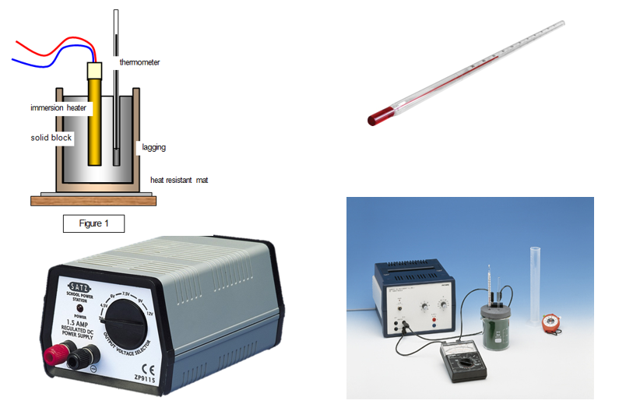

Slide 4
Investigation – How can you use an experiment to calculate the specific heat capacity of a material?
Follow the instructions and collect this data –
Mass of sample -
Temperature before heating -
Temperature after heating -
Change in temperature -
Voltage applied to heater -
Current through heater –
Time heated for (at least 5 mins) -
Electrical energy = Current x Voltage x Time

Slide 5
Specific Heat Capacity Experiment
Mass of sample (kg) -
Temperature before heating -
Temperature after heating -
Change in temperature -
Voltage applied to heater (V) -
Current through heater (A) -
Time taken (s) -
Electrical energy = Current x Voltage x Time =
Specific heat capacity of sample = Energy
mass x temp. change
Specific heat capacity of sample =

Slide 6
Complete the exam questions on specific heat capacity experiments.

