Slide 1
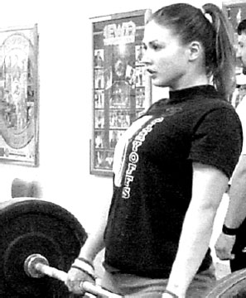
Work
Whenever you lift or move something, energy is being transferred from one form to another.
The amount of energy transferred when you move something is called the work done.
Imagine lifting a weight.
What 2 things affect the amount of work done?

Slide 2
Work done
Memorise all of this!
Work done = force x distance
W is the work done (in J)
F is the force (in N)
d is the distance moved in the direction of the force – this is also known as the displacement (in m)

Slide 3
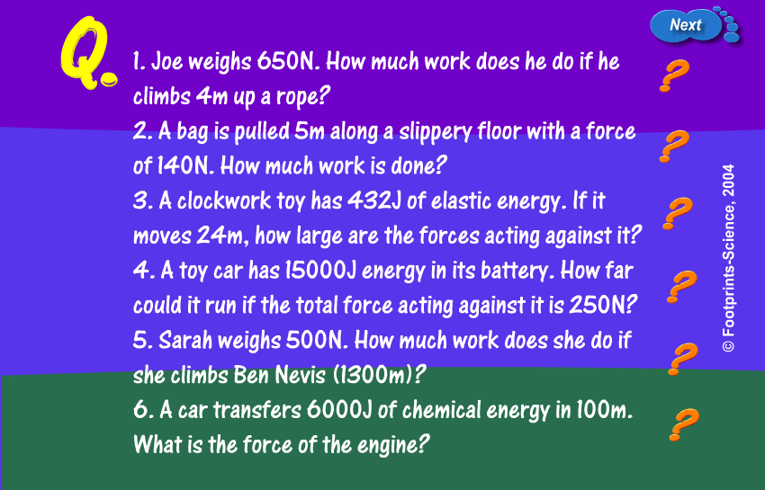
Work done
Work done

Slide 4
What is potential energy?
Potential energy means stored energy.
Gravitational potential energy is the energy something has because it is above the ground.
It is the energy involved in moving something against the force of gravity.

Slide 5
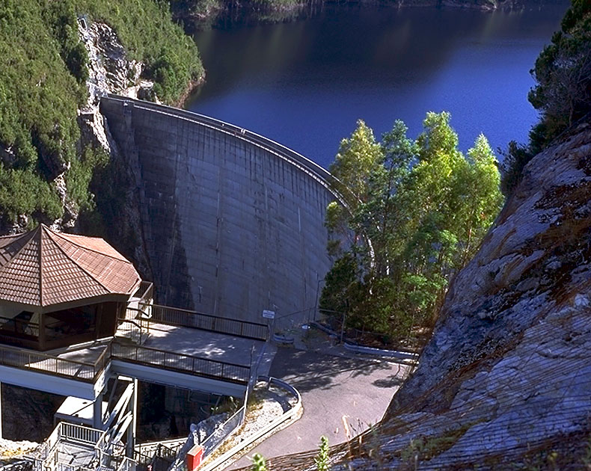
Gravitational potential energy
If you lift something, it gains gravitational potential energy
This can be useful...
For example: in hydro-electric power stations water high up is held back by a dam. When the water is allowed to fall, electricity can be produced.

Slide 6
Gravitational potential energy
Memorise all of this!
Gravitational potential energy (in J)
= mass (in kg) x gravity (in m/s²) x change in height (in m)
g is 10 m/s² on Earth
This can be written more easily as:
GPE = mgh

Slide 7
A kitten has a mass of 750g. It jumps up onto a chair that is 80cm tall. How much gravitational potential energy does it gain?
A hiker is climbing a mountain and so far has transferred 70,000J of gravitational potential energy. She has a mass of 60kg. How high up has she climbed so far?

Slide 8
A kitten has a mass of 0.5kg. It runs across a room chasing a laser with a velocity of 8m/s. What is the kinetic energy of the kitten?
A sprinter has a mass of 65kg and 3000J of kinetic energy. What is their speed?

Slide 9
Elastic Energy Mini Starter
What is elastic potential energy? Give an example.
A spring extends by 6cm when 100g is added to it. How much do you think it will extend by if 200g is added?
A spring extends by 4cm when 30g is added to it. How much mass is required to cause an extension of
(a) 12cm?
(b) 2cm?

Slide 10
What is ‘Hooke’s Law’?
The more force that was put on materials the more they extended
Some materials extended in a linear way, e.g. if the force was doubled so did the extension

Slide 11
Since Force is proportional to extension Hooke’s Law could be put as
F = k e
Where F is the force in Newtons
e is the extension in metres
k is the spring constant.
Memorise this!
Notes:
11

Slide 12
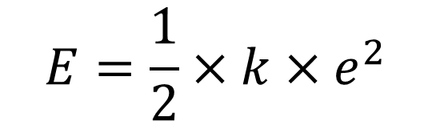
Work Done
When a spring or elastic band experiences a force, work is being done to stretch it.
This work being done by the spring is being stored as elastic potential energy.
This energy can be found by this equation:
$$E=\frac{1}{2}×k×e^{2}$$

