Slide 1
P1 Conservation and dissipation of energy
1.1 Changes in energy stores
Key points
Energy be stored as different energy stores.
Energy is transferred by heating, by waves, by electric current, or by force moving an object.
When an object falls, its stored gravitational PE decreases and its kinetic energy (KE) store increases.
When a falling object hits the ground, without bouncing, its KE store decreases. Some, or all, of its energy is transferred to the surroundings as thermal energy and sound waves.

Slide 2
P1.1 Changes in energy stores
Describe the changes to energy stores that take place when:
a) a ball flies through the air
b) an electric heater is switched on.
2a) List two different objects you could use to light a room if you have a power cut. For each object, describe the energy transfers and changes to energy stores that occur when it lights up the room.
Which of the two objects in a) is:
i. Easier to obtain the energy from?
ii. Easier to use?
3. Describe the changes in energy stores of an electric train as it:
a) moves up hill at a constant speed
b) approaches a station and brakes to a halt.
4) Describe the changes in energy stores that take place when food is heated in a microwave oven.

Slide 3
.P1.1 Changes in energy stores (answers)
1. Describe the changes to energy stores that take place when:
a) a ball flies through the air
1a) Chemical (in arm) to KE. KE is lost as grav. PE is gained.
Coming down, grav. PE is lost as KE is gained. Some KE is lost due to air resistance, and thermal energy is given to air, and sound and heat and elastic on landing.
b) an electric heater is switched on
Electrical energy is transformed into heat energy and some light energy, as the heater usually glows red. Some heat=> surroundings.
2a) List two different objects you could use to light a room if you have a power cut. For each object, describe the energy transfers and changes to energy stores that occur when it lights up the room.
Torch: Chemical => electrical energy => light and wasted heat => surroundings.
Candle: Chemical => light and wasted heat =. surroundings.
Which of the two objects in a) is:
i. Easier to obtain the energy from? Candle
ii. Easier to use?
i) & ii) the torch; flick of a switch and (if the batteries are OK) you have immediate light and no hot wax or fire to have to deal with.

Slide 4
.P1.1 Changes in energy stores (answers)
3. Describe the changes in energy stores of an electric train as it:
a) moves up hill at a constant speed
b) approaches a station and brakes to a halt.
a) Electrical energy is converted into KE which is turned into grav PE as the train gains height. The train’s KE remains constant, as its mass and speed remain the same.
b) Train’s KE => heat of the brake discs and pads due to friction => dissipated to the air as thermal energy. Once stationary, the train has no KE.
4) Describe the changes in energy stores that take place when food is heated in a microwave oven.
Electrical energy in wires =>
light energy in microwaves =>
thermal energy in the water molecules in the food =>
increase in thermal energy store of the food as a whole =>
dissipated to the surroundings.

Slide 5
P1.2 Conservation of energy
Key Points
Energy cannot be created or destroyed
Conservation of energy applies to all energy changes
A closed system is an isolated system in which no energy transfers take place out of or into the energy stores of the system.
Energy can be transferred between energy stores within a closed system.
The total energy of the system is always the same, before and after any such transfers.

Slide 6
P1.2 Conservation of energy
1. When a roller coaster gets to the bottom of a descent, describe the energy transfers and changes to energy stores that happen if: a) the brakes are applied to stop it
b) it goes up and over a second hill.
2a. A ball dropped onto a trampoline returns to almost the same height after it bounces. Describe the energy transfers and changes to the energy stores of the ball from the point of release to the top of its bounce.
b) Describe the energy stores of the ball at the point of release compared with its energy stores at the top of the bounce.
c) Describe how you would use the test in ‘a’ to see which of the trampolines is the bounciest.
3. One exciting fairground ride acts like a giant catapult. The capsule in which you are strapped is fired high into the sky by the rubber bands of the catapult. Explain the changes to the energy stores that take place in the ride as you move upwards.

Slide 7
P1.2 Conservation of energy (answers)
1. When a roller coaster gets to the bottom of a descent, describe the energy transfers and changes to energy stores that happen if: a) the brakes are applied to stop it
b) it goes up and over a second hill.
a) KE => heat energy of the brake discs and pads => dissipated as heat to the surroundings + sound.
b) KE transferred into grav. PE on the way up to the next summit, then GPE transferred back into KE as it goes down the far side of the second hill. GPE lost as KE gained.
2a. A ball dropped onto a trampoline returns to almost the same height after it bounces. Describe the energy transfers and changes to the energy stores of the ball from the point of release to the top of its bounce.
Descent: GPE lost as KE gained during fall => KE lost & elastic PE gained as the ball hits trampoline causing it to deform elastically, + some lost as sound & heat.
Ascent: Elastic PE => KE as trampoline recoils, but less KE than before. KE on way up transformed to GPE, until all energy is GPE at top of bounce + some energy lost to surroundings due to air resistance.

Slide 8
P1.2 Conservation of energy (answers)
b) Describe the energy stores of the ball at the point of release compared with its energy stores at the top of the bounce.
At point of release its GPE was greater than at the top of its bounce.
c) Describe how you would use the test in ‘a’ to see which of the trampolines is the bounciest.
Drop a ball from the same height onto each of the 3 trampolines and see for which one the balls bounced back closest to its original height. The bounciest trampoline would transfer least KE to heat and sound, and return most as KE, which in turn transfers to GPE as it bounces upwards.

Slide 9
P1.2 Conservation of energy (answers)
3. One exciting fairground ride acts like a giant catapult. The capsule in which you are strapped is fired high into the sky by the rubber bands of the catapult. Explain the changes to the energy stores that take place in the ride as you move upwards.
Prior to release: Energy stored as elastic strain energy in the stretched rubber bands.
Stored elastic energy => KE and a gain in GPE as the ball picks up speed going upwards.
The KE decreases as the GPE increases, and then the elastic strain energy increases too if the rubber bands become taut.
At the summit, the KE is zero, the GPE is a maximum, and the stored elastic strain energy will depend on how taut the ropes are, but would be a maximum at the top of the first bounce.

Slide 10
P1.3 Energy and work
Key points:
Work is done on an object when a force makes the object move.
Energy transferred = work done.
Work done is W = F.s where F is the force and s is the distance moved (along the line of action of the force).
Work done to overcome friction is transferred as energy to the thermal energy stores of the objects that rub together and to the surroundings.

Slide 11
P1.3 Energy and work
1a) State what happens to the energy transferred:
i) by a rower rowing a boat
ii) by an electric motor used to raise a car park barrier.
b) Calculate how much work is done when a force of 3000N pulls a truck through a distance of 50m in the direction of the force.
2. A car is brought to a standstill when the driver applies the brakes.
a) Explain why the brake pads become warm.
b) The car travelled a distance of 20m after the brakes were applied. The braking force on the car during this time was 7000N. Calculate the work done by the braking force.
3a) Calculate the work done when:
i) a force of 20N makes an object move 4.8m in the direction of the force
ii) an object of weight 80N is raised through a height of 1.2m
b) When a cyclist brakes, his kinetic energy store is reduced from 1400J to zero in a distance of 7.0m. Calculate the braking force.
4 A student pushes a box at a steady speed a distance of 12m across a level floor.
a) The student applied a horizontal force of 25N to the box. Calculate the work done by the student.
b) Describe the energy transfers and changes to energy stores as the box moves.

Slide 12
P1.3 Energy and work (answers)
1a) State what happens to the energy transferred:
i) by a rower rowing a boat
ii) by an electric motor used to raise a car park barrier.
b) Calculate how much work is done when a force of 3000N pulls a truck through a distance of 50m in the direction of the force.
1ai) chemical energy in rower’s muscles => KE & heat energy of body => KE of the boat + sound & heat due to work against friction
1aii) electric energy => KE of motor => KE of barrier => GPE as barrier rises & heat & sound.
b) W = F.s
W = 3000 x 50
W = 150,000J
2. A car is brought to a standstill when the driver applies the brakes.
a) Explain why the brake pads become warm.
b) The car travelled a distance of 20m after the brakes were applied. The braking force on the car during this time was 7000N. Calculate the work done by the braking force.
a) The car’s KE is turned into heat energy by the friction of the brake pads against the brake discs.
b) W = F.s
W = 7000 x 20
= 140,000J

Slide 13
P1.3 Energy and work (answers)
3a) Calculate the work done when:
i) a force of 20N makes an object move 4.8m in the direction of the force
ii) an object of weight 80N is raised through a height of 1.2m
i) W = F.s , W = 20 x 4.8
W = 96J
ii) W = F.s, W = 80 x 1.2
W = 96J
b) When a cyclist brakes, his kinetic energy store is reduced from 1400J to zero in a distance of 7.0m. Calculate the braking force.
b) W = F.s , Rearrange: F = W/s
F = 1400/7
F = 200N
4 A student pushes a box at a steady speed a distance of 12m across a level floor.
a) The student applied a horizontal force of 25N to the box. Calculate the work done by the student.
b) Describe the energy transfers and changes to energy stores as the box moves.
a) W = F.s
W = 25 x 12
W = 300J
b) chemical energy in student’s muscles => KE of body => KE of box => heat of floor and box due to friction

Slide 14
P1.4 Gravitational potential energy stores
Key points: Since PE =mgh
Grav. PE increases when the object moves higher, decreases as it is lowered.
Work is done to overcome gravitational force as it is raised.
Graviational field strength on Earth is 10N/kg, it is 1/6^{th,} or 1.67N/kg, on the Moon
The change in grav.PE store of an object is:
ΔE_{p}= mgΔh
Where Δ is “change in”
m is mass,kg
g is gravitational field strength, N/kg
h is height,m

Slide 15
P1.4 Gravitational potential energy stores
1a) Describe the changes to the energy stores of a ball when it falls and rebounds without regaining its original height.[4]
1b) When a ball of 1.4N is dropped from rest from a height of 2.5m above a flat surface, it rebounds to a height of 1.7m above the surface.
i) Calculate the total energy lost from the ball’s energy stores when it reaches the maximum rebound height. [2]
ii) Name to two causes of energy transfer [2]
2. A student of weight 450N steps on a box of height 0.2m.
a) Calculate the increase in her gravitational potential energy store.
b) Calculate the work done by the student if she steps on and off the box 50 times.

Slide 16
P1.4 Gravitational potential energy stores
3a) A weightlifter raises a steel bar of mass 25kg through a height of 1.8m. Calculate the change to the grav.PE store of the bar. The grav.field strength on Earth is 9.8N/kg.
3b) The weightlifter then lowers the bar by 0.3m and drops it so it falls to the ground. Calculate the change to its grav.PE store in this fall.
4) You use energy when you hold an object stationary in your outstretched hand. Suggest what happens to the energy that must be supplied to your muscles to keep them contracted.

Slide 17
P1.4 Gravitational potential energy stores (answers)
1a) Describe the changes to the energy stores of a ball when it falls and rebounds without regaining its original height.[4]
Descent: GPE => KE as it falls, KE => Elastic PE + sound and heat as it hits the ground, elastic PE => KE as it rebounds, KE => GPE as it rises to top of bounce height (some KE to air KE as pushed aside by ball).
1b) When a ball of 1.4N is dropped from rest from a height of 2.5m above a flat surface, it rebounds to a height of 1.7m above the surface.
i) Calculate the total energy lost from the ball’s energy stores when it reaches the maximum rebound height. [2]
1b) i)ΔGPE = mgΔh, ΔGPE = 1.4N x (2.5-1.7)m = 1.12J
ii) Name to two causes of energy transfer [2]
ii) Energy lost as sound of impact and work done in deforming the ball, turning some to heat.
2. A student of weight 450N steps on a box of height 0.2m.
a) Calculate the increase in her gravitational potential energy store.
ΔGPE = mgΔh, student up onto box
ΔGPE = 450N x 0.2m = 90J for one step up.
b) Calculate the work done by the student if she steps on and off the box 50 times.
Does 50 step ups, 90 x 50 = 4500J

Slide 18
P1.4 Gravitational potential energy stores
3a) A weightlifter raises a steel bar of mass 25kg through a height of 1.8m. Calculate the change to the grav.PE store of the bar. The grav.field strength on Earth is 9.8N/kg.
3a). ΔGPE = mgΔh,
g = 9.8N/kg,
ΔGPE = 25 x 9.8 x 1.8 = 441J,
weight lifter lifts 25kg 1.8m
3b) The weightlifter then lowers the bar by 0.3m and drops it so it falls to the ground. Calculate the change to its grav.PE store in this fall.
b) lowers bar to 1.5m, then drops it.
ΔGPE = 25 x 9.8 x 1.5 = 367.5J lost as it falls
4) You use energy when you hold an object stationary in your outstretched hand. Suggest what happens to the energy that must be supplied to your muscles to keep them contracted.
Your arm constantly drops due to gravity, so you must lift it a tiny amount to recover the position. Energy is transferred to grav.PE through constantly raising your arm. Energy is released through respiration (releasing energy from food) as heat to surroundings from hot muscles.
(Note – if object doesn’t move, no work done)

Slide 19
P1.5 Kinetic energy and elastic energy stores
Key points:
The energy in the kinetic energy store of a moving object depends on its mass and its speed.
The kinetic energy store of the object is E_{k} = ½ mv².
Elastic potential energy is the energy stored in an elastic object when work is done on the object.
The elastic potential energy stored in a stretched spring is E_{e} = ½ ke², where e is the extension of the spring.

Slide 20
P1.5 Kinetic energy and elastic energy stores
1a) Calculate the kinetic energy store of:
i) a vehicle of mass 500kg moving at a speed of 12m/s [2]
ii) a football of mass 0.44kg moving at a speed of 20m/s.
1b) Calculate the velocity of a 500kg vehicle with twice the KE store as calculated in ai)
2a) A catapult is used to fire an object into the air. Describe the energy transfers when the catapult is:
i) stretched:
ii) released:
2b) An object of weight 2.0N fired vertically upwards from a catapult reaches a maximum height of 5.0m. Calculate: i) the increase in gravitational energy store of the object.
ii) The speed of the object when it left the catapult.

Slide 21
P1.5 Kinetic energy and elastic energy stores
A car moving at a constant speed has 360,000J of KE store. When the driver applies the brakes, the car stops in a distance of 100m.
Calculate the force that stops the vehicle.
b) The speed of the car was 30m/s when its kinetic energy store was 360 000J. Calculate its mass.
4. A mobility aid to assist walking uses a steel spring to store energy when the walker’s foot goes down, and returns energy as the foot is lifted. The spring has a spring constant of 250N/m. Calculate the elastic potential energy stored in the spring when its extension is 0.21m.

Slide 22
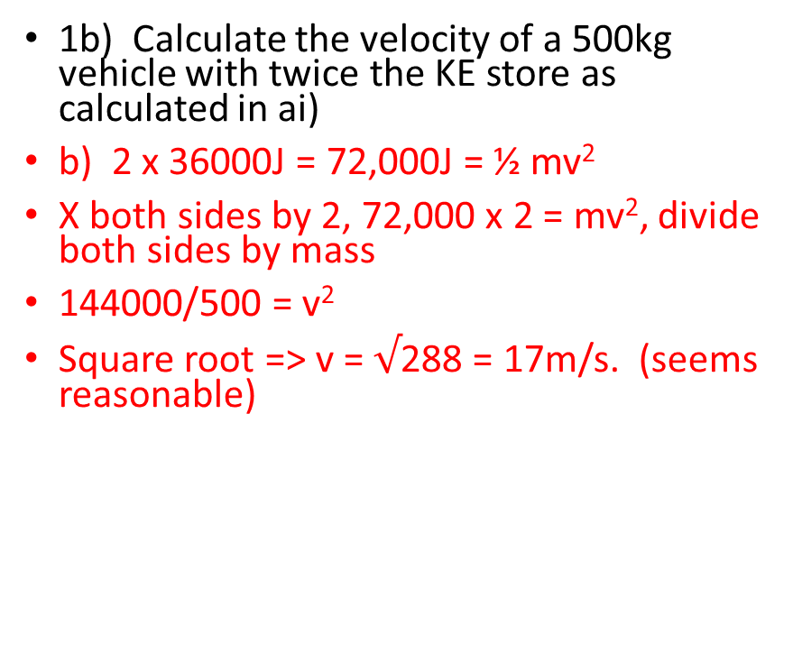
P1.5 Kinetic energy & elastic energy stores
1a) Calculate the kinetic energy store of:
i) a vehicle of mass 500kg moving at a speed of 12m/s [2]
ii) a football of mass 0.44kg moving at a speed of 20m/s.
i) KE = ½ mv²,
= ½ x 500 x 12²
= 36,000J
ii) KE = ½ mv²,
= ½ x 0.44 x 20²
= 88J
1b) Calculate the velocity of a 500kg vehicle with twice the KE store as calculated in ai)
b) 2 x 36000J = 72,000J = ½ mv²
X both sides by 2, 72,000 x 2 = mv², divide both sides by mass
144000/500 = v²
Square root => v = $√$288 = 17m/s. (seems reasonable)

Slide 23
P1.5 KE and Elastic PE stores
2a) A catapult is used to fire an object into the air. Describe the energy transfers when the catapult is:
i) stretched:
ii) released:
2ai) chemical PE of muscles => KE => elastic PE of catapult.
2aii) elastic PE => KE of missile and rubber + a twang as sound
2b) An object of weight 2.0N fired vertically upwards from a catapult reaches a maximum height of 5.0m. Calculate: i) the increase in gravitational energy store of the object.
ii) The speed of the object when it left the catapult.
2b) An object of weight 2.0N fired vertically upwards from a catapult reaches a maximum height of 5.0m. Calculate: i) the increase in gravitational energy store of the object.
GPE = mgh,
= 2.0N x 5m
= 10J of GPE
ii) The speed of the object when it left the catapult.
assuming all GPE from initial KE,
then 10J = ½ mv²,
Multiplying both sides by 2, 20J = mv²
Divide both sides by mass of 0.2kg (weight 2.0N), 100J = v²
Then square root both sides => v = 10m/s.

Slide 24
P1.5 KE and Elastic PE stores
3. A car moving at a constant speed has 360,000J of KE store. When the driver applies the brakes, the car stops in a distance of 100m.
Calculate the force that stops the vehicle.
KE lost = braking force x stopping distance
360,000 = braking force x 100m,
Dividing both sides by 100,
=> braking force = 3600N.
b) The speed of the car was 30m/s when its kinetic energy store was 360 000J. Calculate its mass.
Given to find mass, m, or car, knowing KE = 360,000J, and v = 30m/s.
360,000 = ½ mv², divide both sides by v², or 900 and x 2 to get rid of ½
m = 800kg.
4. A mobility aid to assist walking uses a steel spring to store energy when the walker’s foot goes down, and returns energy as the foot is lifted. The spring has a spring constant of 250N/m. Calculate the elastic potential energy stored in the spring when its extension is 0.21m.
Knowing the equation: elastic potential energy = ½ k x²
Elastic PE = ½ x 250N/m x 0.21² = 5.51J

Slide 25
P1.6 Energy Dissipation
Key points:
Useful energy is the energy in the place we want it and in the form we need it.
Wasted energy is the energy that is not useful and is transferred by an undesired pathway.
Wasted energy is eventually transferred to the surroundings, which become warmer.
As energy dissipates (spreads out), it gets less and less useful.

Slide 26
P1.6 Energy dissipation
1. Copy and complete the table below:
Energy transfer by | Useful energy output | Wasted energy output
a) Electric fan heater | Warms the air and surrounding objects
b) TV
c) Electric kettle
d) Headphones

Slide 27
P1.6 Energy dissipation (answers)
1. Copy and complete the table below:
Energy transfer by | Useful energy output | Wasted energy output
a) Electric fan heater | Warms the air and surrounding objects | noise
b) TV | Light & sound | heat
c) Electric kettle | heat | sound
d) Headphones | sound | Heat and lost sound

Slide 28
P1.6 Energy dissipation
2. Describe what would happen, in terms of energy transfer and energy stores, to:
2a) A gear box that was insulated so it could not transfer energy by heat to the surroundings?
2b) the running shoes of a jogger are well insulated
2c) a blunt electric drill bit used to drill into hard wood
2d) the metal wheel discs of the brakes of a car when the brakes are applied.
3a) Describe the energy transfers and changes to energy stores of a pendulum as it swings from one side to the middle, and then to the opposite side.
b) Explain why a swinging pendulum eventually stops.
The pendulum eventually stops as energy is dissipated as heat to surroundings due to air resistance.
4. A freewheeling cyclist on a level road gradually stops moving. Describe the energy transfers and changes to the energy stores of the cyclist and the bicycle.

Slide 29
P1.6 Energy dissipation
2. Describe what would happen, in terms of energy transfer and energy stores, to:
2a) A gear box that was insulated so it could not transfer energy by heat to the surroundings?
It would overheat and the cogs would expand and seize => ruined.
2b) the running shoes of a jogger are well insulated
The runner’s feet would overheat, sweat and become uncomfortable leading to sweating, and fungal infection.
2c) a blunt electric drill bit used to drill into hard wood
There would be a lot of rubbing (not cutting) => heat and smoke due to dissipation of KE as heat.
2d) the metal wheel discs of the brakes of a car when the brakes are applied.
The brake pads will cause huge heating due to friction, would done = force of pad x circular distance travelled as disc rotates.
3a) Describe the energy transfers and changes to energy stores of a pendulum as it swings from one side to the middle, and then to the opposite side.
Go to https://phet.colorado.edu/sims/pendulum-lab/pendulum-lab_en.html and play.
GPE => KE => GPE , with a changing ratio of both in between.

Slide 30
P1.6 Energy dissipation
b) Explain why a swinging pendulum eventually stops.
The pendulum eventually stops as energy is dissipated as heat to surroundings due to air resistance.
4. A freewheeling cyclist on a level road gradually stops moving. Describe the energy transfers and changes to the energy stores of the cyclist and the bicycle.
KE => heat and noise due to wind resistance and contact friction with the road, until no KE left.

Slide 31
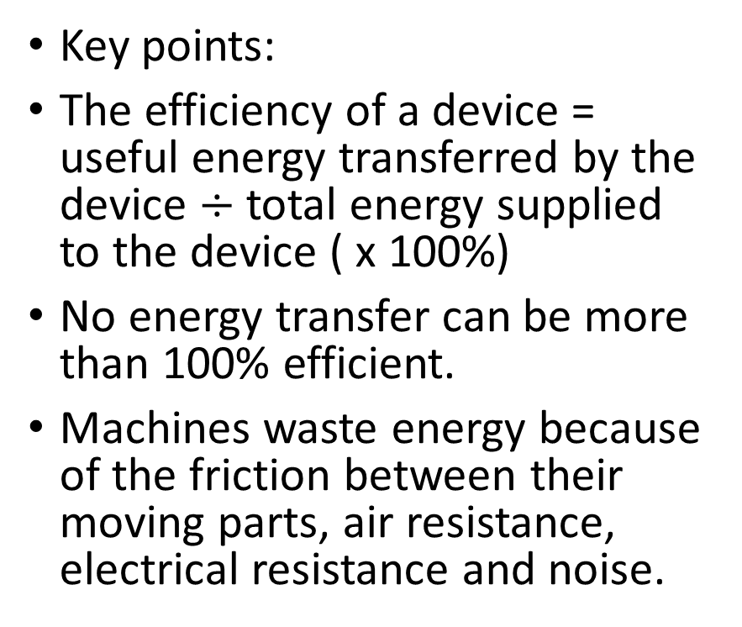
P1.7 Energy and efficiency
Key points:
The efficiency of a device = useful energy transferred by the device $÷$ total energy supplied to the device ( x 100%)
No energy transfer can be more than 100% efficient.
Machines waste energy because of the friction between their moving parts, air resistance, electrical resistance and noise.
Machines can be made more efficient by reducing the energy they waste. For example, lubrication is used to reduce friction between moving parts.

Slide 32
P1.7 Energy and efficiency
1a) Compare the useful output energy by a machine and the input energy supplied to the machine.
b) Explain why the percentage efficiency of a machine can never be:
i) > 100%.
ii) equal to 100%.
2 An electric motor is used to raise a weight. When you supply 60J of energy to the motor, the weight gains 24J of gravitational potential energy. Calculate:
a) the energy wasted the motor
b) the efficiency of the motor

Slide 33
P1.7 Energy and efficiency
A machine is 25% efficient. If the total energy supplied to the machine is 3200J, calculate how much useful energy can be transferred.
An electric fan heater contains a motor that blows hot air into the room. Describe the changes in the energy stores of the heater.

Slide 34
P1.7 Energy and efficiency
1a) Compare the useful output energy by a machine and the input energy supplied to the machine.
Best done with an example, e.g. a light bulb. We want light (useful output) but inevitably get some heat out too, but this is not wanted, so is wasted. The input energy has to provide enough to cover both.
b) Explain why the percentage efficiency of a machine can never be:
> 100%.
That would break the law of Physics, that energy can neither be created nor destroyed.
ii) equal to 100%.
In transforming from one energy type to another, energy will be lost, usually as sound or heat, which cannot be recovered into a useful form of energy.
2 An electric motor is used to raise a weight. When you supply 60J of energy to the motor, the weight gains 24J of gravitational potential energy. Calculate:
a) the energy wasted the motor
Total in – useful = wasted energy
60J – 24J = 36J
b) the efficiency of the motor
Efficiency = useful/total x 100%
efficiency = 24/60 x 100 = 40%

Slide 35
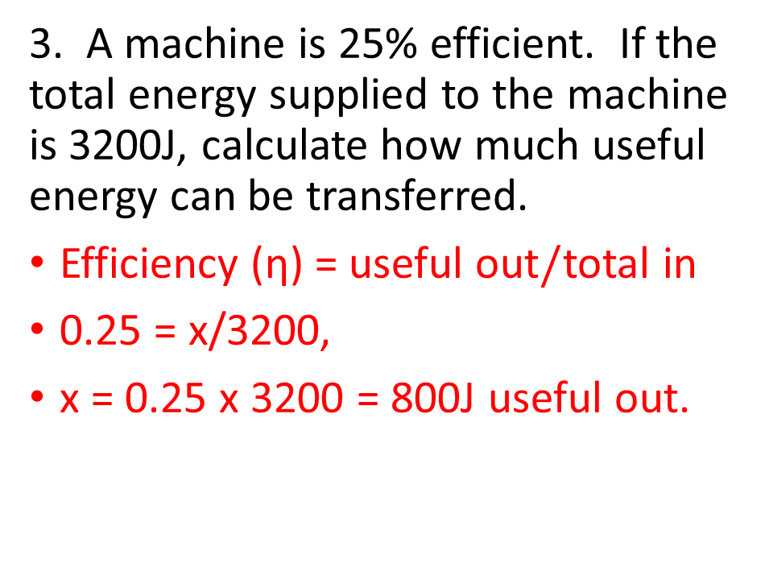
P1.7 Energy and efficiency
3. A machine is 25% efficient. If the total energy supplied to the machine is 3200J, calculate how much useful energy can be transferred.
Efficiency (η) = useful out$/$total in
0.25 = x/3200,
x = 0.25 x 3200 = 800J useful out.
An electric fan heater contains a motor that blows hot air into the room. Describe the changes in the energy stores of the heater.
Electrical energy => heat,KE, noise.
The noise is wasted.

Slide 36
P1.8 Electrical appliances
Key points
Electricity and gas and/or oil supply most of the energy you use in your home.
Electrical appliances can transfer energy in the form of useful energy at the flick of a switch.
Uses of everyday electrical appliances include, heating, lighting, motors, and radio and TVs.
An electrical appliance is designed for a particular purpose and should waste as little energy as possible.

Slide 37
P1.8 Electrical appliances
1. Match each electrical appliance in the list below with the energy transfer A or B it is designed to bring about. A => sound, B => KE
a) Electric drill
b) Food mixer
c) Electric bell
2a) Explain why a clockwork radio needs to be wound up before it can be used.
2b) Describe the changes in energy stores that take place in a clockwork radio when it is wound up and then switched on.
c) Give one advantage and one disadvantage of a clockwork radio compared with a battery-operated radio.

Slide 38
P1.8 Electrical appliances
3) An electric dishwasher heats up water and sprays the hot water at the dishes. It then pumps the water out.
a) Describe how energy is usefully used in the machine.
b) Describe how energy is wasted by the machine.
4. A laptop battery stores energy with an efficiency of 80% when it is recharged from a low-voltage power supply. When it is connected to the laptop, it transfers energy to the laptop with an efficiency of 60%.
a) Calculate the overall efficiency of the laptop battery.
b) Calculate the overall percentage of the energy wasted.

Slide 39
P1.8 Electrical appliances (answers)
1. Match each electrical appliance in the list below with the energy transfer A or B it is designed to bring about. A => sound, B => KE
a) Electric drill => KE
b) Food mixer => KE
c) Electric bell => sound
2a) Explain why a clockwork radio needs to be wound up before it can be used.
Needs a store of elastic PE that can be steadily transformed into KE.
2b) Describe the changes in energy stores that take place in a clockwork radio when it is wound up and then switched on.
Chemical energy=>KE=> elastic PE => KE => electrical => sound & heat.

Slide 40
P1.8 Electrical appliances (answers)
3) An electric dishwasher heats up water and sprays the hot water at the dishes. It then pumps the water out.
a) Describe how energy is usefully used in the machine.
Electricity => heat and KE, a spray of hot water. Electrical energy => KE as the water is pumped out.
b) Describe how energy is wasted by the machine.
The dishwasher itself gets hot, and also unwanted sound is created and wasted as part of the washing process.
4. A laptop battery stores energy with an efficiency of 80% when it is recharged from a low-voltage power supply. When it is connected to the laptop, it transfers energy to the laptop with an efficiency of 60%.
a) Calculate the overall efficiency of the laptop battery.
b) Calculate the overall percentage of the energy wasted.
Say 100J is provided to the low-voltage supply. 80J of that is stored by the battery charger, and 60%, so 0.60 x 80J => laptop => 48J, so:
a) laptop battery % efficiency is: 100J in, 48J useful out = 48%.
b) Overall percentage wasted must be 52%.

Slide 41
P1.9 Energy and Power
Key points: Power is the rate of transfer of energy.
The power of an appliance is P = E/t
Efficiency of an appliance = useful power out/total power in
(x 100%)
Power wasted by an appliance = total power input – useful power output

Slide 42
P1.9 Energy and Power
1a) State which of the following is most powerful:
i) A torch bulb or a mains filament lamp?
ii) A 3kW electric kettle or 1 10000W electric cooker?
1b) There are about 20 million occupied homes in England. If a 3kW electric kettle was switched on in 1 in 10 homes at the same time, work out how much power would need to be supplied.
2. The total power supplied to a lift motor is 5000W. In a test, the motor transfers 12000J of energy in 20s to the gravitational PE store of the lift.
a) Calculate how much energy is supplied to the motor by the current through it in 20s.
b) Calculate its efficiency in the test

Slide 43
P1.9 Energy and Power
3. A machine has an input power rating of 100kW. If the useful energy transferred by the machine in 50s is 1500kJ, calculate:
a) its output power in kilowatts
b) its percentage efficiency.
4a) Describe the energy transfers and changes to the energy stores of an electric hot water shower when it is operation. [5 marks!]
4b) A 12kW electric shower is used 4 times a day for 20 minutes each time. Calculate the electricity supplied to it by electricity in one day.

Slide 44
P1.9 Energy and Power (answers)
1a) State which of the following is most powerful:
i) A torch bulb or a mains filament lamp?
A mains filament lamp (1W<100W)
ii) A 3kW electric kettle or 1 10000W electric cooker?
Cooker, as 10kW>3kW
1b) There are about 20 million occupied homes in England. If a 3kW electric kettle was switched on in 1 in 10 homes at the same time, work out how much power would need to be supplied.
1 in 10 of 20M => 2 000 000, times 3kW => 6000MW.
2. The total power supplied to a lift motor is 5000W. In a test, the motor transfers 12000J of energy in 20s to the gravitational PE store of the lift.
a) Calculate how much energy is supplied to the motor by the current through it in 20s.
E = P x t, = 5000 x 20 = 100 000J
b) Calculate its efficiency in the test
ƞ = useful/total x 100%
Ƞ = 12000/100000 x 100% = 12%

Slide 45
P1.9 Energy and Power
3. A machine has an input power rating of 100kW. If the useful energy transferred by the machine in 50s is 1500kJ, calculate:
a) its output power in kilowatts
Useful out P=E/t,
P = 1500kJ/50 = 30kW
b) its percentage efficiency.
Ƞ = useful / total x 100
= 30kW/100kW) x 100 = 30%
4a) Describe the energy transfers and changes to the energy stores of an electric hot water shower when it is operation. [5 marks!]
1: Electrical to heat
2: Electrical to KE, pump
3: KE to PE, water pump up and out of shower head.
4: GPE => KE as water falls
5: Heat energy of water lost to air as energy dissipates into bathroom.

Slide 46
P1.9 Energy and power
4b) A 12kW electric shower is used 4 times a day for 20 minutes each time. Calculate the electricity supplied to it by electricity in one day.
Energy = power x time
E = 4 x (12kW x (20 x 60)s)
E = 57600kJ

Slide 47
P1 Conservation and dissipation of energy
1. An electric fan heater contains an electric heater and a fan driven by an electric motor.
a) electricity => heat,
Electricity => kinetic energy & sound
b) i) For the fan heater, the useful energy is the heat and the movement (of the air).
ii) The wasted energy is the noise.
2. A bungee jumper jumps, from a platform and transforms 12000J from his gravitational potential energy store before the rope attached to him becomes taut and starts to stretch. He then transfers a further 24000J from his gravitational potential energy store before he stops falling and begins to rise.

Slide 48
.
2. A bungee jumper jumps, from a platform and transforms 12000J from his gravitational potential energy store before the rope attached to him becomes taut and starts to stretch. He then transfers a further 24000J from his gravitational potential energy store before he stops falling and begins to rise
12000J of PE lost before rope even starts to stretch and store elastic energy
Further 24000J
of PE lost, but transferred into
Elastic energy.
2ai) GPE lost as KE gained as jumper descends.
2aii) GPE continues to be lost as jumper descends, KE lost as (s)he slows, Elastic PE gained as bungee stretches, until no KE left, as stationary at bottom of flight.
2b) Maximum KE = 12000J, as once elastic is taut, the jumper starts to slow down as KE converted to elastic potential energy.

