Slide 1
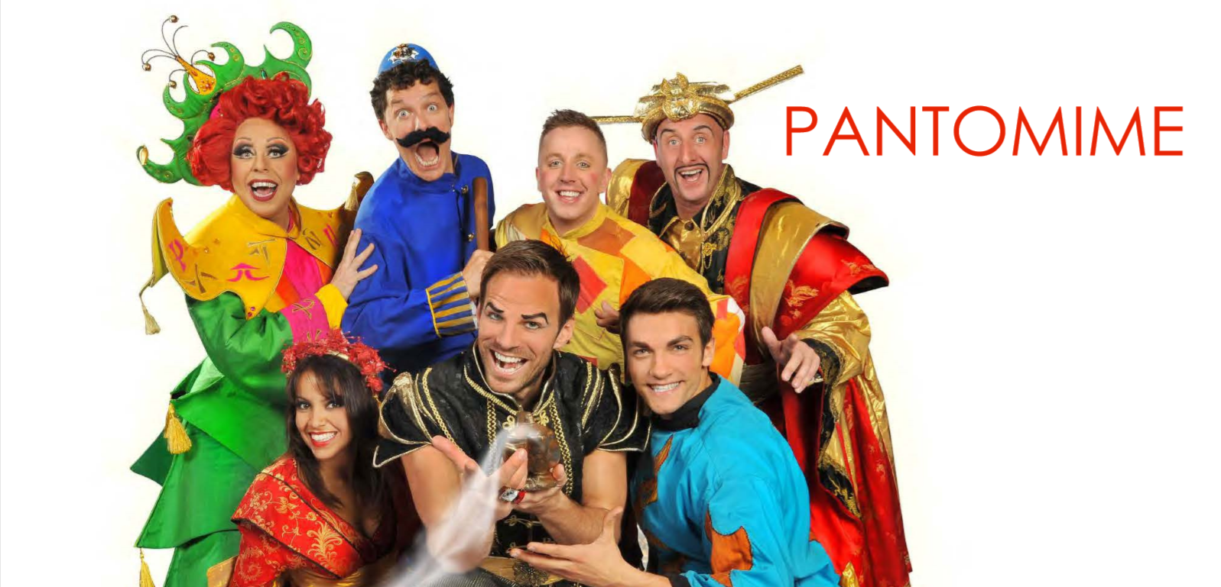
Lesson 1

Slide 2
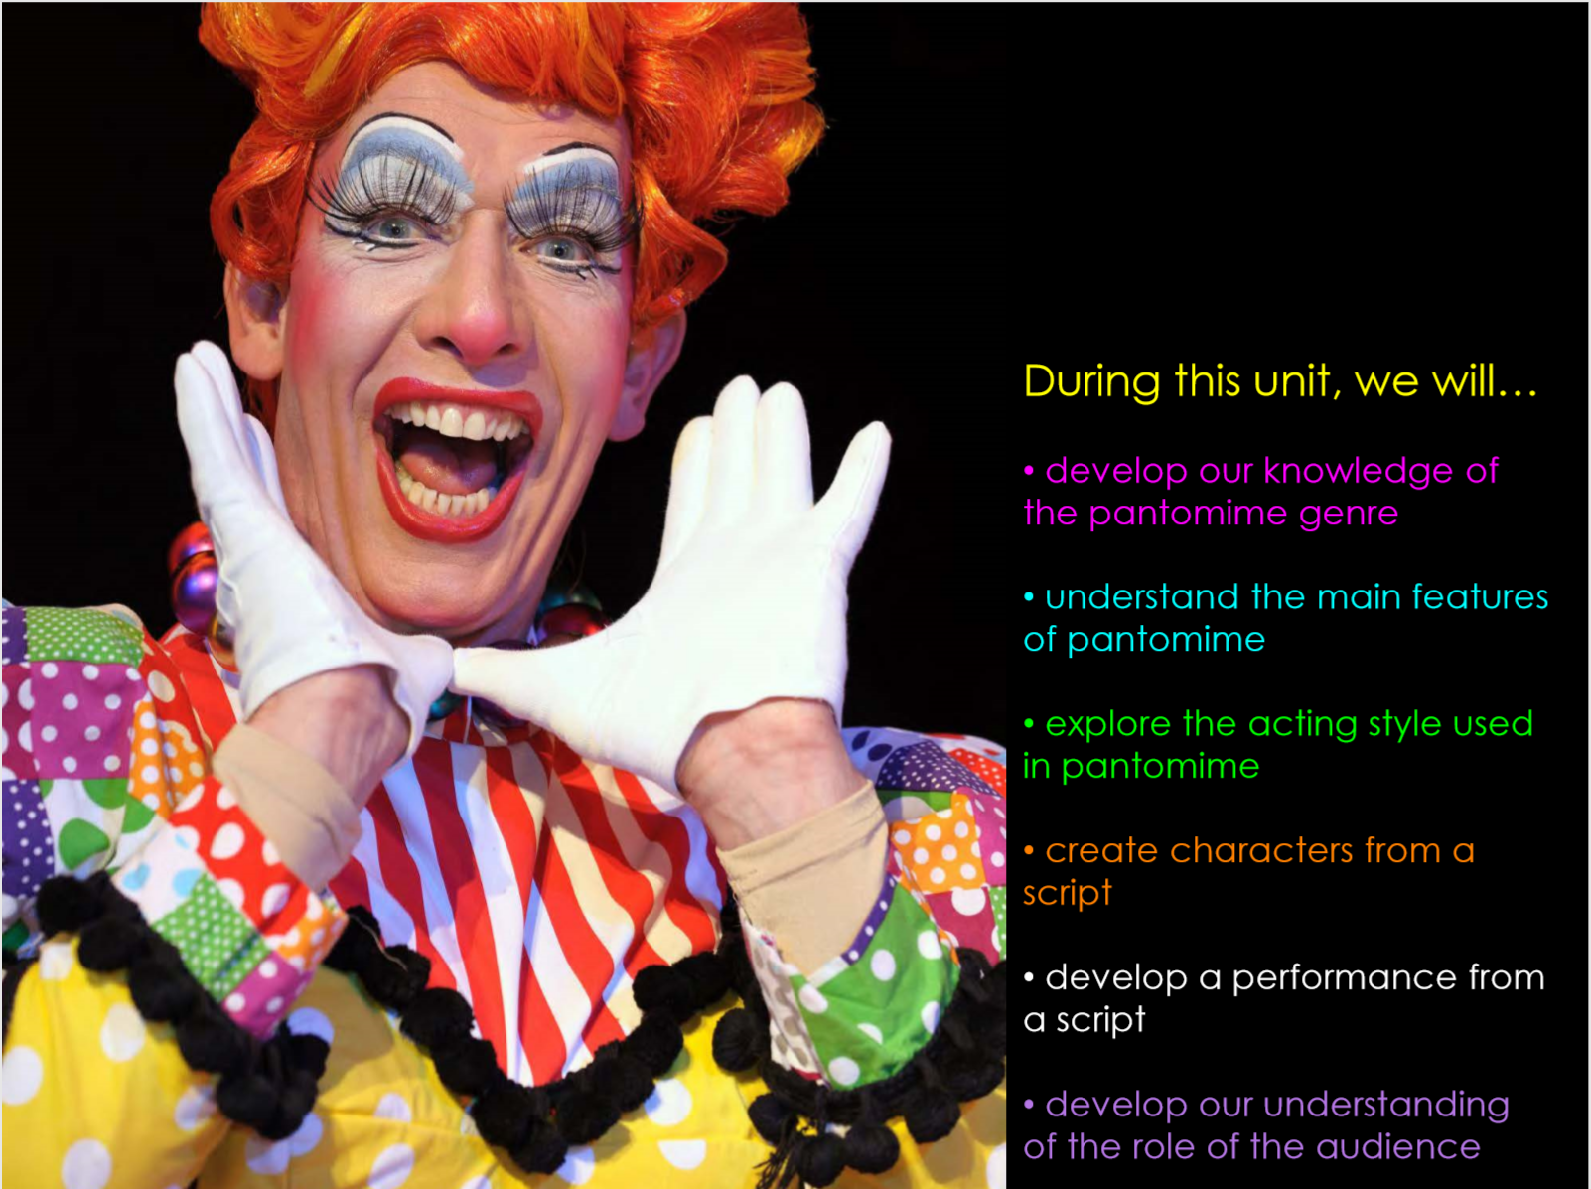

Slide 3
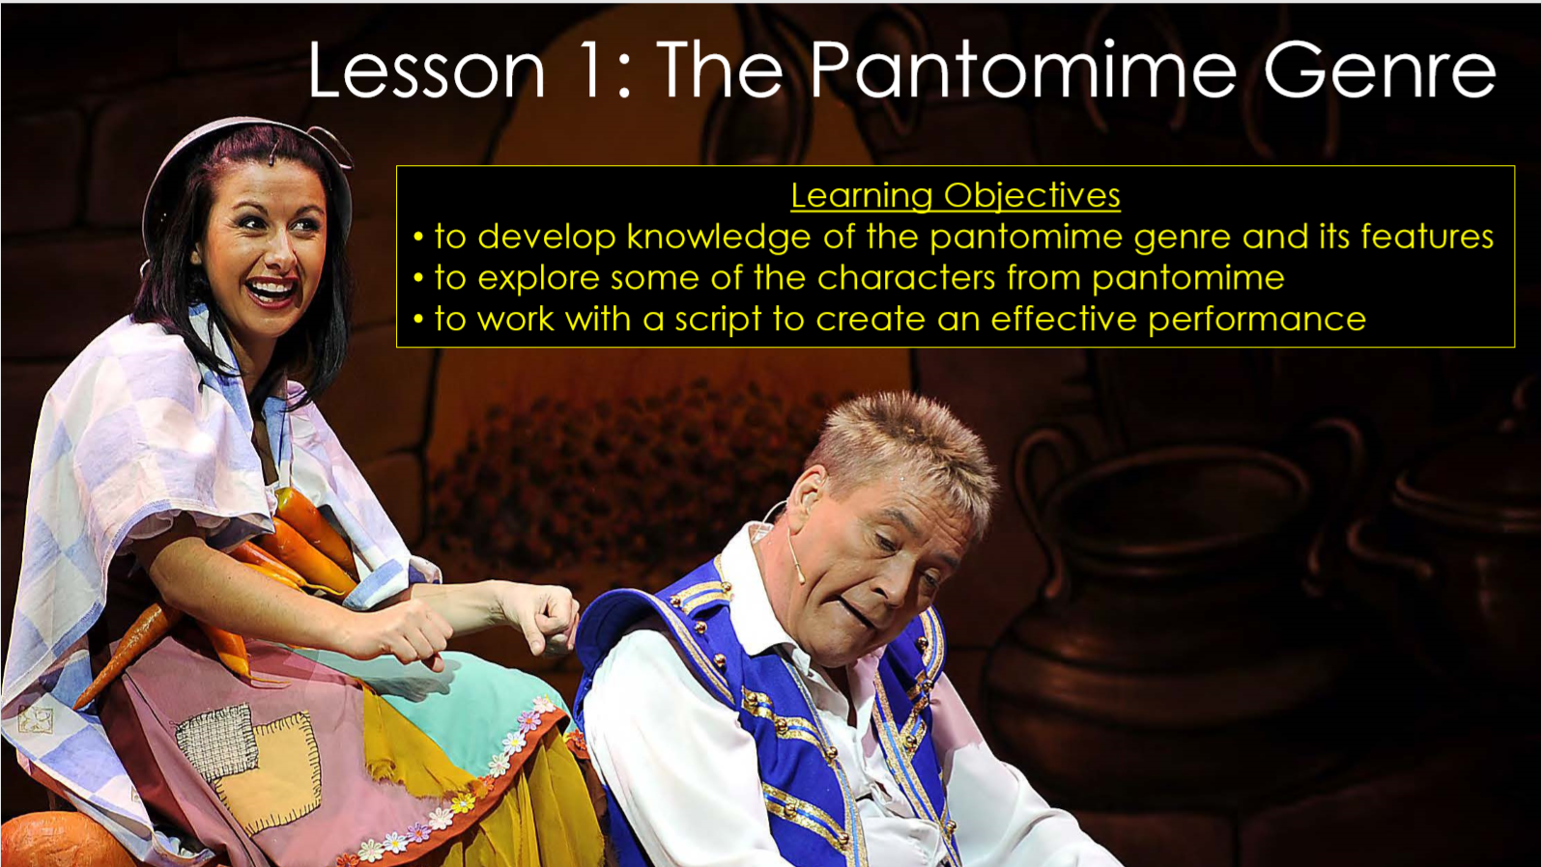

Slide 4
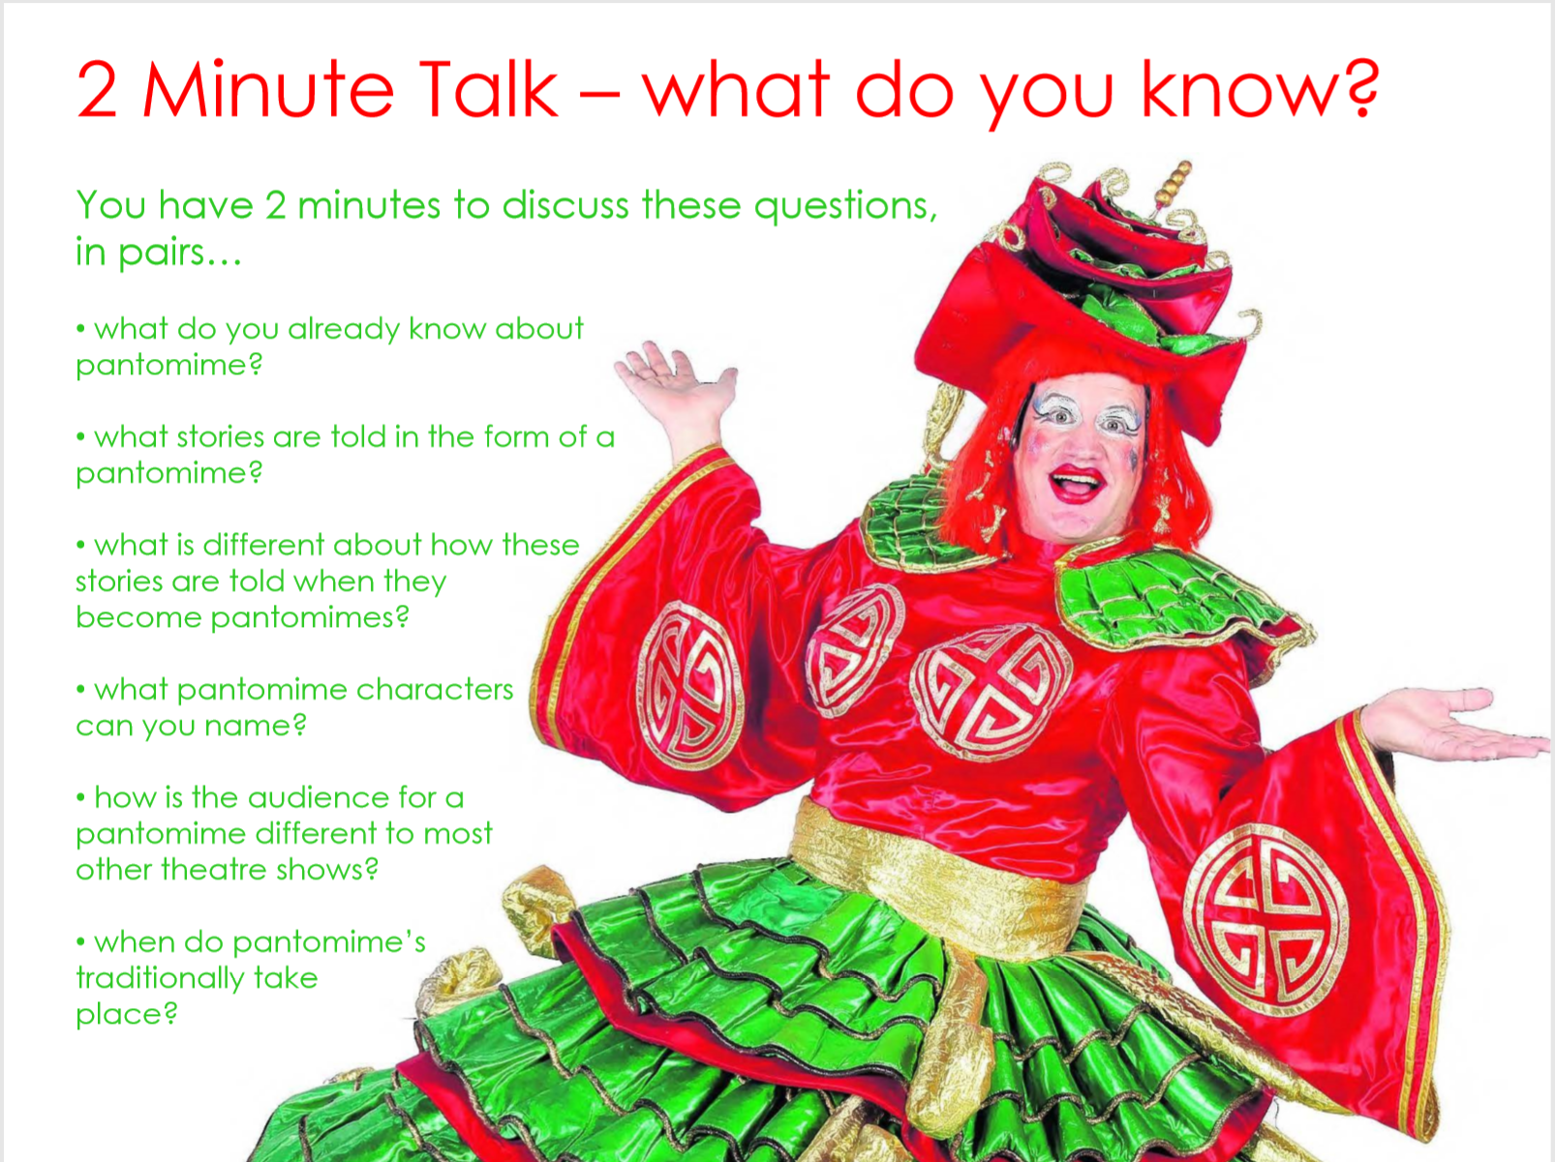

Slide 5
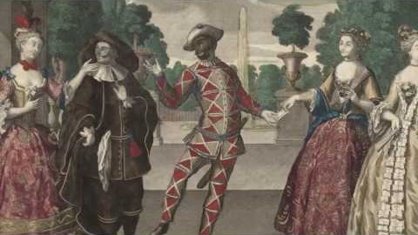
The history of Pantomime

Slide 6
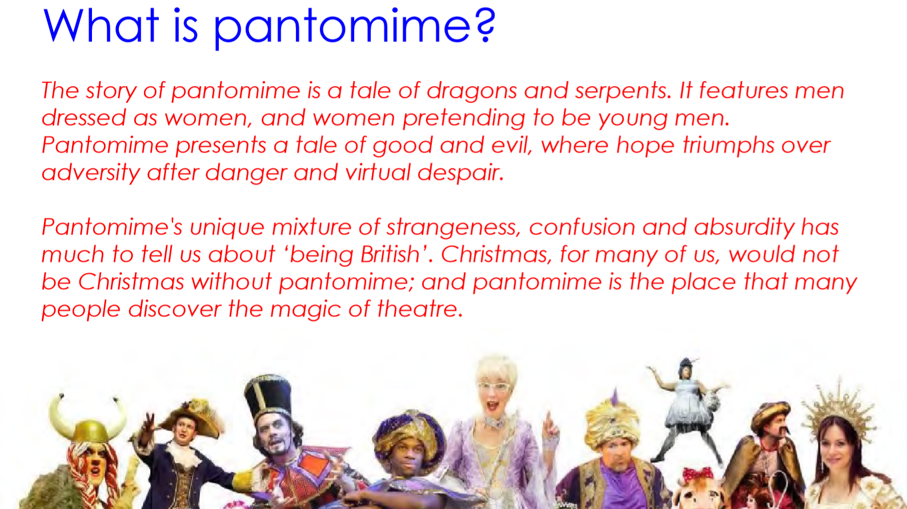

Slide 7
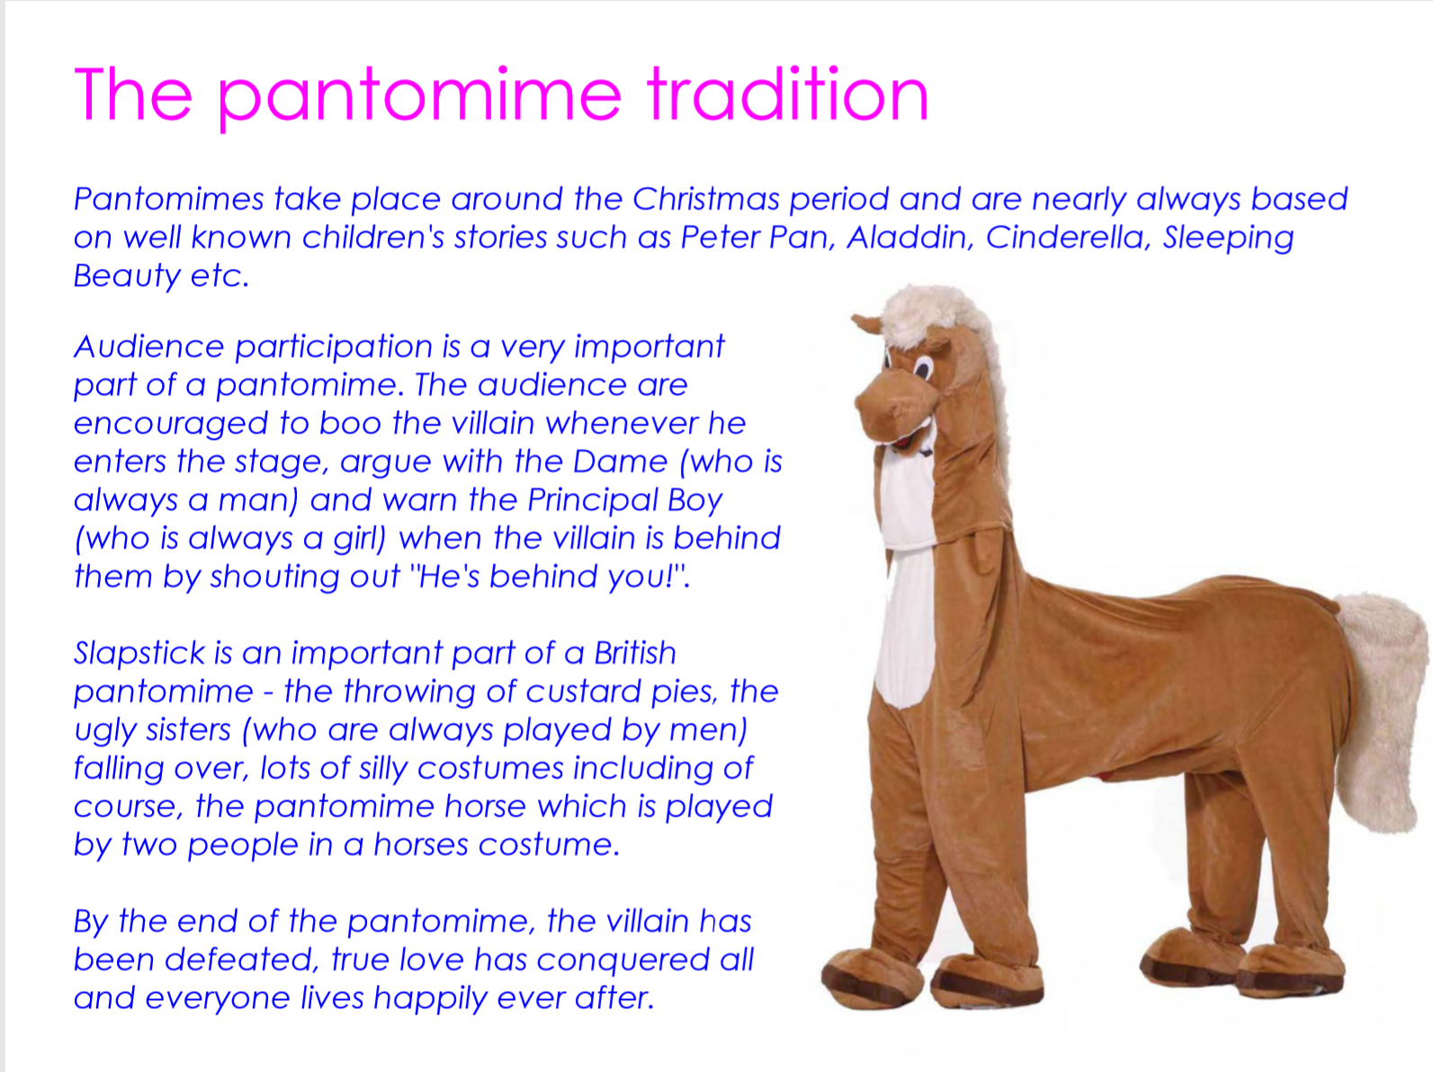

Slide 8
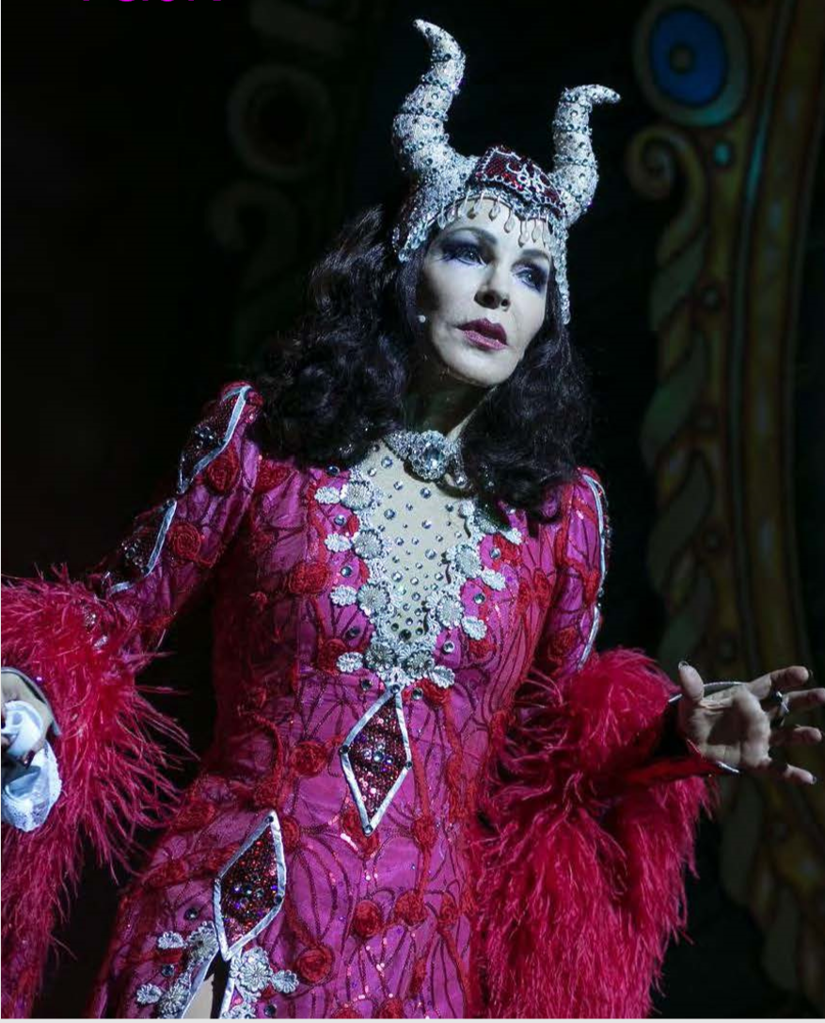
Task
Get yourselves into pairs.
Together, read through the following script extract 2 times, with each of you getting a chance to play all of the parts in turn.
Try to think about how your voice should sound for each of the characters. What do you think might be an appropriate ‘sound’ for them? Can you use your voice to make them sound convincing?

Slide 9
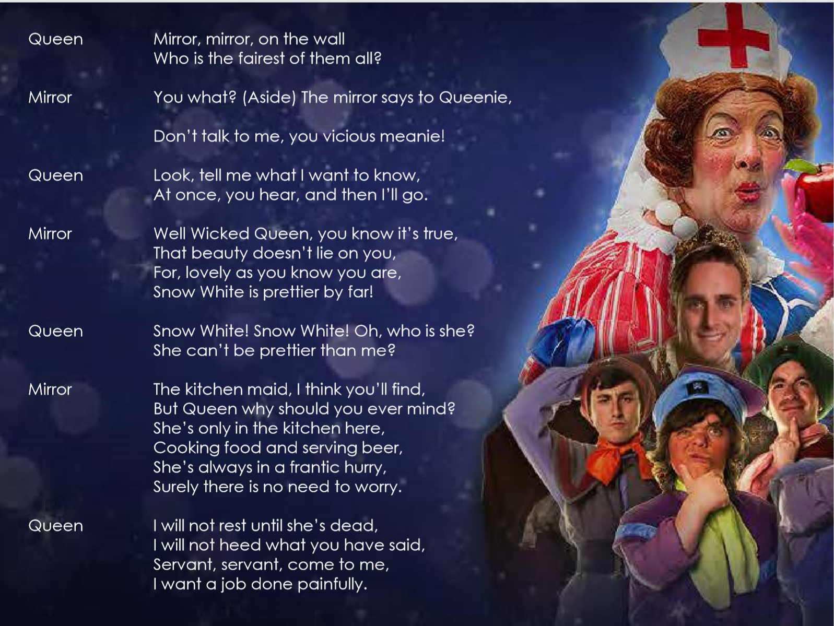

Slide 10
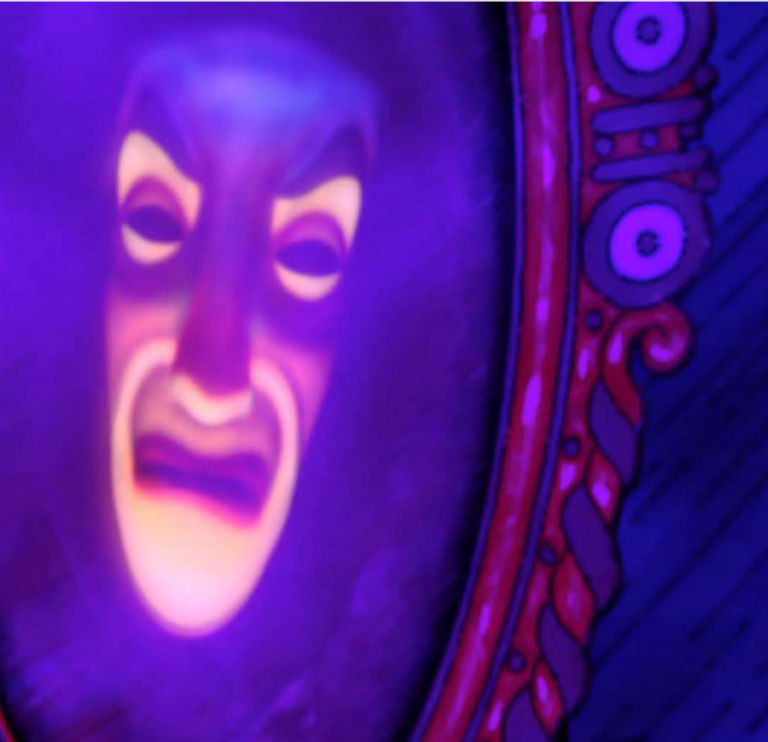
Together, your task is to create your own version of the magic mirror scene.
DON’T try to remember the exact words – make up your own! They don’t have to rhyme!
DO use your imagination to create believable characters that sound different to your normal voice.
REMEMBER – to give both of your characters attitude!

Slide 11
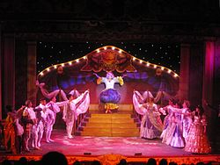
Plenary
Which of the mirror scenes that you watched today were most successful?
What did the actors do well?
What could have been improved?
Which were the most successful examples of effective characterisation?
What two things have you learned about pantomime in today’s lesson that you didn’t know before?

