Slide 1
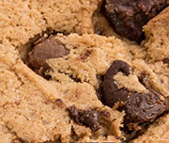
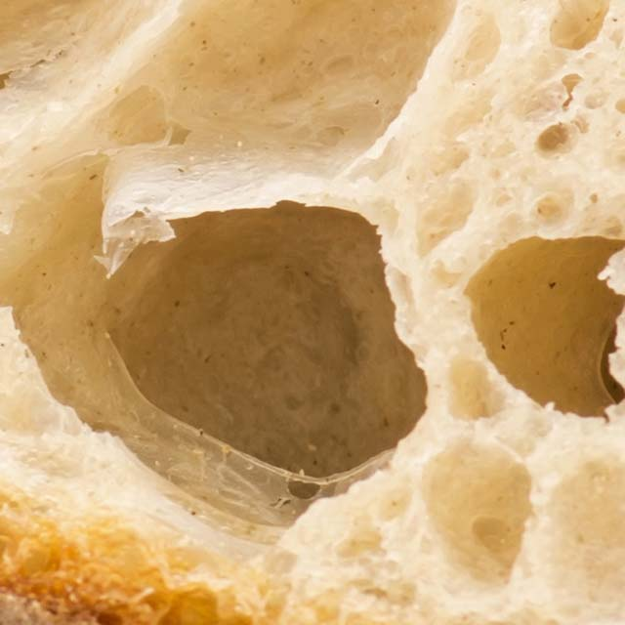
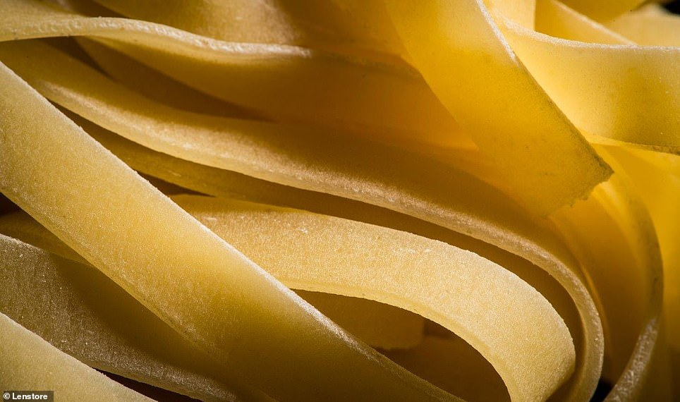

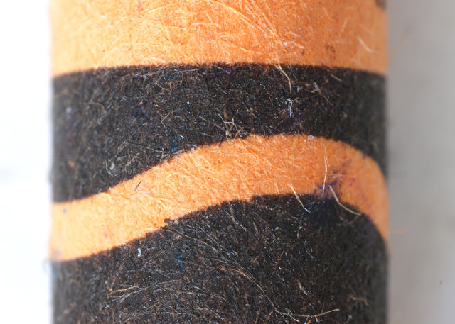
Microscopes:
Starter:
Can you work out what the following zoomed in pictures are of?

Slide 2
Microscopes:
Starter:
Can you work out what the following zoomed in pictures are of?
Chocolate-chip cookie!
Spaghetti!
Bread!
Guitar!
Crayon!

Slide 3
Learning Objectives
SUCCESS!!
To calculate total magnification
To describe how a light microscope can be used to observe cells
To label the different parts of a light microscope

Slide 4
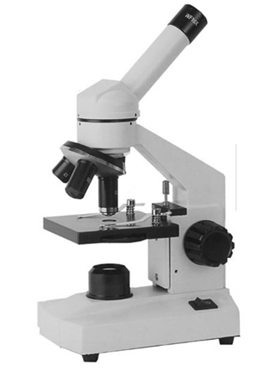
Light microscope:
Can you label your light microscope:

Slide 5
Visualiser Demo

Slide 6
Using a light microscope youtube
https://www.youtube.com/watch?v=tVcEEw6qbBQ

Slide 7
How does a light microscope work?
Put the following statements in order:
Place the object you want to observe on the stage.
Repeat steps 1 – 5 using an objective lens with a higher magnification to see the object in greater detail.
Look through the eyepiece and turn the coarse-focus knob slowly until you see your object
Turn the fine-focus knob until your object comes into focus.
Move the stage to its lowest position.
Select the objective lens with the lowest magnification.

Slide 8
How does a light microscope work?
Put the following statements in order:
Move the stage to its lowest position.
Place the object you want to observe on the stage.
Select the objective lens with the lowest magnification.
Look through the eyepiece and turn the coarse-focus knob slowly until you see your object
Turn the fine-focus knob until your object comes into focus.
Repeat steps 1 – 5 using an objective lens with a higher magnification to see the object in greater detail.

Slide 9
Magnification and Resolution
Magnification is the number of times larger an image of an object is compared to its actual size.
Resolution is how clearly you can see two separate points.

Slide 10
How To Calculate Total Magnification:
Total magnification equation:
TOTAL MAGNIFICATION = EYEPIECE LENS x OBJECTIVE LENS
For example:
200x = 10 x 20
Now copy and complete the table >
Eyepiece lens | Objective lens | Total magnification
10x | 4x
10x |  | 100x
10x | 40x
10x |  | 1000x

Slide 11
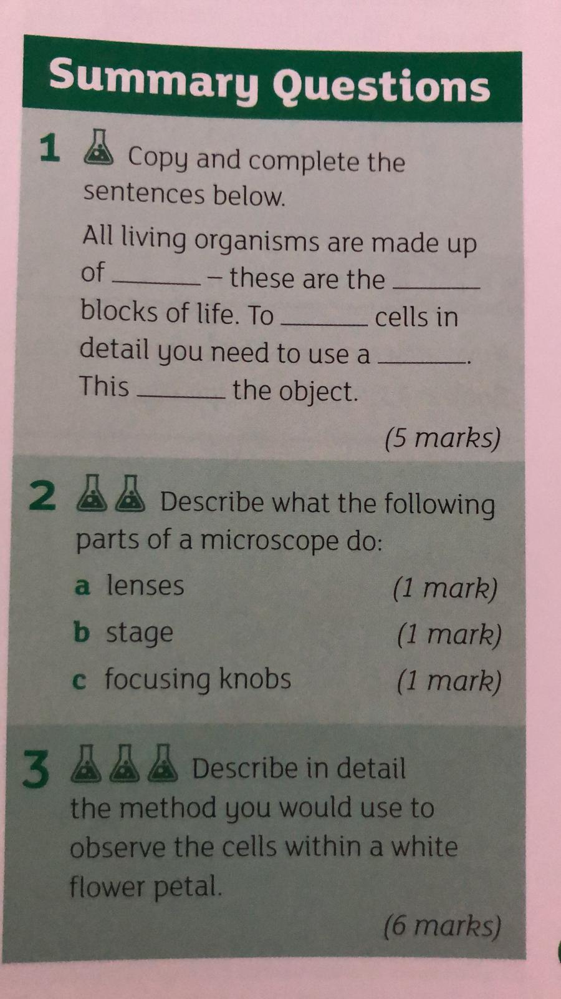
Summary:

