Slide 1
Plant and Animal Cells
What are the following zoomed-in pictures of?

Slide 2
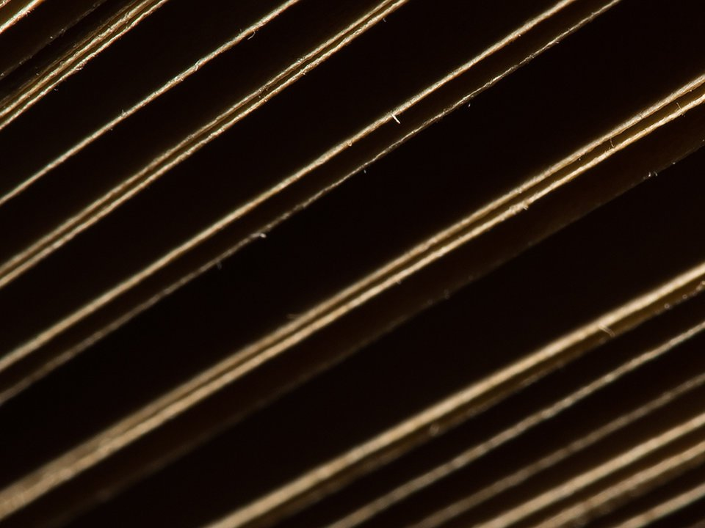
Notes:
Book

Slide 3

Book!
Notes:
Book

Slide 4
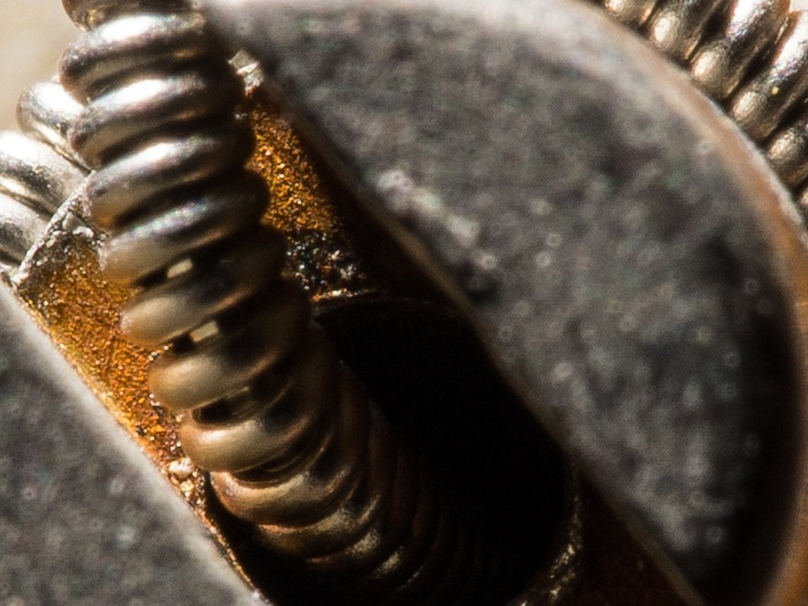
Notes:
Guitar

Slide 5
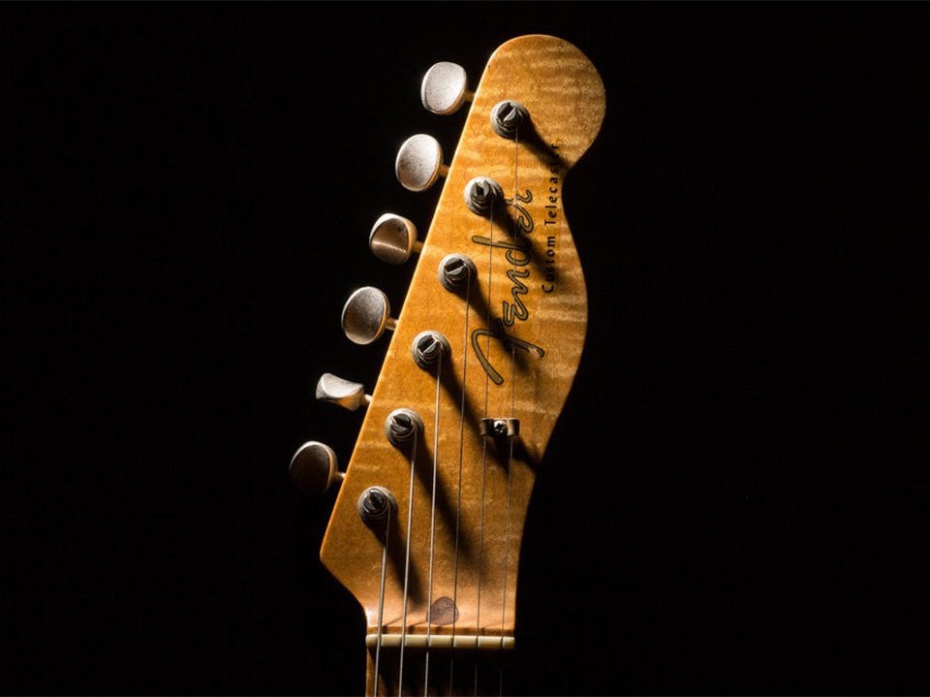
Guitar!
Notes:
Guitar

Slide 6
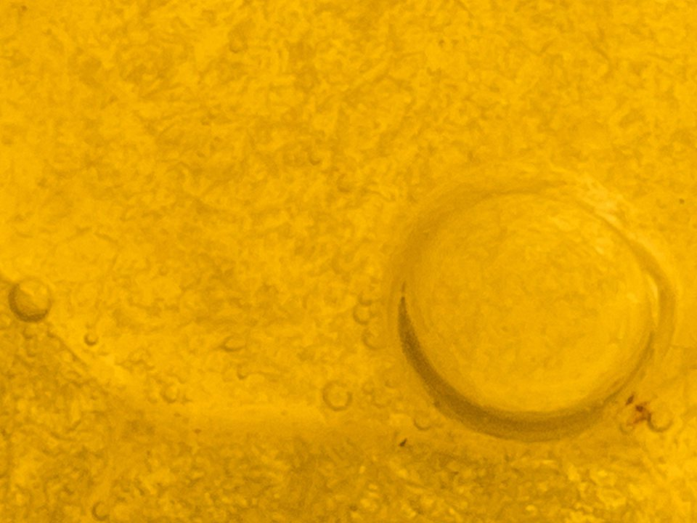
Notes:
Honeycomb

Slide 7
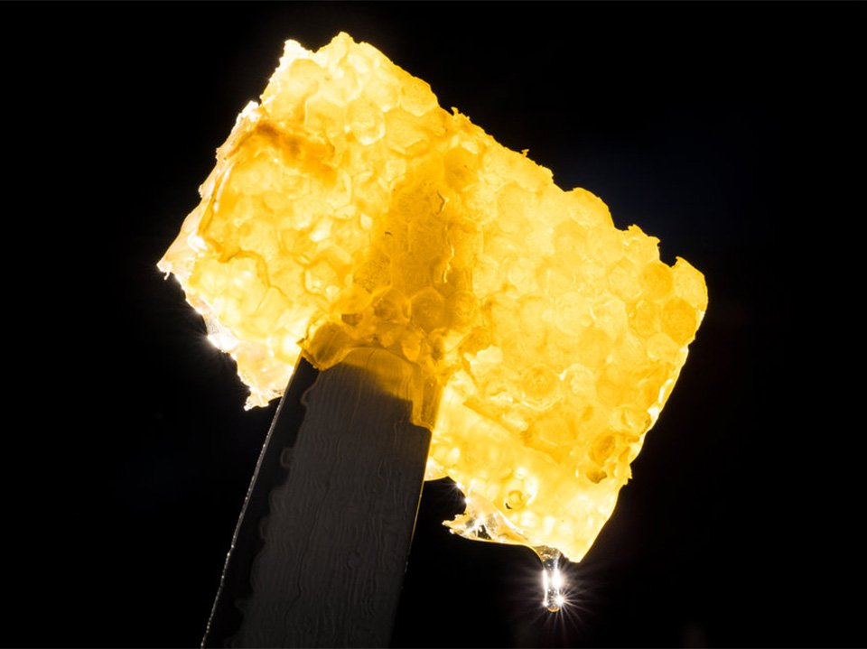
Honeycomb!
Notes:
Honeycomb

Slide 8
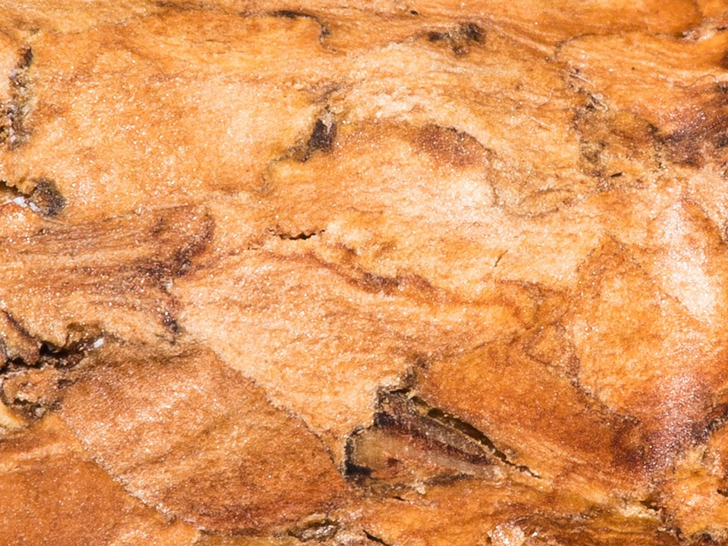
Notes:
Cork

Slide 9
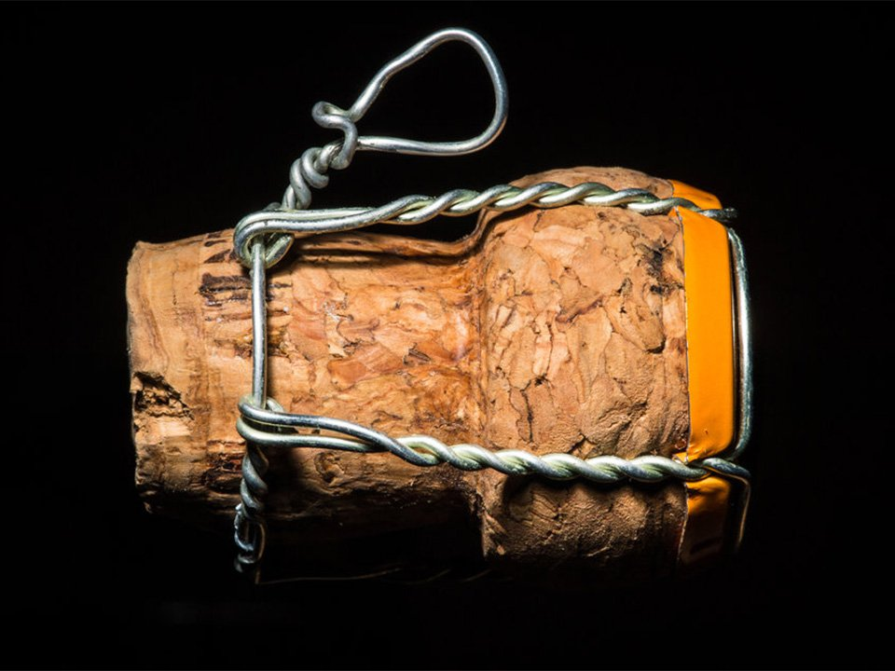
Cork!
Notes:
Cork

Slide 10
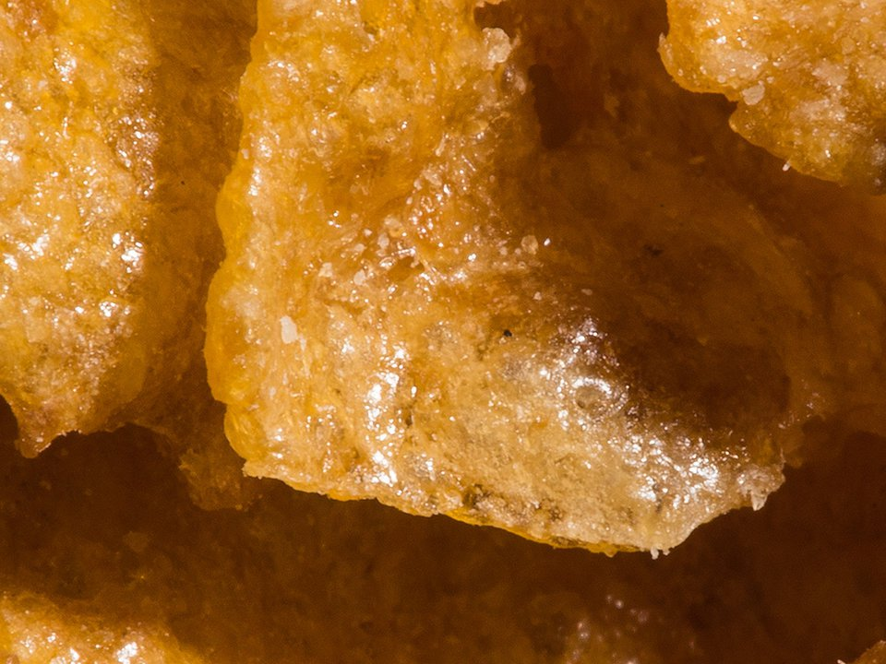
Notes:
Cornflakes

Slide 11
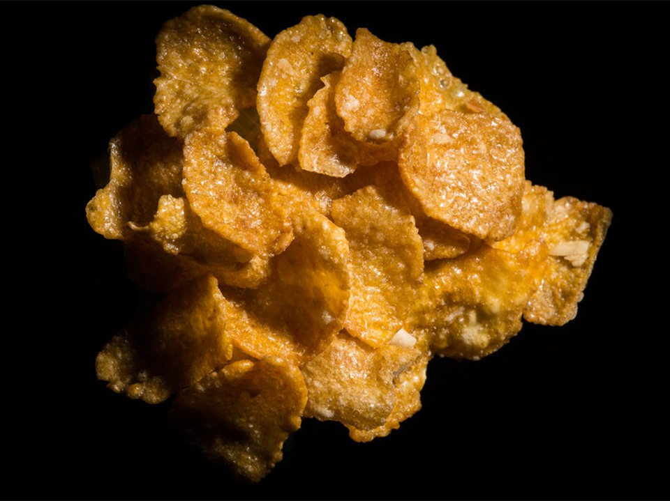
Cornflakes!
Notes:
Cornflakes

Slide 12
Learning Objectives
SUCCESS!!
To compare the structures of animal and plant cells
To describe the function of different cell components
To identify different structures within cells

Slide 13
YouTube Video
https://www.youtube.com/watch?v=PHTvqW7CzXY

Slide 14
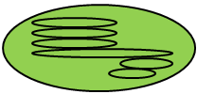
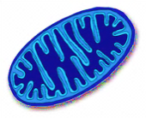
Copy and label the plant and animal cell using the key words below
Plant cell
Animal cell
Key words:
mitochondria, nucleus, vacuole, chloroplast, cell wall, cell membrane, cytoplasm

Slide 15
Label the plant and animal cell using the key words below
Chloroplast
Plant cell
Animal cell
Mitochondria
Vacuole
Cytoplasm
Nucleus
Cell wall
Cell membrane
Key words:
mitochondria, nucleus, vacuole, chloroplast, cell wall, cell membrane, cytoplasm

Slide 16
Roles of each structure in the cell
NUCLEUS
Respiration occurs here releasing energy
CELL MEMBRANE
Controls the activity of the cell
CELL WALL
Jelly-like substance in which many of the cell’s activities happen
MITOCHONDRIA
A storage space which supports the cell filled with sap
CHLOROPLASTS
Controls the movement of substances in and out of the cell
CYTOPLASM
Supports the cell and keeps its shape
LARGE VACUOLE
Absorbs light energy and allows the plant to make food via photosynthesis

Slide 17
Roles of each structure in the cell
NUCLEUS
Respiration occurs here releasing energy
CELL MEMBRANE
Controls the activity of the cell
CELL WALL
Jelly-like substance in which many of the cell’s activities happen
MITOCHONDRIA
A storage space which supports the cell filled with sap
CHLOROPLASTS
Controls the movement of substances in and out of the cell
CYTOPLASM
Supports the cell and keeps its shape
LARGE VACUOLE
Absorbs light energy and allows the plant to make food via photosynthesis

Slide 18
Roles of each structure in the cell
NUCLEUS
Respiration occurs here releasing energy
CELL MEMBRANE
Controls the activity of the cell
CELL WALL
Jelly-like substance in which many of the cell’s activities happen
MITOCHONDRIA
A storage space which supports the cell filled with sap
CHLOROPLASTS
Controls the movement of substances in and out of the cell
CYTOPLASM
Supports the cell and keeps its shape
LARGE VACUOLE
Absorbs light energy and allows the plant to make food via photosynthesis

Slide 19
Roles of each structure in the cell
NUCLEUS
Respiration occurs here releasing energy
CELL MEMBRANE
Controls the activity of the cell
CELL WALL
Jelly-like substance in which many of the cell’s activities happen
MITOCHONDRIA
A storage space which supports the cell filled with sap
CHLOROPLASTS
Controls the movement of substances in and out of the cell
CYTOPLASM
Supports the cell and keeps its shape
LARGE VACUOLE
Absorbs light energy and allows the plant to make food via photosynthesis

Slide 20
Roles of each structure in the cell
NUCLEUS
Respiration occurs here releasing energy
CELL MEMBRANE
Controls the activity of the cell
CELL WALL
Jelly-like substance in which many of the cell’s activities happen
MITOCHONDRIA
A storage space which supports the cell filled with sap
CHLOROPLASTS
Controls the movement of substances in and out of the cell
CYTOPLASM
Supports the cell and keeps its shape
LARGE VACUOLE
Absorbs light energy and allows the plant to make food via photosynthesis

Slide 21
Roles of each structure in the cell
NUCLEUS
Respiration occurs here releasing energy
CELL MEMBRANE
Controls the activity of the cell
CELL WALL
Jelly-like substance in which many of the cell’s activities happen
MITOCHONDRIA
A storage space which supports the cell filled with sap
CHLOROPLASTS
Controls the movement of substances in and out of the cell
CYTOPLASM
Supports the cell and keeps its shape
LARGE VACUOLE
Absorbs light energy and allows the plant to make food via photosynthesis

Slide 22
Roles of each structure in the cell
NUCLEUS
Respiration occurs here releasing energy
CELL MEMBRANE
Controls the activity of the cell
CELL WALL
Jelly-like substance in which many of the cell’s activities happen
MITOCHONDRIA
A storage space which supports the cell filled with sap
CHLOROPLASTS
Controls the movement of substances in and out of the cell
CYTOPLASM
Supports the cell and keeps its shape
LARGE VACUOLE
Absorbs light energy and allows the plant to make food via photosynthesis

Slide 23
Roles of each structure in the cell
NUCLEUS
Respiration occurs here releasing energy
CELL MEMBRANE
Controls the activity of the cell
CELL WALL
Jelly-like substance in which many of the cell’s activities happen
MITOCHONDRIA
A storage space which supports the cell filled with sap
CHLOROPLASTS
Controls the movement of substances in and out of the cell
CYTOPLASM
Supports the cell and keeps its shape
LARGE VACUOLE
Absorbs light energy and allows the plant to make food via photosynthesis

Slide 24
Roles of each structure in the cell
NUCLEUS
Respiration occurs here releasing energy
CELL MEMBRANE
Controls the activity of the cell
CELL WALL
Jelly-like substance in which many of the cell’s activities happen
MITOCHONDRIA
A storage space which supports the cell filled with sap
CHLOROPLASTS
Controls the movement of substances in and out of the cell
CYTOPLASM
Supports the cell and keeps its shape
LARGE VACUOLE
Absorbs light energy and allows the plant to make food via photosynthesis

Slide 25
Copy the table and tick the box if the structure is found in a plant or animal cell.
 | Plant Cell | Animal Cell
Nucleus
Cell membrane
Cell wall
Cytoplasm
Chloroplasts
Large vacuole
Mitochondria

Slide 26
Copy the table and tick the box if the structure is found in a plant or animal cell.
 | Plant Cell | Animal Cell
Nucleus |  | 
Cell membrane |  | 
Cell wall | 
Cytoplasm |  | 
Chloroplasts | 
Large vacuole | 
Mitochondria |  | 

Slide 27
Plenary – Complete the Summary Questions
Compare plant and animal cells (6 mark exam Q)
Which plant cell would contain chloroplasts? A leaf or root cell. Why
What is the substance found in chloroplasts? What is its job?
State the function of the nucleus
What cell component carries out respiration?
Which cell structures are found in plant cells but NOT in animal cells

