Slide 1
Specialised Cells:
Last Lesson | Last Week | Last Term
What is the function of the nucleus? | How do light microscopes work? | How do we calculate weight?
Which cell structure is a gel like substance where reactions occur? | Describe how to observe cells with a microscope? | State a contact force and a non-contact force.
Compare an animal cell with a plant cell. | How do you calculate magnification? | Explain what is meant by ‘speed’ and ‘velocity’.

Slide 2
Learning Objectives
SUCCESS!!
To create a newspaper advert for a specialised cell job!
To describe how some different specialised cells are adapted for their function
To explain what is meant by the term ‘specialised cell’

Slide 3
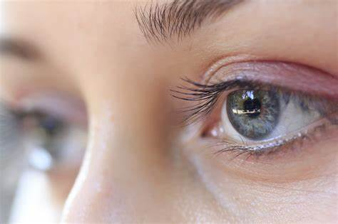
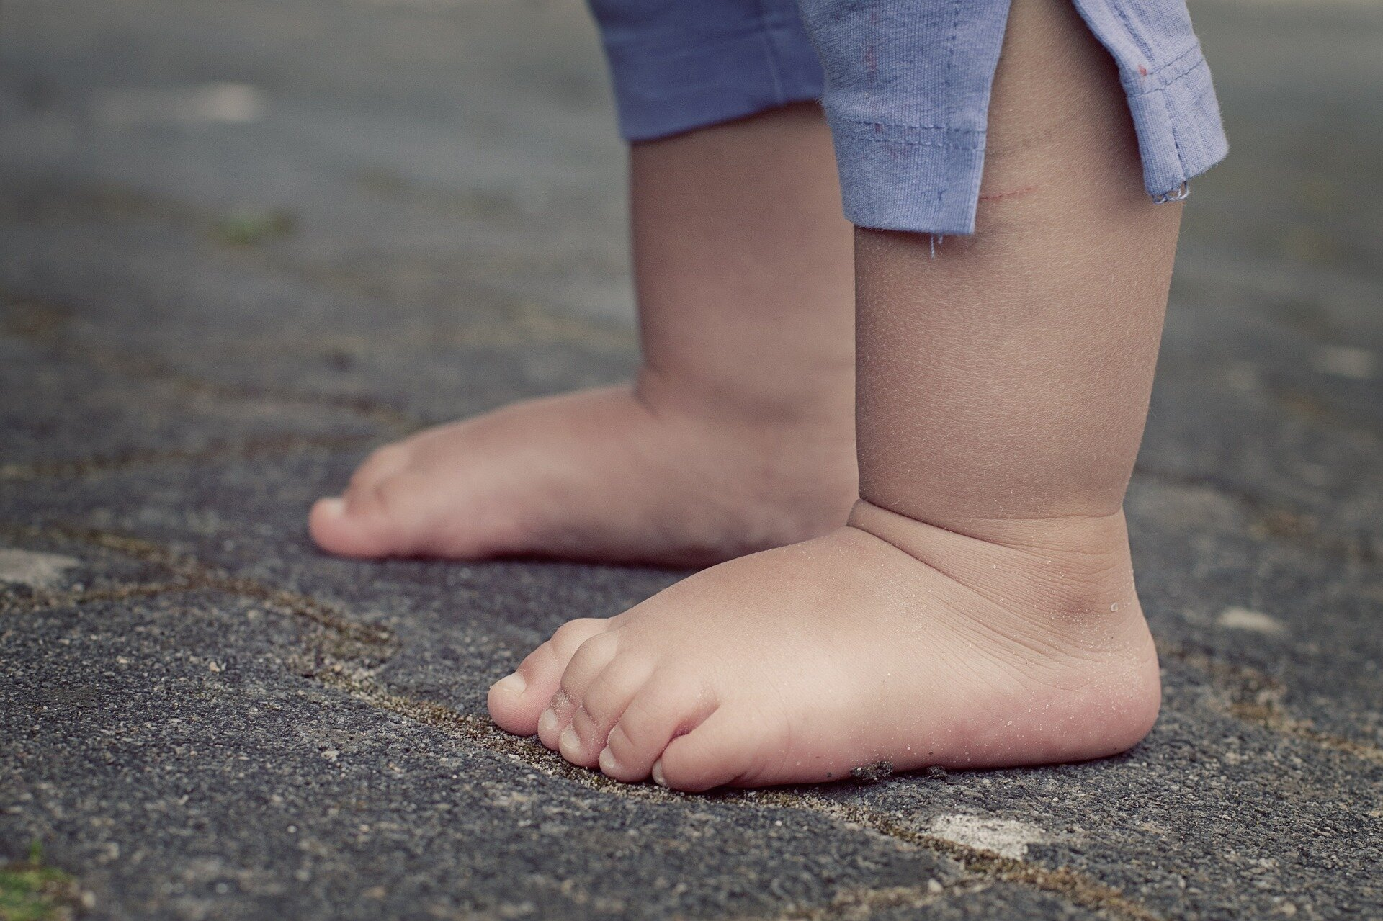

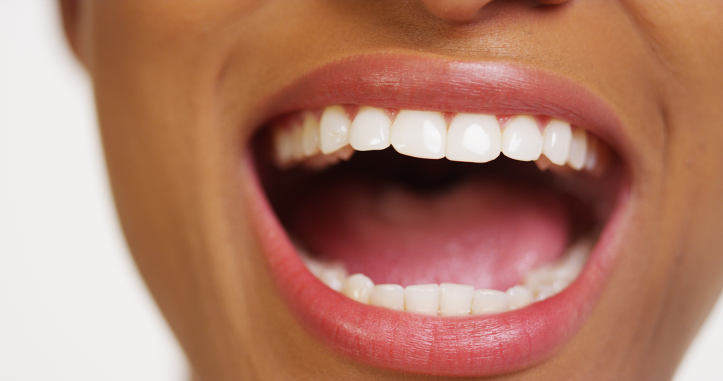
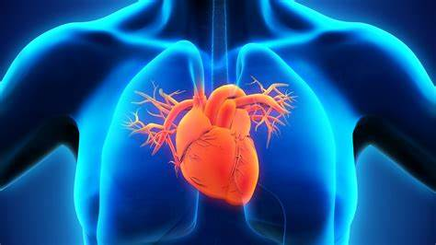
Look at your body…
In pairs, explain what the different parts of your body are designed to do and how they are designed to do this.

Slide 4
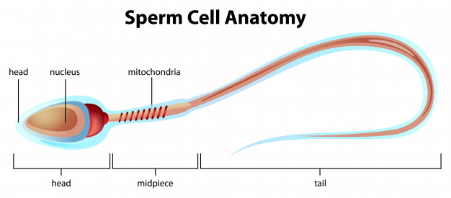
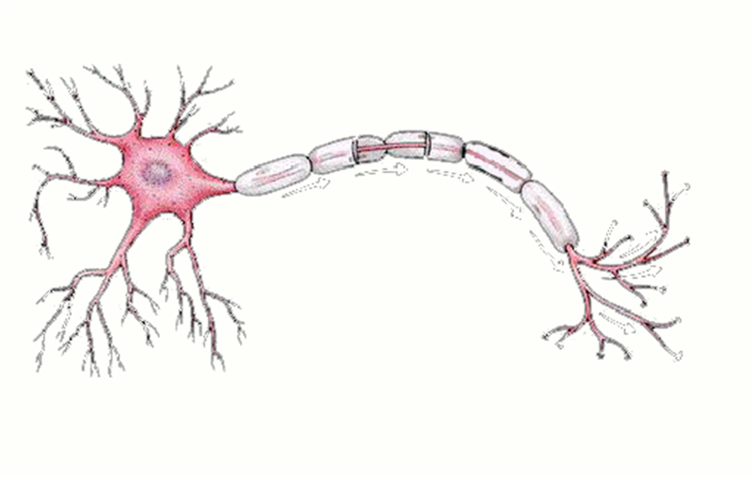
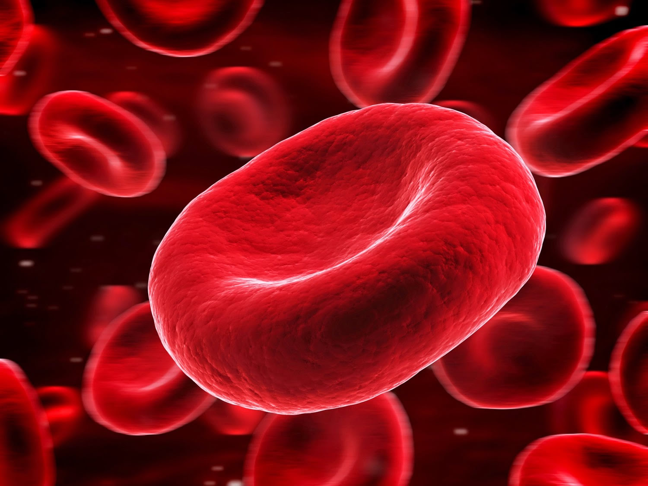
What is a ‘Specialised Cell’?
A specialised cell is a cell which has a specific shape or function to carry out a particular function.
Examples Include:
- Sperm cell
Nerve cells
Red blood cells
Leaf cells
Root hair cells

Slide 5
Find out about the following cells:
Using the following slides, find out about the different specialised cells.
For each one in your books you MUST have:
A labelled diagram
A description of their function
An explanation of how they are adapted to do their job.

Slide 6
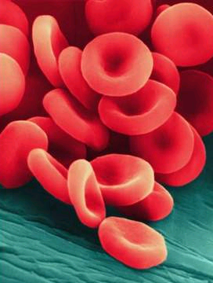
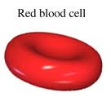
Red blood cells
Red Blood Cells
Structure:
Large surface area
Contains haemoglobin which picks up oxygen
Has no nucleus to make room for more oxygen
Function:
Carries oxygen from the lungs to the body and carbon dioxide from the body back to the lungs.

Slide 7
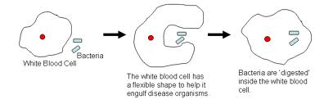
Red blood cells
White Blood Cells
Function:
These cells are found in your blood.
They are attracted to diseases and bacteria that enter your body
They then ‘eats’ any bacteria/disease so the microbe can’t infect you and make you ill

Slide 8
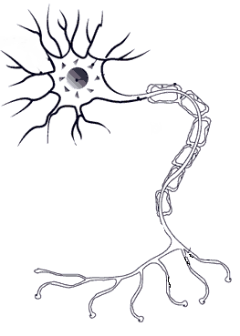
Nerve cells
Nerve Cells
Structure:
These are extremely elongated (long) cells
They have many branches at both ends to connect to other nerve cells
The long axis (main branch) is covered in fat to prevent the electrical impulses affecting the surrounding parts of your body
Function:
To carry nerve impulses around your body

Slide 9
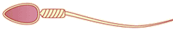
Sperm cells
Sperm Cell
Structure:
Have a long tail so they can swim to find an egg
There are enzymes (like scissors) in the head of the sperm to help the sperm get into the egg
Made in the testis of males
Function:
To carry the father’s genetic information (DNA) to the egg

Slide 10
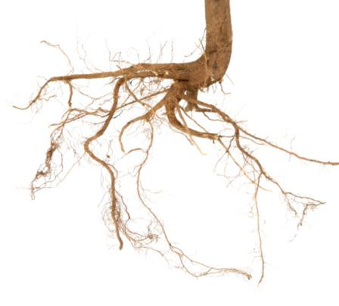
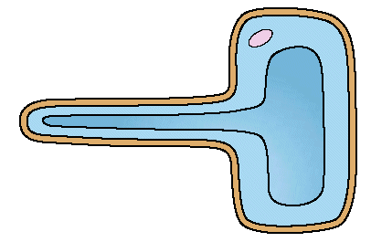
Root hair cells
Root Hair Cell
Structure:
Large surface area to absorb lots of water
Thin cell wall to allow water to pass through easily
Doesn’t contain any chloroplasts unlike all other plant cells
Function:
Absorbs minerals and water from soil

Slide 11
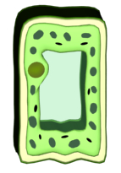
Palisade Cell
Palisade Cell
Structure:
Found in the top of a leaf
Tall and has a large surface area to catch as much sunlight as possible
Packed with chloroplasts to absorb sunlight
Function:
to carry out photosynthesis
to help make plant food.

Slide 12
Create a poster for a job advert
Choose a specialized cell and write a newspaper job description.
E.g. SPERM CELL WANTED! Must be a good swimmer, have a specially shaped head and have lots of energy!
Success criteria:
A cartoon drawing
A description of the job in question
Specific characteristics and why this is important

Slide 13
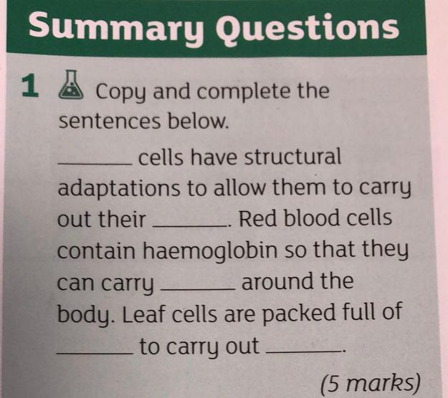
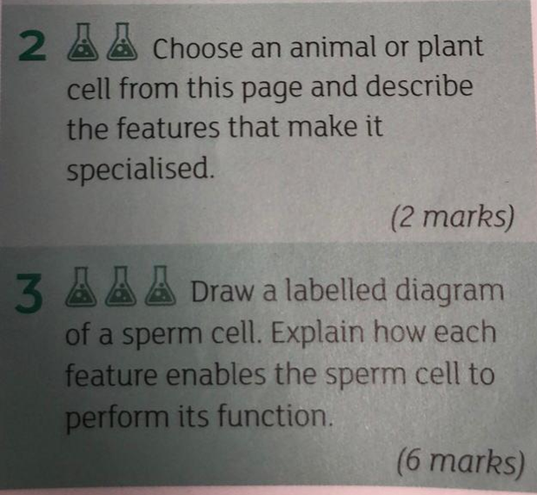
Plenary – Complete the summary Questions

