Slide 1
Starter:
Answer one question from each column below
From last lesson | From last week | From last term
Recall two specialised cells | Describe one similarity between plant and animal cells. | What is meant by the term accuracy?
Explain how sperm cells are adapted for their function | Describe one difference between plant and animal cells | Give an example of a contact and a non-contact force.
What is the function of root hair cells in plants? | Draw a labelled diagram of either a plant cell or an animal cell | Recall the formula linking weight, mass and gravitational field strength

Slide 2
Learning Objectives
SUCCESS!!
To explain the importance of diffusion and osmosis in biology
To describe how diffusion and osmosis occur
To explain what is meant by the term diffusion and osmosis

Slide 3
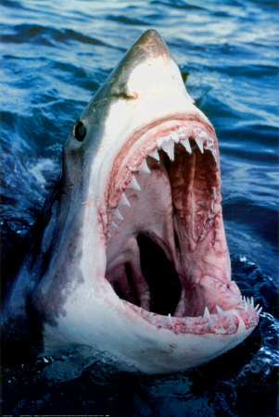

Diffusion & Life
How can a shark find injured prey so quickly?
Think pair share

Slide 4
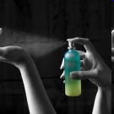
Diffusion
  Explain in terms of particles how the smell of the perfume gets from one side of the class to the other

Slide 5
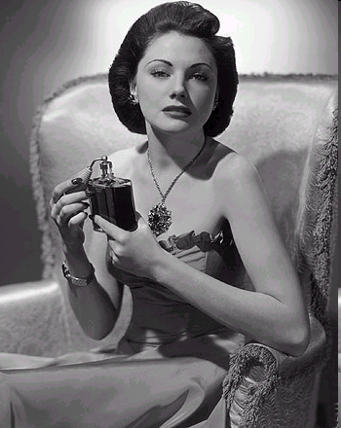
When you have just sprayed perfume, the concentration of perfume particles in that area is very high.
Diffusion is the movement of the ‘smelly’ particles, through particles of air, to an area where they are at a
lower concentration.

Slide 6
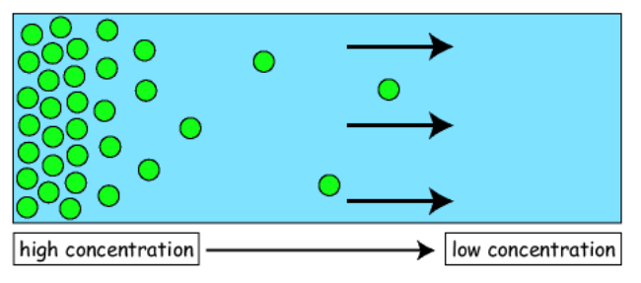
1) Copy the diagram and the notes from the slide.
2) Design a cartoon strip to show how diffusion occurs!
Diffusion IS…
The net movement of particles from an area of high concentration to an area of low concentration
Due to the random movement of particles
A passive process which means that no energy is needed

Slide 7
More on diffusion
At first, particles are very concentrated. This means there are a lot of particles in on place.
Over time the particles spread out to fill the container or room they are in evenly.
Diffusion allows cells to obtain things such as oxygen which is needed for respiration.
https://www.youtube.com/watch?v=c_IYK8sy0QA

Slide 8
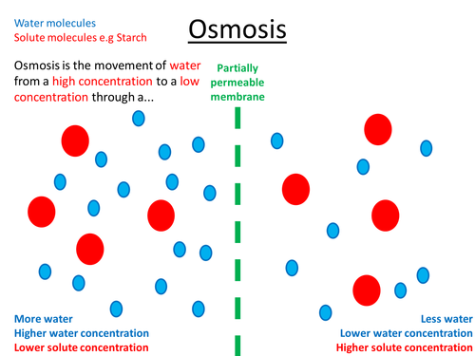
Osmosis
Osmosis is the movement of water from an area of high concentration to an area of low concentration.
This occurs through a partially permeable membrane.

Slide 9
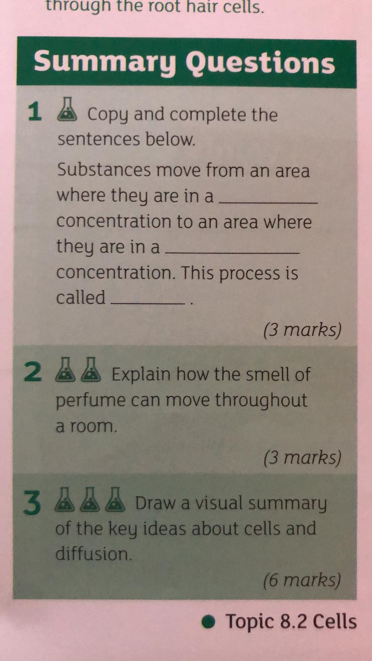
Complete the questions below:
2) Design an experiment to show the next year 7 group all about diffusion or osmosis

