Slide 1

A LITTLE STORY…
A ship sails along the great seas. The ship is made from many pieces of wood. Over time, some of the pieces of wood are removed and replaced. The removed pieces are put into storage. This happens for many years until all the original pieces have been replaced and put in storage.
One day, notorious Pirate Henry Avery decides to steal the wood and build a ship with it. Now there are two ships sailing the seas!
But… which one is the original ship?

Slide 2
A LITTLE STORY…
What do you think the pieces of wood represented in the story…
A: Your body’s cells!
They are renewing themselves all the time! None of your cells you were born with are the same as the cells you

Slide 3

STARTER:
What things do our bodies contain?
Draw a spider-diagram for all the things you can remember.

Slide 4
ORGANISATION
Explain how the different tissues in an organ, and the different organs in an organ system function together
Describe the sequence of the hierarchy of organisation in a multicellular organism.
State what is meant by the terms ‘cell’, ‘tissue’, ‘organ’, ‘organ system’ and ‘organism’

Slide 5
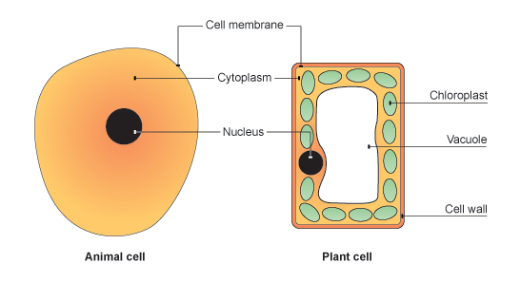
ORGANISATION
What is the definition of a cell?
The smallest structural and functional unit of an organism, which is typically microscopic and consists of cytoplasm and a nucleus enclosed in a membrane.
Learning Objectives
State what is meant by the terms ‘cell’, ‘tissue’, ‘organ’, ‘organ system’ and ‘organism’
Describe the sequence of the hierarchy of organisation in a multicellular organism.
Explain how the different tissues in an organ, and the different organs in an organ system function together

Slide 6
ORGANISATION
How many cells do our bodies contain?
37.2 trillion (37,200,000,000,000)!!!
So why aren’t we a load of cells just lying on the floor?
Learning Objectives
State what is meant by the terms ‘cell’, ‘tissue’, ‘organ’, ‘organ system’ and ‘organism’
Describe the sequence of the hierarchy of organisation in a multicellular organism.
Explain how the different tissues in an organ, and the different organs in an organ system function together

Slide 7





ORGANISATION
The next stage up from a cell is a tissue.
Learning Objectives
State what is meant by the terms ‘cell’, ‘tissue’, ‘organ’, ‘organ system’ and ‘organism’
specialised cell
tissue
organ
system
organism
Describe the sequence of the hierarchy of organisation in a multicellular organism.
Explain how the different tissues in an organ, and the different organs in an organ system function together
muscle cell
muscle
tissue
heart
circulatory
system
circulatory
system makes up
part of the
human body

Slide 8
ORGANISATION
The next stage up from a cell is a tissue.
Learning Objectives
State what is meant by the terms ‘cell’, ‘tissue’, ‘organ’, ‘organ system’ and ‘organism’
specialised cell
tissue
organ
system
organism
Describe the sequence of the hierarchy of organisation in a multicellular organism.
Explain how the different tissues in an organ, and the different organs in an organ system function together
muscle cell
muscle
tissue
heart
circulatory
system
circulatory
system makes up
part of the
human body

Slide 9
ORGANISATION
The organisation of the body is like that of a school:
Learning Objectives
State what is meant by the terms ‘cell’, ‘tissue’, ‘organ’, ‘organ system’ and ‘organism’
Cell
Pupil
Describe the sequence of the hierarchy of organisation in a multicellular organism.
Tissue
Registration groups
Organ
Subject Classes
Explain how the different tissues in an organ, and the different organs in an organ system function together
Organ system
Year
Organism
School

Slide 10
ORGANISATION
Match up the definitions with the correct terms.
Learning Objectives
State what is meant by the terms ‘cell’, ‘tissue’, ‘organ’, ‘organ system’ and ‘organism’
CELL ORGAN ORGANISM TISSUE ORGAN SYSTEM
Describe the sequence of the hierarchy of organisation in a multicellular organism.
A group of cells of similar structure and function working together to perform a function.
A group of organs working together to perform a major function within an organism.
Explain how the different tissues in an organ, and the different organs in an organ system function together
A group of tissues working together to perform a function.
Basic unit of life. This is the building block of living things.
This is a living thing which is capable of performing the seven characteristics of life.

Slide 11
ORGANISATION
Match up the definitions with the correct terms.
Learning Objectives
State what is meant by the terms ‘cell’, ‘tissue’, ‘organ’, ‘organ system’ and ‘organism’
CELL
Basic unit of life. This is the building block of living things.
Describe the sequence of the hierarchy of organisation in a multicellular organism.
TISSUE
A group of cells of similar structure and function working together to perform a function.
ORGAN
A group of tissues working together to perform a function.
Explain how the different tissues in an organ, and the different organs in an organ system function together
ORGAN SYSTEM
A group of organs working together to perform a major function within an organism.
ORGANISM
This is a living thing which is capable of performing the seven characteristics of life.

Slide 12

ORGANISATION
State what is meant by the terms ‘cell’, ‘tissue’, ‘organ’, ‘organ system’ and ‘organism’

Slide 13
ORGANISATION
How is the body organised?
Draw a flow chart to show the hierarchy of organisation.
Learning Objectives
State what is meant by the terms ‘cell’, ‘tissue’, ‘organ’, ‘organ system’ and ‘organism’
Describe the sequence of the hierarchy of organisation in a multicellular organism.
CHALLENGE:
Can you provide examples for each level?
Explain how the different tissues in an organ, and the different organs in an organ system function together

Slide 14
ORGANISATION
Cells make up a tissue.
Tissues make up an organ.
Organs make up an organ system
Organ systems make up an organism
Learning Objectives
Organ system
Organism
Cell
Tissue
Organ
State what is meant by the terms ‘cell’, ‘tissue’, ‘organ’, ‘organ system’ and ‘organism’
Describe the sequence of the hierarchy of organisation in a multicellular organism.
Explain how the different tissues in an organ, and the different organs in an organ system function together

Slide 15
Describe the sequence of the hierarchy of organisation in a multicellular organism.

Slide 16
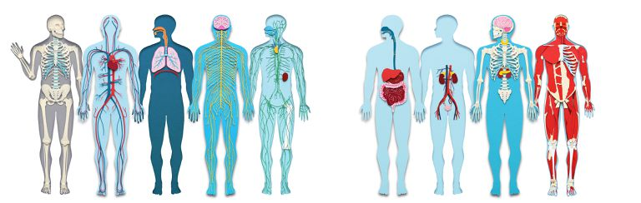
ORGANISATION
The penultimate level is an organ system.
What organ systems are there?
Learning Objectives
State what is meant by the terms ‘cell’, ‘tissue’, ‘organ’, ‘organ system’ and ‘organism’
Describe the sequence of the hierarchy of organisation in a multicellular organism.
Explain how the different tissues in an organ, and the different organs in an organ system function together

Slide 17
The Digestive System:
Find out what each organ in the digestive system do:
Mouth
Oesophagus
Stomach
Small intestine
Large intestine
Liver and Gall bladder
Rectum and Anus
Learning Objectives
State what is meant by the terms ‘cell’, ‘tissue’, ‘organ’, ‘organ system’ and ‘organism’
Describe the sequence of the hierarchy of organisation in a multicellular organism.
Explain how the different tissues in an organ, and the different organs in an organ system function together

Slide 18
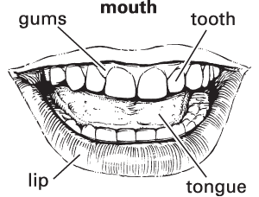
MOUTH
The mouth is the first stop in digestion. Food is broken down by the teeth. Enzymes are released by the salivary glands to help break down certain foods.
Learning Objectives
State what is meant by the terms ‘cell’, ‘tissue’, ‘organ’, ‘organ system’ and ‘organism’
Describe the sequence of the hierarchy of organisation in a multicellular organism.
Explain how the different tissues in an organ, and the different organs in an organ system function together

Slide 19
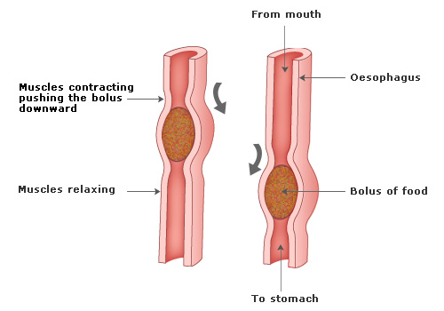
OESOPHAGUS
The oesophagus is the muscular tube connecting the mouth to the stomach. The muscles in the oesophagus push the food down toward the stomach
Learning Objectives
State what is meant by the terms ‘cell’, ‘tissue’, ‘organ’, ‘organ system’ and ‘organism’
Describe the sequence of the hierarchy of organisation in a multicellular organism.
Explain how the different tissues in an organ, and the different organs in an organ system function together

Slide 20
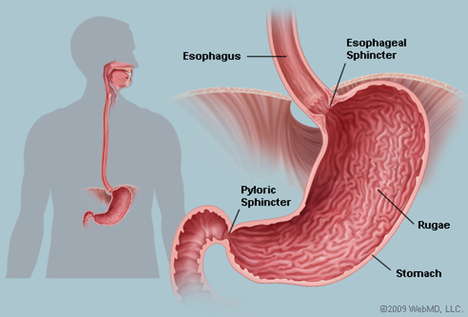
STOMACH
The stomach is a muscular organ that churns food to break it down. Stomach acid and special chemicals help to digest food.
Learning Objectives
State what is meant by the terms ‘cell’, ‘tissue’, ‘organ’, ‘organ system’ and ‘organism’
Describe the sequence of the hierarchy of organisation in a multicellular organism.
Explain how the different tissues in an organ, and the different organs in an organ system function together

Slide 21
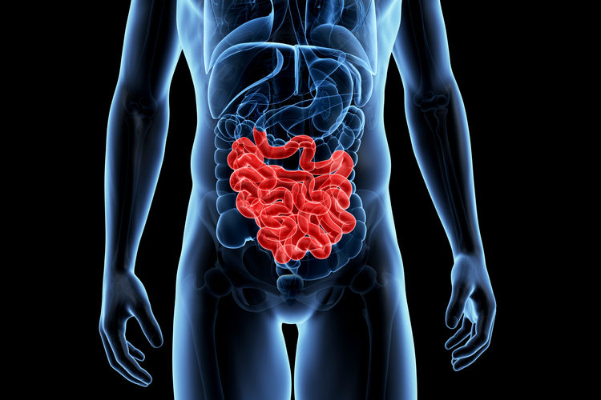
SMALL INTESTINE
The small intestine is where food is further broken down and nutrients are absorbed into the bloodstream.
Learning Objectives
State what is meant by the terms ‘cell’, ‘tissue’, ‘organ’, ‘organ system’ and ‘organism’
Describe the sequence of the hierarchy of organisation in a multicellular organism.
Explain how the different tissues in an organ, and the different organs in an organ system function together

Slide 22
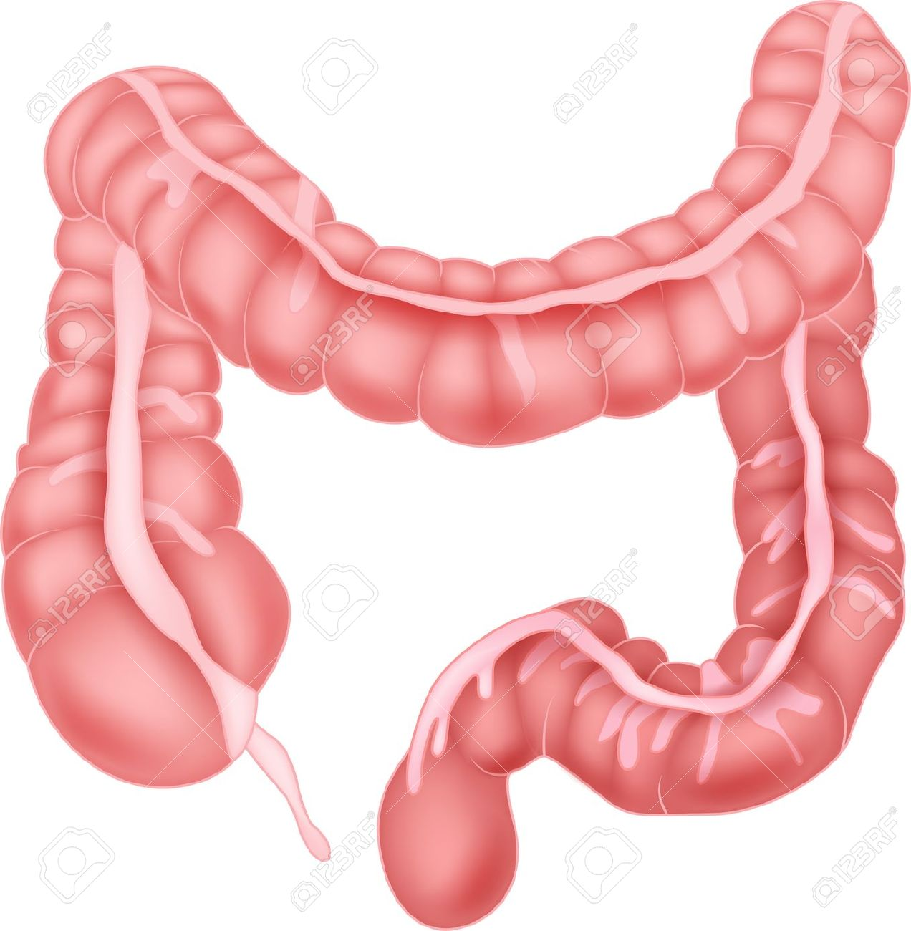
LARGE INTESTINE
The large intestine is where water is reabsorbed from the waste into the blood.
Learning Objectives
State what is meant by the terms ‘cell’, ‘tissue’, ‘organ’, ‘organ system’ and ‘organism’
Describe the sequence of the hierarchy of organisation in a multicellular organism.
Explain how the different tissues in an organ, and the different organs in an organ system function together

Slide 23
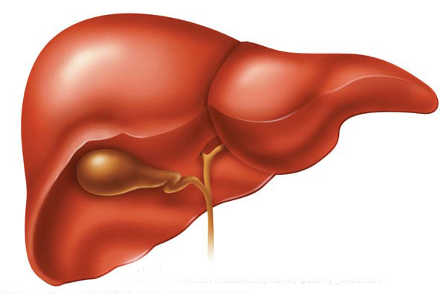
LIVER & GALLBLADDER
The liver produces bile which is stored in the gallbladder.
Bile is used to neutralise the acidic food when it has left the stomach.
Learning Objectives
State what is meant by the terms ‘cell’, ‘tissue’, ‘organ’, ‘organ system’ and ‘organism’
Describe the sequence of the hierarchy of organisation in a multicellular organism.
Explain how the different tissues in an organ, and the different organs in an organ system function together

Slide 24
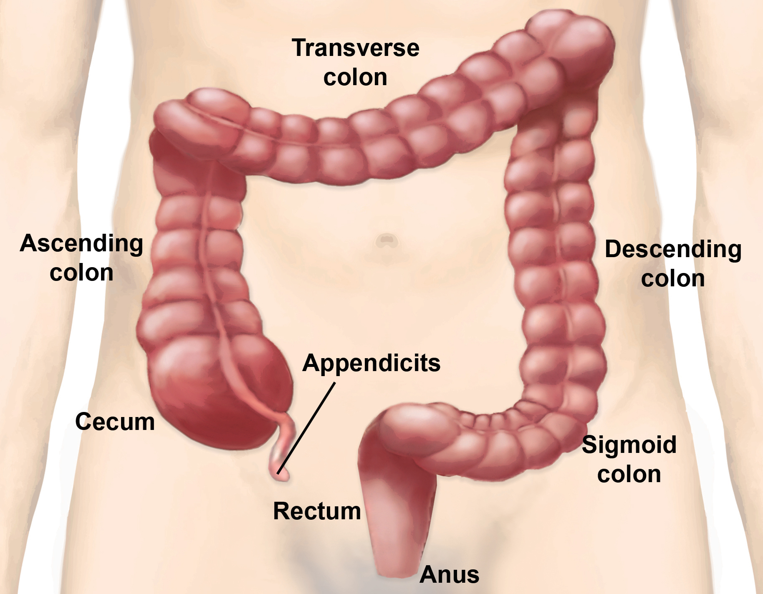
RECTUM & ANUS
The rectum is the end of the large intestine. It is where the waste is stored before it exits the body through an opening called the anus.
Learning Objectives
State what is meant by the terms ‘cell’, ‘tissue’, ‘organ’, ‘organ system’ and ‘organism’
Describe the sequence of the hierarchy of organisation in a multicellular organism.
Explain how the different tissues in an organ, and the different organs in an organ system function together

Slide 25
Explain how the different tissues in an organ, and the different organs in an organ system function together

Slide 26
PLENARY
Answer one of the questions
Learning Objectives
State what is meant by the terms ‘cell’, ‘tissue’, ‘organ’, ‘organ system’ and ‘organism’
1.
How is the organisation system in organisms similar to that in a school?
2.
Describe the hierarchy of organisation. How does a lower level produce a higher level?
3.
Describe how food passes through the digestive system. What organs are involved?
Describe the sequence of the hierarchy of organisation in a multicellular organism.
Explain how the different tissues in an organ, and the different organs in an organ system function together

