Slide 1
Joints
Where on your body can you find different joints?
Write a list of all the different joints you can think of in your body!
How many do you think there are in total?
There are 230 different joints in the body!!

Slide 2
Learning Objectives
SUCCESS!!
To describe the role of synovial joints in the human body
To state examples of different types of joints in the human body
To explain what is meant by the term ‘joint’

Slide 3
Joints:
A joint occurs where two or more bones join together
Most joints are flexible but some are joined rigidly and can’t move.
There are different types of joints.
I am going to demonstrate each one. You must copy the information from the slides and draw an example of the joint

Slide 4
HINGE JOINT:
For backwards and forwards movement.
The knee:
The elbow:

Slide 5
BALL-AND-SOCKET JOINT
For movement in all directions.
The hip:
The shoulder:

Slide 6
FIXED JOINTS
Do not allow any movement.
The skull:

Slide 7
YouTube video
https://www.youtube.com/watch?v=YbEfPtYR9tY
Make a notes box for your video. I will do one too!

Slide 8
Synovial Joint
A synovial joint is the name given to any joint that allows for movement.
They include things that help prevent the bone from wearing away:
Cartilage = strong, smooth tissue that covers the end of the bone.
Synovial fluid = fluid that lubricates (makes slippery) the cartilage.
Ligaments = connect the two bones together.

Slide 9
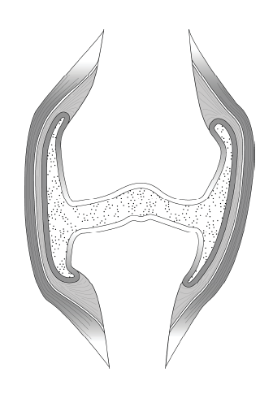
Synovial Joint
Label the following structures on the diagram:
- Synovial membrane
- Ligament
- Cartilage
- Synovial fluid
Extension:
What do you think might happen to these types of joints in sufferers of arthritis
Why can the tendons not be seen in this picture?

Slide 10
Synovial Joint
Label the following structures on the diagram:
- Synovial membrane
- Ligament
- Cartilage
- Synovial fluid
Cartilage
Synovial fluid
Ligament
Synovial membrane
Why can the tendons not be seen in this picture?
There are no muscle tissues in the picture and tendons attach muscle to bone.

Slide 11
Recap / Reflection
Answer the questions below:
What are 2 functions of the skeleton?
-
-
Can you give 1 example of an organism with an exoskeleton and one example of an organism with a hydrostatic skeleton?
Exoskeleton –
Hydrostatic –
i) What component attaches bone to bone?
ii) What component attaches muscle to bone?
iii) What does cartilage and synovial fluid reduce in a synovial joint?
4. How do antagonistic muscle work?

Slide 12
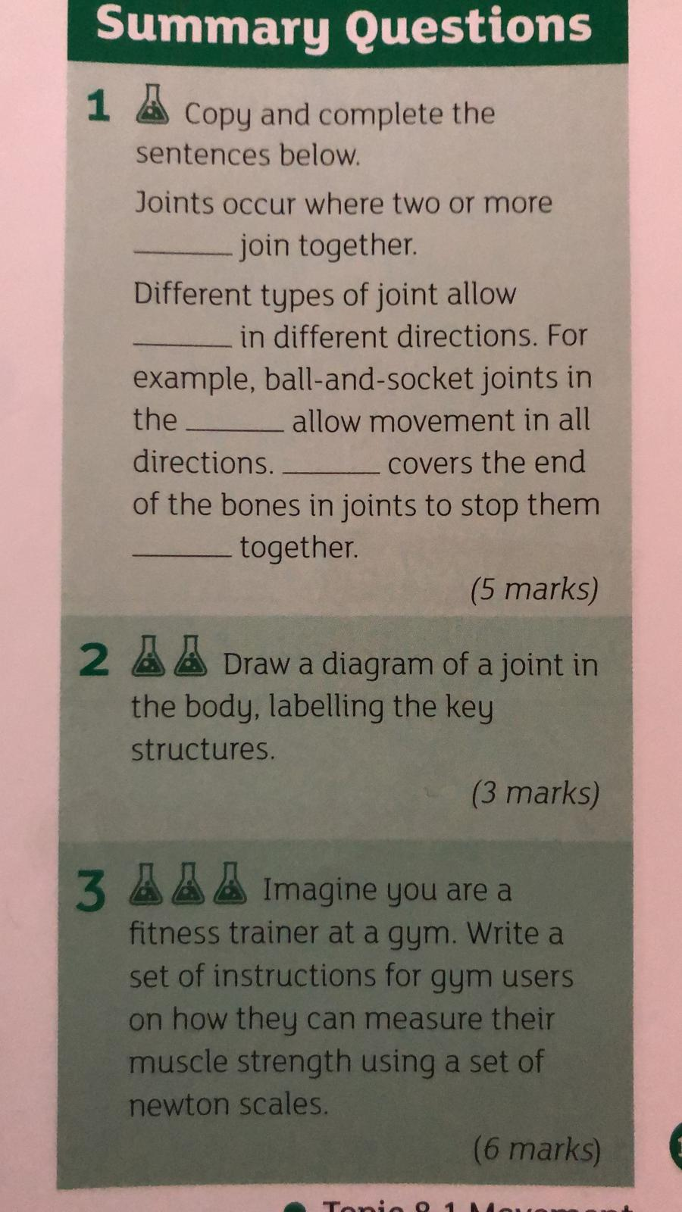
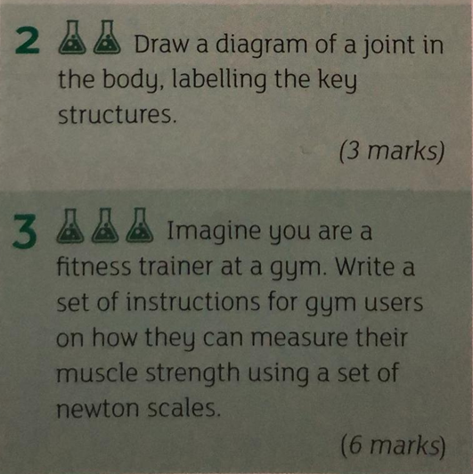
Summary – Complete the Questions

