Slide 1
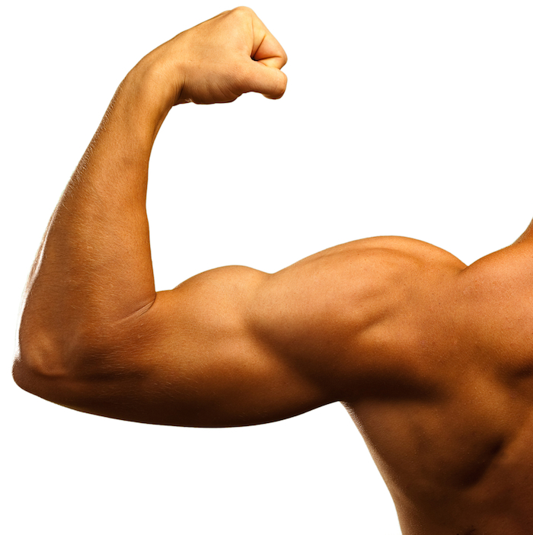
How many muscles are there in the body?
Write down as many as you can name!
P1s for the most!

Slide 2
The human body has 650 muscles!
What is the function of muscles?

Slide 3
The human body has 650 muscles!
What is the function of muscles?
Muscles allow us to move about! Without any muscles, we would be stuck in the same place!

Slide 4
Explain what is meant by the terms ‘voluntary’ and ‘involuntary’ muscle
Describe the action by which muscles work.
Identify the different muscle groups in the human body.

Slide 5
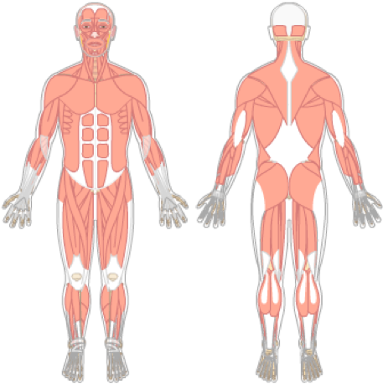
Which muscle groups are important for movement?
Identify the different muscle groups in the human body.
Describe the action by which muscles work.
Explain what is meant by the terms ‘voluntary’ and ‘involuntary’ muscle

Slide 6
Neck muscles = Hold the head up and allow it to move
Shoulder muscles = Raise and lower the arms
Identify the different muscle groups in the human body.
Tricep = Straighten the arm
Bicep = Bend the arm
Abdominals = Move the torso and help with breathing
Describe the action by which muscles work.
Quadriceps = Move the lower leg
Explain what is meant by the terms ‘voluntary’ and ‘involuntary’ muscle
Shin muscles = Help move the foot up and down an side to side
Calf muscles =Pull the heel up and point the toes

Slide 7

Identify the different muscle groups in the human body.
A 100m sprinter uses many muscles to run. How might different muscle groups help them to run?
What is the purpose of the triceps? Which muscle are they the opposite off?
Name three different muscles groups in the body used for movement. What does each one do?

Slide 8

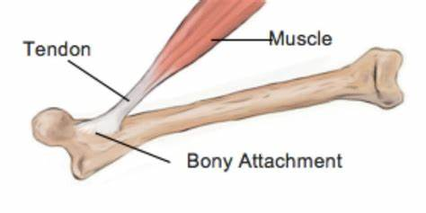
How do muscles work?
Muscles are attached to the bone by fibres called tendons.
Identify the different muscle groups in the human body.
Muscles work by shortening. We say the muscle contracts.
Describe the action by which muscles work.
Explain what is meant by the terms ‘voluntary’ and ‘involuntary’ muscle
https://www.bbc.co.uk/bitesize/clips/zj2kjxs

Slide 9
How do muscles work?
Muscles cannot push, they can only pull. This means two muscles must work together at a joint.
These are called antagonistic muscle pairs.
Demo
Identify the different muscle groups in the human body.
Describe the action by which muscles work.
Explain what is meant by the terms ‘voluntary’ and ‘involuntary’ muscle

Slide 10
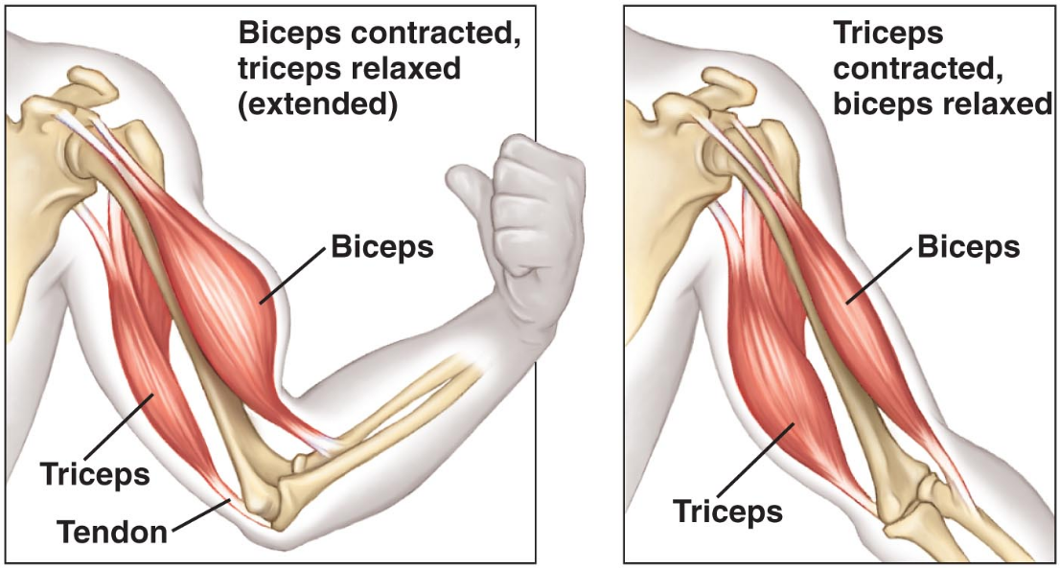
How do muscles work?
Identify the different muscle groups in the human body.
Describe the action by which muscles work.
Task:
Research different antagonistic muscle pairs. How many can you find? Write them down in your book!
Explain what is meant by the terms ‘voluntary’ and ‘involuntary’ muscle

Slide 11
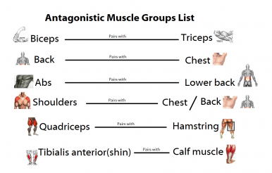
Antagonistic muscle pairs
Identify the different muscle groups in the human body.
Describe the action by which muscles work.
Explain what is meant by the terms ‘voluntary’ and ‘involuntary’ muscle

Slide 12
Match the key term to the definition:
A muscle lengthening
Identify the different muscle groups in the human body.
Contract
Connective tissue joining muscle to bone
Relax
Describe the action by which muscles work.
Antagonistic muscle
A muscle shortening
Explain what is meant by the terms ‘voluntary’ and ‘involuntary’ muscle
A muscle that works opposite to another muscle
Tendon

Slide 13
Match the key term to the definition:
A muscle lengthening
Identify the different muscle groups in the human body.
Contract
Connective tissue joining muscle to bone
Relax
Describe the action by which muscles work.
Antagonistic muscle
A muscle shortening
Explain what is meant by the terms ‘voluntary’ and ‘involuntary’ muscle
A muscle that works opposite to another muscle
Tendon

Slide 14
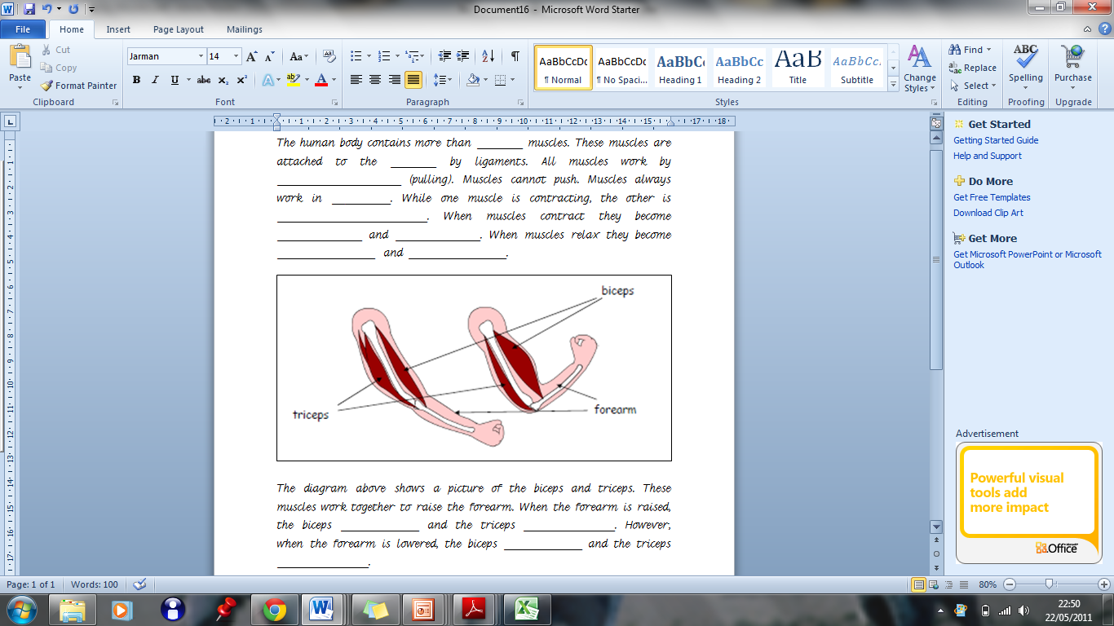
Word bank:
650, thinner, relaxing, contract, relax,
bone, pairs, shorter, relax, contract, fatter, longer, tendons, contracting,
________

Slide 15
650
bone
tendons
contracting
________
pairs
relaxing
Identify the different muscle groups in the human body.
shorter
fatter
longer
thinner
Describe the action by which muscles work.
Explain what is meant by the terms ‘voluntary’ and ‘involuntary’ muscle
contract
relax
relax
contract

Slide 16
Describe the action by which muscles work.
A man in the gym does many bicep curls. Describe what happens to the muscles in arms when he does this.
Why do muscles need to work in pairs?
What do we call two muscles that work opposite to one another. Can you give an example?

Slide 17
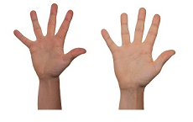
Voluntary Muscle
Some muscles are ‘voluntary’ – They only work when you tell them to.
Write down some examples you may be able to think of.
Identify the different muscle groups in the human body.
Describe the action by which muscles work.
Explain what is meant by the terms ‘voluntary’ and ‘involuntary’ muscle

Slide 18
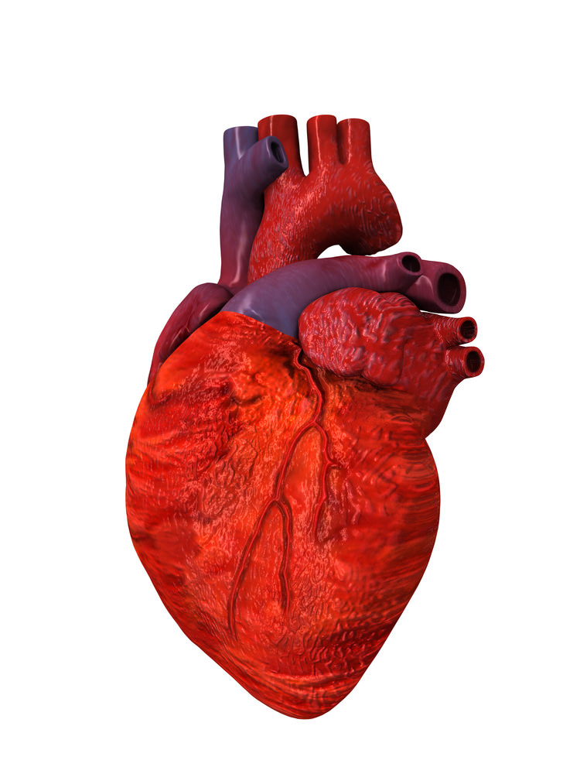
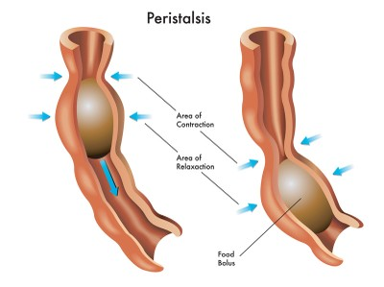
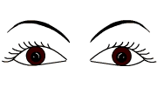
Involuntary Muscle
Some muscles are not under our cognitive control.
What examples might there be?
Identify the different muscle groups in the human body.
Describe the action by which muscles work.
Explain what is meant by the terms ‘voluntary’ and ‘involuntary’ muscle

Slide 19
Explain what is meant by the terms ‘voluntary’ and ‘involuntary’ muscle
Can a muscle be both involuntary and voluntary? Give a reason for your answer.
Why is it important for some muscles to be involuntary?
Write a definition for ‘voluntary muscles’ and ‘involuntary muscles’

