Slide 1
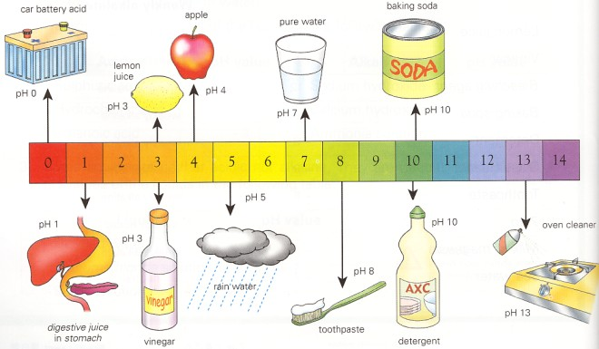
Acids & Alkalis
07/02/20
Learning Objectives:
To identify the meaning of the hazard symbols
To state some examples of acids and alkalis
To distinguish between an acid and an alkali using an indicator
Starter task
Match hazard symbols with meaning on the worksheet on your desk.

Slide 2
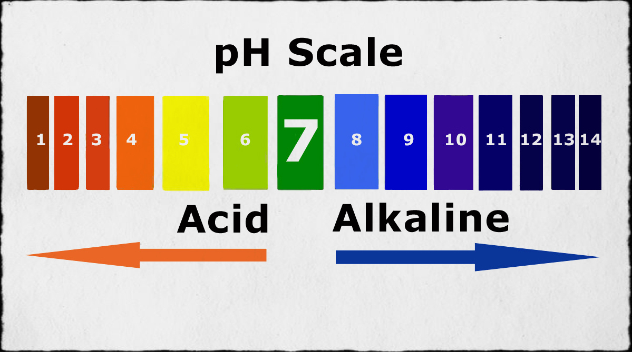
The pH scale

Slide 3
Key Terms
Acids = Substances with a pH below 7.
Bases = Substances with a pH above 7.
Alkalis = A type of base that is soluble (can dissolve) in water.

Slide 4
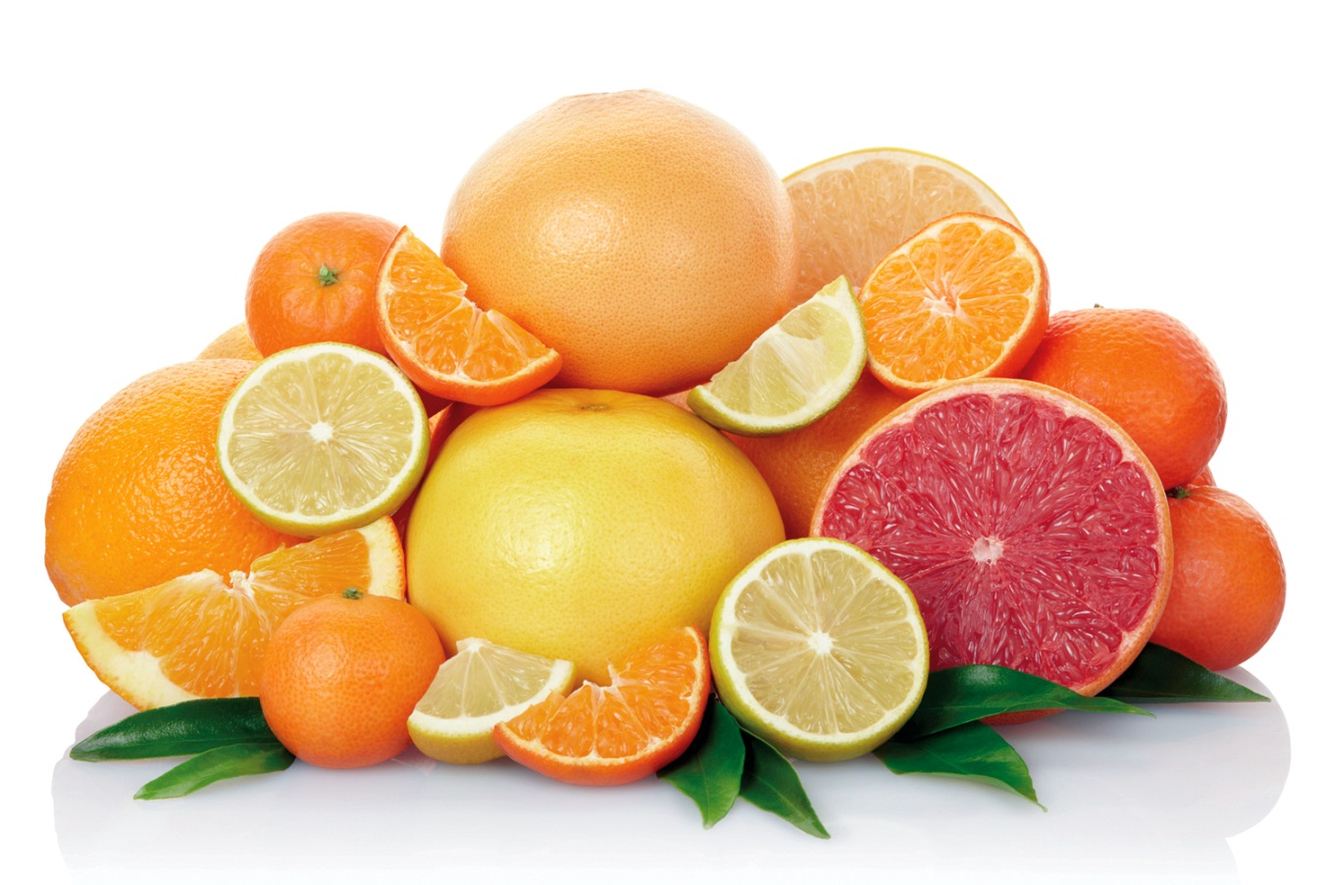
Examples of acids & alkalis

Slide 5
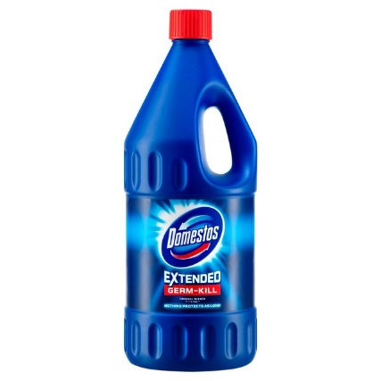
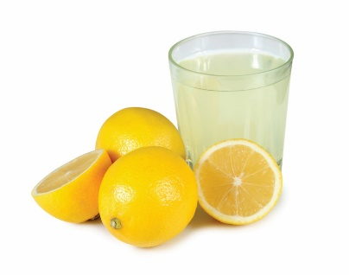
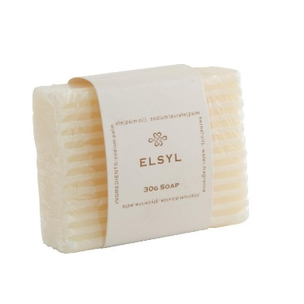
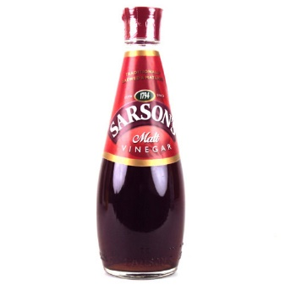
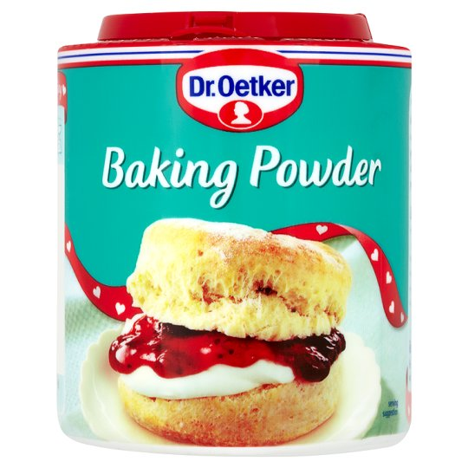
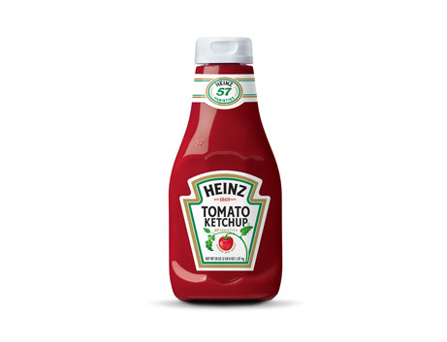
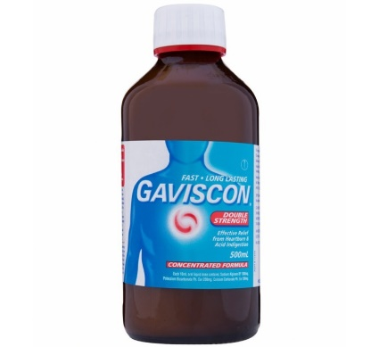
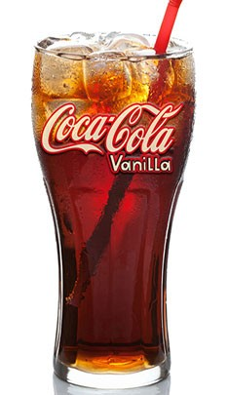
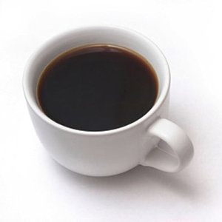
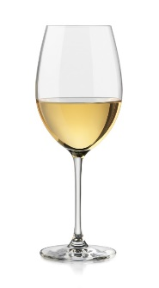
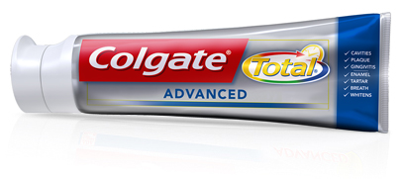
Decide if the following are acids or alkalis.

Slide 6


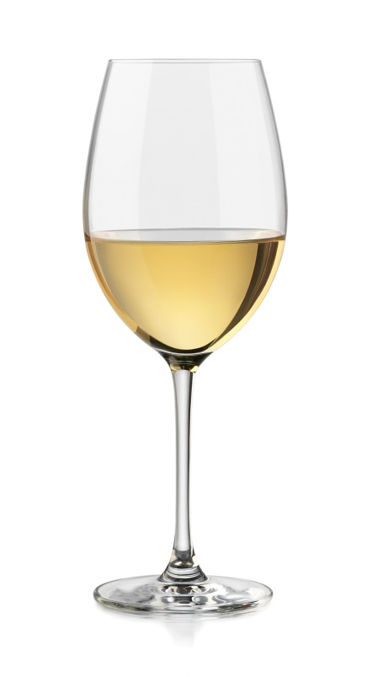

Slide 7


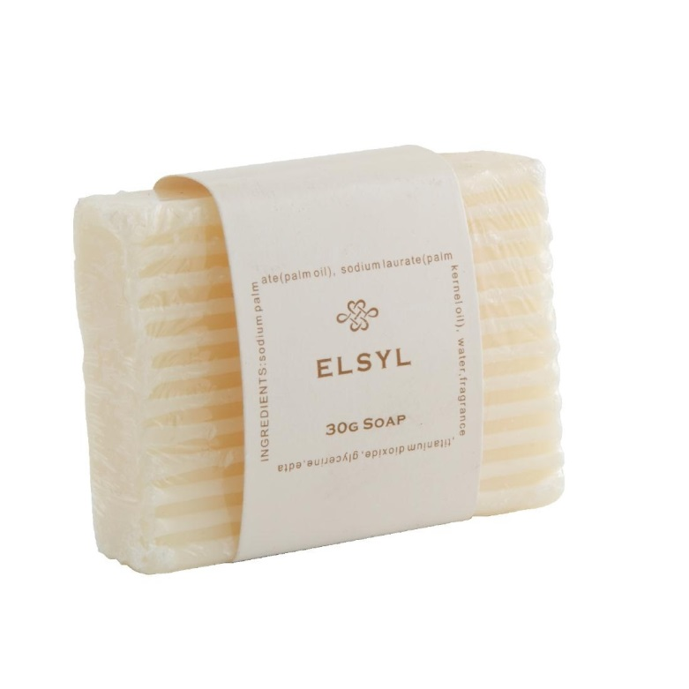

Slide 8
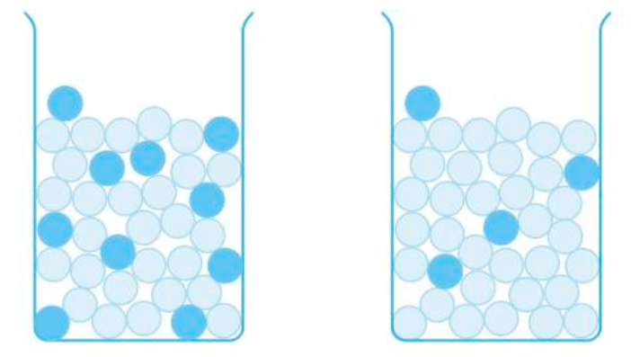
Acids and Alkalis can be described as being either Concentrated or Dilute. Using the images below have a go at defining the words concentrated and dilute.
Challenge:
List as many acids and alkalis as you can.
P points for the longest list!
Acid Particle
Water Particle
This beaker shows a concentrated acid
This beaker shows a dilute acid

Slide 9
Acid Particle
Concentrated acid has a high number of acid particles per litre
Dilute acid has a low number of acid particles per litre

Slide 10
As well concentration, we can also order acids by their strength. Strength is separate to concentration.

Slide 11
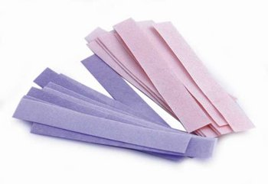
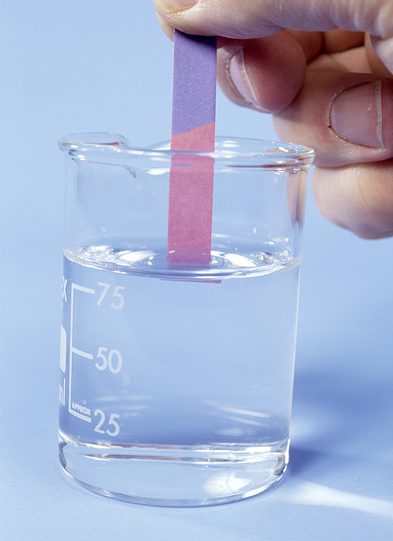
Litmus paper
Litmus paper is an indicator.
Indicators show us if a substance is acid, alkali or neutral by a colour change.
Blue litmus paper:
Turns red if the chemical is an acid
Stays blue if the chemical is a base
Red litmus paper:
Turns blue if the chemical is an base Stays red if the chemical is an acid

Slide 12
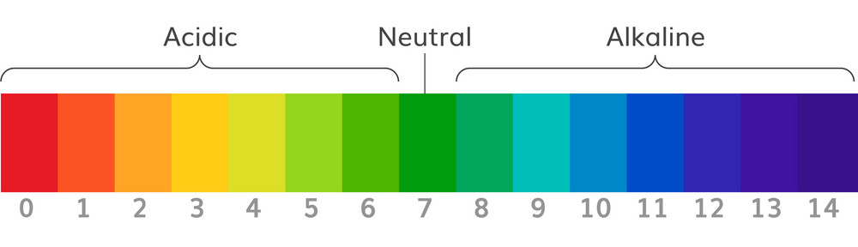
Practical
Copy the table into your books
Place a few drops of each test substance into separate dimples in a spotting tile- REMEMBER WHICH ONE WENT WHERE
Add a few drops of universal indicator to each dimple
Test with litmus paper
Record observations
Name | pH Value | Litmus paper colour | Acid/Alkali/ Neutral | Strong/Weak
Citric Acid
Hydrochloric Acid
Tap Water
Sodium Hydrogen Carbonate
Sodium Hydroxide
Salt Solution

Slide 13
pH Indicator or Litmus paper
If I wanted to compare the strength of 2 acids?
If I wanted to compare the strength of 2 alkalis?
If I wanted to find out if a mystery liquid was acid or alkali?
Challenge: What makes an acid strong or weak?

Slide 14
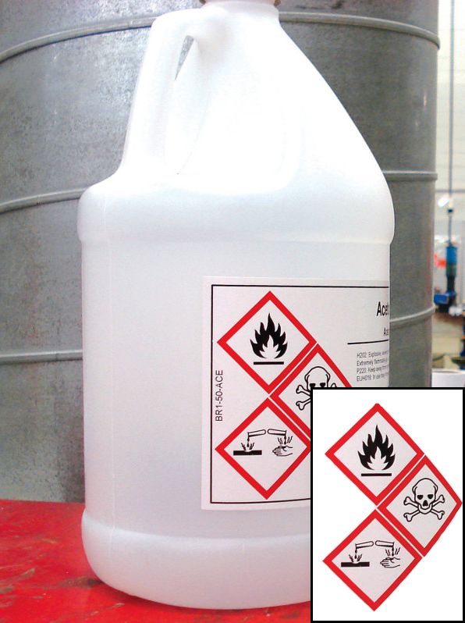
What precautions should be taken when handling this chemical?

