Slide 1
Acid Strength and Indicators
Starter: Answer the questions in the boxes below
Last Lesson
What colour does acid turn universal indicator?
Last Week
Describe the difference between a concentrated acid and a dilute acid
Red
High number of acid particles per unit volume
Last Term
Explain why will filtering not separate salt and water
This Lesson
Given and acid and an alkali how could you make a neutral solution?
Salt particles are too small for the filter paper to stop

Slide 2
Learning Objectives
Discover how litmus paper changes colour in the presence of acids and alkalis
Name 3 strong acids and 2 weak acids
Use data to predict the pH of a solution

Slide 3
How would I find out if something is an acid or alkali?
I could use an indicator!
An indicator is a substance that shows whether something is acidic or alkaline
Indicators include:
Litmus paper
Universal indicator

Slide 4
Litmus Paper vs Universal Indicator
In an acid, litmus paper turns RED
In an alkali litmus paper turns BLUE
Universal indicator allows us to whether a substance is an acid or alkali but also the strength of the acid or alkali (The pH).

Slide 5
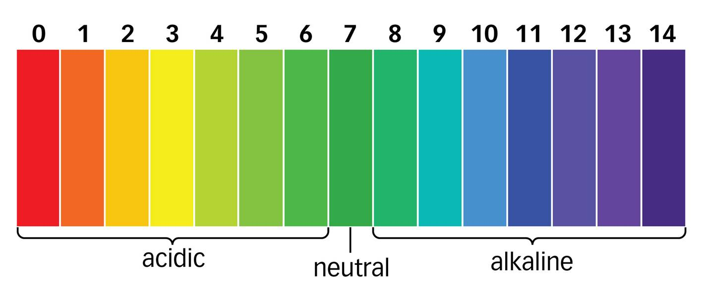
Task:
Copy out the pH scale below.
On the next slide are some substances. You must try to work out what their pH will be and then write them next to that pH

Slide 6
Hydrochloric acid
Drain cleaner
Milk of magnesia
Blood
Lemon juice
Vinegar
Water
Tea
Toothpaste
Sodium hydroxide
Saliva
Coca-Cola

Slide 7
Lemon juice
Hydrochloric acid
Sodium hydroxide
Saliva
Milk of magnesia
Water
Coca-Cola
Vinegar
Drain cleaner
Tea
Blood
Toothpaste

Slide 8
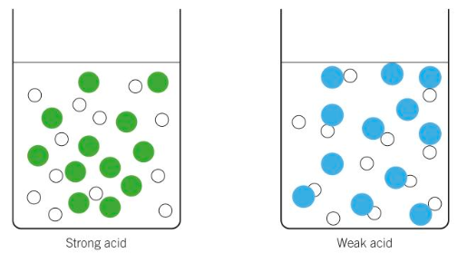
Spot the difference
What is the difference between a strong acid and weak acid

Slide 9
Task 1: Copy and Complete
Hydrochloric acid is a _________ acid and ethanoic acid (vinegar) is a _______ acid. Hydrochloric acid is a strong acid as ________ the particles have split up. In ethanoic acid, only ________ of the particles have split up.
Word Bank: Weak, Strong, All, Some
Task 2: Identify which acids are strong and which are weak:
Sulfuric acid
Nitric acid
Citric acid

Slide 10
https://www.kerboodle.com/api/courses/42148/interactives/169186.html

Slide 11
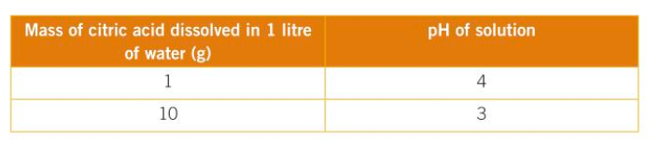
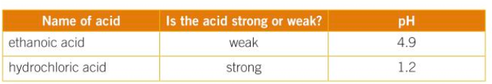
Task 3:
What conclusions can you draw from the data above
Suggest a reason for your conclusions

Slide 12
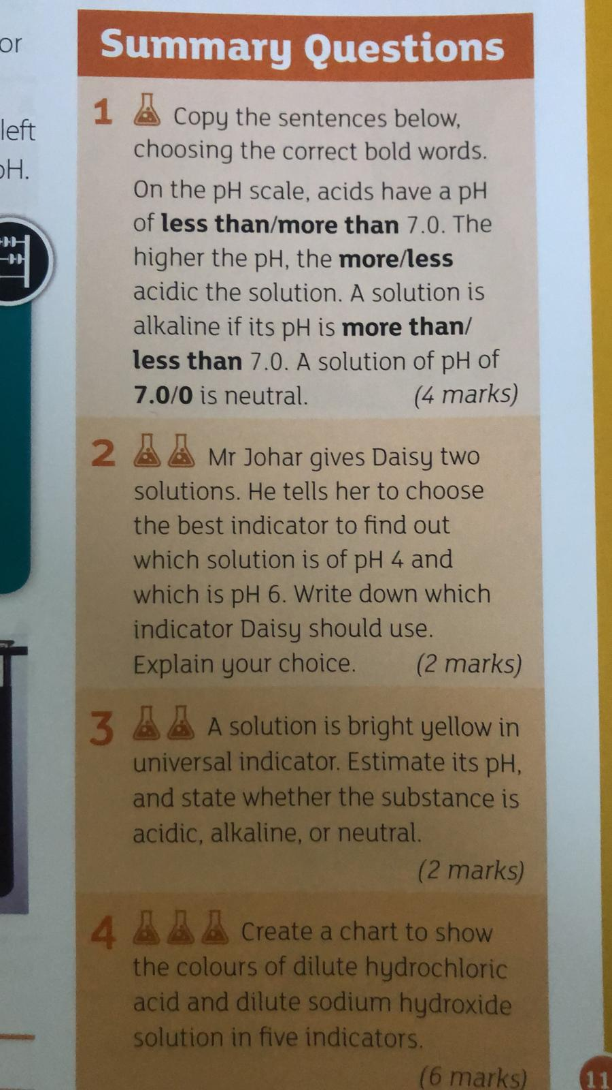
Plenary – Complete the summary questions:

