Slide 1
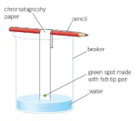
Neutralisation
Starter: Answer the questions in the boxes below
Last Lesson
Describe the concentration between a strong acid and a concentrated acid
Last Week
Name one strong acid and one weak acid
Concentrated = lots of acid particles per litre
Strong = All particles split up
Strong = Hydrochloric acid
Weak = Citric acid
Last Term
Draw a diagram showing how to set up chromatography apparatus. Annotate your diagram.
This Lesson
Write down what you know about salts

Slide 2
Learning Objectives
State what products are formed between an acid and an alkali
Explain some of the uses of neutralisation reactions
Set up tomorrows practical

Slide 3
During this video draw a notes box about 6 lines down and 2/3 of a page across like this:
https://www.youtube.com/watch?v=-aGRYS7JVd8
As we watch the video you need to fill your box with information you learn.

Slide 4
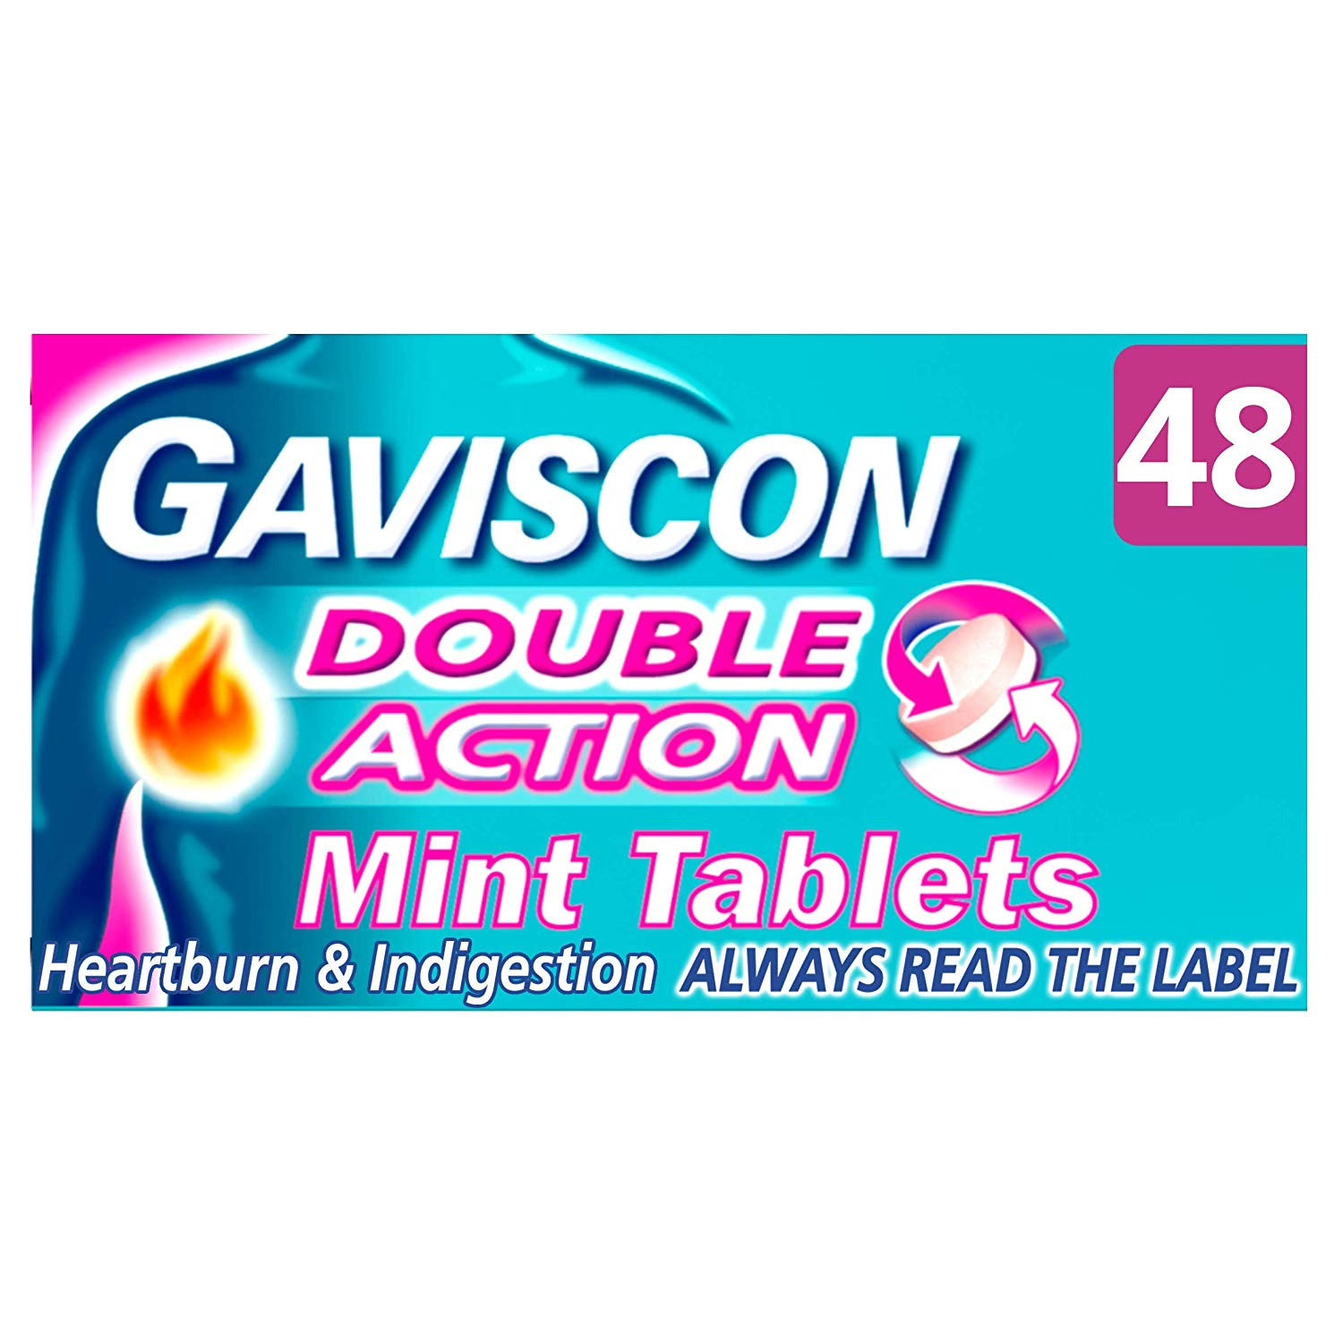
We get stomach aches because we have too much stomach acid. To get better we take indigestion tablets which react with the acid as part of a neutralisation reaction.

Slide 5
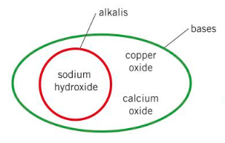
A base is a substance which neutralises acids
Alkalis are soluble bases
This means they dissolve in water

Slide 6
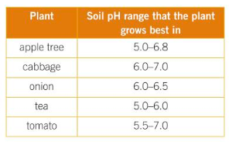
Task 1: Copy and Complete
A base cancels out an acid in a ________ reaction. An alkali is a soluble ________.
Word Bank: Base, Neutralisation
Task 2:
Using the information in the orange table and what you saw earlier in the video, suggest 2 situations where neutralisation reactions could be useful
Challenge: Using a diagram and a step by step method describe how you could go about neutralising a mystery acid into a neutral solution

Slide 7
https://www.youtube.com/watch?v=qIOMlwBoe_4

Slide 8
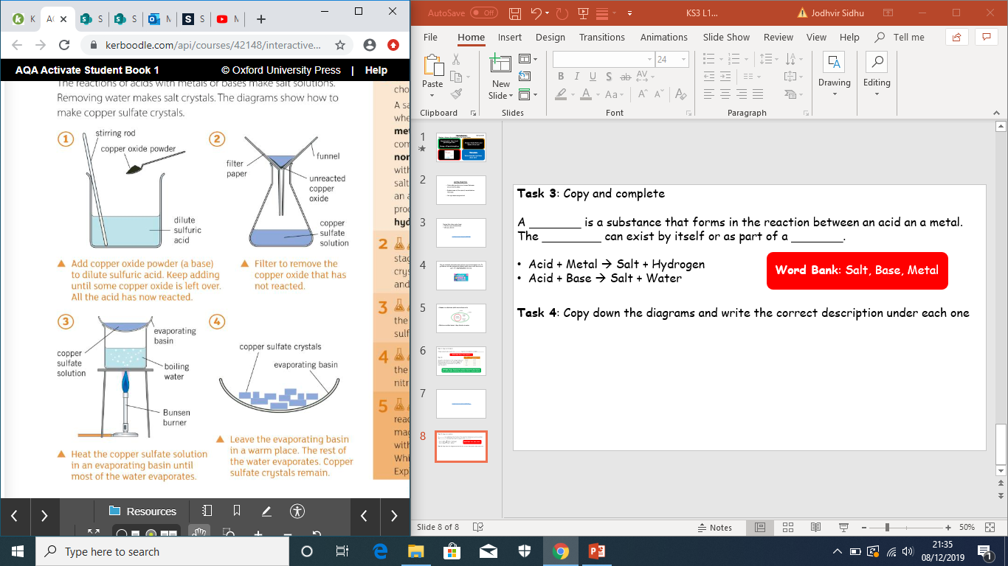
Task 3: Copy and complete
A _______ is a substance that forms in the reaction between an acid an a metal. The ________ can exist by itself or as part of a _______.
Acid + Metal → Salt + Hydrogen
Acid + Base → Salt + Water
Word Bank: Salt, Base, Metal
Task 4: Copy down the diagrams and write the correct description under each one
Leave the evaporating basin in a warm place until the rest of the water evaporates
Filter to remove excess copper oxide
Add copper oxide to dilute sulphuric acid. Keep adding until it no longer dissolves
Heat the evaporating basin using a Bunsen burner

Slide 9
Draw a cartoon strip to show a neutralisation reaction. You can be as creative as you like.
Make sure you explain what is happening at each stage!

Slide 10
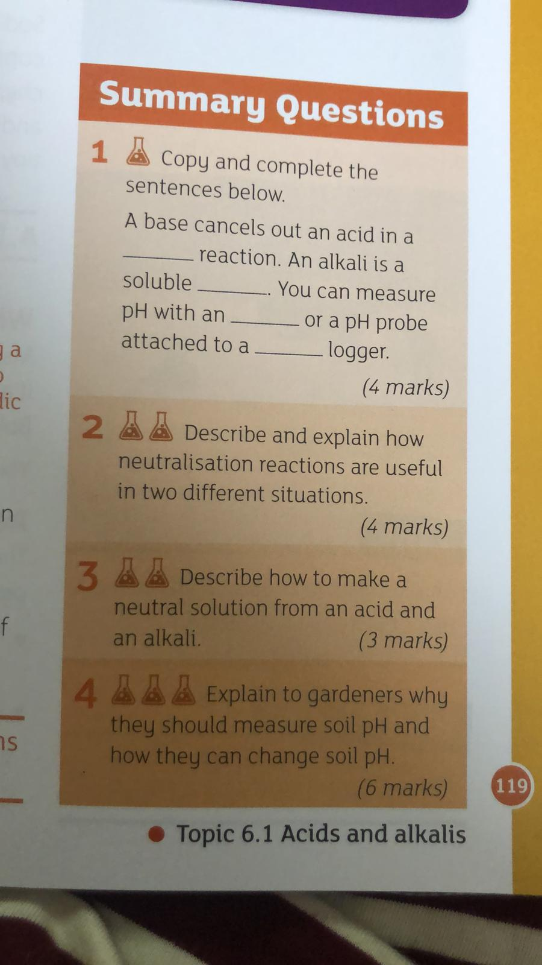
Plenary:
Complete the summary questions below:

