Slide 1
Making Salts
1. What type of salts do you know about?
Create a list for all the salts you know!
2. What are some uses of salt?

Slide 2
Learning Objectives
SUCCESS!!
To describe an experiment to produce dry crystals of copper sulfate
To explain how to make a salt from an acid and a metal
To explain how to make a salt from a neutralisation reaction

Slide 3
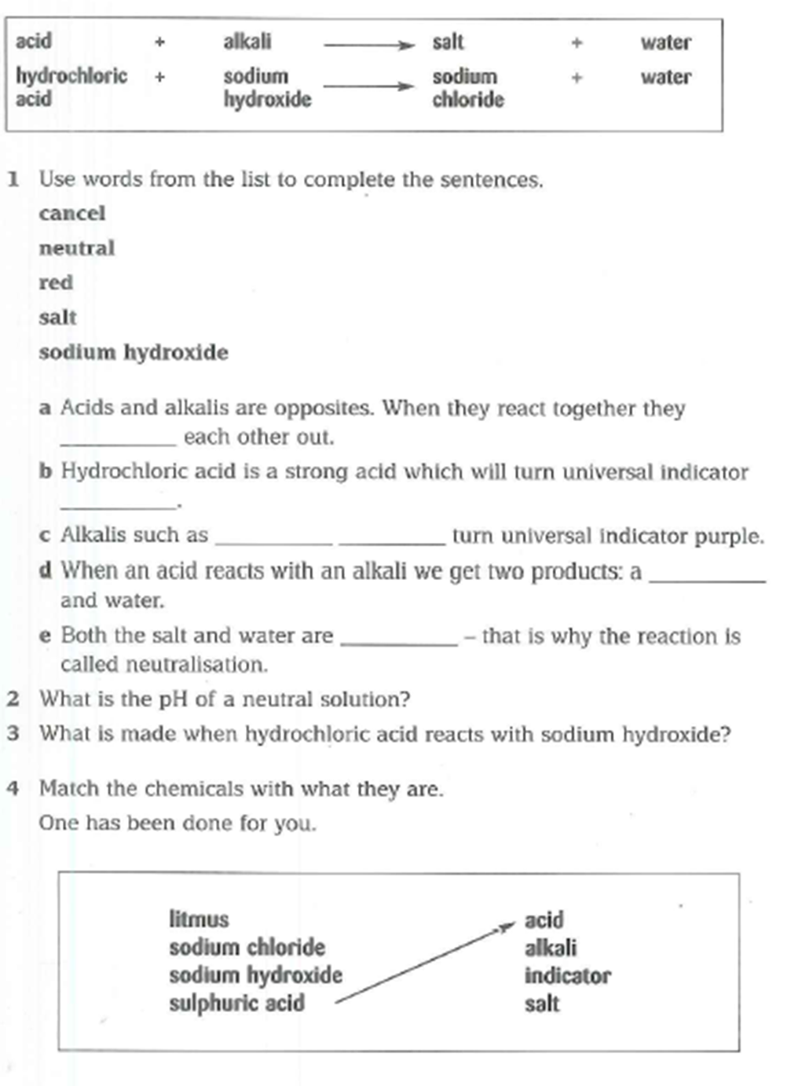

Slide 4
How might we be able to get a salt from an acid and an alkali?
Think, Pair, Share
A salt is produced following a neutralisation reaction between an acid an alkali.

Slide 5
Neutralisation Reaction Equations
When an acid and alkali produce a neutralisation reaction, a salt and water is produced.
ACID + ALKALI SALT + WATER
For example:
Hydrochloric acid + Sodium hydroxide Sodium chloride + Water

Slide 6
When naming a salt:
When we name a salt, the first part of the alkali name remains (e.g. sodium) but the type of acid changes:
Hydrochloric = ‘chloride’
Nitric = ‘nitrate’
Sulfuric = ‘sulfate’

Slide 7
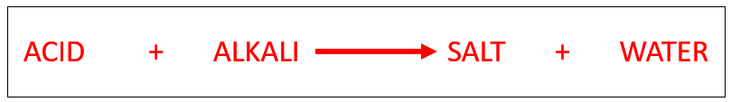
Copy and complete the following equations, using the general equation above for guidance:
Hydrochloric acid + ___________ hydroxide Potassium chloride + water
_________ acid + sodium hydroxide sodium nitrate + water
Sulfuric acid + calcium hydroxide calcium __________ + water
______________ acid + magnesium hydroxide magnesium chloride + water
___________ acid + ______ hydroxide calcium sulfate + water
___________ acid + potassium hydroxide ______ nitrate + water

Slide 8
Some salts can also be made by reacting metals with acids
When a metal reacts with an acid it produces a salt and hydrogen:
METAL + ACID SALT + HYDROGEN
For example:
Copper oxide + hydrochloric acid copper chloride + hydrogen

Slide 9
YouTube video
https://www.youtube.com/watch?v=qIOMlwBoe_4

Slide 10
Using the video we have just watched, put the statements in order for how to make a salt from an acid and alkali
Keep adding copper oxide powder until it won’t dissolve anymore
Filter the mixture to remove the excess copper oxide that didn’t react
Heat the copper sulfate solution in an evaporating basin until most of the water has evaporated.
You are left with crystals of copper sulfate
Add copper oxide powder to dilute sulfuric acid
Leave the evaporating basin in a warm place to let the rest of the water evaporate.

Slide 11
Using the video we have just watched, put the statements in order for how to make a salt from an acid and alkali
1) Add copper oxide powder to dilute sulfuric acid
2) Keep adding copper oxide powder until it won’t dissolve anymore
3) Filter the mixture to remove the excess copper oxide that didn’t react
4) Heat the copper sulfate solution in an evaporating basin until most of the water has evaporated.
5) Leave the evaporating basin in a warm place to let the rest of the water evaporate.
6) You are left with crystals of copper sulfate

Slide 12
Plenary
Explain, with diagrams, how to create a sample of copper chloride from dilute hydrochloric acid and copper oxide powder.
Write out the word equation for a reaction between sulfuric acid and magnesium hydroxide
Write out the word equation for a reaction between zinc oxide and sulfuric acid
Describe what is meant by a neutralisation reaction
Recall the equation for a neutralisation reaction
Recall the equation for a reaction between a metal and an acid

