Slide 1
Starter:
Solvent
Solute
Solution
Solid
Liquid
Gas
Melting
Evaporation
Condensation
Melting
Freezing
Sublimation
Element
Atom
Compound

Slide 2
Learning Objectives
State the meaning of a saturated solution
Describe the meaning of solubility
Explain how temperature affects solubility
Work scientifically to study the link between temperature and solubility

Slide 3
Solutes, Solvents and Solutions
A solute is a substance that dissolves in a solvent (e.g. sugar)
A solvent is a substance that allows solutes to dissolve in it (e.g. water)
A solution is formed when a solute dissolves in solvent.

Slide 4
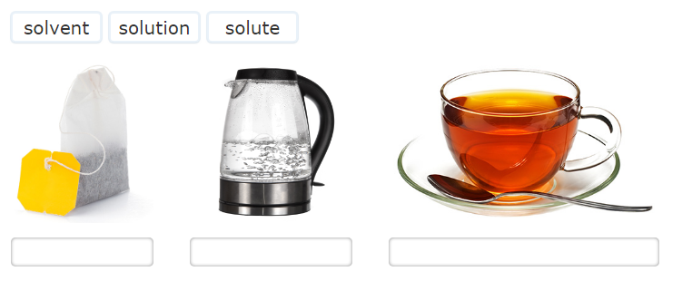
Solubility
In the scenario below, identify what the solvent, solute and solution are.
Challenge: What is the definition for solvent, solute and solution

Slide 5
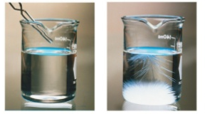
Different amounts of salt have been added to water and mixed.
Challenge: Draw a particle diagram to show the arrangement of water and salt particles in the left image (use different colours)
Which solution do you think received the most salt?
The solution on the right is described as ‘saturated’ what could this mean?
What could you do to dissolve the excess salt in the picture on the right?

Slide 6
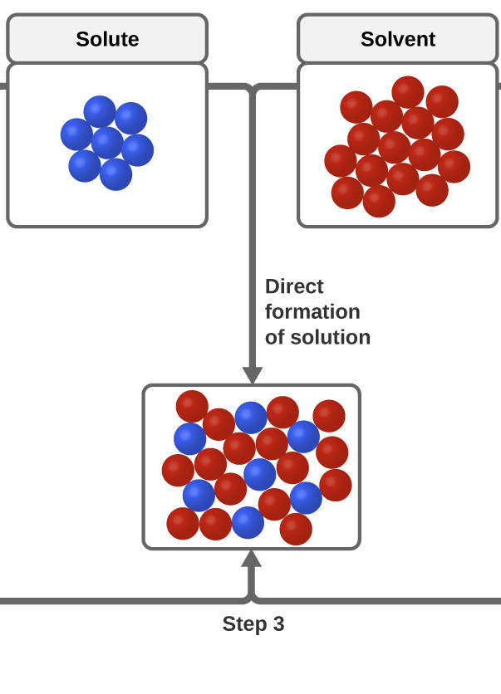
Copy down the diagram
Challenge: Draw a diagram to show the arrangement of a saturated solution

Slide 7
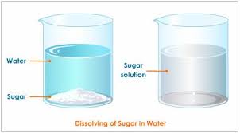
A Saturated solution
At room temperature you can dissolve 200 g of sugar in a 100 mL of water – 40 teaspoons!
However, if you add anymore it just falls to the bottom.
A saturated solution contains the maximum mass of a substance that will dissolve

Slide 8

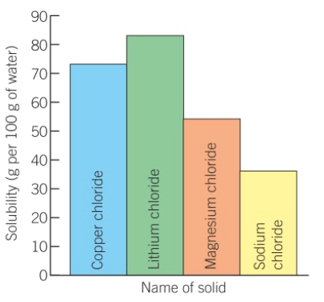
Solubility
The mass of solute that will dissolve in 100 g of water is called its solubility
Every substance has its own solubility – some are insoluble
Which substance is the most soluble
Which is the least soluble?
Which has a solubility of around 73g?
Lithium chloride
Sodium chloride
Copper chloride

Slide 9

Learning checkpoint – Match up
A saturated solution…
Does not dissolve
An insoluble substance
Is the mass of substance that dissolves in 100g of water
Solubility
Is a solution that contains the greatest mass of solid that can dissolve
Stretch: What could the term supersaturation mean?

Slide 10


Design your practical – solubility of salt
Kris wants to find out about the amount of salt dissolved in seawater.
Design a practical investigation to find out whether the solubility of salt in seawater differs according to the temperature of the region.

Slide 11

How does temperature affect solubility?
Temperature (ºC) | Solubility of sugar (g/100g of water)
20 | 202
40 | 236
60 | 289
80 | 365
100 | 476
  What does the data show?
  How does solubility change with temperature
  Do your results align with your prediction
  How could you improve the accuracy and reproducibility of your results?

Slide 12
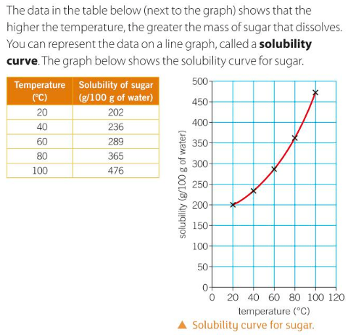
Using the data from the practical, draw a sketch graph in your book.
Include a description of the graph

