Slide 1
Explain how an atom is different to a compound
Starter: Answer one box of each colour
Describe the arrangement of particles in a solid
Describe the arrangement of particles in a gas
What process converts a gas to a liquid
What process converts a solid to a liquid
What process converts a liquid to a solid

Slide 2


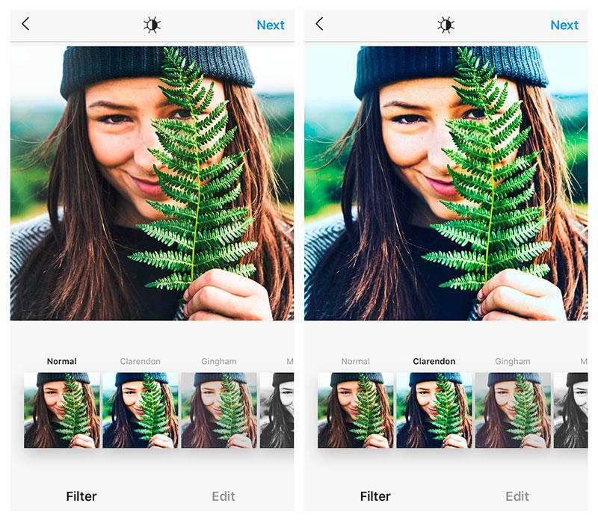
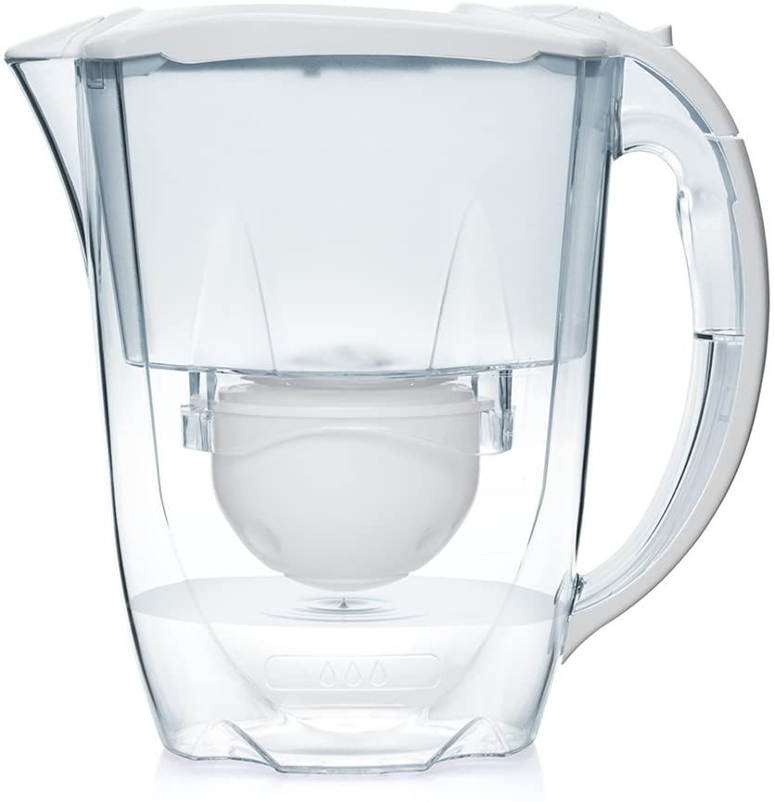
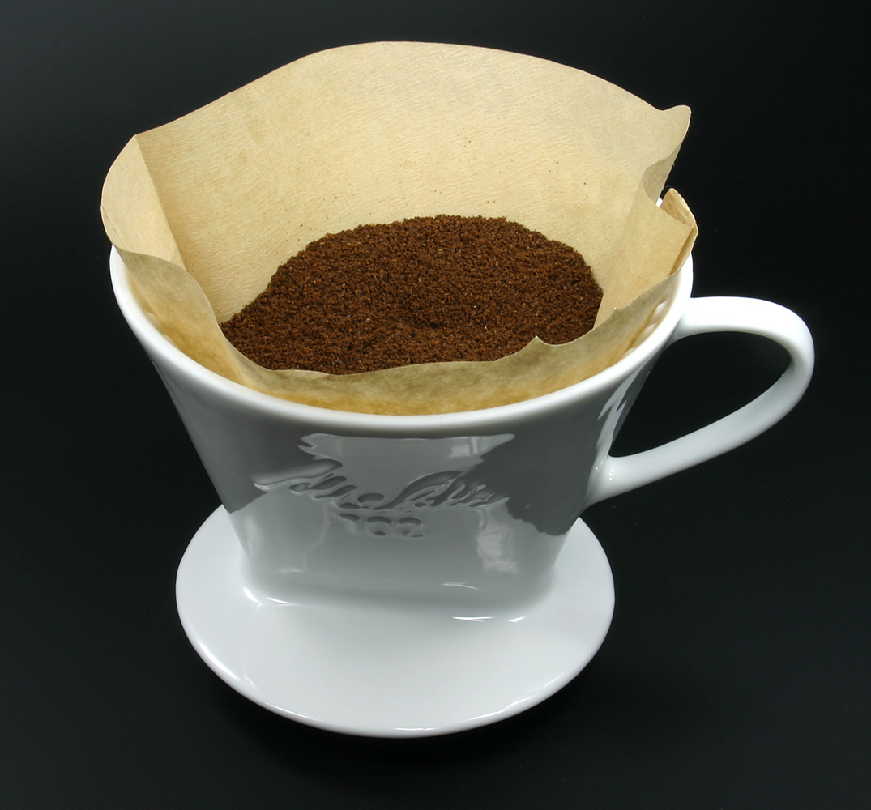
What are we learning about today?

Slide 3
Learning Objectives
State why is possible to separate mixtures
Explain why filtration works to separate a particular mixture
Choose when to use filtration to separate mixtures

Slide 4
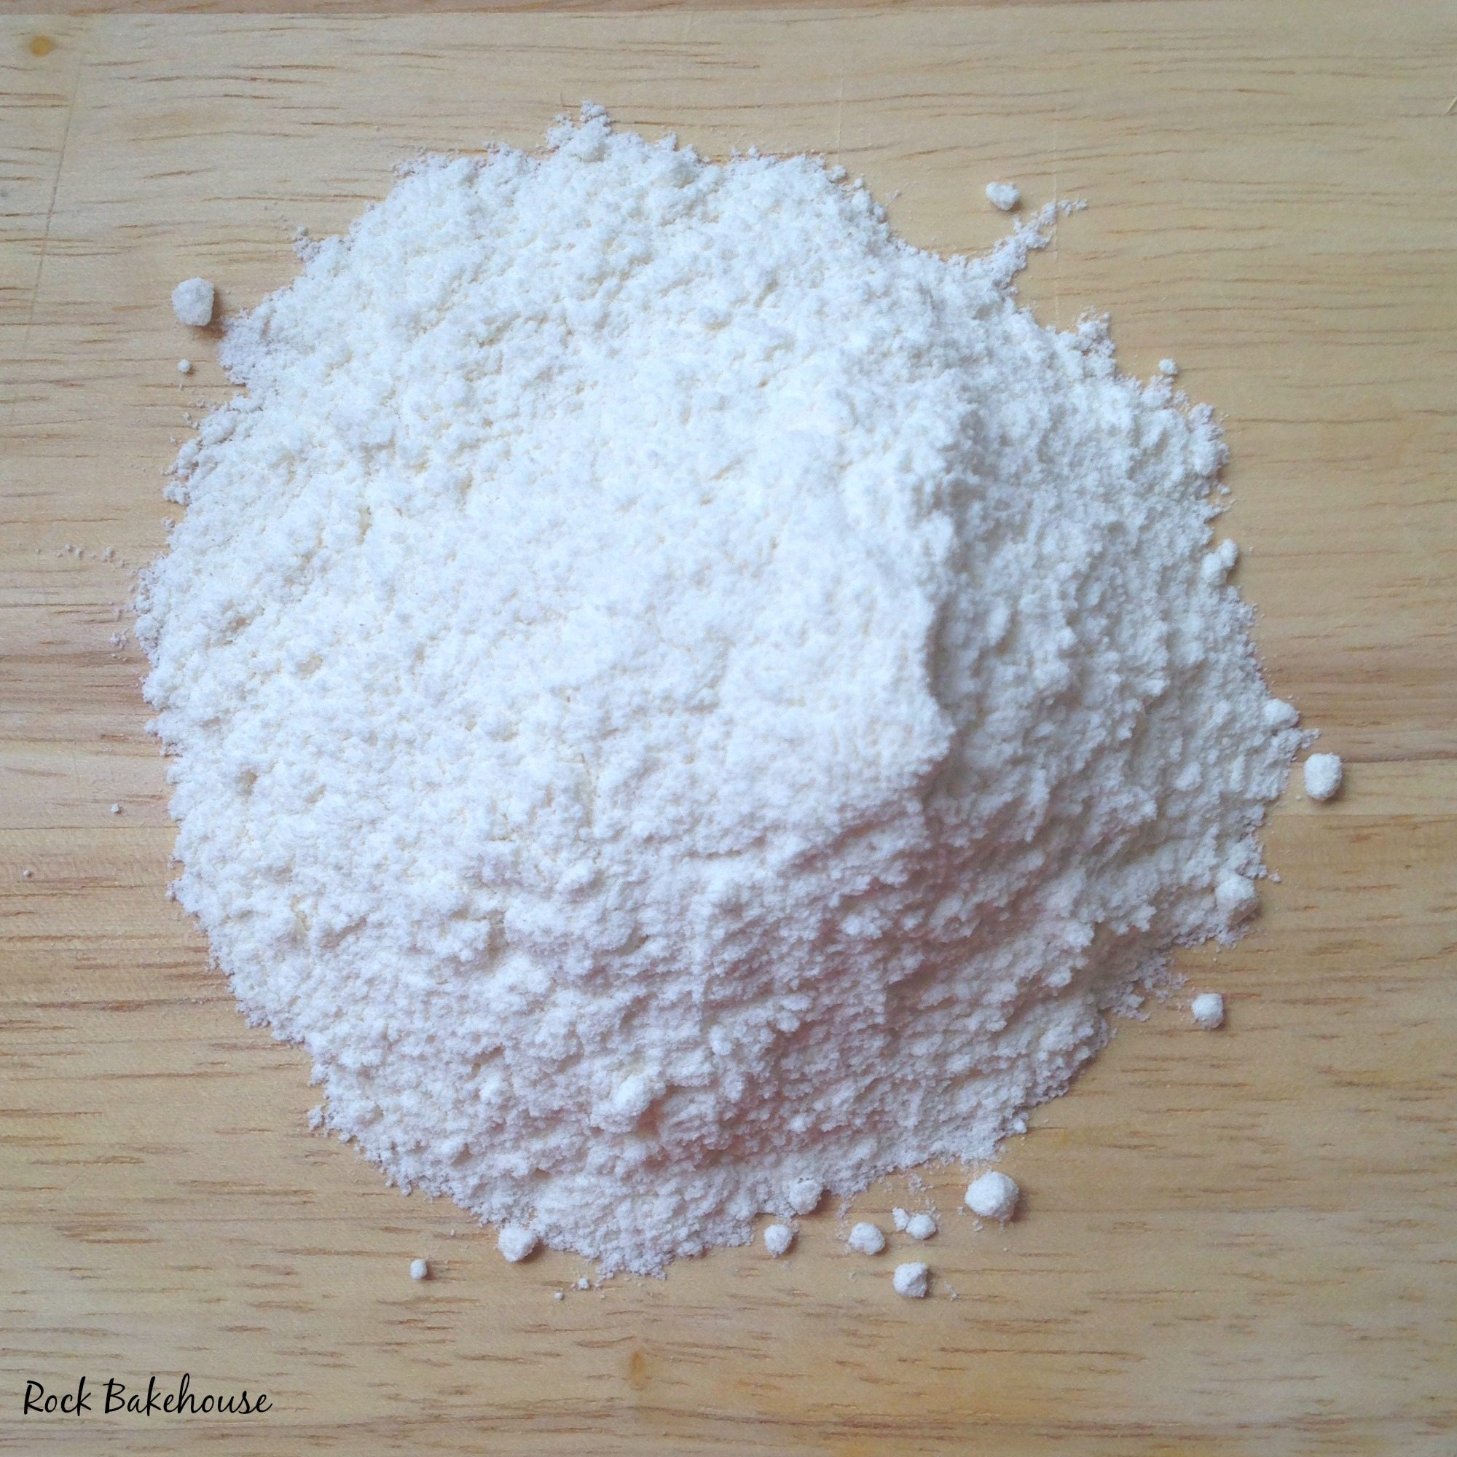
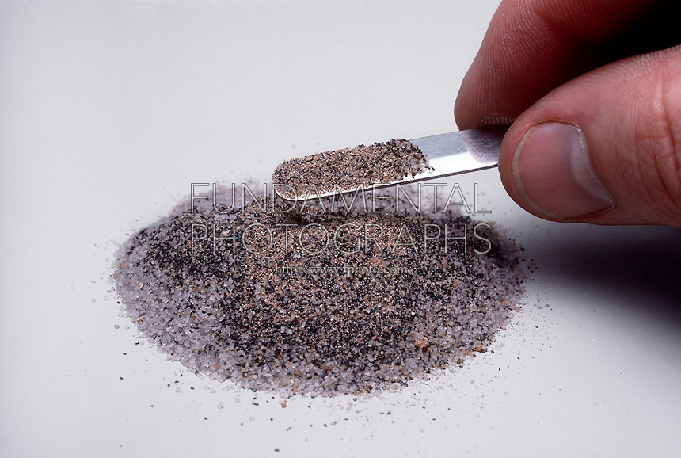
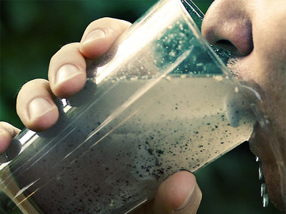
How would you remove the following:
Dirt in water?
Iron filings (small bits of iron) from sand?
Rocks from flour?

Slide 5
Key terms
In pairs, come up with a definition the terms:
‘filter’
‘filtration’
‘filtrate’
- A filter is something that only lets a certain substance pass through it.
- Filtration is a process by which we remove unwanted substances from a mixture.
- A filtrate the removed substance during the filtration process

Slide 6
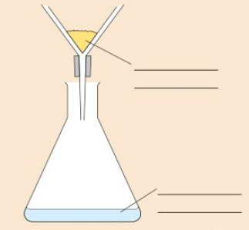
Task 1: Match the key word to it’s definition
The solid that collects in the filter paper
Filtrate
Residue
The liquid or solution that collects in the container after filtering
Task 2: Using your definitions to help, draw and label the diagram showing the filtering of water and sand into your book
Word Bank: Liquid, Filtrate, Insoluble, Residue
Challenge: Suggest how you could separate salt and water

Slide 7
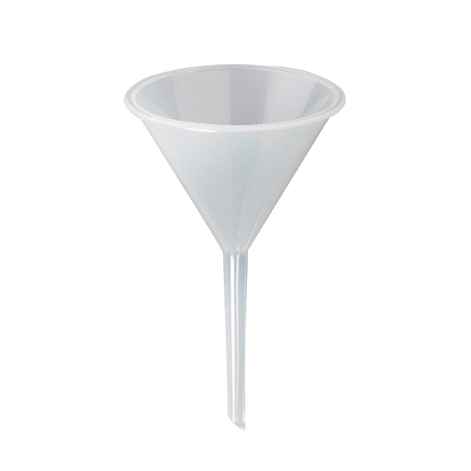
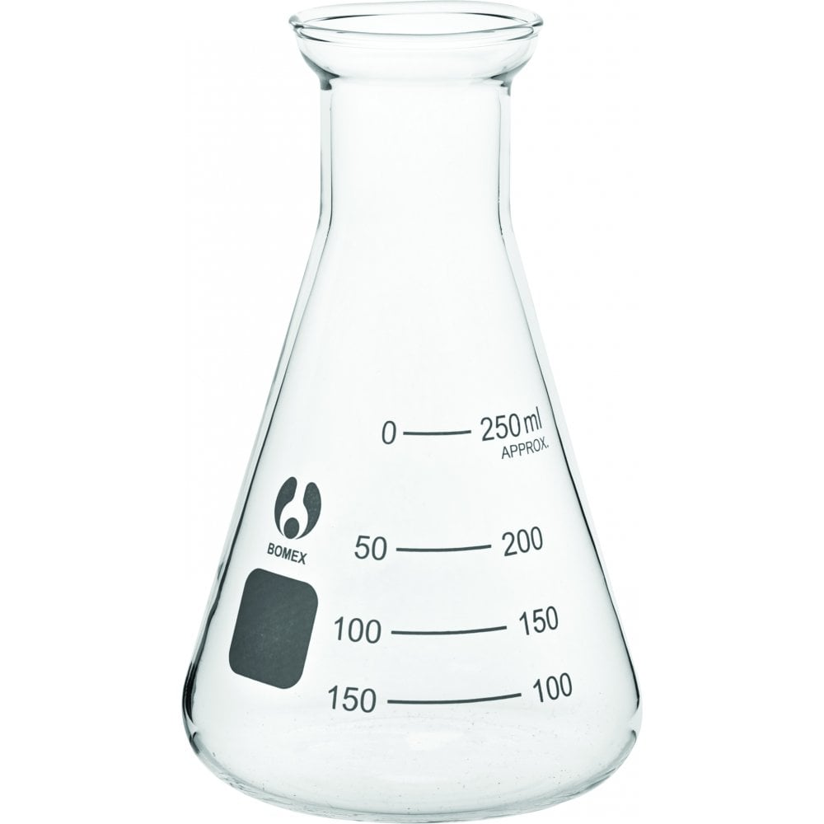
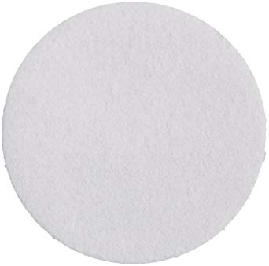
Task:
You will be given 2 mixtures:
sand and water
salt and water.
Your task will be to use filtration techniques to separate the two of them. Above are images of the equipment you will be able to use.
1) Identify the names of the pieces of equipment you will be using
2) Draw a diagram to show how you will set up your equipment
3) Create a 3 step method to detail how you could carry out a practical to filter the two mixtures.
Challenge: Suggest how a filter works

Slide 8
“Filter paper is made up of small holes”
Task 3: Use this to suggest why you could separate water and sand but not sand and salt
YouTube video:
Ryan’s world filtering
https://www.youtube.com/watch?v=6Z3JBH-Hg8w

Slide 9
Draw a poster to show where filtration can be used
You can use your phones to research.
How many different things can you find out?

Slide 10
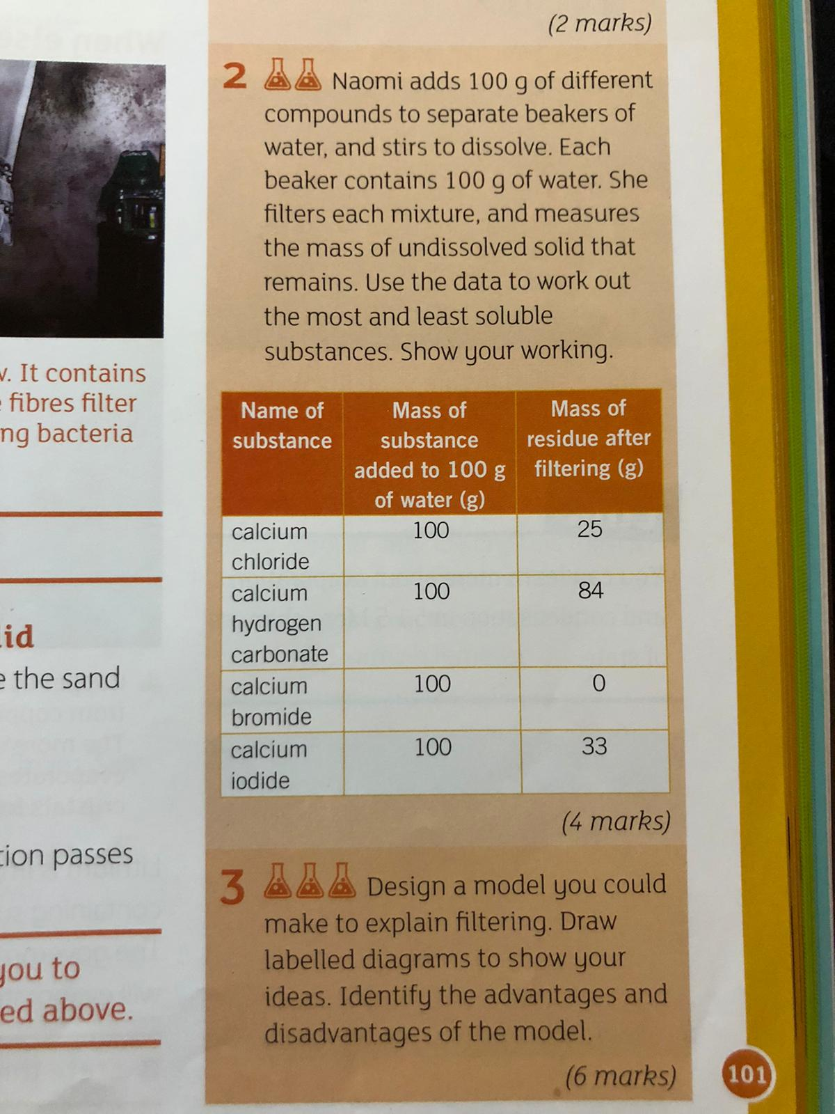
Plenary – Complete the Summary Qs

