Slide 1
Chromatography
Starter: Each list below contains an odd word. Identify the word and explain why it is the odd one out
Solid
Liquid
Gas
Atom
Element
Compound
Boiling
Freezing
Condensing
Filtration
Diffusion
Evaporation
Solution
Solvent
Solute

Slide 2
Learning Objectives
Describe what is meant by distillation
Describe how chromatography separates substances
Prepare for next lessons practical

Slide 3

You are trapped on a desert island which has no fresh water. Using the techniques we have been learning about, how will you separate the sand and salt from the sea water?
What equipment will you use
How will you use it
Diagram

Slide 4
Evaporation and Distillation
Evaporation can remove the water from a solution to leave a solute.
Distillation uses both evaporation and condensation to separate the water and a solute.

Slide 5
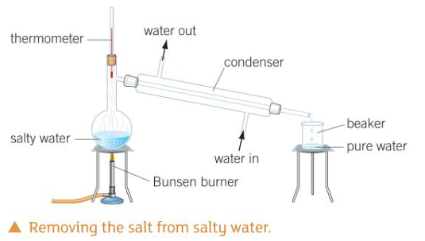
Task 1: Copy and complete
Distillation uses _____ and condensing points to ______ substances with different boiling points.
Word Bank: Separate, Boiling
Task 2: Order the statements below to describe distillation
Challenge: Why is it better to filter out sand rather than remove it via distillation?
Steam travels through the condenser and cools down
Steam condenses to form liquid which then drips into the beaker
Steam leaves the solution
On heating, the water in the sea water begins to boil. The salt does not as it has a higher boiling point

Slide 6
https://www.youtube.com/watch?v=PvHvx7k7UPU

Slide 7
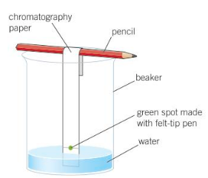
Task 1: Copy and complete
Chromatography is a method of _______. We can use it to find which dyes make up a specific ________. All the dyes are attracted to paper, just some are more _________ than others- chromatography uses these differences.
Word Bank: Separation, Attracted, Colour
Word Bank 2: Chromatograph, Attracted
Task 2: Copy the diagram and complete the sentences
The picture made from chromatography is called a ________. The colours at the bottom are those strongly _______ to the paper.
Challenge:

Slide 8
Task:
Design an experiment to separate water from a salt-water solution.
Design an experiment to determine which teacher wrote a note to Mr Martin.

Slide 9
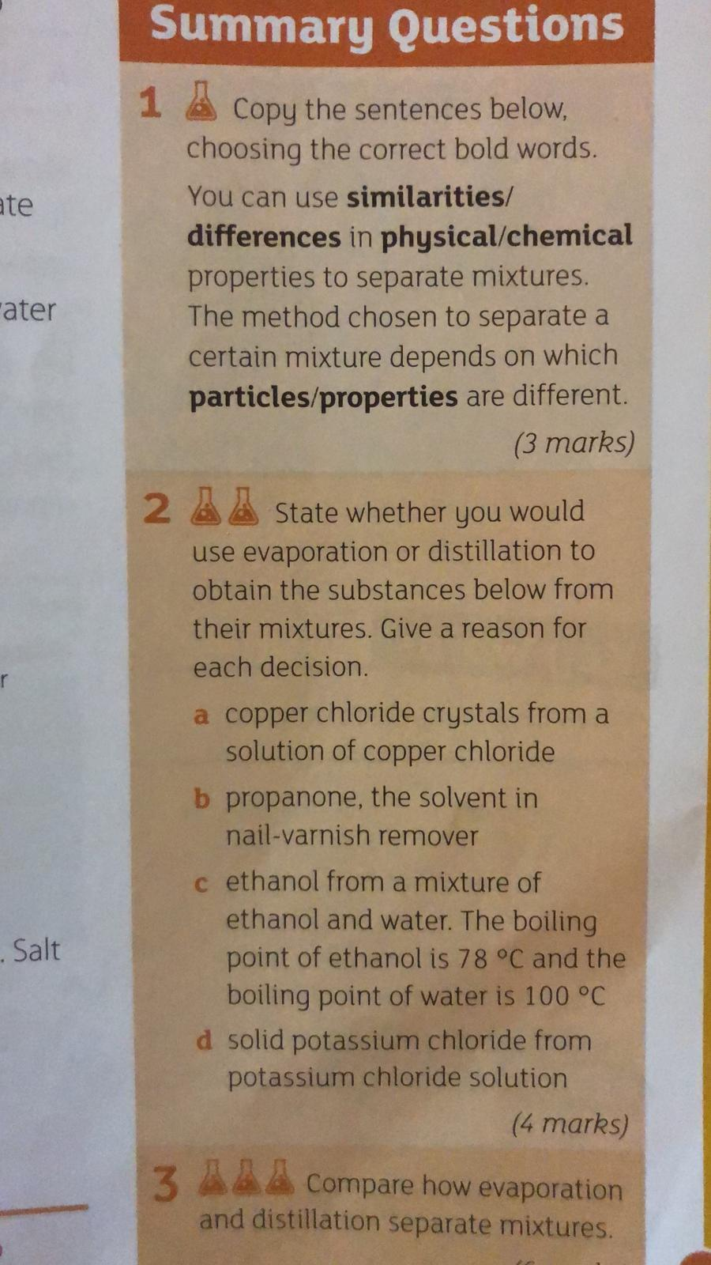
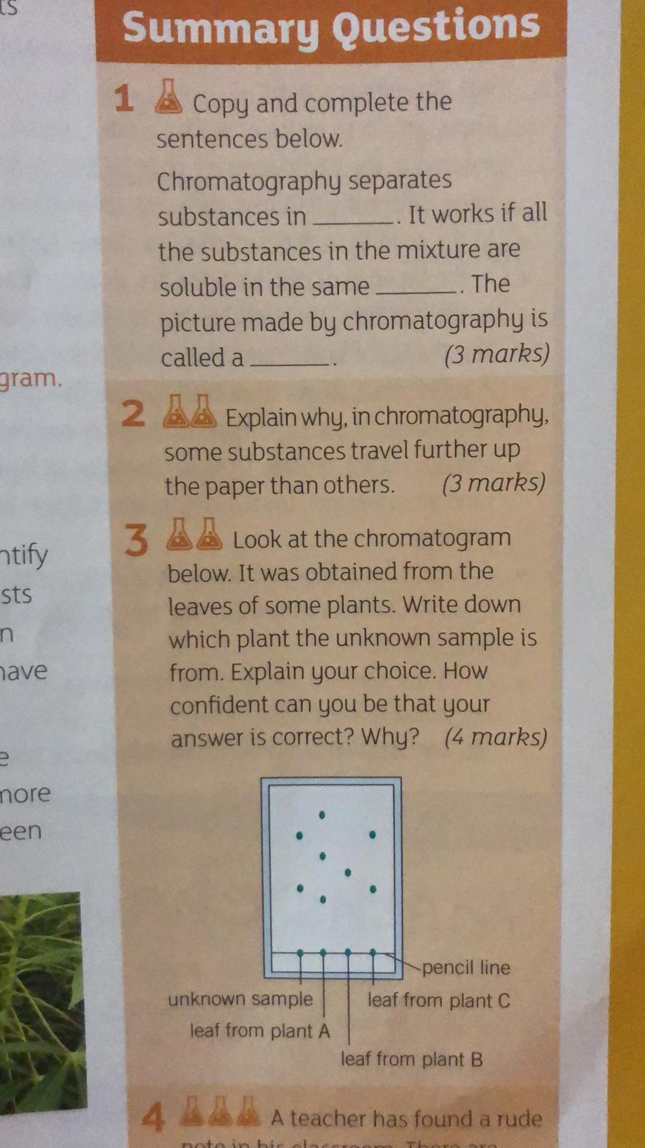
Summary:
Choose either Question Set A or Question Set B
Set A:
Set B:

