Slide 1
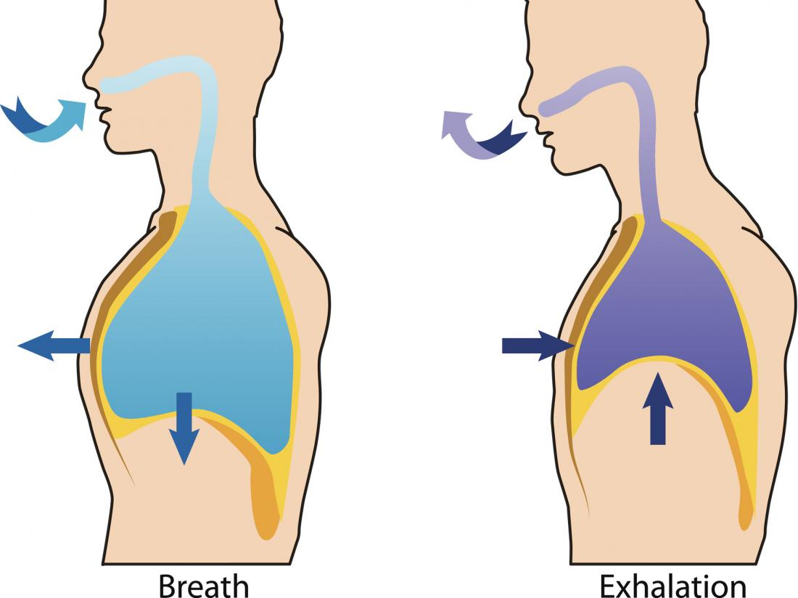
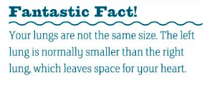
L1 - Gas Exchange
STARTER: What happens when you breathe?
LESSON OBJECTIVES:
Describe the function of the gas exchange system
Explain how parts of the gas exchange system are adapted to their function
Explain why your breathing rate and volume can change

Slide 2
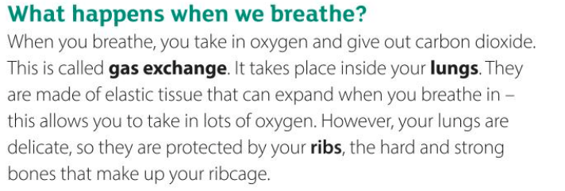
Read the paragraph below: which point do you think is the most important.

Slide 3
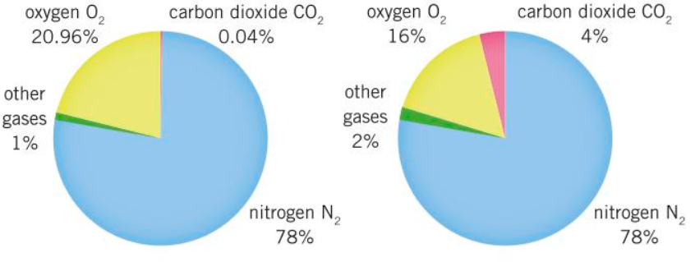
Describe the similarities and differences
Challenge: explain what these are representing

Slide 4
Breathing
Respiration
What is the difference?

Slide 5
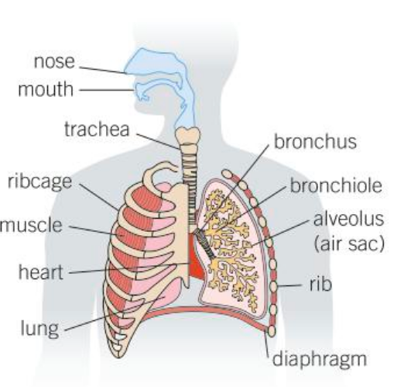
Which structures can you label? – click the box to reveal the label

Slide 6
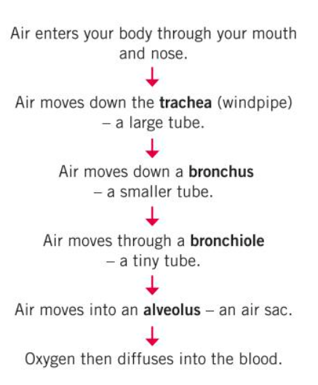
Task 2: Create a flow chart to show how air gets into your blood
Task 1: Put the following into order to show how oxygen gets into your blood
Mouth
Alveolus
Bronchus
Nose
Blood
Trachea
Diffuse
Bronchiole
CHALLENGE: How are the alveoli adapted?

Slide 7
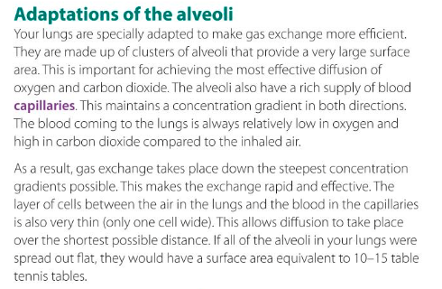
Using the video and the information here, identify how the alveoli are adapted
CHALLENGE: Do you only breath oxygen in and carbon dioxide out? Explain your answer
https://www.youtube.com/watch?v=Nwz4EaO5H2Y

Slide 8
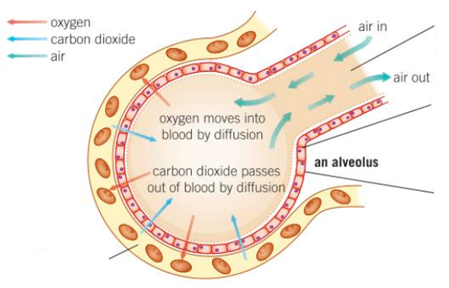
Good blood supply…
Ventilation moves air in and out…
Very thin alveolus wall…
Spherical shape…
…gives a large surface area for diffusion
…maintains concentration gradient for diffusion
CHALLENGE: How do fish get oxygen and remove carbon dioxide?
…maintains a steep diffusion gradient
…gives a short distance for diffusion

Slide 9
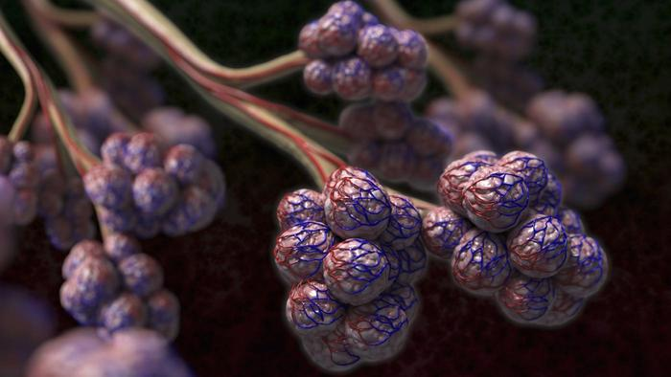
L2 - Breathing
STARTER:
What substances are exchanged in the lungs?
What is this? Where would you find them?
LESSON OBJECTIVES:
Describe the “process” of “inhaling” and “exhaling”.
Describe how a “bell jar” can be used to model what happens during breathing.
Explain how to measure lung “volume”.

Slide 10
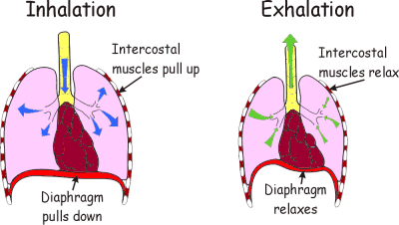
Describe 2 differences and 2 similarities

Slide 11
TASK 1: draw out this flow diagram and fill in the missing words. Use this diagram to help
Intercostal muscles ________
Ribcage moves ________ and ________
The diaphragm ________ (moves down)
The volume inside your chest ________
The pressure inside your chest ________
Air is ___________your lungs

Slide 12

Intercostal muscles contract
Ribcage moves up and out
The diaphragm contracts (moves down)
The volume inside your chest increases
The pressure inside your chest decreases
Air is drawn into your lungs

Slide 13
TASK 2: draw out this flow diagram and fill in the missing words. Use this diagram to help
Intercostal muscles ________
Ribcage moves ________ and ________
The diaphragm ________ (moves up)
The volume inside your chest ________
The pressure inside your chest ________
Air is ________ your lungs

Slide 14
Intercostal muscles relax
Ribcage moves down and in
The diaphragm relaxes (moves up)
The volume inside your chest decreases
The pressure inside your chest increases
Air is pushed out your lungs

Slide 15
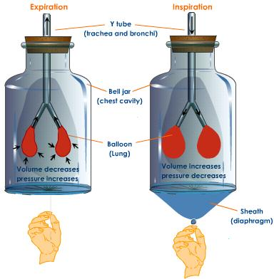
Bell jar model
Watch this video: https://www.youtube.com/watch?v=rUVMok4Qp-Y
The two balloons represent a persons lungs.
The rubber sheath represents a muscle called the diaphragm.
Pulling the sheath increases chest volume, which causes pressure in the chest (outside the lungs) to decrease, so air is sucked into the lungs.

Slide 16
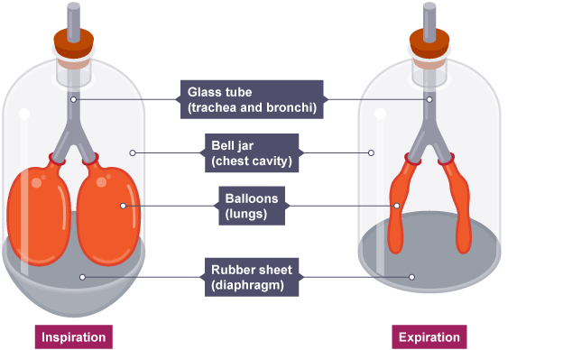
Identify what each part of the model represents.
Discuss in pairs what happens during inhalation and exhalation.
Evaluate the bell-jar model of the breathing system, considering what is good about the model and what is bad in terms of how it matches the real breathing system.
Challenge: How could you improve the model?

Slide 17
Bell jar model - Breathing in
TASK 3: Copy & complete
Inhale means breathing ___
Rib muscles contract, pulling ribcage u and o .
Sheath (d m) cont s, pulling downwards.
V inside chest I , so the p d .
Low pressure causes air to be
sucked into the balloons (l ).

Slide 18
Bell jar model-Breathing in
Inhale means breathing in.
Rib muscles contract, pulling ribcage up and out.
Sheath (diaphragm) contracts, pulling downwards.
Volume inside chest increases, so the pressure decreases.
Low pressure causes air to be sucked into the balloons (lungs).

Slide 19
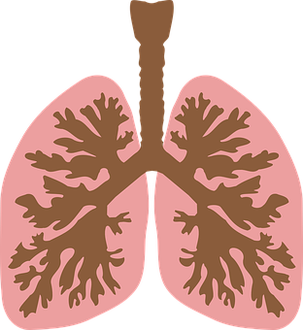
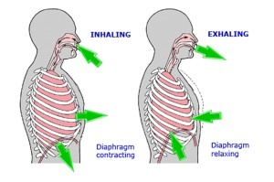
Your turn !
Breathing out is just the opposite of breathing in. Now that you understand breathing in, think about breathing out.
In pairs take turns explaining to each other what happens when you breath out…
Now, let’s look at it on the next slide – no need to take notes, just think…

Slide 20
Bell jar model-Breathing out
Exhale: (Breathing out)
Rib muscles relax, pulling ribcage down and in.
Sheath (diaphragm) relaxes, it moves up.
Volume inside chest DECREASES, so the pressure INCREASES.
Higher pressure pushes air out of the balloons (lungs).

Slide 21


Inhale or exhale?
Rib muscles contract, pulling ribcage UP and OUT. Inhale or exhale?
Sheath (diaphragm) contracts, pulling downwards.
Volume inside chest DECREASES, so the pressure INCREASES.
Air is pushed out of the balloons (lungs).

Slide 22
Inhale or exhale ?
Rib muscles contract, pulling ribcage UP and OUT. INHALE
Sheath (diaphragm) contracts, pulling downwards. INHALE
Volume inside chest DECREASES, so the pressure INCREASES. EXHALE
Air is pushed out of the balloons (lungs).
EXHALE

Slide 23
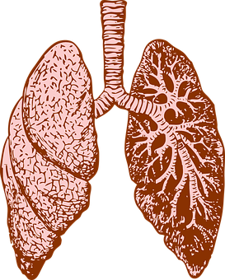
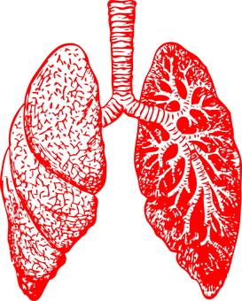
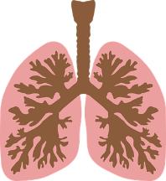
What factors can affect lung volume?
Write down the factors that affect lung volume - 1 mark each.

Slide 24


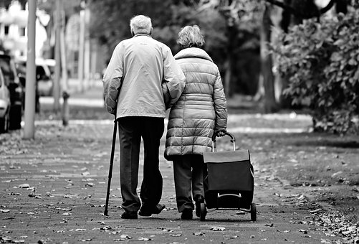
What factors can affect lung volume
1. Chest Size
2. Fitness
3. Age
4. Gender
5. Health

Slide 25
Describe what is happening when you breath in (6 marks)
Include these key words:
Rib cage
Diaphragm
Volume
Pressure
Increase or decrease or both

Slide 26
Describe what is happening when you breath in.
Rib muscles contract, [1]
this pulls ribcage UP and OUT. [1 for either]
Diaphragm moves down (OR contracts). [1]
Volume inside chest INCREASES [1]
So the pressure DECREASES. [1]
Air is drawn (sucked) into lungs. [1]
If 4 sentences, with capital letters, and full stops and good spelling then one mark for SPaG (Spelling, Punctuation and Grammar) [1]

