Slide 1
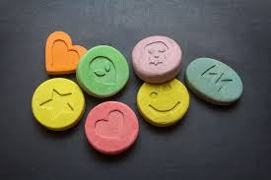
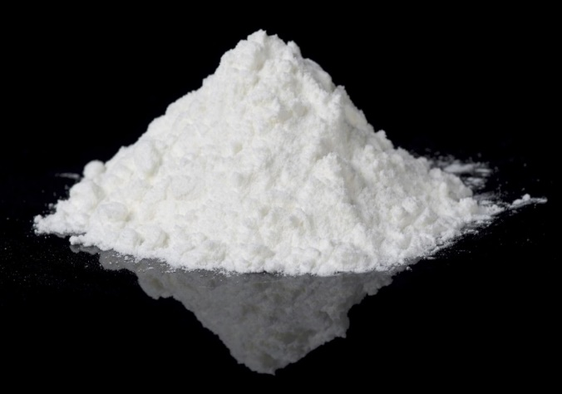

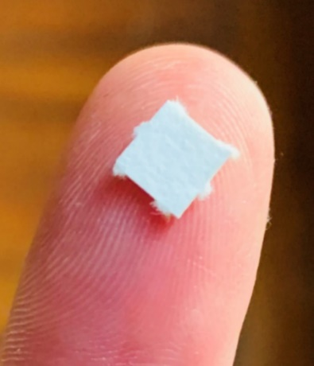
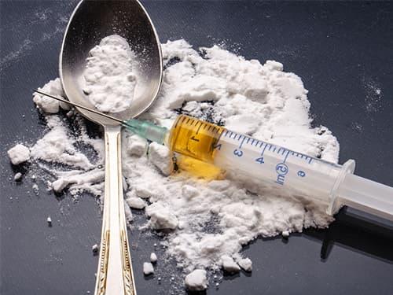
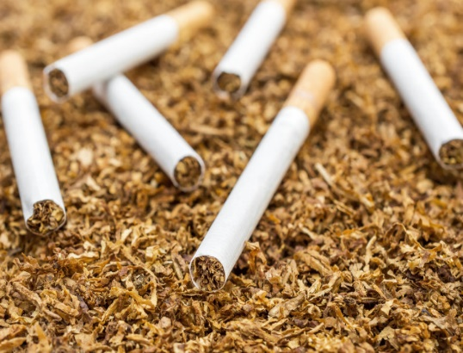
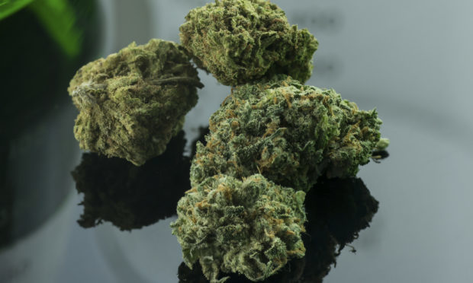
L1 - Drugs
STARTER: Which drug is the most harmful?
ECSTASY
COCAINE
Keywords: painkillers, hallucinogens, stimulants and depressants.
HEROIN
ALCOHOL
LSD
LESSON OBJECTIVES:
State the difference between medicinal and recreational drugs
Describe the effects of drugs on health and behaviour
TOBACCO
CANNABIS

Slide 2
What is a drug?
Can you think of your own definition?
A drug is any chemical (taken into the body) that changes the way the body or mind works.

Slide 3
Groups of drugs
Medicines are drugs that help people suffering from pain or disease.
Recreational drugs are taken for pleasure.
- Some are legal (eg. Alcohol and tobacco)
- Some are illegal (eg. heroin, cocaine, cannabis)
Notes:
Pupils do a card sort to place drugs into the three groups.

Slide 4
Why are drugs so dangerous?
People can become addicted to drugs. This means they develop a physical and mental need for the drug.
People can have an overdose. An overdose is when someone takes too much of a drug. This can lead to death or serious illness.
https://www.youtube.com/watch?v=4T1F1UfXf_8
Notes:
Explanation of key terms that they will come across during poster or in the lesson

Slide 5
The main four categories of drugs are:
Painkillers
Hallucinogens
Stimulants
Analgesics
Notes:
Poster activity followed where pupils gather information independently about these categories of drugs. Posters at the bottom of the slides.

Slide 6
TASK 1: Draw out this table in your books. Read the information sheets on the next 4 slides and fill in your tables as you read.
Type of drug (Category) | Effect on body | Example
TASK 2: answer the following questions
Which drug has the worst effects?
Which drug has the biggest risks to the user?
Do you agree with the Law for each of the 4 types of drugs?
Put the 4 drugs into order from the worst drug to use to the least worst.
FOR EACH QUESTION, EXPLAIN FULLY YOUR CHOICE & REASONS
Notes:
Modelling of activity for pupils.

Slide 7

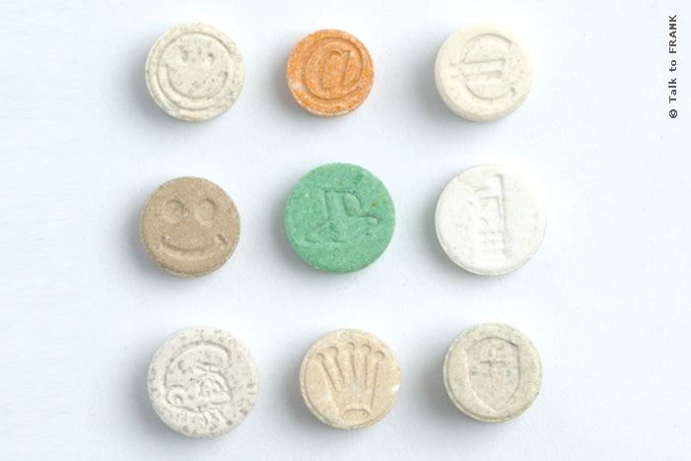
Hallucinogens
The law
Is illegal and a Class A drug.
Possession can get you up to 7 years in jail.
The maximum sentence for supplying halluginogens is life imprisonment and an unlimited fine.
Facts
Include LSD, magic mushrooms and ecstasy.
They have powerful mind-altering effects and cause people to see and hear things that are not there (hallucinate).
The risks
“Trips” or hallucinations can sometimes have very frightening effects.
Taking hallucinogens when in a bad mood has been known to make people harm themselves.

Slide 8
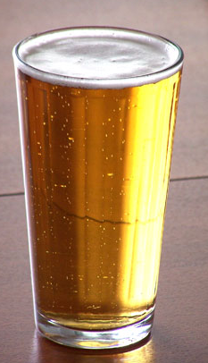

Depressants
The law
Alcohol is legal for anyone to buy over the age of 18.
Cannabis is a class C drug, if you are found with an amount with the intent to supply you can face 2 years in prison, and unlimited fine- or both.
Facts
Such as alcohol and cannabis
Can slow down the nervous system causing sleepiness and forgetfulness
The risks
Highly addictive as depressants are often ‘social’ drugs
Cannabis is linked to symptoms of paranoia and can lead to complications in the brain.

Slide 9
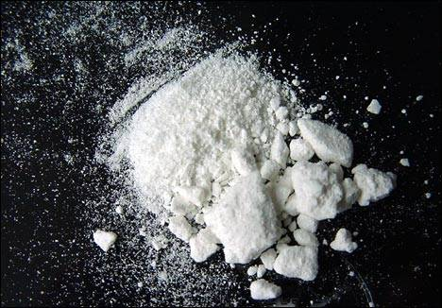

Stimulants
The law
Can be legal (caffeine) or illegal (cocaine)
Carries various penalities dependant on the classificication of the drug.
Facts
Include ecstasy, cocaine and caffeine
Speed up the activity of the nervous system.
Increase feelings of well-being, and increase energy and alertness.
The risks
Highly addictive because of the enhancement of users mood.
Psychological effects if stopped, the body ‘crashes’ can become depressed, nervous and suicidal.

Slide 10
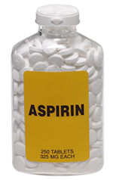
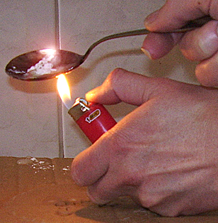
Analgesics
The law
Class A drugs are considered the most harmful and/or addictive.
They carry heavy prison sentences and unlimited fines for possession.
Facts
Examples such as heroin and aspirin.
Pain killers block nerve impulses.
They reduce the pain felt and for this reason become very addictive.
The risks
Highly addictive as they block pain this can lead to poor judgement of risky situations.
Heroin is often sold as a mixture of other products.

Slide 11
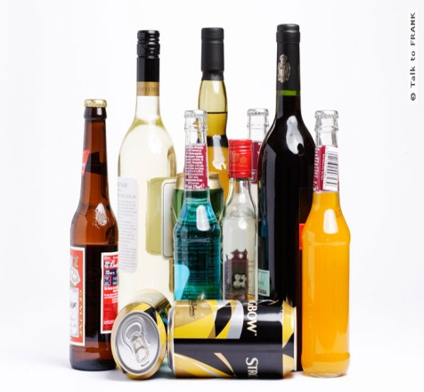
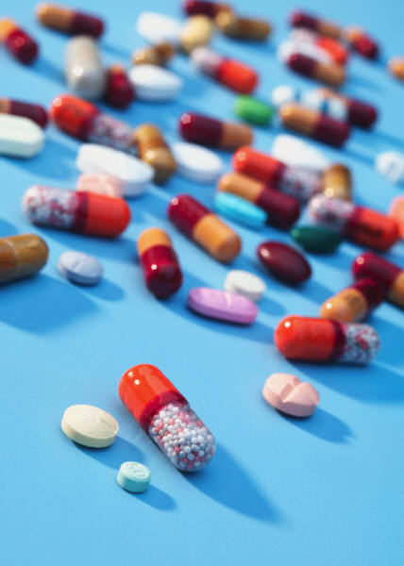
True or False?
All drugs are harmful
All drugs are illegal
Drugs are chemical substances which change the way the body functions
Drugs change the way a person behaves and feels
Hallucinogens are drugs which change what a person sees and hears
Depressants slow down the workings of the brain
Alcohol is a depressant
Illegal drugs are classified based on how dangerous they are
Caffeine is a drug
Paracetamol is an antibiotic
Heroin is a painkiller
Heroin was originally designed as a non addictive painkiller
Aspirin is made from the bark of willow trees
Coca Cola used to contain the drug cocaine
Nicotine is the drug found in tobacco
Cannabis is a drug which can cause mental illness
Alcohol and tobacco cause more deaths than any other drug

Slide 12

True or False?
All drugs are harmful
All drugs are illegal
Drugs are chemical substances which change the way the body functions
Drugs change the way a person behaves and feels
Hallucinogens are drugs which change what a person sees and hears
Depressants slow down the workings of the brain
Alcohol is a depressant
Illegal drugs are classified based on how dangerous they are
Caffeine is a drug
Paracetamol is an antibiotic
Heroin is a painkiller
Heroin was originally designed as a non addictive painkiller
Aspirin is made from the bark of willow trees
Coca Cola used to contain the drug cocaine
Nicotine is the drug found in tobacco
Cannabis is a drug which can cause mental illness
Alcohol and tobacco cause more deaths than any other drug

Slide 13

Plenary
What have you learnt today that surprised you?
Has your opinion about taking drugs changed at all?
What are the main concerns for yourself about drugs?

Slide 14

L2 - Alcohol
STARTER:
What is meant by the term alcoholic?
Why is it illegal to drink and drive?
What harmful affects does alcohol have on the body?
LESSON OBJECTIVES:
Understand the terms ‘stimulant’ and ‘depressant’
Recognise the dangers of alcohol misuse
Explain how drinking and can lead to some serious diseases.
Keywords: ethanol, alcohol, unit, liver, foetal alcohol syndrome

Slide 15
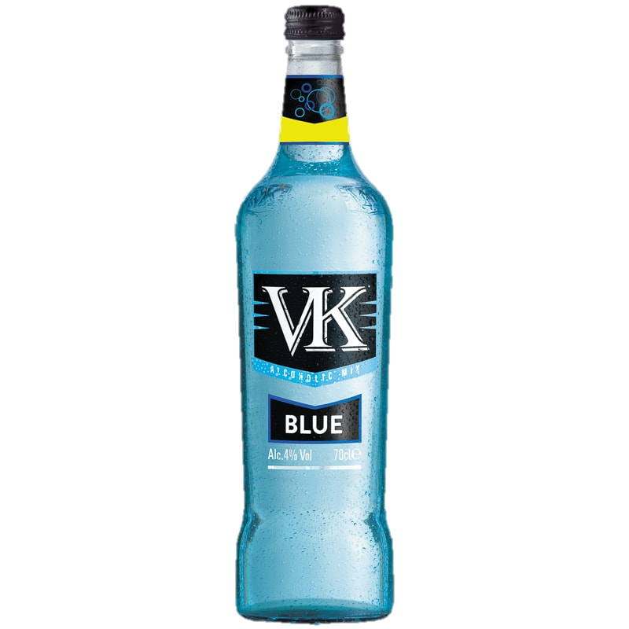
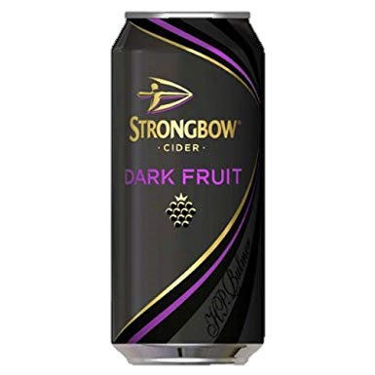



WHAT IS ALCOHOL?
Alcohol contains a drug called ethanol. Ethanol is a type of drug called a depressant. What do we mean by the term ‘depressant’?
A depressant drug slows down the speed that messages are sent from the brain to parts of the body along nerves.
What type of alcoholic drinks are there?

Slide 16

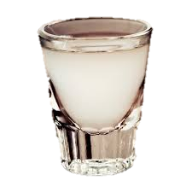

HOW MUCH ALCOHOL CAN YOU DRINK SAFELY?
Alcohol consumption is measured in units.
One unit of alcohol = 10ml of pure alcohol.
Different alcoholic drinks have different units:
Pint of Beer = Alcopop =
3 units 1.5 units
Glass of wine = Shot of spirit =
2 units 1 unit
The government recommends that adults don’t drink more than 14 units of alcohol a week. However, this may change depending on height, weight, gender, etc.

Slide 17

WHAT ARE THE EFFECTS OF DRINKING ALCOHOL?
Ingesting a depressant drug such as alcohol can lead to an individual becoming drunk. What are the effects of being drunk?
- Feelings of well-being (happy and relaxed)
- Lowered inhibition
- Slowed thinking
- Slowed muscular activity and reaction time
- Blurred vision and/or hallucinations.
- Unconsciousness
- Death

Slide 18

WHAT ARE THE EFFECTS OF DRINKING ALCOHOL?
TASK 1: Draw the figure of a person out.
As you watch the video, add arrows to your person explaining what alcohol does to this part of the body.
Watch this video
https://www.youtube.com/watch?v=V2Aj-iJ6p38

Slide 19
WHAT ARE THE EFFECTS OF DRINKING ALCOHOL?
Persistent misuse of alcohol can lead to some serious long-term effects on the body:
Brain damage / Memory loss (Korsakoff’s syndrome)
Drop in mental health
Stroke
Addiction
(‘alcoholism’)
Heart disease / High blood pressure
Liver damage / Liver failure
Various forms of cancers
Sexual dysfunction / infertility

Slide 20

“IT SHOULD BE ILLEGAL FOR PREGNANT WOMEN
DRINK?”
Do you agree with this statement?
Notes:
Group discussion / debate

Slide 21
SHOULD PREGNANT WOMEN
DRINK?
Pregnant women should not drink any alcohol.
When pregnant women drink, the ethanol enters their bloodstream and can diffuse into the baby’s blood.
Other effects of pregnant women drinking include:
Increase risk of miscarriage
Premature birth
Low-birth-weight of the child.
Drinking alcohol when pregnant is the baby may suffer from Foetal Alcohol Syndrome.

Slide 22
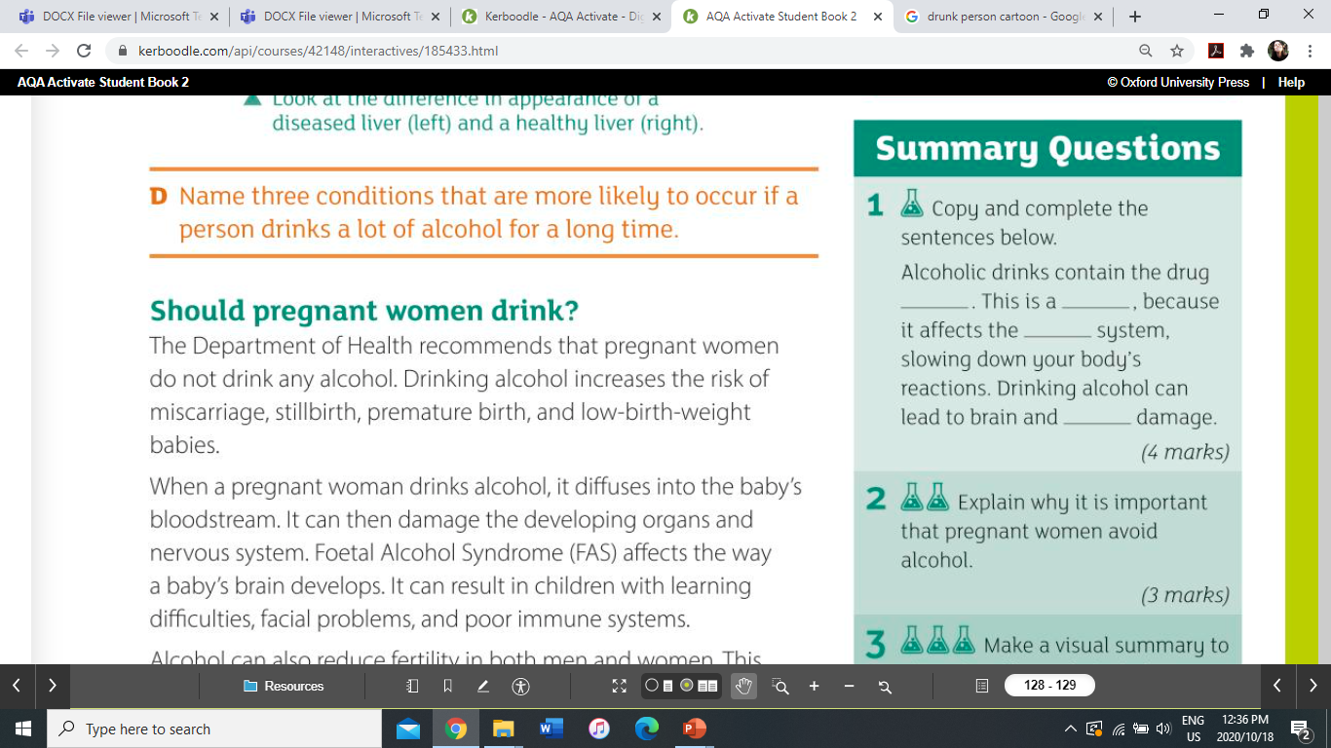
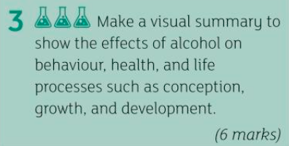
TASK 2: answer the following questions

Slide 23
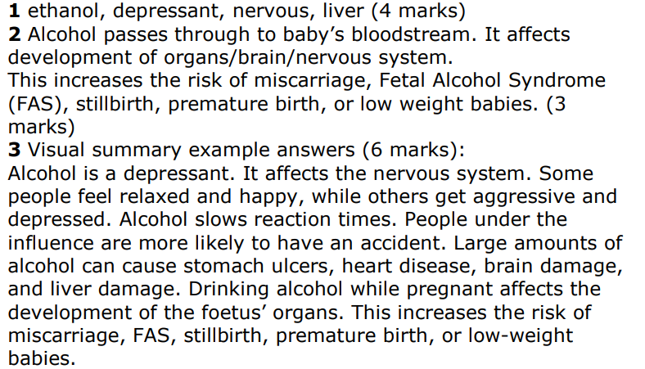
Self-assessment

Slide 24
Plenary – if these are the answers, what are the questions?
Foetal alcohol syndrome
Depressant
Ethanol
14 units

Slide 25
L3 - Smoking
STARTER:
How many chemicals do you think there are in a cigarette?
LESSON OBJECTIVES:
Describe the effects of tobacco smoke on health
Explain the effects of tobacco smoke on health
Keywords: passive smoking, stimulant, mucus

Slide 26
WHAT IS TOBACCO
Tobacco is a substance made from over 400 different chemicals. The most dangerous are:
Tar = a black sticky substance that sticks to the lining of the lungs. Some chemicals of tar are carcinogens.
Carbon monoxide = A poisonous gas which stops the blood carrying as much oxygen as it should be able to.
Nicotine = A type of drug called a stimulant. Nicotine makes the heart beat faster and narrows blood vessels.

Slide 27
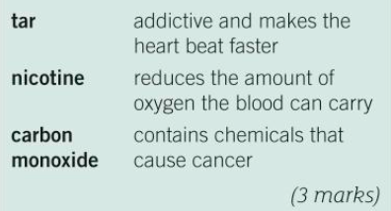
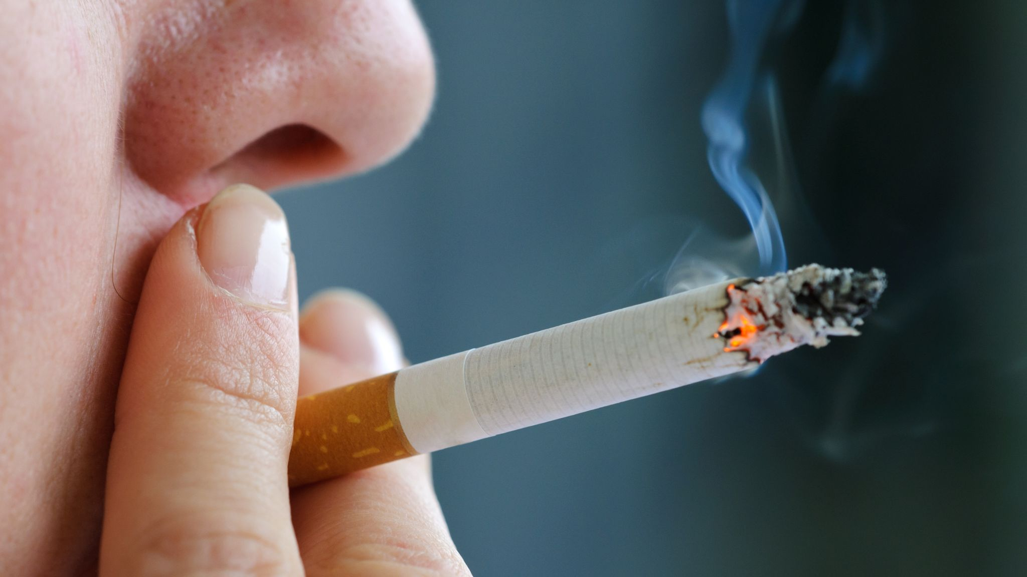
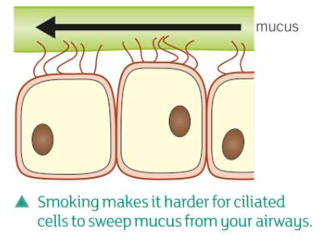
TASK 1: match the chemicals in tobacco smoke to their harmful effect
Challenge: suggest why smokers often cough a lot when they wake up in the morning

Slide 28
Self-assessment
Challenge: they cough to remove mucus, as their cilia that would normally do this are paralysed by smoking

Slide 29
WHY IS SMOKING DANGEROUS
Smoking puts people at risk of breathing problems, heart attacks, strokes and various cancers.
“Smoking only affects the person doing it – it is their choice so what’s the problem?”
Do you agree or disagree with the statement above?

Slide 30

WHY IS SMOKING DANGEROUS
Smoking can also affect other people nearby through a process called passive smoking.
Passive smoking can be dangerous for babies and young children. Parents who smoke when a baby is born can increase the risk of breathing problems in their children, including bronchitis and pneumonia.
It can also cause the sudden death of the child.
Up until 2007 it was legal to smoke in indoor public places.

Slide 31
EFFECTS OF SMOKING
TASK 2: draw up the following table. Divide these effects into the correct columns
Short –term effects | Long-term effects
Reduced potency in men
Reduced fertility in women
Lung diseases
Premature aging
Circulatory problems
Cancers (Smoking related cancers are: lung, mouth, throat, stomach, bladder, cervix and more)
Weaker immune system
Heart disease
Bad breath
Spontaneous miscarriage
Reduction in taste and smell
Yellowish shade on teeth and fingers
Continuous cough
Negative effects on pregnant women and their baby
Notes:
RED = LONG TERM, BLUE= SHORT TERM.

Slide 32
Self-assessment
EFFECTS OF SMOKING
Short –term effects | Long-term effects
Yellowish shade on teeth and fingers Reduced potency in men and reduced fertility in women Bad breath Reduction in taste and smell Continuous cough Weaker immune system | Circulatory problems Premature aging Lung diseases Cancers (smoking related cancers include lung, mouth, throat, stomach, bladder, cervix and more) Heart diseases Negative effects on pregnant women and their baby Spontaneous miscarriage
Notes:
RED = LONG TERM, BLUE= SHORT TERM.

Slide 33
DISEASES CAUSED BY SMOKING
Heart disease = Smoking causes the arteries to narrow or become blocked which can lead to a heart attack or a stroke.
Emphysema = Little air sacs called alveoli in the lungs have their walls weakened by chemicals in cigarette smoke. This means they don’t fill with air properly or burst when you breathe in making you feel breathless.
Respiratory infections = Chemicals in smoke stop little hairs called cilia from sweeping mucus out of your lungs. This makes it hard to breathe and can lead to infection.

Slide 34
DISEASES CAUSED BY SMOKING
TASK 3:
Often adults engage in smoking when they go to pubs or nightclubs.
You need to design a poster or leaflet to advise adults on the dangers of excess alcohol use and smoking.
You might need to use this site to help find some extra information: https://www.bbc.co.uk/bitesize/guides/zy2hpv4/revision/2
Notes:
Homework is to finish the poster.

Slide 35
PLENARY:
What is the difference between a stimulant and a depressant drug? Can you give an example of each?
Describe some of the long-term effects of alcohol misuse and excessive smoking.
How might smoking contribute to the development of respiratory infections?

Slide 36
Now complete the task on the pdf file named 14.12.2020 smoking statistics

