Slide 1
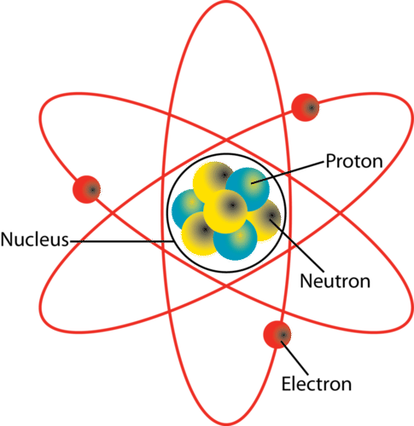
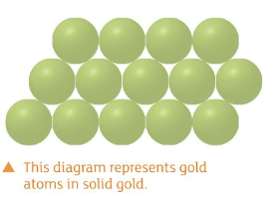
L1 - Atoms & Elements
Starter:
What is an atom?
Lesson Objectives
Define the term element
Recall the chemical symbol for 16 elements
An atom is the smallest part of an element.
Everything is made from atoms.

Slide 2
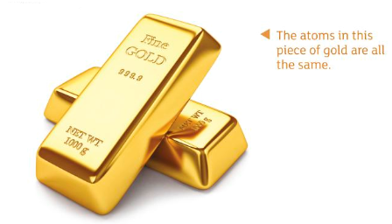
What is an element?
How many elements are there?
Elements are substances that contain only one type of atom. ​
Every material, and everything in the Universe, is made up of one or more elements. ​
​
It is not possible to break down an element into other substances. There are 98 naturally occurring elements.
They are all listed on the periodic table.

Slide 3
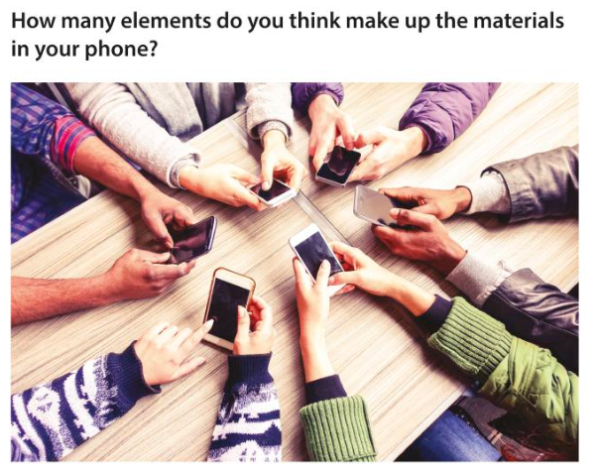
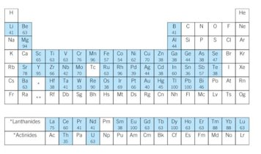
A smartphone contains around 60 elements. ​​

Slide 4
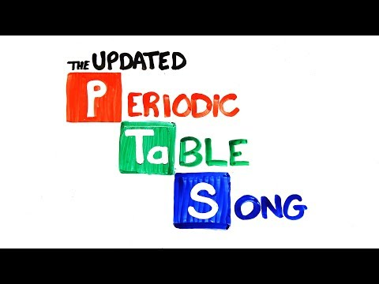

Slide 5
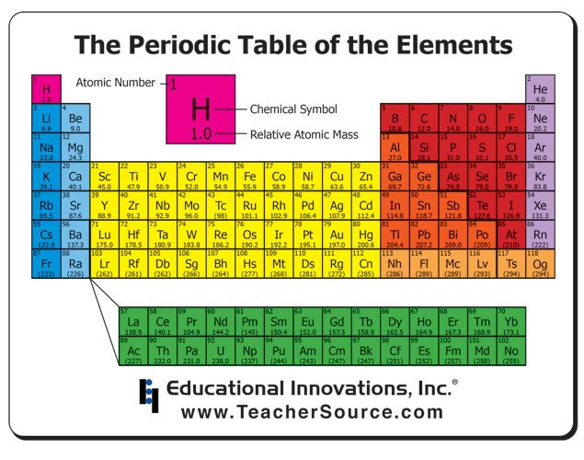
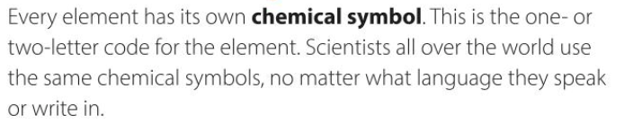

Chemical symbols
Mg mg mG MG - which is correct?​
Which element is it for?​

Slide 6
Atoms and Symbols
TASK 1: Find the name of element with symbol
O
H
Mg
Cl
K
Ne
Be
Al
TASK 2: Find the symbol of the element
Helium
Nitrogen
Sodium
Iron
Gold
Fluorine
Carbon
Sulfur

Slide 7
Atoms and Symbols
Find the name of element with symbol
Find the symbol of the element
O - oxygen
H - hydrogen
Mg - magnesium
Cl - chlorine
K - potassium
Ne - neon
Be - beryllium
Al - aluminium
Helium - He
Nitrogen - N
Sodium - Na
Iron - Fe
Gold - Au
Fluorine - F
Carbon - C
Sulfur - S

Slide 8
Task 3: Pick 1 element on the periodic table.
Write a paragraph in your books about your element.
You must include:
Its full name
Its chemical symbol
3 key properties (eg boiling point, state at room temperature, density etc.)
2 important uses
CHALLENGE: can you memorize the first 20 elements in the periodic table? (in order of atomic number)

Slide 9
Plenary: True or False?
Elements are made up of one type of atom
Water is an element
H is the symbol for Hydrogen
The symbol for sodium is NA
All elements are shown on the periodic table
Elements like Chlorine go around as pairs of atoms

Slide 10
True or False?
Elements are made up of one type of atom
Water is an element (water is a compound – made up Hydrogen and Oxygen)
H is the symbol for Hydrogen
The symbol for sodium is NA (the symbol for sodium is Na)
All elements are shown on the periodic table
Elements like Chlorine go around as pairs of atoms

Slide 11
Now complete the task on the pdf file named 16.11.2020 properties of atoms and elements

Slide 12
Starter: Which are elements?
L2 - Compounds
Lesson Objectives
Define the term compound
Represent elements, compounds, molecules and mixtures using a particle diagram
1
2
3
4
5
6

Slide 13

Which are elements?
2
1
3
4
5
6

Slide 14
TASK 1: Match up – draw a particle diagram to represent the definition
Element: Made up of one type of substance
Compound: A mixture of compounds and / or elements not bonded together
Mixture: More than one different type of substance bonded together.

Slide 15
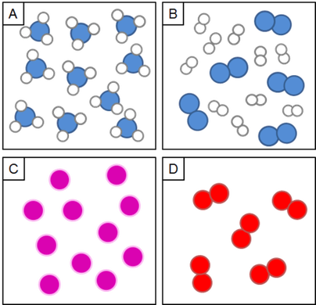
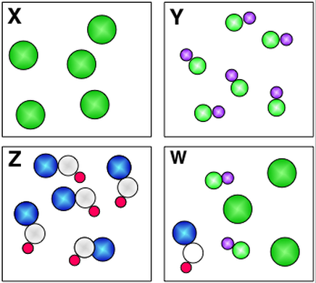
TASK 2: Identify each diagram as either an element, mixture or compound.
Element: Made up of one type of substance.
Compound: More than one different type of substance bonded together.
Mixture: A mixture of compounds and / or elements not bonded together.
Challenge: If blue is nitrogen (N), white is hydrogen (H) and red is oxygen (O), write the chemical formula for the molecules in A, B, D and Z.
Super Challenge: How can you tell if something is an element or a compound by looking at it’s formula?

Slide 16

Compound
Mixture
Element
Compound
Challenge: If blue is nitrogen (N), white is hydrogen (H) and red is oxygen (O), write the chemical formula for the molecules in A, B, D and Z.
A – NH₃
B – N₂ and H₂
D – O₂
Z - NHO
Super Challenge: When there are more than one chemical symbols. These always begin with a capital letter
Element
Element
Compound
Mixture

Slide 17
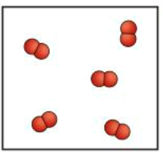
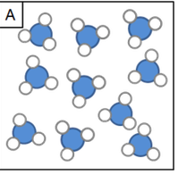
Molecules and Compounds
This diagram shows some molecules:
What is a molecule?
A molecule is a collection of two or more atoms held together by chemical bonds
This diagram shows a compound:
What is a compound?
Challenge: The compound diagram shows ammonia as a gas. Have a go at drawing ammonia as a liquid.
Compound: More than one different type of substance bonded together.

Slide 18
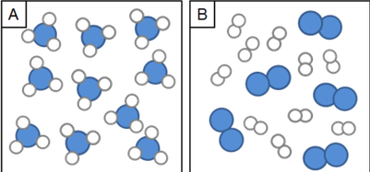
Atoms and Molecules
An atom is the smallest part of an element.
Everything is made from atoms.
A molecule is 2 or more atoms bonded together.
molecules
atoms
Challenge: Draw a diagram to show the molecules in water (H₂O)

Slide 19
Video: atoms, elements, compounds and molecules
https://www.youtube.com/watch?v=AfXxZwNLvPA

Slide 20
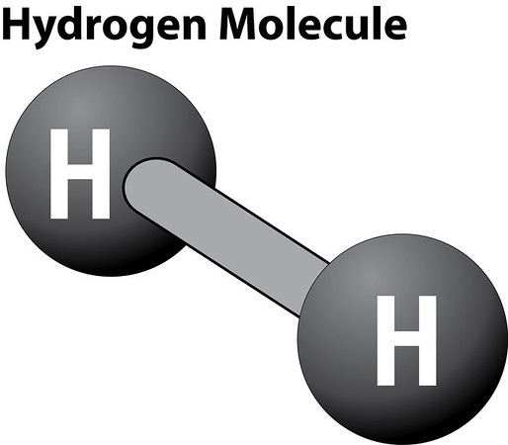
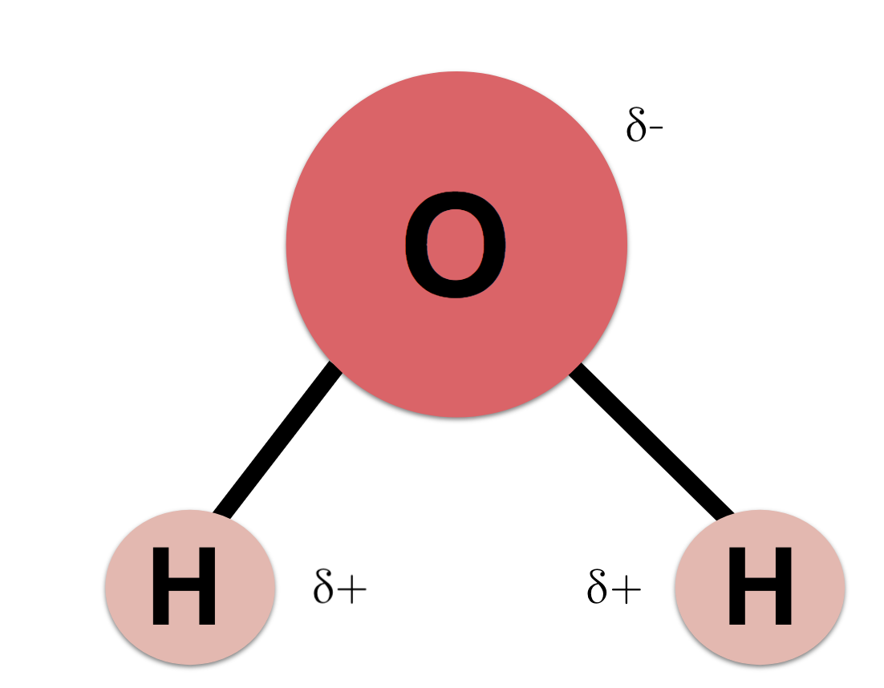
Water molecules are different to hydrogen molecules and oxygen molecules. They have different properties.
Water Molecule
Weak forces
Strong forces
So it takes less energy to break the atoms apart.
Therefore the boiling point is lower
So it takes more energy to break the atoms apart.
Therefore the boiling point is higher

Slide 21
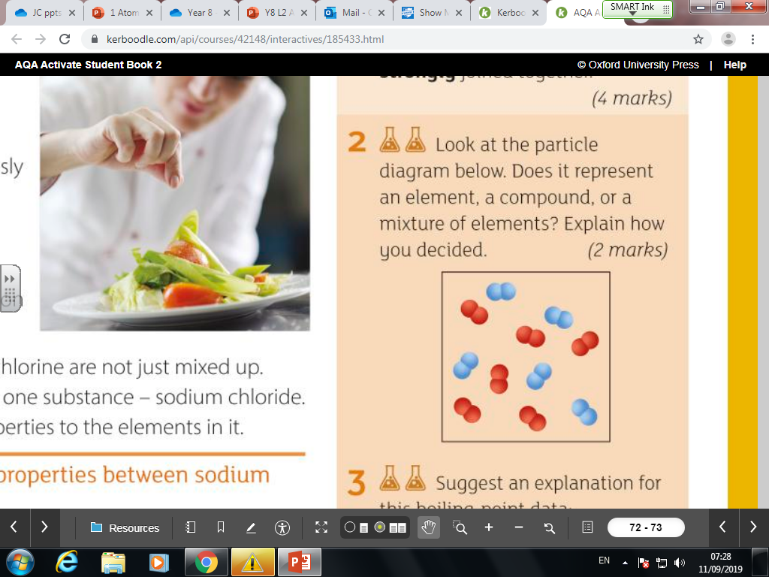
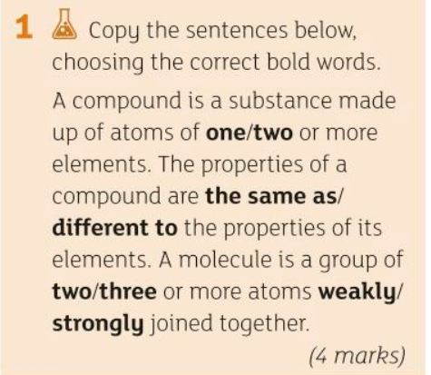
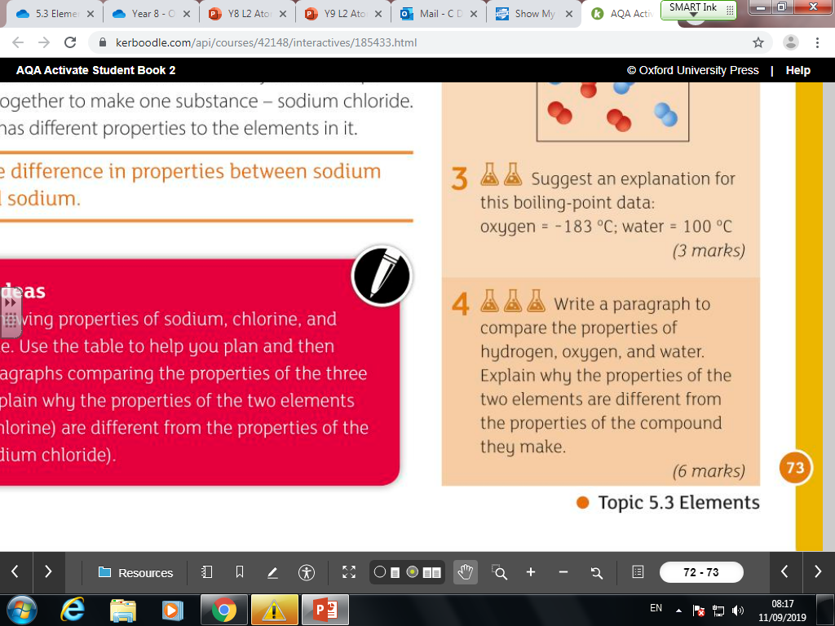

Slide 22
Mixture. The red and blue molecules are different from one another. They are not bonded together chemically.

Slide 23
The bonds between the oxygen atoms in liquid oxygen are very weak so it takes very little energy to break them apart. Therefore the boiling point is very low.
The bonds between the hydrogen and oxygen atoms in H2O (water) are much stronger so it takes much more energy to break them apart. Therefore the boiling point is much higher.

Slide 24
Atoms in Compounds - Formulae
The chemical formula of a compound tells you how many atoms of each element are in the compound.
e.g. H₂O = 2 x hydrogen and 1 x oxygen
Have a go at counting the atoms in the compounds below. You can complete them in any order.
CO₂ Na₂O C₂H₆
MgO Al₂O₃ LiF
CaSO₄ Mg(CO₃)₂ C₁₀₀H₂₀₀
KCl (NH₄)₂SO₄ (NH₄)₃PO₄

Slide 25
Atoms in Compounds - Formulae
The chemical formula of a compound tells you how many atoms of each element are in the compound.
e.g. H₂O = 2 x hydrogen and 1 x oxygen
Have a go at counting the atoms in the compounds below. You can complete them in any order.
CO₂ 1xC 2xO Na₂O 2xNa 1xO C₂H₆ 2xC 6xH
MgO 1xMg 1xO Al₂O₃ 2xAl 3xO LiF 1xLi 1xF
CaSO₄ 1xCa 1xS 4xO Mg(CO₃)₂ 1xMg 2xC 6xO C₁₀₀H₂₀₀ 100xC 200xH
KCl 1xK 1xCl (NH₄)₂SO₄ 2xN 8xH 1xS 4xO (NH₄)₃PO₄ 3xN 12xH 1xP 4xO

