Slide 1
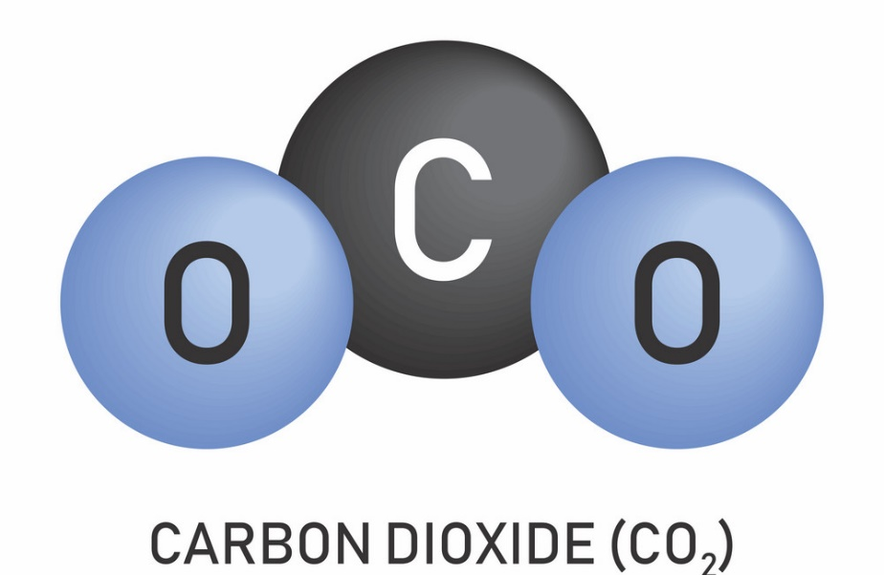
L1 - Chemical formulae
Starter questions:
What is the difference between a compound and a mixture?
What is an example of a compound?
List the atoms in these molecules:
Li₃PO₄
H₂SO₄
MgCl₂
Lesson objectives:
To identify how many atoms are in compounds based on their formulae​
To draw molecules using chemical formulae​
To name compounds from their formulae

Slide 2
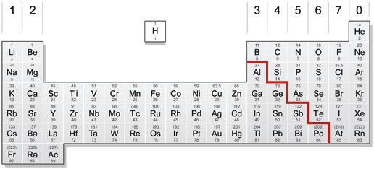
Metals and Non-metals
TASK 1: The periodic table is split into metals and non-metals. Colour in the metals on your periodic table, then copy and complete the table.
Element name | Element symbol | Metal or non-metal?
Lithium | Li | Metal
Carbon | C | Non-metal
Oxygen | O | Non-metal
Sodium | Na | Metal
Iron | Fe | Metal
Krypton | Kr | Non-metal
Metals
Non-Metals
Challenge: Why do some of the elements have 2 letters in their symbol?
Super Challenge: What do you notice about the numbers in your periodic table?

Slide 3
Naming Compounds
In a formula, each new capital letter means a new element.
If there is a non-metal in the compound, the end of the element changes to “–ide” e.g. KBr = potassium bromide, not potassium bromine.
To give more information about some compounds, “mon” and “di” are sometimes used e.g. carbon monoxide = CO, carbon dioxide = CO₂
If there is oxygen in a compound with a metal and 2 non-metals, the last part of the name is “-ate”. e.g. CaS = calcium sulfide, CaSO₄ = calcium sulfate
Task 2: state how many of each element are in the compounds below e.g. H₂O = 2 x hydrogen, 1 x oxygen.
Task 3: Use the rules above to name each compound.
NaCl
NO₂
MgS
MgSO₄
H₂O
6. LiI
7. KNO₃
8. SrCO₃
9. Na₃PO₄
10. Be(CO₃)₂
Challenge: Have a go at writing the formulae of these compounds:
Sulfur dioxide
Lithium chloride
Magnesium oxide
Calcium sulfate

Slide 4

Naming Compounds
In a formula, each new capital letter means a new element.
If there is a non-metal in the compound, the end of the element changes to “–ide” e.g. KBr = potassium bromide, not potassium bromine.
To give more information about some compounds, “mon” and “di” are sometimes used e.g. carbon monoxide = CO, carbon dioxide = CO₂
If there is oxygen in a compound with a metal and 2 non-metals, the last part of the name is “-ate”. e.g. CaS = calcium sulfide, CaSO₄ = calcium sulfate
NaCl sodium chloride
NO₂ nitrogen dioxide
MgS magnesium sulfide
MgSO₄ magnesium sulfate
H₂O hydrogen oxide
Challenge: Have a go at writing the formulae of these compounds:
Sulfur dioxide SO₂
Lithium chloride LiCl
Magnesium oxide MgO
Calcium sulfate CaSO₄
6. LiI lithium iodide
7. KNO₃ potassium nitrate
8. SrCO₃ strontium carbonate
9. Na₃PO₄ sodium phosphate
10. Be(CO₃)₂ beryllium carbonate

Slide 5
More Practice – naming comounds
In a formula, each new capital letter means a new element.
If there is a non-metal in the compound, the end of the element changes to “–ide” e.g. KBr = potassium bromide, not potassium bromine.
To give more information about some compounds, “mon” and “di” are sometimes used e.g. carbon monoxide = CO, carbon dioxide = CO₂
If there is oxygen in a compound with a metal and 2 non-metals, the last part of the name is “-ate”. e.g. CaS = calcium sulfide, CaSO₄ = calcium sulfate
MgCl₂
SO₂
Li₃P
Li₃PO₄
SO₃
6. CaF₂
7. RbNO₃
8. Fr₂CO₃
9. H₂SO₄
10. Sr(CO₃)₂
Challenge: Have a go at writing the formulae of these compounds:
Sulfur dioxide
Lithium chloride
Magnesium oxide
Calcium sulfate

Slide 6
Naming Compounds
In a formula, each new capital letter means a new element.
If there is a non-metal in the compound, the end of the element changes to “–ide” e.g. KBr = potassium bromide, not potassium bromine.
To give more information about some compounds, “mon” and “di” are sometimes used e.g. carbon monoxide = CO, carbon dioxide = CO₂
If there is oxygen in a compound with a metal and 2 non-metals, the last part of the name is “-ate”. e.g. CaS = calcium sulfide, CaSO₄ = calcium sulfate
MgCl₂
SO₂
Li₃P
Li₃PO₄
SO₃
6. CaF₂
7. RbNO₃
8. Fr₂CO₃
9. H₂SO₄
10. Sr(CO₃)₂
Challenge: Have a go at writing the formulae of these compounds:
Sulfur dioxide SO₂
Lithium chloride LiCl
Magnesium oxide MgO
Calcium sulfate CaSO₄
Magnesium chloride
Calcium fluoride
Sulfur dioxide
Rubidium nitrate
Lithium phosphide
Francium carbonate
Lithium phosphate
Hydrogen sulfate
Sulfur trioxide
Strontium carbonate

Slide 7
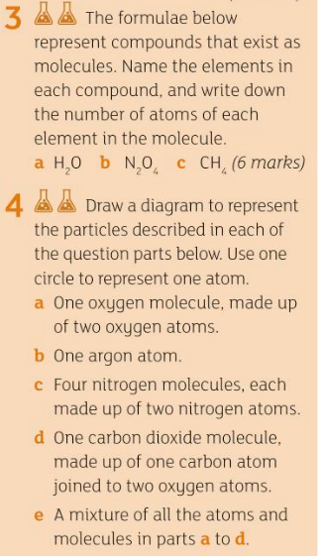
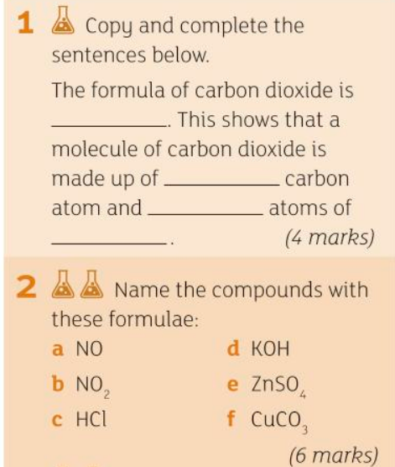
TASK 4: Answer the following questions

Slide 8
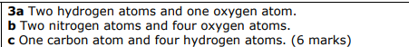
CO₂
One
two
oxygen
Nitrogen monoxide
Potassium hydroxide
Nitrogen dioxide
Zinc sulfate
Hydrogen chloride
Copper carbonate

Slide 9

Atoms, compounds and formulae guide
Make a guide for a new year 8 student on the chemistry you have learned so far. Include:
The difference between an element, mixture and compound (including diagrams)
How to find out the symbol of an element
What an atom is
What a molecule is
What chemical formulae tells you about a compound
How to name a compound
How to draw diagrams of molecules using formulae

Slide 10



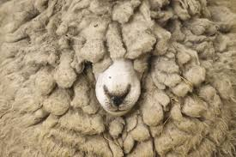
L2 - Polymers
Starter questions:
What are the similarities and differences between the 4 pictures?
Can you think of something that links them all?
Lesson objectives:
To describe the structure of a polymer
To link a polymer’s structure to its properties
To recognise patterns in data

Slide 11
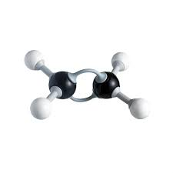
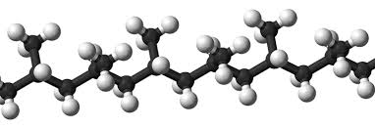


What has happened in this “reaction”?
What do you think the paper clips represent?

Slide 12
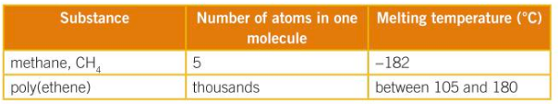
Polymer Properties
Most polymers are solid at room temperature, as they have many weak intermolecular forces
(bigger molecules = stronger/more intermolecular forces).
When a polymer is melted, the intermolecular forces are broken.
TASK 1: Use the information above to describe and explain the information in the table below.
Challenge: Draw a diagram to show the long polymer chains held together by weak intermolecular forces.
Super Challenge: What do you think holds the chain together?

Slide 13
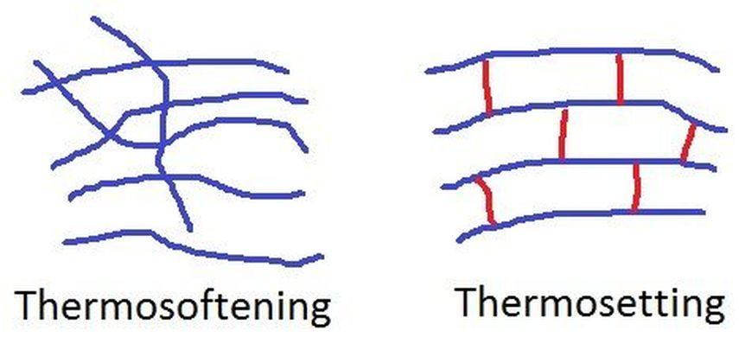
Polymer Properties
Most polymers are solid at room temperature, as they have many weak intermolecular forces (bigger molecules = stronger/more intermolecular forces).
You’re going to take a polymer with just intermolecular forces holding the chains together (PVA) and add covalent bond cross links to see how this affects the properties.
What do you think will happen?

Slide 14
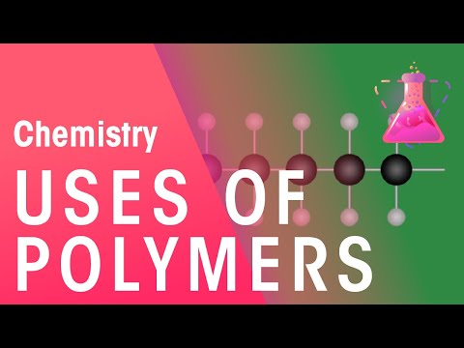
TASK 2: Watch the video and list as many different types of polymers as you can.
List some of the problems associated with polymers.

Slide 15
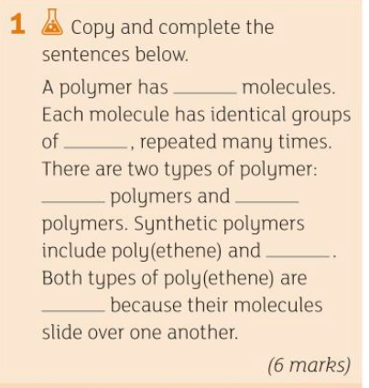
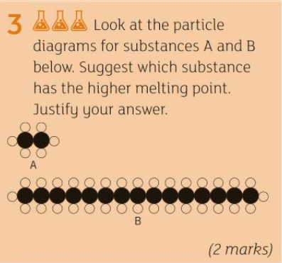
TASK 3 : Answer the following questions

Slide 16
long
atoms
natural
synthetic
PVC
flexible
Because it has larger molecules

Slide 17
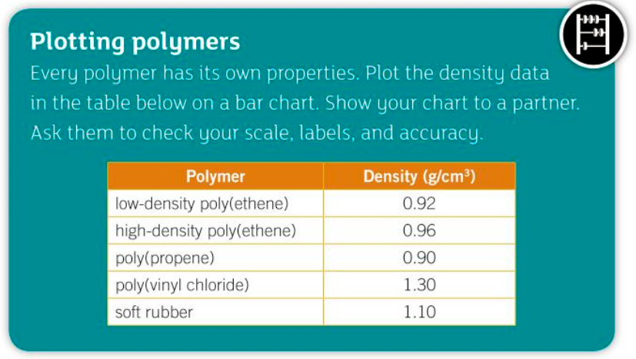
TASK 4: plot a graph using this data

