Slide 1
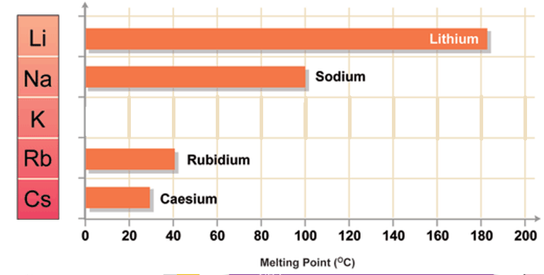
L1 - The Periodic Table
STARTER: Use the graph to estimate the melting point of potassium.
LESSON OBJECTIVES:
To state what periods and groups are on the periodic table​
To use data to describe a trend in physical properties​
To use trends and data to estimate properties
Challenge: Try to relate this trend to the Periodic Table.

Slide 2
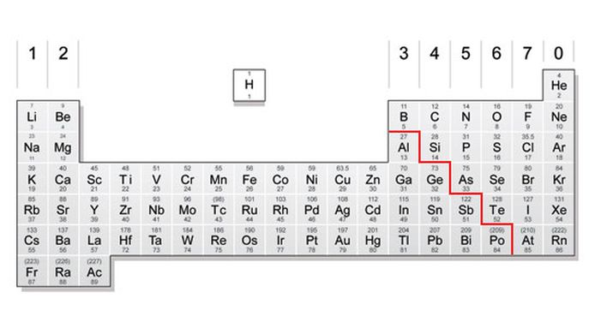
TASK 1: On your periodic table, draw the line separating the metals and non-metals.
Colour in the non-metals.
Challenge: What do you think the other numbers on the periodic table mean? Use the key to help you.
We will be studying groups 1, 7 and 0.
Label group 1 as the alkali metals.
Label group 7 as the halogens.
Label group 0 as the noble gases.
Which elements do you think are in period 3 of the table?

Slide 3
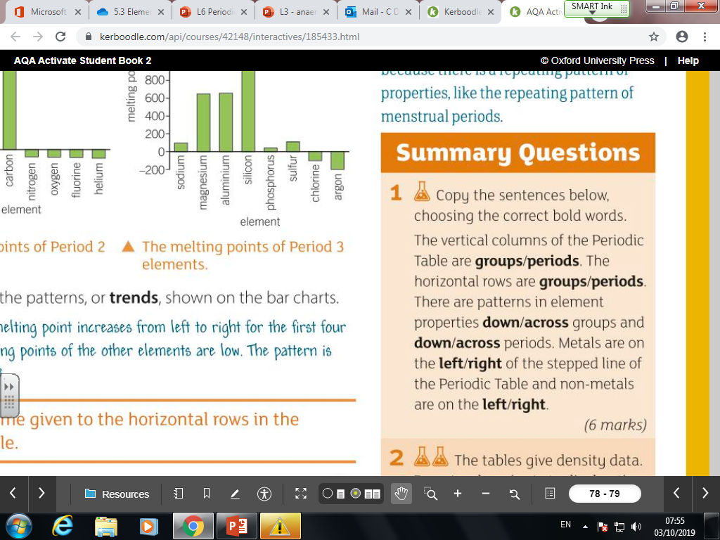
TASK 2: Copy the sentences below, choosing the correct bold words

Slide 4


Slide 5
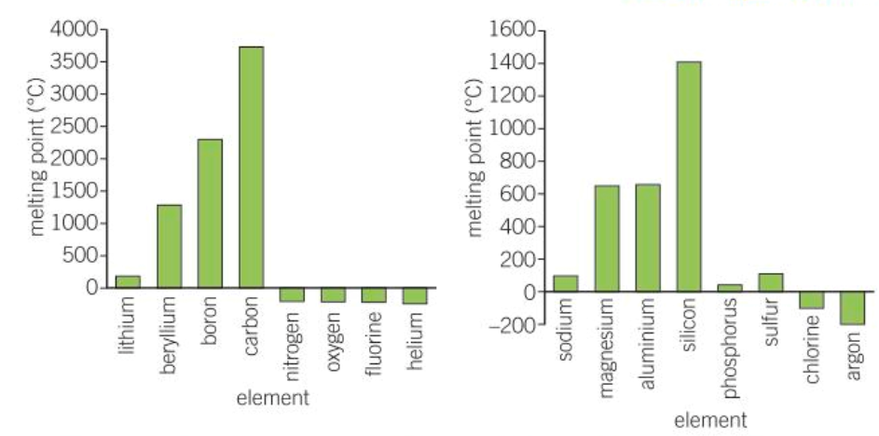
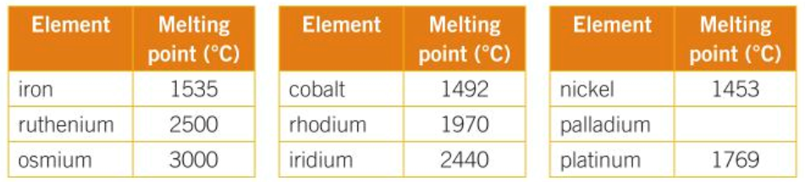
Look at the bar graphs showing the trends in melting points for period 2 and 3. Describe the trend for each period.
Look at the melting point data in the tables. Predict the melting point for iridium and for palladium. Explain your answer.
Challenge: Why do you think the melting point increases as you go down the groups?

Slide 6
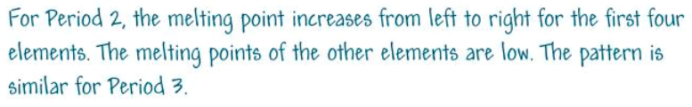
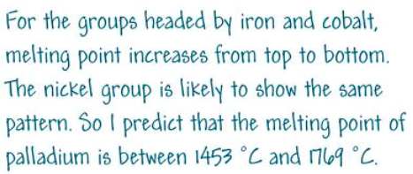
Look at the bar graphs showing the trends in melting points for period 2 and 3. Describe the trend for each period.
Look at the melting point data in the tables. Predict the melting point for iridium and for palladium. Explain your answer.
1550
Challenge: Why do you think the melting point increases as you go down the groups? As the mass number increases, the melting point increases (within a group).

Slide 7
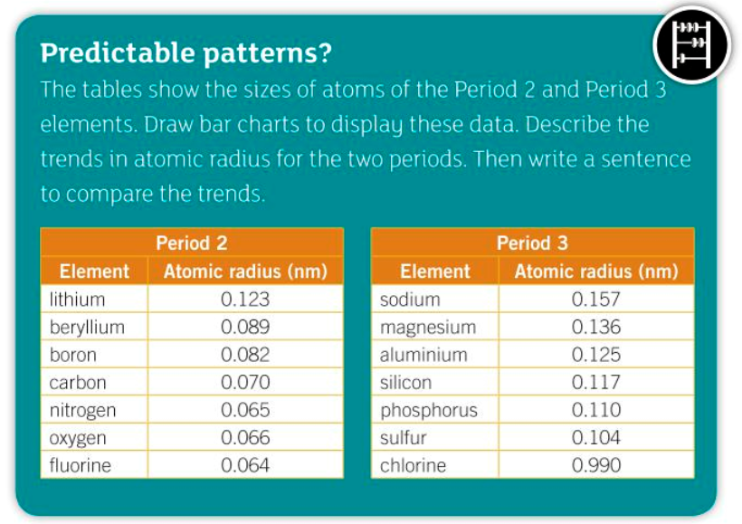
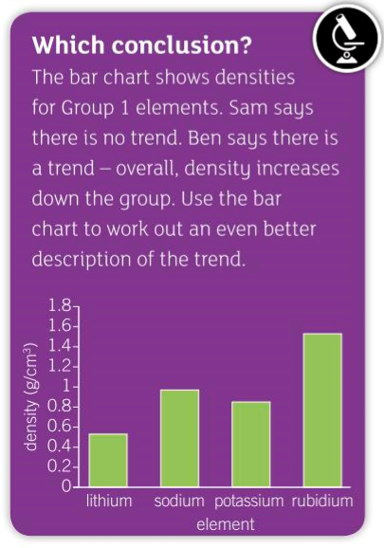

Slide 8
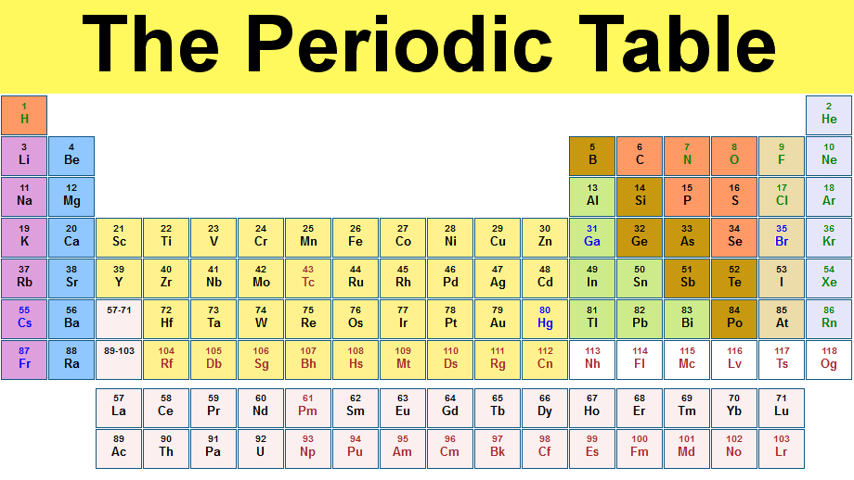
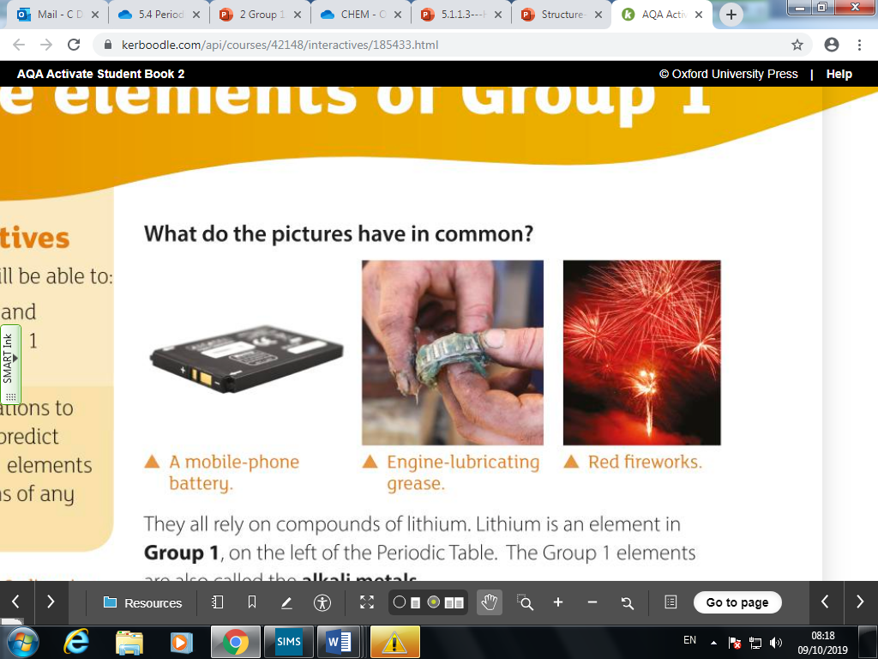
L2 -Group 1 (the Alkali Metals)
Starter questions:
List 3 Group 1 elements
Are they metals or non-metals?
Do you think that they are reactive or unreactive?
Lesson objectives:
To describe some properties of group 1 metals
To describe trends in group 1 metals and predict properties
To write word and symbol equations for the reactions of group 1 metals with water

Slide 9
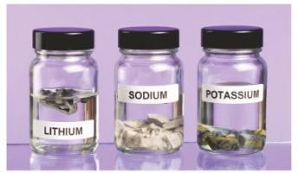
Why are the alkali metals stored in oil?
the Group 1 elements are very reactive... They must be stored under oil to keep air and water away from them

Slide 10
Group 1 elements are all metals that conduct electricity. They are very reactive.
They are shiny when they are cut

Slide 11
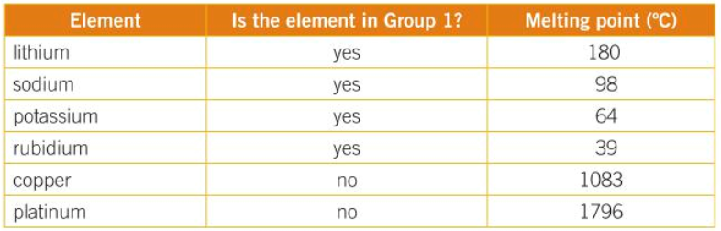
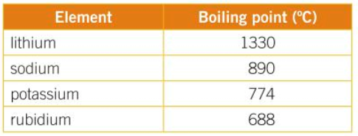
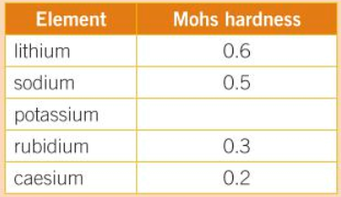
Look at each of the data tables. What conclusions can you draw from the data (you should be able to come up with 3 points).
Use the data to justify your answer.
Challenge: Predict the missing value for potassium. Explain why you have made this prediction.

Slide 12
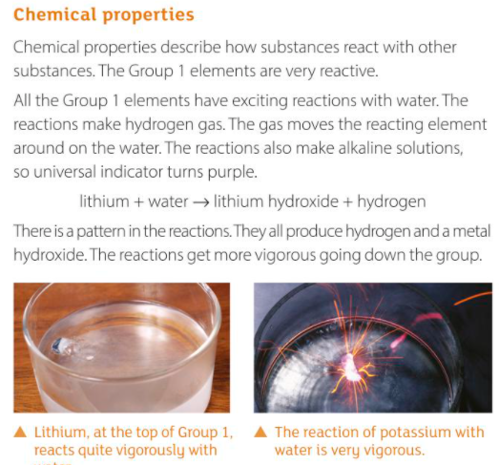
TASK: Read through the information and then watch the video
https://www.youtube.com/watch?v=m55kgyApYrY&t=53s

Slide 13
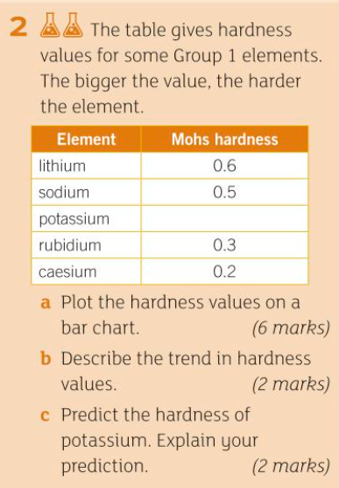
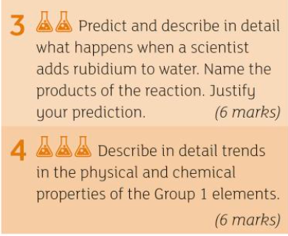
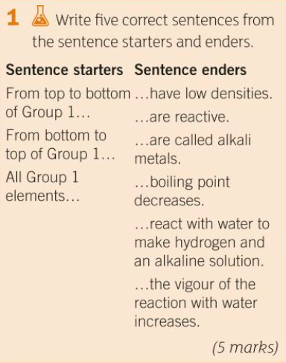
TASK: answer as many of these questions as you can

Slide 14
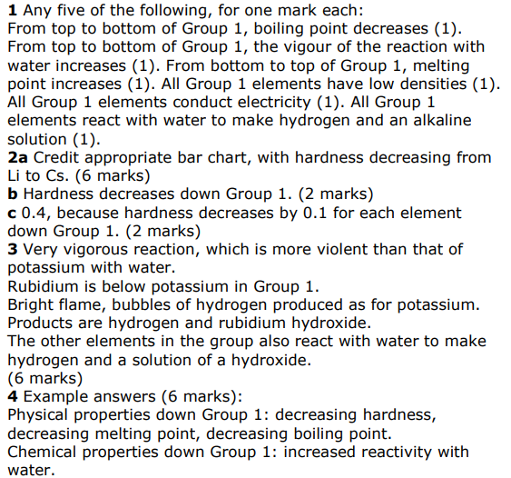

Slide 15
Exam Question! - what would you score out of 6 marks?
Explain the trend in reactivity as you go down group 1. Refer to what you know about the electron structure of the elements. [6]

Slide 16
Mark Scheme
As you go down the group the reactivity increases.
The alkali metals all have one outer electron
They all form 1+ ions
As you go down the group, the atoms become bigger
The outer electron is further away from the nucleus (it is shielded by the other electrons)
The outer electron is held less tightly, and is more easily lost

Slide 17
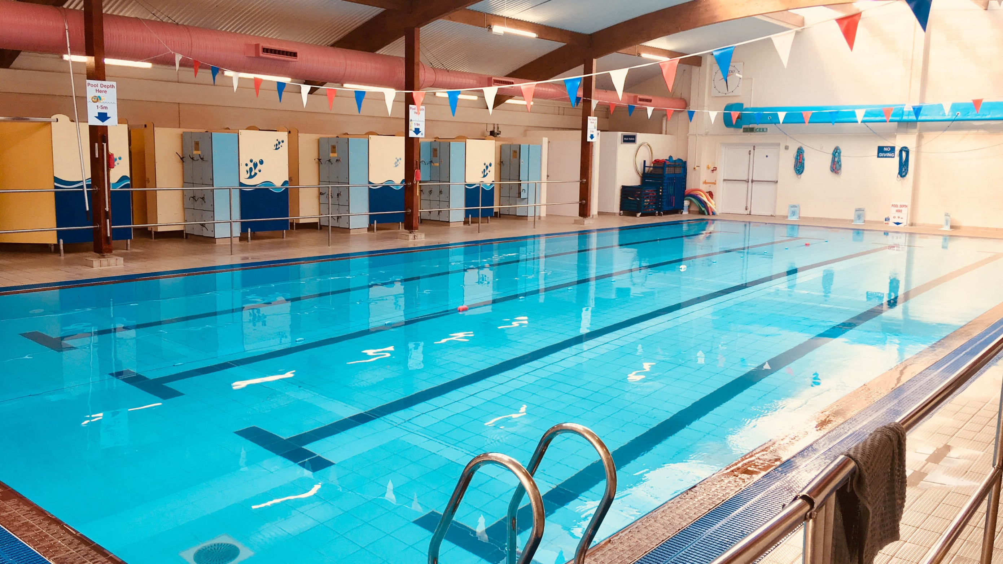
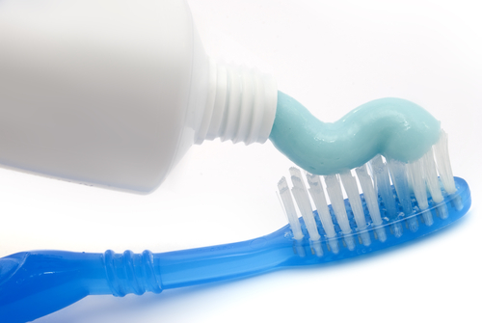

L3 - Group 7 (the Halogens)
Starter questions:
What happens when group 1 elements react with water?
What happens to reactivity as you move down group 1?
List 3 Group 7 elements
Are they metals or non-metals?
Lesson objectives:
To describe some properties of group 7 elements
To examine and describe trends in reactivity of group 7 elements
What links these 3 pictures?

Slide 18
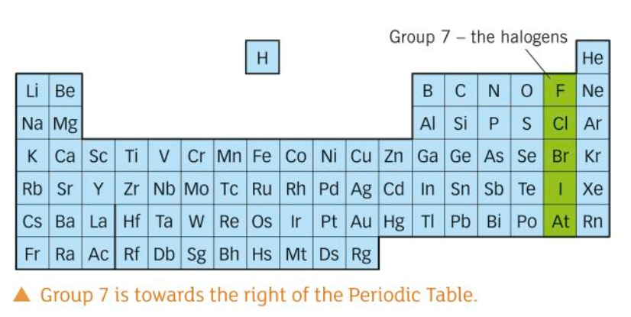
Group 7 elements have low melting points and do not conduct electricity

Slide 19




What are the general properties of the halogens?
All the halogens are:
non-metals and so do not conduct electricity
brittle and crumbly when solid
poisonous and smelly.
They become darker in colour down the group:
is pale yellow
is yellow-green
is red-brown
is grey

Slide 20



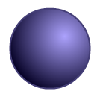
Halogen
Relative size
Melting point (°C)
Boiling point (°C)
State at room temp
-220
-118
gas
-101
-34
gas
-7
59
liquid
114
184
solid

Slide 21
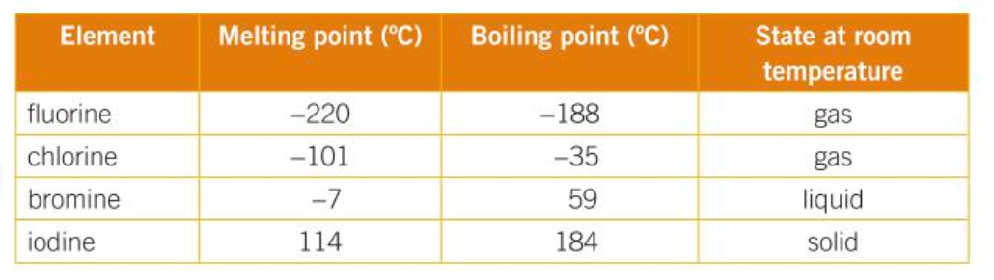
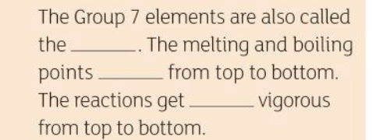
Can you predict what state these group 7 elements are in?
Copy and complete these sentences:
halogens
increase
less

Slide 22
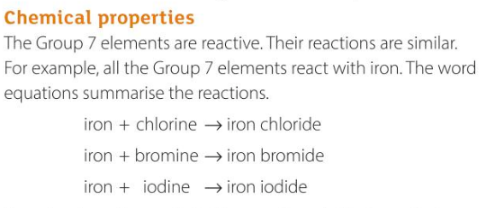
There is a trend in reactivity. The reaction of chlorine with iron is very vigorous. There is a bright flame. The reactions get LESS vigorous going down the group.

Slide 23

Describe this image….

Slide 24
Displacement reactions
Reaction where a more reactive element displaces (takes the place of) a less reactive element from a compound.
We can observe displacement reactions in order to determine how reactive an element is.
Eg: Chlorine + potassium bromide --> potassium chloride + bromine
We will observe chlorine, bromine and iodine as they react with compounds. If an element in the compound is displaced, the substance will change to the colour of the displaced element.

Slide 25

Describe what is happening in the reaction below:
HINT: Chlorine is more reactive than Bromine
Show the displacement reaction between Bromine and potassium iodine
What will happen between Fluorine and the other halogens?

Slide 26
Displacement reactions
Potassium + chlorine
Bromide
Potassium + chlorine
Iodide
Potassium + Bromine
iodide

Slide 27
Why is there no reaction?
potassium + Bromine Potassium + Bromine
Chloride Chloride
Which other one will show no reaction?

Slide 28
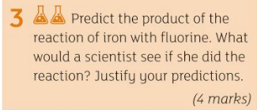
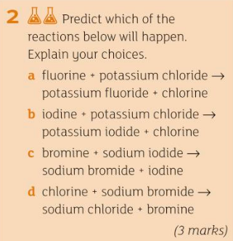
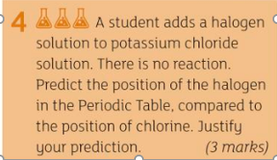
TASK: answer the following questions

Slide 29
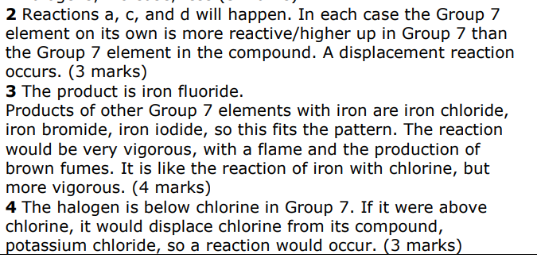

Slide 30

L4 - Group 0 (the Noble Gases)
Starter questions:
What are groups on the periodic table?
List 3 noble gases
Why do helium balloons float?
Lesson objectives:
To state the properties and reactivity of Group 0 elements
To describe trends and predict properties of Group 0 elements
To summarise what you have learned so far about elements and the periodic table

Slide 31
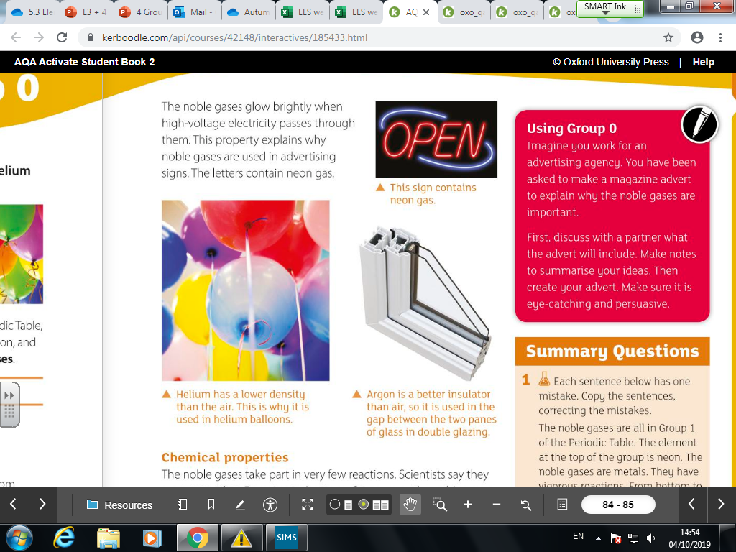
The group 0 elements are all unreactive, colourless gases.
https://www.tes.co.uk/teaching-resource/Video-resource-on-Group-8-18-The-Noble-G-6339973/

Slide 32
Copy and complete the table!
Element | Symbol | State at room temp |  | Reaction?
 | He | Gas | -269
 | Ne |  | -246 | None
Argon |  |  | -186 | ArHF once made, but only exists below -265ºC
 | Kr |  | -152 | Reacts with fluorine to make KrF₂
Xenon |  |  | -108 | Forms compounds with fluorine and oxygen
Extension: What happens to the boiling points as you go down the group?
Can you think of a reason why they are so unreactive?

Slide 33
Element | Symbol | State | Boiling Point (°C) | Reaction
Helium | He | Gas | -269 | None
Neon | Ne | Gas | -246 | None
Argon | Ar | Gas | -186 | ArHF once made, but only exists below -265ºC
Krypton | Kr | Gas | -152 | Reacts with fluorine to make KrF₂
Xenon | Xe | Gas | -108 | Forms compounds with fluorine and oxygen

Slide 34
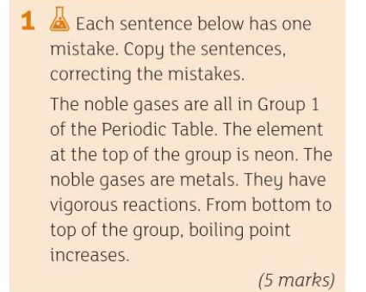
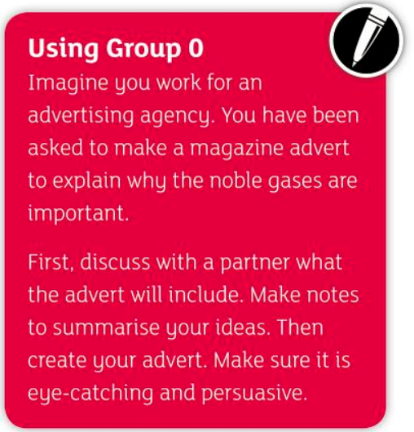
CHALLENGE:
The noble gases are all in group 0 of the Periodic Table.
The element at the top of the group is Helium.
The noble gases are gases.
They are unreactive.
From top to bottom of the group, boiling point increases.

Slide 35
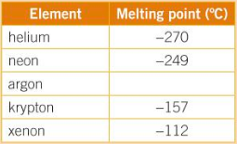
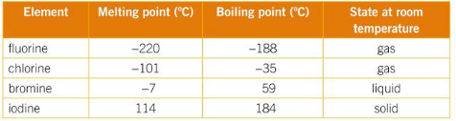
Describe the trend in melting point for group 0 and predict the melting point of argon.
Compare the trends in melting point between group 7 and group 0.
Why do you think the melting point changes in this way? Have a look at the numbers on the periodic table.

Slide 36
Now answer the pdf file labelled 30.11.2020 periodic table

