Slide 1
L2 Transport
Diffusion
Aims – to remember what diffusion is.
-Know how the concentration of particles affects their diffusion.
-Know how the cell membrane affects diffusion.
Starter What is diffusion? (quick recap.)

Slide 2
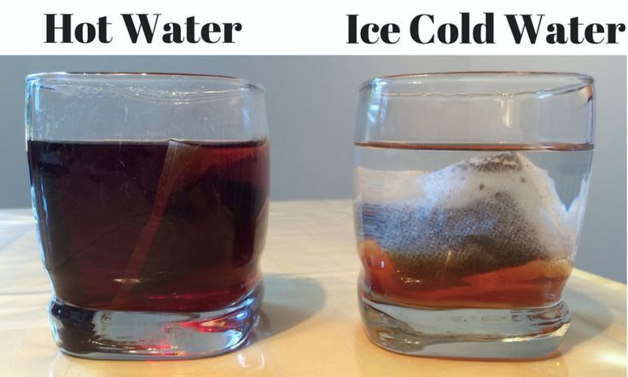
Some questions
Why does diffusion take place faster when there is an increase in temperature?
Explain why many cells have folded membranes along one surface.

Slide 3
Q1.Diffusion is the spreading out of particles of any substance,in solution or a gas, resulting in a net movement from an area of…. to an area of….down a concentration gradient.
Q2. An increase in temperature makes particles move more quickly. This makes diffusion take place more _______ as the movement of particles ___________.
Q3 Folding the membrane increases the area for diffusion to occur over (think how the folds in your mask allow it to have more material through which you breath)

Slide 4
Q1.Diffusion is the spreading out of particles of any substance,in solution or a gas, resulting in a net movement from an area of…. to an area of….down a concentration gradient.
Q2. An increase in temperature makes particles move more quickly. This makes diffusion take place more _______ as the movement of particles ___________.
Q3 Folding the membrane increases the area for diffusion to occur over (think how the folds in your mask allow it to have more material through which you breath)

Slide 5
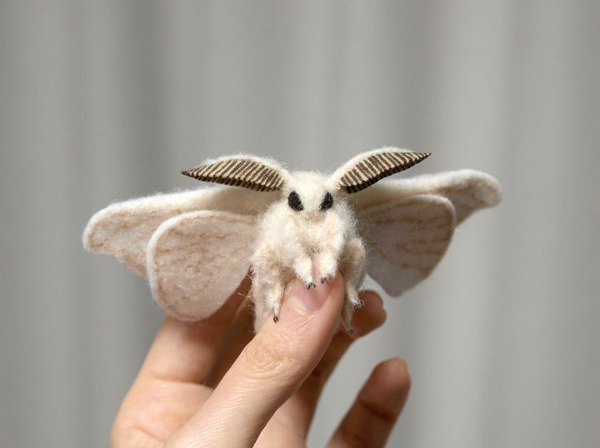
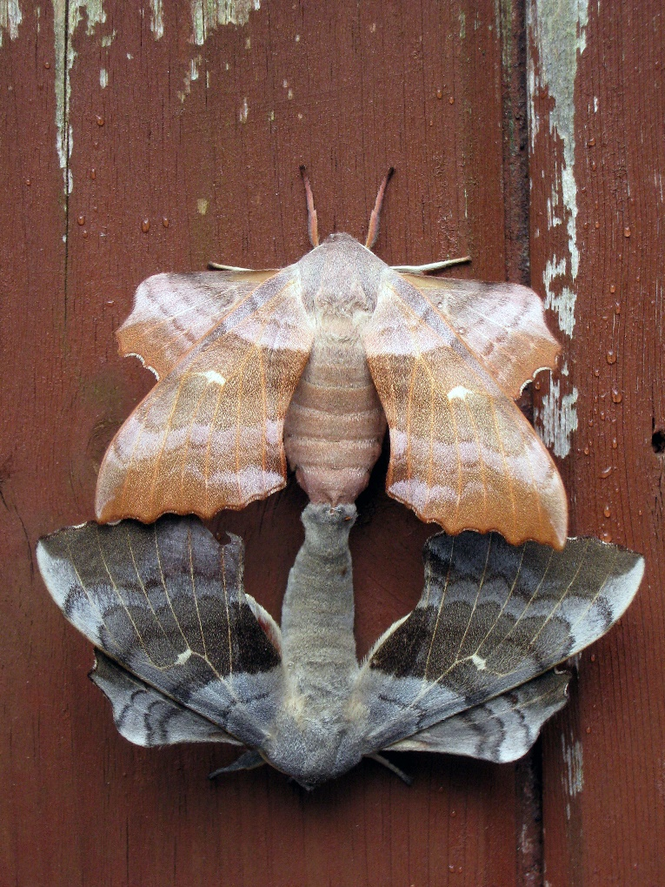
Some examples
A.Digested food in your gut moving into your blood stream.
B. Carbon dioxide from blood( in capillaries of the lungs) into the air of your lungs.
C. a male moth tracking a female moth (who releases special chemicals).

Slide 6
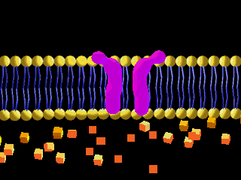
Movement of Substances
What substances need to be transported in the human body?
Oxygen and carbon dioxide – Transferred between cells and the environment during gas exchange
Urea – Diffuses from cells into the blood and then removed from the body by the kidneys

Slide 7
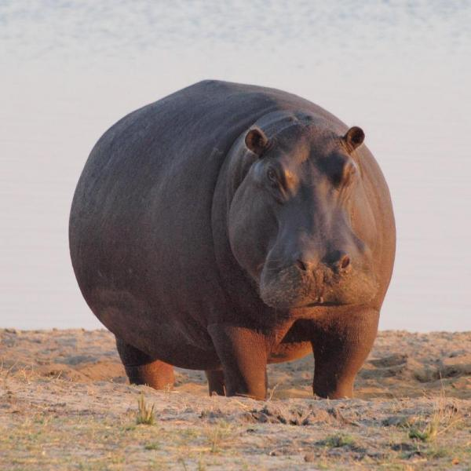
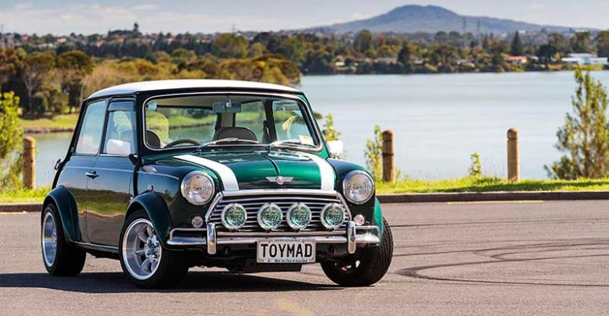
Surface Area to Volume Ratio
A ratio shows how big one value is when compared to another
6 Kg
1 Kg
We use these ratios to show how easily an organism can exchange substances with its surrounding.
The larger the surface area to volume ratio the better at exchanging substances an organism is.

Slide 8
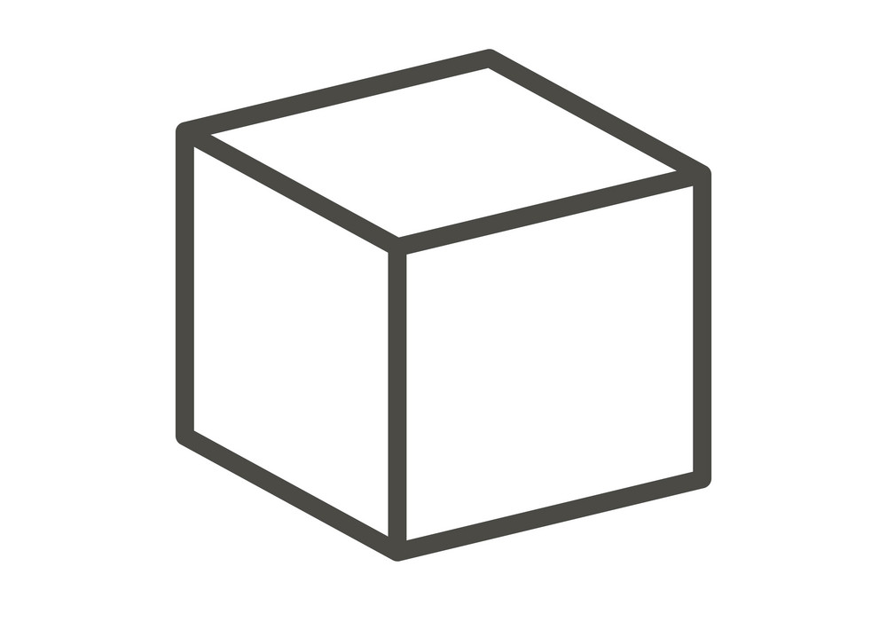
Calculating Area
To calculate the surface area we use the equation
Surface Area = length x width
Then add the total of all the faces together to get the total area
3cm
3cm
3cm

Slide 9
Calculating Volume
Volume is the amount of space inside something
To calculate volume we use the equation
Volume = length x width x height
3cm
3cm
3cm

Slide 10

The bigger an object is the smaller it’s surface area to volume ratio will be
Calculate the surface area to volume ratios for these two blocks. Give your ratios in their most simple form.
5cm
1cm
5cm
1cm
5cm
1cm

Slide 11
Task 1 – Complete the worksheet
Answers:
7:1
Pigeon 10:1, Elephant 5:2.
Pigeon has the larger ratio.
60:11
37:30

