Slide 1
Lesson 3

Slide 2
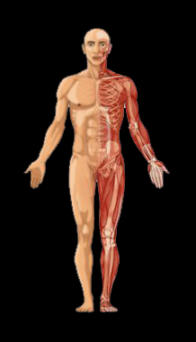
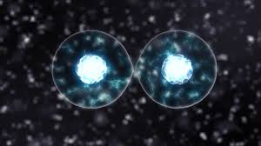
Why are exchange surfaces needed?
Single cell organisms have a high surface area to volume ratio so they can absorb enough of the substances they need from their surroundings.
Multicellular organisms have much smaller surface area to volume ratio and therefore cant absorb the substances they need from just the environment, so need specialised exchange surfaces to allow for substance transport.

Slide 3
Exchange surfaces
Exchange surfaces are tissues specialised for the exchange of substances in the body and are adapted for this function
These adaptions include:
-Thin membranes
-Large surface areas
-Lots of blood vessels
-Ventilation

Slide 4
Exchanging Substances
Copy this table into your books
Function | Exchange Surface | Substances Exchanged | Adaptations
The exchange of gases | alveolus |  | Very thin walls with a moist lining. Lots of blood capillaries to carry gases away
Absorb the products of digestion
Gas exchange in leaves
Gas exchange in fish

Slide 5
Exchanging Substances
Copy this table into your books
Function | Exchange Surface | Substances Exchanged | Adaptations
The exchange of gases | alveolus |  | Very thin walls with a moist lining. Lots of blood capillaries to carry gases away
Absorb the products of digestion
Gas exchange in leaves
Gas exchange in fish

Slide 6
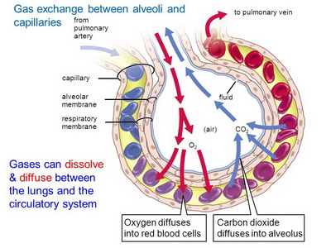
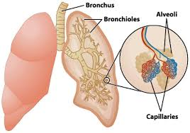
Gas Exchange in Humans
The job of the lungs is to transfer oxygen into the blood and carbon dioxide out of it. To carry out this job the lungs are full of air sacs called alveoli where this gas exchange takes place. The alveoli have a large surface area of around 75 m², have thin walls and a moist lining to allow the dissolving of gases. These air sacs are surrounded by blood vessels called capillaries. The two gases diffuse into or out of the blood following the concentration gradient.

Slide 7
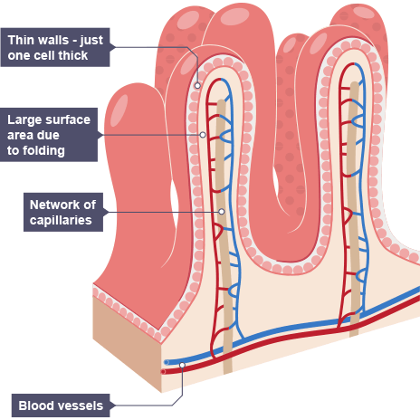
Absorbing the products of digestion
Absorption of nutrients, such as glucose and amino acids, takes place in the small intestine. These are taken into the bloodstream using diffusion and active transport. To aid in this the inside of the small intestine is covered in small projections called villi that increase the surface area of the small intestine. These have very thin walls, only one cell thick, and have a very good blood supply.

Slide 8
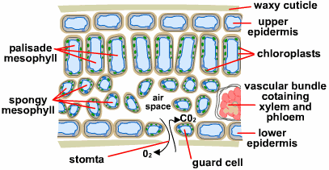
Gas exchange in leaves
Plants need to exchange the oxygen produced in photosynthesis and the carbon dioxide need for the process. The surface where this exchange takes place is the bottom of the leaf. This surface is covered in small holes called stomata where the gases can diffuse into and out of the leaf.
Leaves have a flattened shape in order to increase the surface area available to make diffusion more effective. The walls inside the leaf also form an exchange surface, air spaces within the leaf also act to increase the surface area available for this gas exchange to take place.

Slide 9
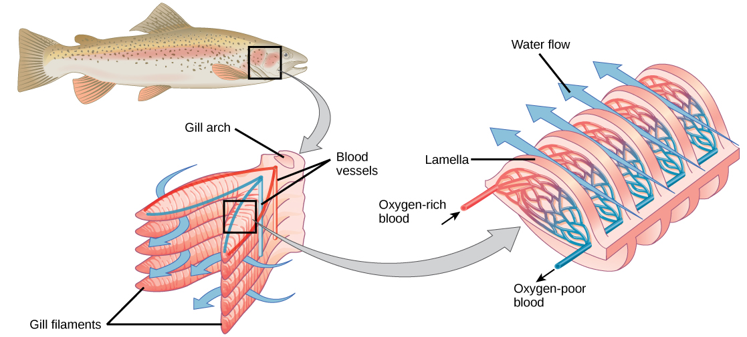
Gas Exchange in Fish
Fish obtain their oxygen from the water so need an exchange surface specialised to be able to do this, these are the gills. Water passes over the gills, allowing oxygen to diffuse into the blood and carbon dioxide to move out as it does.
The gills are made up of thin plates called gill filaments which increase the surface area of the tissue. These are then covered in structures called lamellae which increases the surface area further. The gills have a very good blood supply and very thin walls, this allows for the quick diffusion of gasses across this wall either into or out of the blood.

Slide 10
Function | Exchange Surface | Substances Exchanged | Adaptions and Why
The exchange of gases in humans | The alveoli in the lungs | Oxygen and carbon dioxide | Good blood supply – allows quick diffusion of gasses. Thin cell walls – lower distance for gases to diffuse over Moist lining – to allow for the diffusion of gasses Large surface area
Absorbing the products of digestion | The villi in the small intestine | Glucose and amino acids | Good blood supply – assists with quick absorption Cell wall is one layer thick – small diffusion distance Large surface area

Slide 11
Function | Exchange Surface | Substances Exchanged | Adaptions and Why
Gas exchange in plants | The underside of the leaf | Oxygen and carbon dioxide | Stomata – small holes that allow for the movement of gasses Flattened shape - Large surface area
Gas exchange in fish | The gills | Oxygen and carbon dioxide | Good blood supply – assists with quick absorption Thin walls – low distance for gasses to diffuse Gill filaments and lamellae - Large surface area

Slide 12
Task 2 – Fill in the gaps
Exchange surfaces are adapted in order to carry out their function. They have thin membranes to make it easier for substances to __________ across them. They also have large surface areas to allow lots of a _________ to diffuse at the same time.
There are lots of ______________ to allow substances to enter and leave the blood quickly.
Some exchange surfaces have ventilation which is the movement of ___________ in and out of the tissue, this can be seen in the __________.
Substance Blood vessels Air
Lungs Diffuse
Challenge – Using what you know about diffusion explain why it is important to have a good blood supply present near a exchange surface

Slide 13
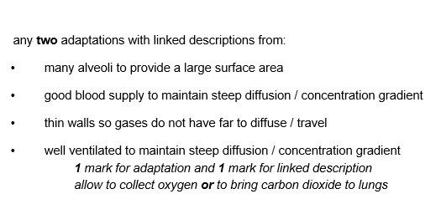
Answers

Slide 14
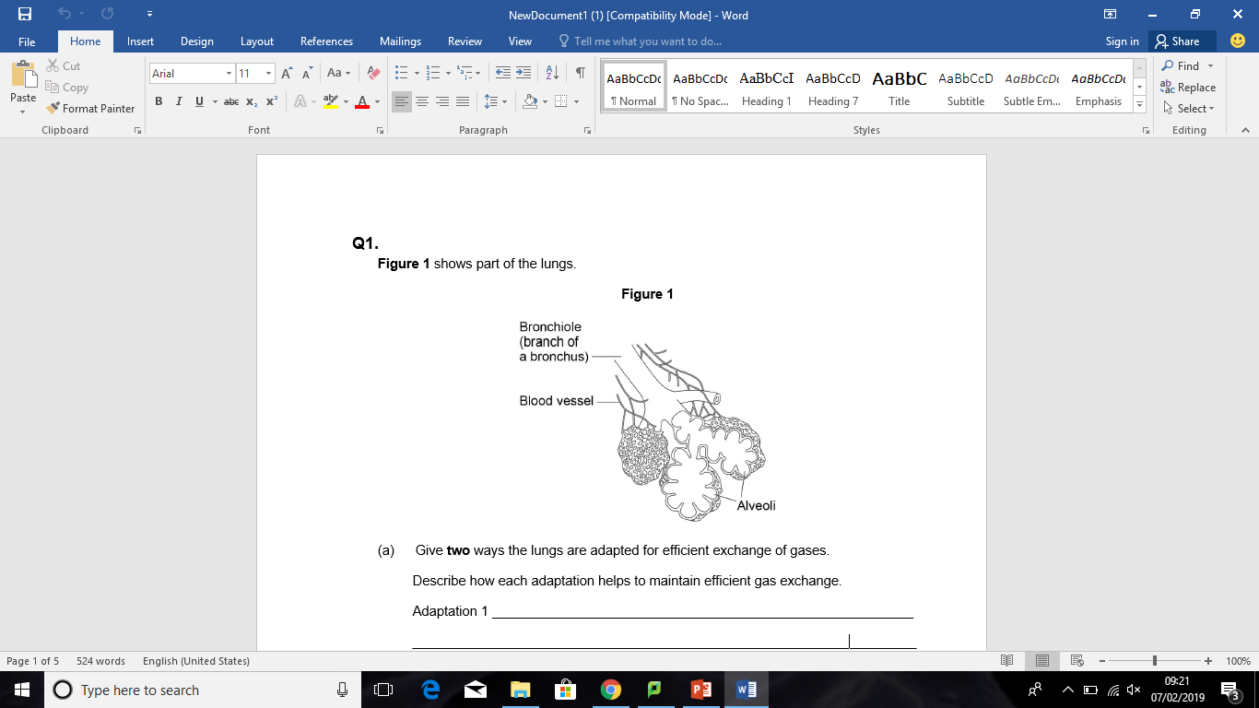
Exam Question
(4 marks)

Slide 15
END

Slide 16
Exchange Surfaces and Exchanging Substances
DQ: Why is it important for multicellular organisms to be able to transport substances?
Starter: Match the key terms to their definitions
Diffusion
The movement of water along a concentration gradient
Osmosis
The movement of molecules against a concentration using energy
Active Transport
The movement of particles from an area of high concentration to an area of low concentration
Challenge: Explain why the process of active transport requires energy

