Slide 1
L4 Transport
Osmosis
STARTER
https://www.youtube.com/watch?v=38pAznD1iWA
Here’s a fun activity – you can do it at home!

Slide 2
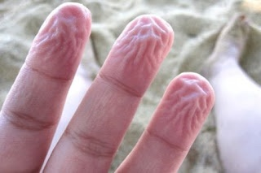
Why does this happen?
Go on – have a guess.
The answer is on the next slide.

Slide 3
When you place your hands in water and your finger tips appear to shrink what is going on?
Actually, nothing is shrinking.
The salty cells inside your finger tips (they are not full of pure water) are swelling up because the freshwater outside your fingers is less salty than the "water" or cytoplasm inside your fingers' cells.
So, water flows into your fingers' cells.
There are tiny little connections under your skin with other parts of your internal finger. As your finger swells these connections become tight and it makes it look like your finger is wrinkled (and shrunken), but really your finger is swollen

Slide 4
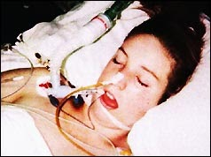
Report from The Times, Nov 22, 1995
LEAH BETTS DIED OF DRINKING WATER TO COUNTER DRUG'S EFFECT her parents published this photo
By Jeremy Laurance, Health Correspondent
Water intoxication occurs when a person drinks so much water - a minimum of three litres –
that the blood becomes diluted. Laboratory results show that on admission to hospital hours after taking
the 10 pounds tablet, Leah's plasma sodium level - a measure of how dilute her blood had become
- had fallen to 126 millimoles per litre compared with a normal range of 134 to 145.
As a result, water was sucked into her brain cells under osmotic pressure, causing them to swell.
This increased pressure on the brain stem, resulting in coma and death.
Overheating and dehydration are known risks of taking Ecstasy, a stimulant which can keep young people dancing
for hours, and drug agencies advise users to drink plenty of water and take frequent rests.
Although she had not been dancing energetically for hours, it is understood that when Leah began to feel unwell
at the party she made repeated trips to the bathroom to drink water. She believed mistakenly that this was the way
to ward off the ill-effects of the drug.
Some of her friends took the same pill but were not affected in the same way.

Slide 5
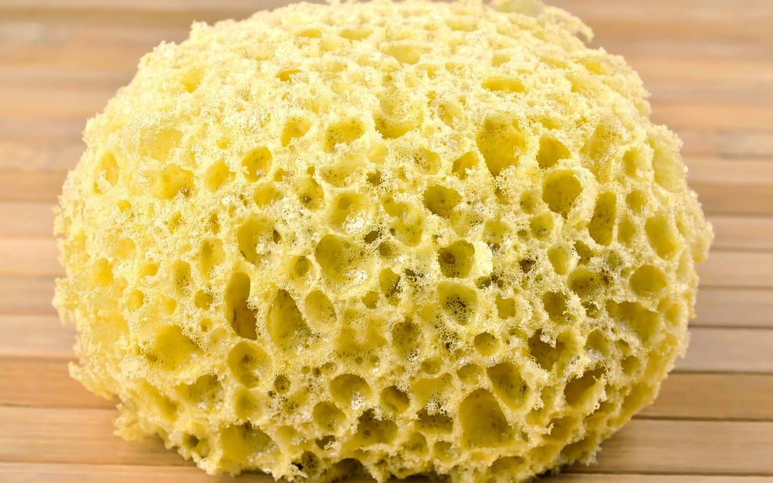
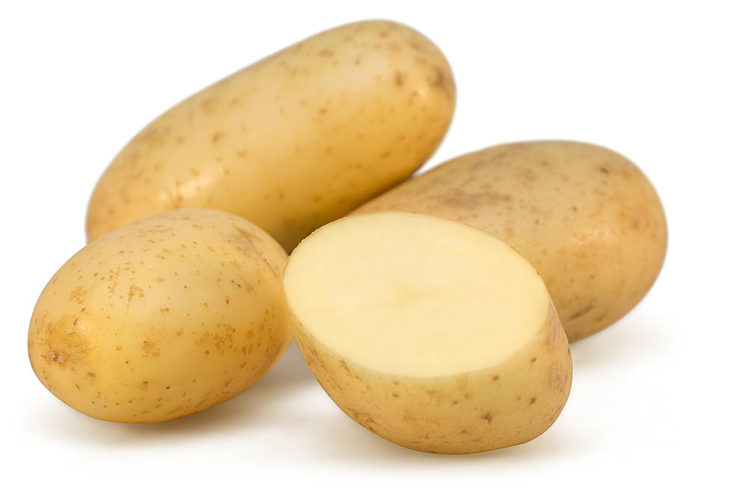
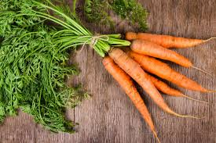
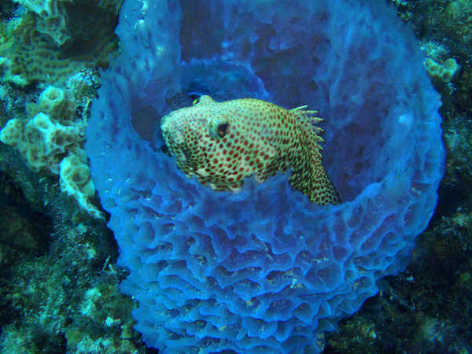
Osmosis
Imagine a damp sponge.
What happens to its mass if you squeeze it and why?
What happens to its mass if you put it in water and why?
A plant cell contains water.
If you put it into pure water would you expect water to move in or out of this cell?
Why?
FUN FACT – here are some plants which contain plant cells and
An animal – YES – a sponge is an animal!!!!!

Slide 6
If you place a piece of potato (lots of potato cells) into pure water what might you expect to happen to its:
length?
mass?
If you place it into very strong sugary solution what would you expect to happen to its:
length?
mass?

Slide 7
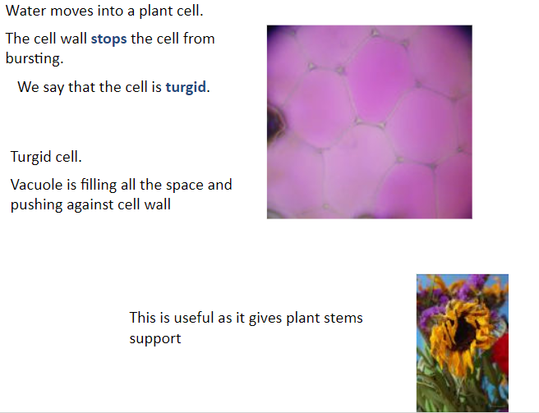

Slide 8
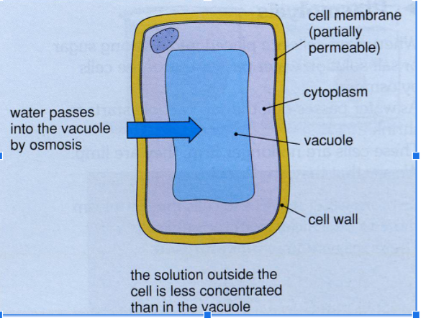
By less concentrated
We mean MORE WATERY

Slide 9
Quick quiz –answers on next slide
1.What is a partially permeable membrane?
2. Which substance moves by osmosis?
3. What happens to plant cells that take up water by osmosis, and what do you call the cell?
4. What happens to plant cells that lose water by osmosis, and what do you call the cell?
5.Why do animal cells become shrunken or ‘haemolysed’ mean?

Slide 10


