Slide 1
B3 – Exchange of materials
LO: to be able to explain the process of active transport and the differences to diffusion.
Starter:
Complete the following
Diffusion is the movement of particles ………… a ………….. gradient from an area of ……………….. concentration to an area of …………………………..

Slide 2
Active Transport
Here’s a really useful recap. (reminder) of diffusion and should also help you to understand the information which follows
https://www.youtube.com/watch?v=AxXN-j6UzOY

Slide 3
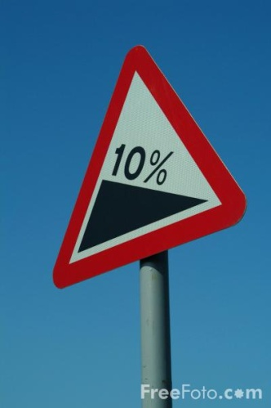
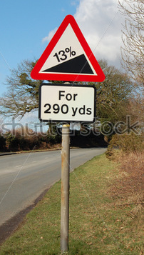
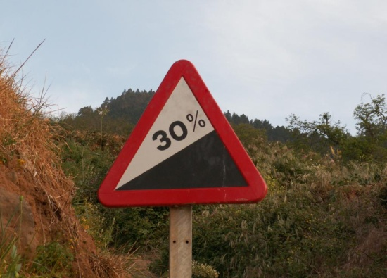
What is a Concentration Gradient?
Hills and graphs have gradients
1) which is the steepest gradient?
30%

Slide 4
moving down a concentration gradient – this is diffusion
Which way will the particles move?
From the left to the right

Slide 5
moving (UP or) against a concentration gradient
ENERGY
The particles can move up the concentration gradient if energy is used
This is active transport

Slide 6
Active transport
This DOES Require energy
Particles move against a concentration gradient.
The energy is needed to make “pumps” move particles the wrong way.
E.g. glucose from the intestine into the blood

Slide 7
Active Transport
Active Transport
Active transport uses the energy from respiration to absorb substances against the concentration gradient.

Slide 8
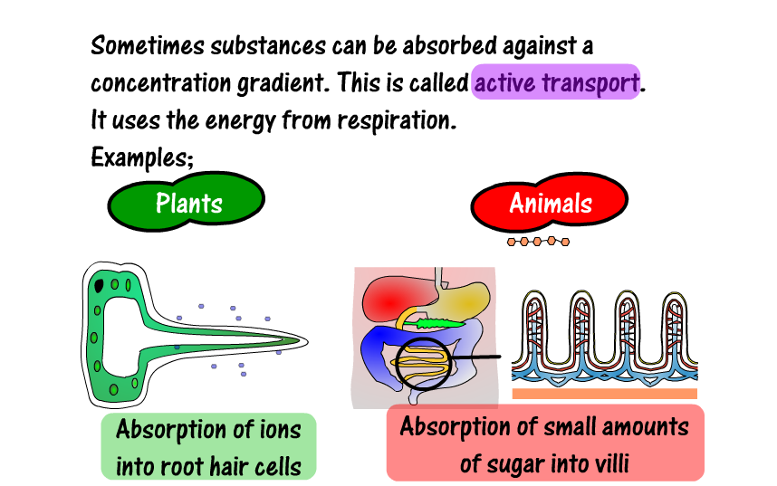
Active Transport
Active Transport

Slide 9
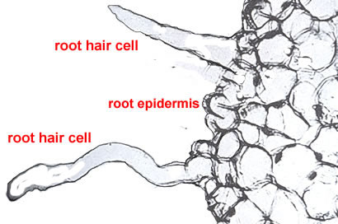
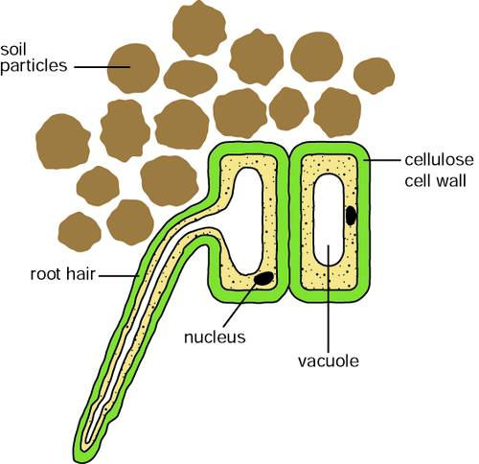
Active transport in plants
Mineral ions moves from the
Soil into the root hair cell.
The concentration of ions inside
the root hair cell is greater than in the soil
so the movement is
Against the concentration gradient
Write your own notes about how active transport works in root hair
cells.Then describe how it works in the intestine (use diagrams
to help you)

Slide 10
Active Transport
Active transport occurs across semi permeable membranes and moves particles from a low concentration to a higher concentration. This is against the concentration gradient.
Transport or carrier proteins are needed to get these molecules into the cells and these use energy.
Cells that do active transport contain large numbers of mitochondria.

Slide 11

Plenary
Make a list of similarities and differences between active transport and diffusion

Slide 12

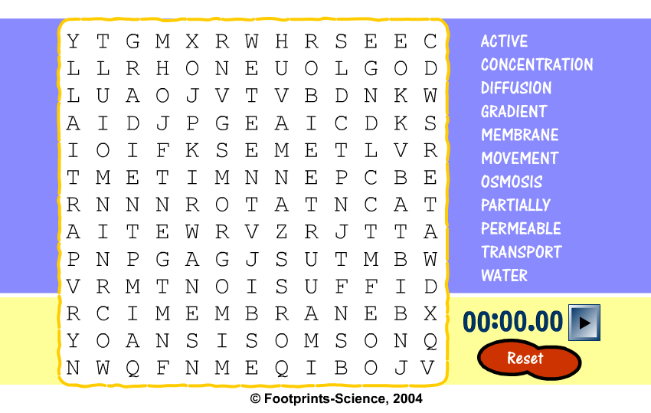
Wordsearch
Wordsearch

