Slide 1
^{7th} Dec 9Y3 The human digestive system aims
To revisit the organs in the digestive system and what they do.
The digestive system is an example of an organ system in which several organs work together to digest and absorb food.
Students should be able to relate knowledge of enzymes to Metabolism.
Students should be able to describe the nature of enzyme molecules and relate their activity to temperature and pH changes.
Students should be able to carry out rate calculations for chemical reactions.
Enzymes catalyse specific reactions in living organisms due to the shape of their active site.

Slide 2
The human digestive system 7th Dec 2018
The digestive system is an example of an organ system in which several organs work together to digest and absorb food.
STARTER THINK PAIR SHARE
Select names of organs which are part of the digestive system.
Stomach kidney oesophagus rectum uterus brain Pancreas small intestine mouth lung heart large intestine liver
Judge Y8 models

Slide 3
The digestive system is an example of an organ system in which several organs work together to digest and absorb food.
Here are 2 pictures of Year 8 model digestive systems.
Pick the one which you think is the best. Explain why you chose it.
SUCCESS CRITERIA SHEET…..
Does it have the correct number of organs?
Are they in the right sequence?
Are they linked up properly?

Slide 4
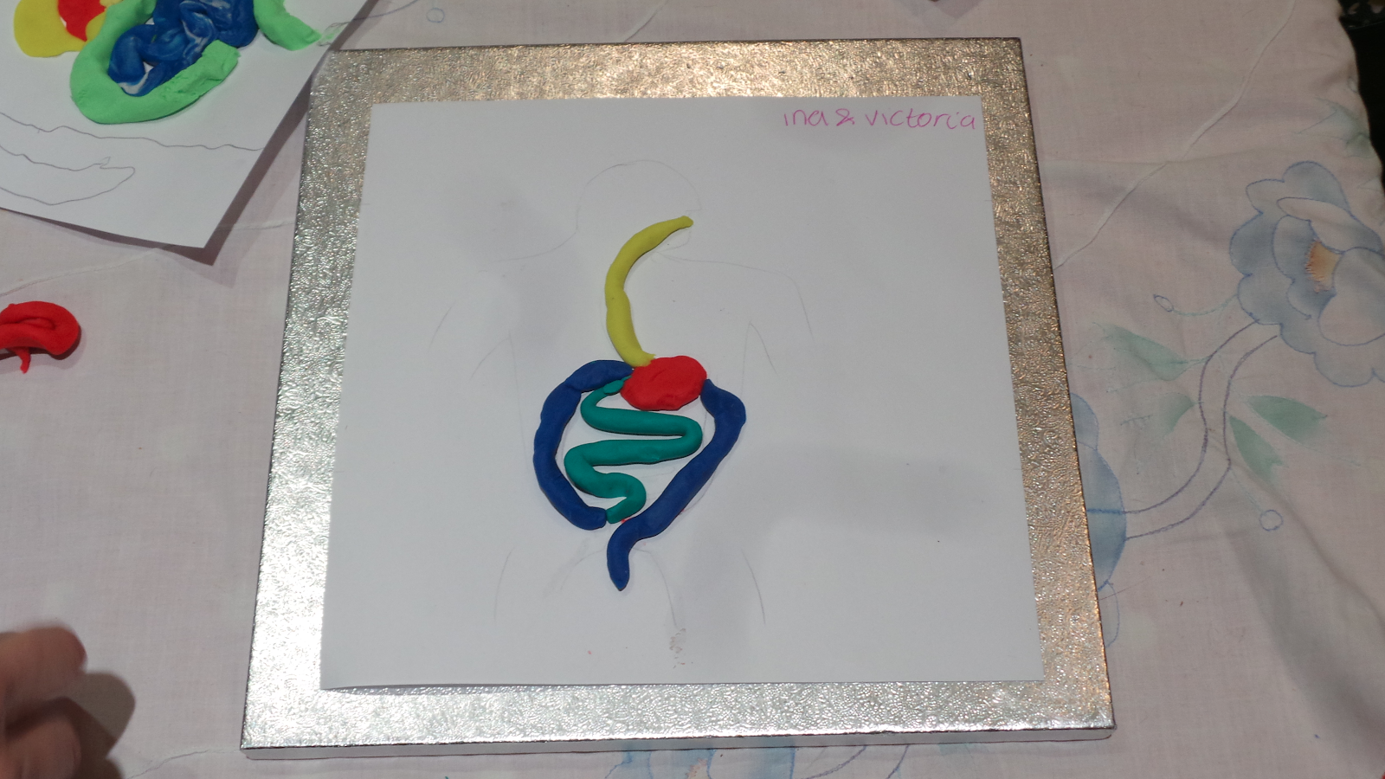

Slide 5
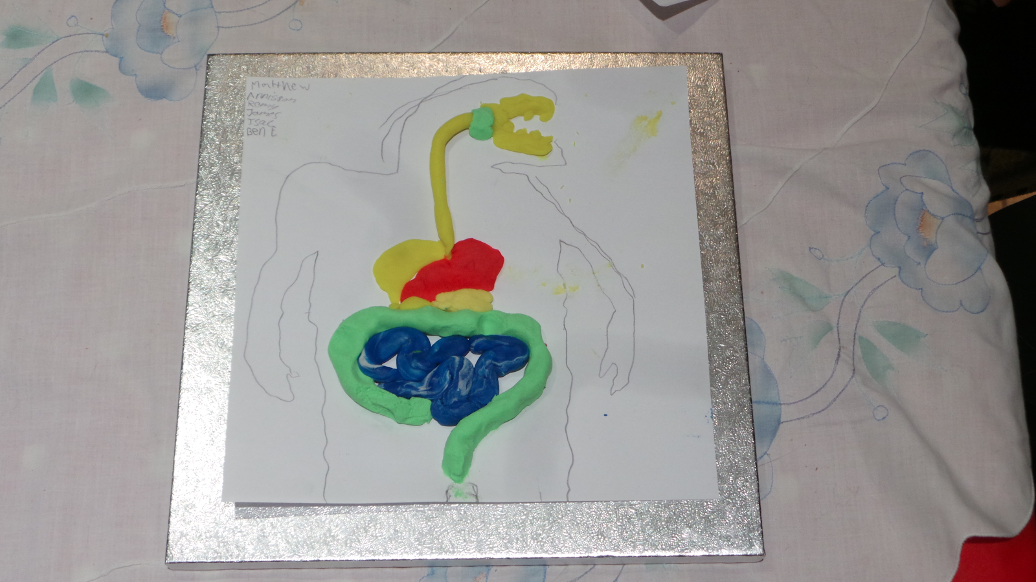

Slide 6
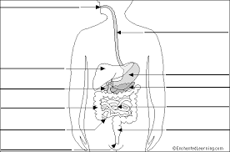
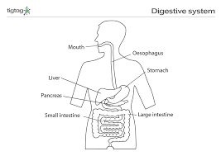
Diagram of a digestive system – can you label these parts?
Have a go – you should remember from y8 then check

Slide 7
An organ system - the digestive system- where several organs work together to digest and absorb food
These three organs make chemicals to digest food =____________________
This organ absorbs water from undigested food = _______________________
Food is absorbed into the blood from this organ_________________________

Slide 8
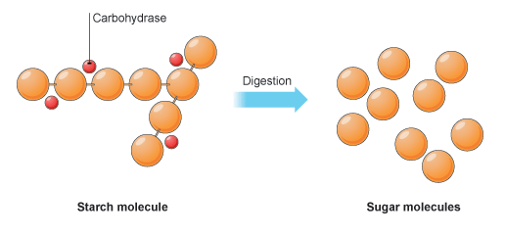
Students should be able to describe the nature of enzyme molecules
Everyone put a piece of bread in their mouth and hold it there – does the taste change?
Q1. What does an enzyme do?
Q2. What is an enzyme ?
Challenge
What is this picture about?

Slide 9
Students should be able to describe the nature of enzyme molecules.
Everyone put a piece of bread in their mouth and hold it there – does the taste change?
Q1. What does an enzyme do? It is made by the body and makes the RATE of a reaction(– in this case breaking down food molecules) go FASTER
Q2. What is an enzyme? It is a protein (made by cells) which
Can attach to, and break down, a particular food molecule.

Slide 10
Students should be able to relate knowledge of enzymes to Metabolism.
Metabolism is the rate of breakdown of substances and build up of substances in the body.
Lipids /fats are broken down by enzymes called LIPASES
Lipases only break down lipids.
ENZYMES ARE SPECIFIC IN THEIR ACTION – they only break down one type of molecule.
Q1. What do you think CARBOHYDRASES do?
They only break down…….
Challenge
Q2. What do you think the enzymes which break down proteins are called?

Slide 11
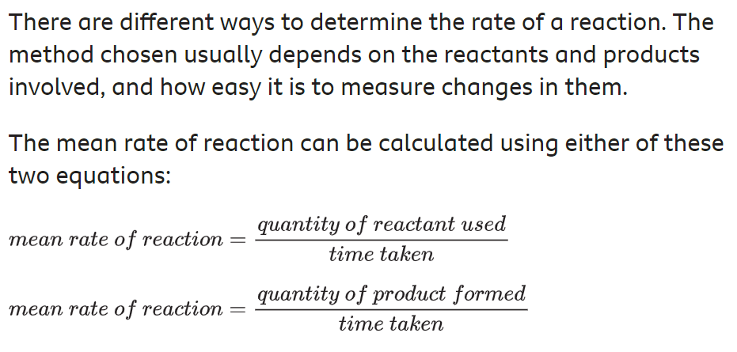

Slide 12
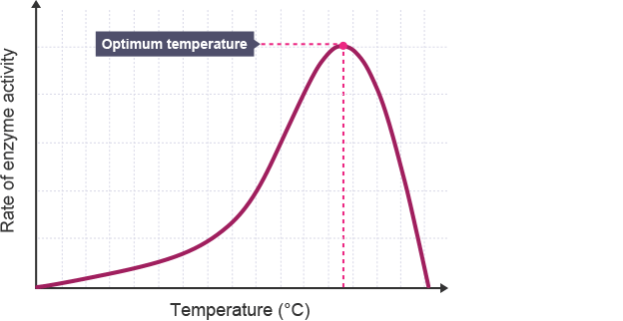
The rate of an enzyme-catalysed reaction is calculated by measuring either the amount of something which is broken down in a particular time OR the rate the amount of something which is produced in a particular amount of time (the rate of breakdown OR the rate of production).
E.g. starch (a carbohydrate) might be broken down to form maltose (a sugar) in the reaction below

Slide 13
Relate the activity of enzymes to temperature
What does this graph show?
The rate of an enzyme-catalysed reaction is calculated by measuring the rate the chemical is broken down OR the rate at which the product is produced.
E.g. Here the rate at which starch is broken down is being measured
Students should be able to describe the nature of enzyme molecules
What do you notice about the rate of enzyme activity as the temperature is increased?
It increases up to an optimum temperature but then it falls because the enzyme has been changed

